Slide 1
Provincial Writing and Math Rubrics
Presented by Shari Martin
August 27, 2018

Slide 2
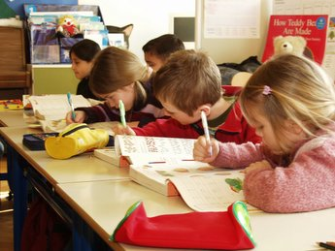
Agenda
Assessment in Saskatchewan
Writing Continuum/Rubrics
Math rubrics/exemplars
Assessment best practices
Resources/Moodle
Playlist for personalized exploration

Slide 3
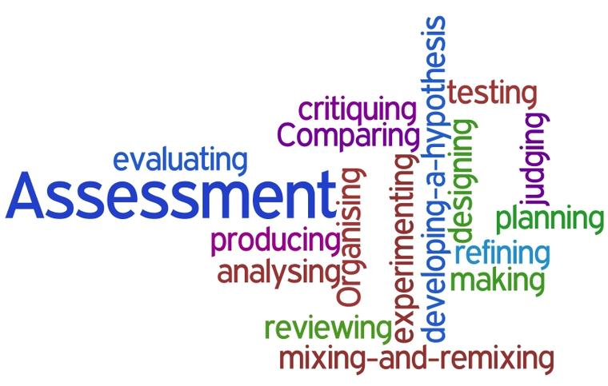
Assessment in Saskatchewan
Overview of provincial assessment plan
Trends in province
Connections to the E.S.S.P. (Educational Sector Strategic Plan)
Grades 4, 7, 9 writing data collected spring 2018
Grades 2, 5 and 8 math data collected spring 2019

Slide 7
Writing Continum, Rubric and Writing Prompts
Overview of writing skills, text forms and strategies for each grade/course
Continuum is NOT intended to replace curriculum
Pre assessment to determine instruction
Provide for a variety of opportunities to write

Slide 8
Math Rubrics, Exemplars and Prompts
Rubrics for number strand for grades 1-9
Exemplars for grades 2, 5 and 8
Terminology
Prompts by grade level contexts

Slide 9
Assessment Reminders
Use a variety of assessment methods/strategies.
Match assessment approaches with learning goals/expectations/curricular outcomes and/or purposes.
Develop clear criteria and provide exemplars.
Provide feedback, reteaching, and multiple opportunities.

Slide 10
Assessment Reminders
Provide many opportunities for self and peer assessment. Keep in mind, however, that evaluation is the teacher’s responsibility.
Report card symbols (letters or numbers) should be based only on the more recent, summative, individual achievement data.

Slide 11
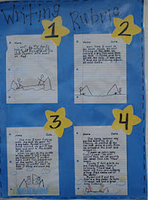
Writing/Math Rubrics
Assessment of student writing/math performance uses teacher’s professional judgement
Use several samples of a student’s writing/math performances to determine most consistent level with emphasis on most recent samples
Teachers may choose to have “writing or math event” and use evidence from that event.
Writing and math prompts are provided. These can be used when student “ready” as well which makes the performance more authentic

Slide 12
How do the provincial rubrics work with the Sun West Rubric?
Ministry level indicates that level 3 and 4 are considered grade level.
Ministry interested in at or below grade level for their documentation
Power Teacher Gradebook column added that has teachers enter the level they assign for Math and writing based on Ministry rubric

Slide 13
Incorporating Writing into your ELA Program
Many ways this can occur
Before/During/After writing stages
Writing skills follow reading skills

Slide 14
Sask Reads Resource
There will be no writing or math equivalent to Sask Reads, just continuum and common rubrics.
There are writing examples being posted on the Sask reads website. May also be math in the future.
SPDU exemplars of writing and a detailed rubric help show students models of what is achievable in writing and a good start to teacher samples
Ministry exemplars for math show how the student may approach the tasks assigned

Slide 15
Writing Instruction
Like reading, writing instruction assumes
All students can write
Oral language and Reading are foundations of literacy
Balance is important in writing instruction
Family and community are partners

Slide 16
Writing Instruction
Ongoing assessment to support individual student growth and plan for lessons (PeBL)
Balance of Modeled, Scaffolded/Guided, Shared and Independent Writing
Instruction must focus on Writing Forms, writing process, writing traits and writing workshop.

Slide 17
Instructional Model for Teaching Writing
Provide a variety of opportunities to write, both structured and unstructured
Gradual release of responsibility model
Integrated with reading assignments, but also make time for creative or free writing

Slide 18
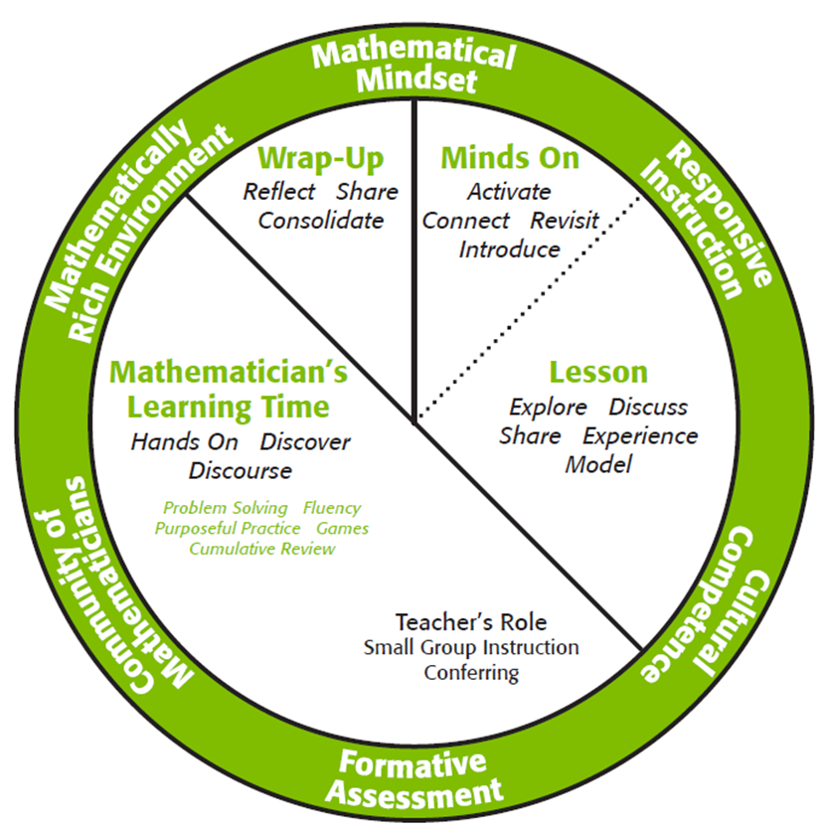
Math Instruction
Like reading, writing instruction assumes
All students can write
Oral language and Reading are foundations of literacy
Balance is important in writing instruction
Family and community are partners

Slide 19
Sun West Moodle Supports
Provincial Writing Rubrics Grade 9
Provincial Writing Rubrics Grade 7
Provincial Writing Rubrics Grade 4
Provincial Math Rubrics Grade 2
Provincial Math Rubrics Grade 5
Provincial Math Rubrics Grade 8
password protected – swsd

Slide 20
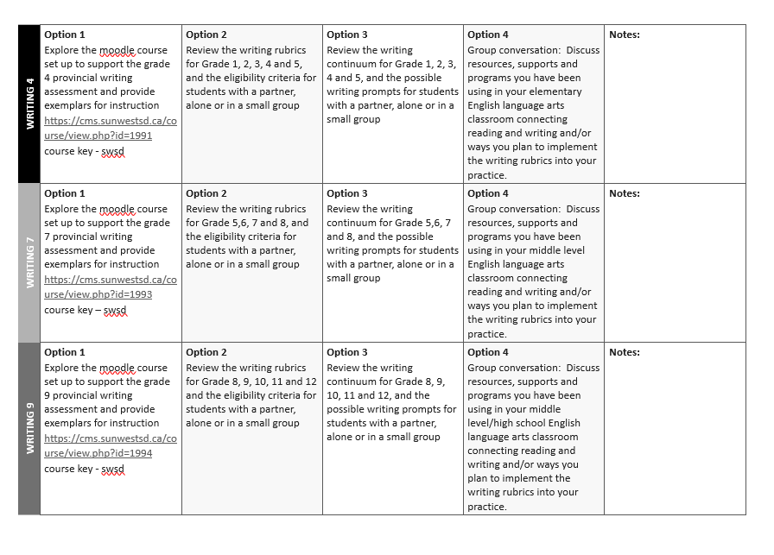
Exploring the Documents

Slide 21
Play list
Select an option that fits your learning style and subject needs
Options 1-4
Parking Lot for additional questions

Slide 22
Thanks so much!
I would love to add to our Writing and Math moodle, so please send me your ideas, plans, samples and I can upload them
Please feel free to contact me should you have any questions!
shari.martin@sunwestsd.ca

