Slide 1
SUPER SCIENCE FUN Camille Hounjet and Scott Stephens

Slide 2
Agenda
Welcome and Introductions
Housekeeping items
Four Corners activity
Curriculum Information
Websites and Apps
So many hands on activities and demos
A couple of musical interludes
Feedback on the workshop
Thank you and safe travels home

Slide 3
HELLO!
I am …
I teach at…
I am here because…
An interesting fact about me is…
http://www.redorbit.com/news/technology/1112882526/nerd-stereotype-deters-women-from-computer-science-062513/

Slide 4
Four Corners
How comfortable are you with hands on science activities in your classroom?
1 – Eek! Won’t something blow up?
2 – I’ve tried a few things but I’m still reluctant.
3 – I’m trying lots of things with what I have.
4 – Let’s make things blow up!
http://www.science20.com/science_20/atrazine_and_the_forever_war_on_science-135693

Slide 5
Intent of Curriculum
The wording tells us a lot!

Slide 6
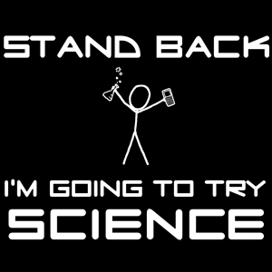
Outcome Verbs
Investigate
Explore
Inquire
Analyze
Measure
Appreciate
Design
Critique
Identify and Describe, through experimentation
https://xmission.com/blog/2013/03/19/salt-lake-valley-science-engineering-fair-kids-doing-really-cool-stuff
Notes:
Laboratory and hands on work is integral to achieving these outcomes.

Slide 7
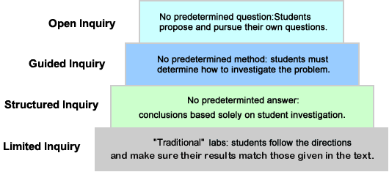
Levels of Inquiry
http://www.materialsworldmodules.org/pedagogy/inquiry_continuum.shtml
Notes:
Inquiry learning provides students with opportunities to build knowledge, abilities, and inquiring habits of mind that lead to deeper understanding of their world and human experience. Inquiry is more than a simple instructional method. It is a philosophical approach to teaching and learning, grounded in constructivist research and methods, which engages students in investigations that lead to disciplinary, interdisciplinary, and transdisciplinary understanding. Inquiry builds on students’ inherent sense of curiosity and wonder, drawing on their diverse backgrounds, interests, and experiences. The process provides opportunities for students to become active participants in a collaborative search for meaning and understanding.
Middle years students who are engaged in inquiry in science should be able to:
• Identify questions that can be answered through scientific investigations.
• Design and conduct a scientific investigation.
• Use appropriate tools and techniques to gather, analyze, and interpret data.
• Develop descriptions, explanations, predictions, and models using evidence.
• Think critically and logically to make the relationships between evidence and explanations.
• Recognize and analyze alternative explanations and predictions.
• Communicate scientific procedures and explanations.
• Use mathematics in all aspects of scientific inquiry

Slide 8
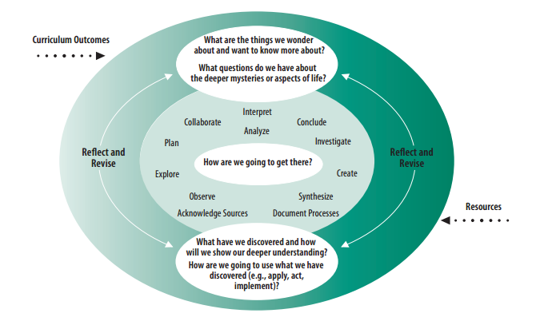
Constructing Understanding Through Inquiry
http://www.materialsworldmodules.org/pedagogy/inquiry_continuum.shtml
Notes:
An important part of any inquiry process is student reflection on their learning and the documentation needed to assess the learning and make it visible. Student documentation of the inquiry process in science may take the form of works-in-progress, reflective writing, journals, reports, notes, models, arts expressions, photographs, video footage, or action plans. Inquiry learning is not a step-by-step process, but rather a cyclical process, with various phases of the process being revisited and rethought as a result of students’ discoveries, insights, and construction of new knowledge. Experienced inquirers will move back and forth among various phases as new questions arise and as students become more comfortable with the process. The following graphic shows various phases of the cyclical inquiry process.
Inquiry learning is not a step-by-step process, but rather a cyclical process, with various phases of the process being revisited and rethought as a result of students’ discoveries, insights, and construction of new knowledge. Experienced inquirers will move back and forth among various phases as new questions arise and as students become more comfortable with the process. The following graphic shows various phases of the cyclical inquiry process.

Slide 9
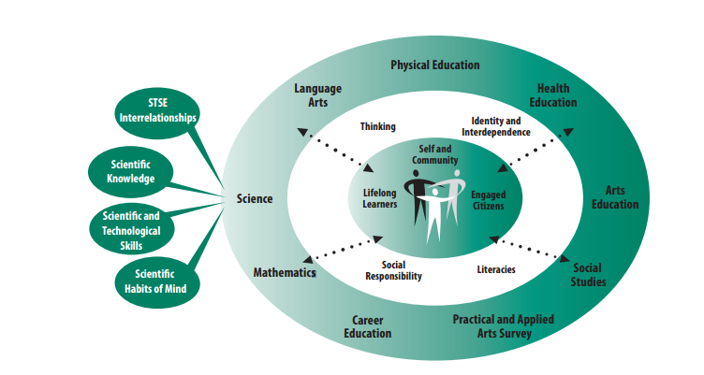
Goals of Science in SK
http://
https://www.edonline.sk.ca/bbcswebdav/library/curricula/English/Science/science_9_2009.pdf
Notes:
Students engaged in constructing and applying science knowledge naturally build a positive disposition towards learning. Throughout their study of science, students bring a natural curiosity about the natural and constructed world which provides the motivation to discover and explore their personal interests more deeply. By sharing their learning experiences with others, in a variety of contexts, students develop skills that support them as lifelong learners.
Students develop and strengthen their personal identity as they explore connections between their own understanding of the natural and constructed world and perspectives of others, including scientific and Indigenous perspectives. Students develop and strengthen their understanding of community as they explore ways in which science can inform individual and community decision making on issues related to the natural and constructed world.
As students explore connections between science, technology, society, and the environment, they experience opportunities to contribute positively to the environmental, economic, and social sustainability of local and global communities. Students reflect and act on their personal responsibility to understand and respect their place in the natural and constructed world, and make personal decisions that contribute to living in harmony with others and the natural world.

Slide 10
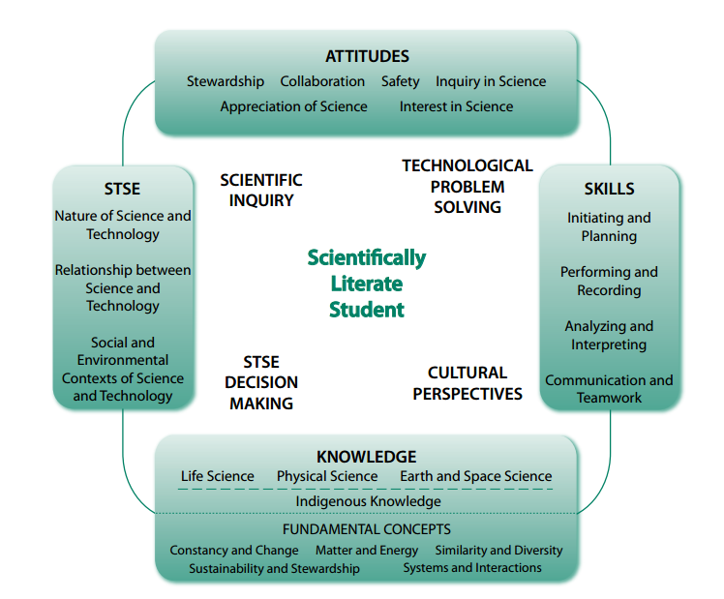
Scientific Literacy Framework
https://www.edonline.sk.ca/bbcswebdav/library/curricula/English/Science/science_9_2009.pdf
Notes:
Foundations of Scientific Literacy are in the centre of the diagram, learning contexts are on the outside of the diagram.
• Understand the Nature of Science and STSE Interrelationships - This foundation is concerned with understanding the scope and character of science, its connections to technology, and the social context in which it is developed. This foundation statement should be considered the driving force of scientific literacy. Three major dimensions address this foundation. Nature of Science and Technology Science is a social and cultural activity anchored in a particular intellectual tradition. It is one way of knowing nature, based on curiosity, imagination, intuition, exploration, observation, replication, interpretation of evidence, and consensus making over this evidence and its interpretation. More than most other ways of knowing nature, science excels at predicting what will happen next, based on its descriptions and explanations of natural and technological phenomena. Science-based ideas are continually being tested, modified, and improved as new ideas supersede existing ideas. Technology, like science, is a creative human activity, but is concerned with solving practical problems that arise from human/social needs, particularly the need to adapt to the environment and to fuel a nation’s economy. New products and processes are produced by research and development through the processes of inquiry and design. Relationships between Science and Technology Historically, the development of technology has been strongly linked to the development of science, with each making contributions to the other. While there are important relationships and interdependencies, there are also important differences. Where the focus of science is on the development and verification of knowledge; in technology, the focus is on the development of solutions, involving devices and systems that meet a given need within the constraints of the problem. The test of science knowledge is that it helps us explain, interpret, and predict; the test of technology is that it works – it enables us to achieve a given purpose. Social and Environmental Contexts of Science and Technology The history of science shows that scientific development takes place within a social context that includes economic, political, social, and cultural forces along with personal biases and the need for peer acceptance and recognition. Many examples can be used to show that cultural and intellectual traditions have influenced the focus and methodologies of science, and that science, in turn, has influenced the wider world of ideas. Today, societal and environmental needs and issues often drive research agendas. As technological solutions have emerged from previous research, many of the new technologies have given rise to complex social and environmental issues which are increasingly becoming part of the political agenda. The potential of science, technology, and Indigenous knowledge to inform and empower decision making by individuals, communities, and society is central to scientific literacy in a democratic society.
• Construct Scientific Knowledge – This foundation focuses on the subject matter of science including the theories, models, concepts, and principles that are essential to an understanding of the natural and constructed world. For organizational purposes, this foundation is framed using widely accepted science disciplines. Life Science Life science deals with the growth and interactions of life forms within their environments in ways that reflect the uniqueness, diversity, genetic continuity, and changing nature of these life forms. Life science includes the study of topics such as ecosystems, biological diversity, organisms, cell biology, biochemistry, diseases, genetic engineering, and biotechnology. Physical Science Physical science, which encompasses chemistry and physics, deals with matter, energy, and forces. Matter has structure, and its components interact. Energy links matter to gravitational, electromagnetic, and nuclear forces in the universe. The conservation laws of mass and energy, momentum, and charge are addressed in physical science. Earth and Space Science Earth and space science brings local, global, and universal perspectives to student knowledge. Earth, our home planet, exhibits form, structure, and patterns of change as do our surrounding solar system and the physical universe beyond. Earth and space science includes such fields of study as geology, hydrology, meteorology, and astronomy.
• Develop Scientific and Technological Skills – This foundation identifies the skills and processes students develop in answering questions, solving problems, and making decisions. While these skills and processes are not unique to science, they play an important role in the development of scientific and technological understanding and in the application of acquired knowledge to new situations. Four broad skill areas are outlined in this foundation. Each area is developed further at each grade level with increasing scope and complexity of application. Initiating and Planning These are the processes of questioning, identifying problems, and developing preliminary ideas and plans. Performing and Recording These are the skills and processes of carrying out a plan of action, which involves gathering evidence by observation and, in most cases, manipulating materials and equipment. Gathered evidence can be documented and recorded in a variety of formats. Analyzing and Interpreting These are the skills and processes of examining information and evidence, organizing and presenting data so that they can be interpreted, interpreting those data, evaluating the evidence, and applying the results of that evaluation. Communication and Teamwork In science and technology, as in other areas, communication skills are essential whenever ideas are being developed, tested, interpreted, debated, and accepted or rejected. Teamwork skills are also important because the development and application of ideas rely on collaborative processes both in science-related occupations and in learning.
• Develop Attitudes that Support Scientific Habits of Mind – This foundation focuses on encouraging students to develop attitudes, values, and ethics that inform a responsible use of science and technology for the mutual benefit of self, society, and the environment. This foundation identifies six categories in which science education can contribute to the development of scientific literacy. Appreciation of Science Students will be encouraged to critically and contextually appreciate the role and contributions of science and technology in their lives and to their community’s culture; and to be aware of the limits of science and technology as well as their impact on economic, political, environmental, cultural, and ethical events. Interest in Science Students will be encouraged to develop curiosity and continuing interest in the study of science at home, in school, and in the community. Inquiry in Science Students will be encouraged to develop critical beliefs concerning the need for evidence and reasoned argument in the development of scientific knowledge. Collaboration Students will be encouraged to nurture competence in collaborative activity with classmates and others, inside and outside of the school. Stewardship Students will be encouraged to develop responsibility in the application of science and technology in relation to society and the natural environment. Safety Students engaged in science and technology activities will be expected to demonstrate a concern for safety and doing no harm to themselves or others, including plants and animals.
Learning Contexts - Learning contexts provide entry points into the curriculum that engage students in inquiry-based learning to achieve scientific literacy. Each learning context reflects a different, but overlapping, philosophical rationale for including science as a Required Area of Study:
• The scientific inquiry learning context reflects an emphasis on understanding the natural and constructed world using systematic empirical processes that lead to the formation of theories that explain observed events and that facilitate prediction.
• The technological problem solving learning context reflects an emphasis on designing and building to solve practical human problems similar to the way an engineer would.
• The STSE decision making learning context reflects the need to engage citizens in thinking about human and world issues through a scientific lens in order to inform and empower decision making by individuals, communities, and society.
• The cultural perspectives learning context reflects a humanistic perspective that views teaching and learning as cultural transmission and acquisition (Aikenhead, 2006).

Slide 11
Websites and Apps
Helping students visualize the science

Slide 12
List of Websites and Apps
http://goo.gl/EDRLWp
http://www.chromoscope.net/
http://goo.gl/Lh76z5
http://goo.gl/ihizeP
https://www.explorelearning.com/
http://goo.gl/eXnQks
http://goo.gl/9WZYGN

Slide 13
Let’s “do” science
Hands on activities linked to your curriculum

Slide 14
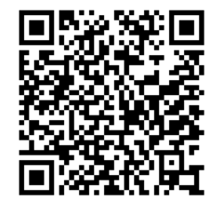
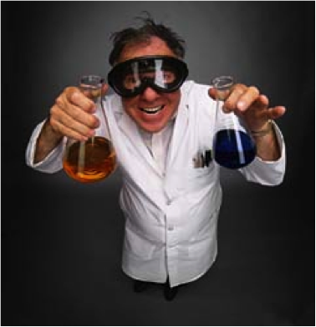
THANKS!
https://goo.gl/hCyJgz
http://www.thinkstockphotos.co.uk/royalty-free/mad-scientist-pictures
Any questions?
You can email us at:
Camille.Hounjet@sunwestsd.ca
Scott.Stephens@sunwestsd.ca
https://reportingscience.wordpress.com/tag/mad-scientist/

