Slide 1
History 10—The English Civil War and the Glorious Revoltuion
Who’s who??? Images of the Important people

Slide 2
Arthur, Prince of Wales DIED YOUNG

Slide 3
Catherine of Aragon of Spain (Queen Consort of England) MARRIAGE ANNULLED

Slide 4
King Henry VIII of England r. 1509-1547 (Tudor)

Slide 5
Funeral brass of Bessie Blount (short lived mistress of Henry VIII)

Slide 6
Henry of Fitzroy (illegitimate son of Henry VIII and Elizabeth (Bessie) Blount) Duke of Richmond and Somerset DIED WITHOUT HEIR

Slide 7
Mary Boleyn (sister to Anne) mistress of Henry VIII

Slide 8
Anne Boleyn—Queen Consort of England (tenure: 1533-1536) BEHEADED

Slide 9
Jane Seymour—Queen Consort of England DIED (childbirth) Tenure: 1536-1537

Slide 10
Catherine Howard—Queen Consort of England (tenure: 1540-1541) BEHEADED

Slide 11
Anne of Cleves—Queen Consort of England (tenure: 1540 for 6 months) MARRIAGE ANNULLED

Slide 12
Catherine Parr—Queen Consort of England (tenure: 1543-1547) OUTLIVED HENRY

Slide 13
Edward VI of England (r. 1547-1553) DIED WITHOUT HEIR

Slide 14
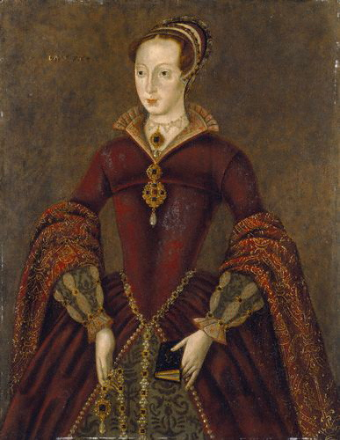
Lady Jane Grey (disputed Queen of England) (r. 1553 for 9 days) DEPOSED

Slide 15
Queen Mary I (r. 1553-1558) DIED (likely ovarian cancer)

Slide 16
Philip II of Spain (King of England during Mary I’s reign as joint ruler)

Slide 17
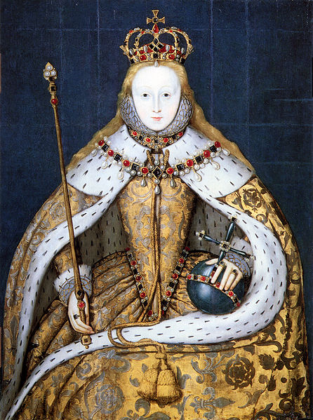
Elizabeth I of England r. 1558-1603 DIED

Slide 18
Mary, Queen of Scots (IMPRISONED FOR 19 YEARS AND THEN EXECUTED FOR TREASON AGAINST ELIZABETH I)

Slide 19
Francis Drake—Vice Admiral of the English Fleet against the Spanish Armada of 1585

Slide 20
James VI of Scotland and I of England (r. 1603-1625)

Slide 21
Charles I of England (and Scotland) (r. 1625-1649) BEHEADED

Slide 22
Oliver Cromwell—Lord Protector of England (in office: 1649-1658) DIED

Slide 23
Richard Cromwell (aka “Tumbledown Dick” (In office: 1658-1660) OVERTHROWN

Slide 24
Charles II (Merry Monarch) (r.1660-1685) DIED

Slide 25
James II of England (r. 1685-1688) OVERTHROWN

Slide 26
William and Mary of Orange of England (r. 1689-1694)

