Slide 1
Math textbook assignment

Slide 2
Lesson 1: Using a math textbook
Lesson questions:
Where do I look to find a specific topic in the textbook?
How do I find a definition?
Where are the answers? (only in older grades)

Slide 3
Where do I look for a specific topic?
Take a textbook tour – what do you find?
Name two things
Table of contents
Shows the location of lessons
Illustrated glossary
Gives definitions
Index
Provides a page number for topics or words

Slide 4
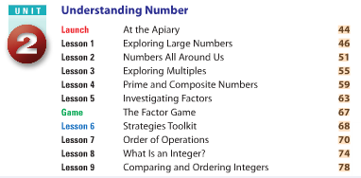
Where do I look for a specific topic?
Find where the textbook teaches about Integers
Two ways
Table of contents
Index
Try these:
Multiplication
Fractions
Area

Slide 5
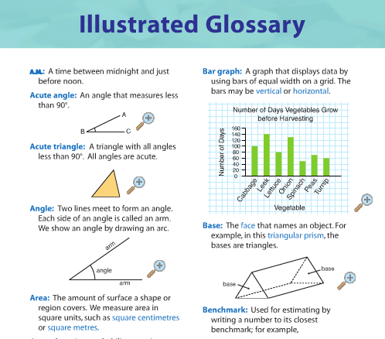
How do I find a definition?
Go to pg. 4-5 (grade 6 text)
What are the “key words”?
Help us to understand the upcoming lesson
Vocabulary for the unit
Where would we find what these words mean?
The illustrated glossary:
Has pictures
Is alphabetical

Slide 6
How do I find a definition?
Find these words:
Angle
Benchmark
Expression
Prime number

Slide 7
Where are the answers? Not all grades
In the back of the book….why?
Things to consider:
Does looking up the answers without doing the work help you in the long run?
Do you learn the content by looking up the answers?
Sometimes…
Do the answers show you how to do the work?

Slide 8
Where are the answers? Not all grades
How can we use the answers to help us?
Sometimes we can work backwards
Use it to discover how the question is solved
Question: 23 x 6
x$\begin{matrix}23 \\ \begin{aligned} 6 \\ \end{aligned}\end{matrix}$
Answer: 138

Slide 9
Lesson 2: Reading a math textbook
Lesson questions:
How do I read a math textbook?
How do I know what is important?

Slide 10
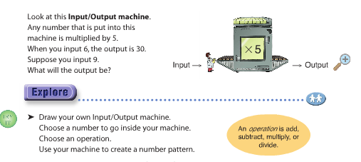
Lesson 2: Reading a math textbook
Go to page 6-7 in grade 6 text book
What does it mean when something is bolded or in a word bubble?

Slide 11
Lesson 2: Reading a math textbook
There are three sections in each lesson
Explore
Connect
Practice
Explore
Goes through an idea or a problem
Connect
Summarizes the math
Practice
Allows you to use and remember the math
*Often if you need a refresher on the math or are unsure of what a word means from the lesson, you can find it in the connect section of the lesson
Go to pg. xii in grade 6 text book to see what each section means.

Slide 12
Lesson 3: How to label your work
Lesson questions
How do I label a notebook assignment
What do I do with graph paper?
How do I show my work?

Slide 13
Labeling notebook assignments
Your teacher needs to know what page and questions you are working on
If you take home homework, you will know what page and questions you are expected to do.

Slide 14
Labeling notebook assignments
pg. 8 # 1- 6
Ex: Please do pg. 8
*Remember*
1 – 6 means 1, 2, 3, 4, 5, and 6.

Slide 15
Labeling notebook assignments
pg. 8 # 1- 6
1.
Put your questions down the margin.
If you have a question with letters, put them one under the other.
X
b)
2. a)
√
b)

Slide 16
Labeling notebook assignments
pg. 8 # 1- 6
If you have a question with a table or the need to draw, make sure you leave enough room before you start the next question.
Use a ruler
1. a)
b)
2. a)

Slide 17
How do I show my work?
When doing math, we need to show our work for our teacher to understand how we got the answers we did.
The process is just as important as the answer
Depends on the type of question

Slide 18

How do I show my work?
General rules
If it’s a word problem, it needs a worded answer
If you need to do any calculations, show them
Make sure your teacher can read your work
Make sure it is clear what your answer is. Sometimes circling the final answer is a good idea.
Don’t forget to include units
If there are six apples in the basket, and I eat one, how many are left?
$$−\begin{matrix}6 \\ \begin{aligned}1 \\ 5 \end{aligned}\end{matrix}$$
There are 5 apples left.

