Slide 1
Self-Regulation Strategies
Be Organized
Self-Management

Slide 2
Does this sound like you?
“I can never find my homework”
“Why is there never enough time in the day to do everything I need to do?”
“How can I possibly get to my next class in 5 minutes?”
“I’m always late in the morning because I…”
“I don’t do as well as I want on assignments because I always seem to forget to do some part of it…”
I get myself or other people stressed out because I’m always forgetting where I put things, times when things are happening, or what I’m supposed to be doing.”

Slide 3
Why are Good Organizational Skills necessary in EVERYTHING?
They allow you to work efficiently and effectively at any task you undertake.
They reduce stress that can hinder your achievement
They buy you time and energy to reach your true potential
They allow your true talents and abilities to shine through by preventing chaos and disorder.

Slide 4
Do you have an Organizational Problem?
Complete the quiz in your student package to determine if you are as organized as you could be.

Slide 5
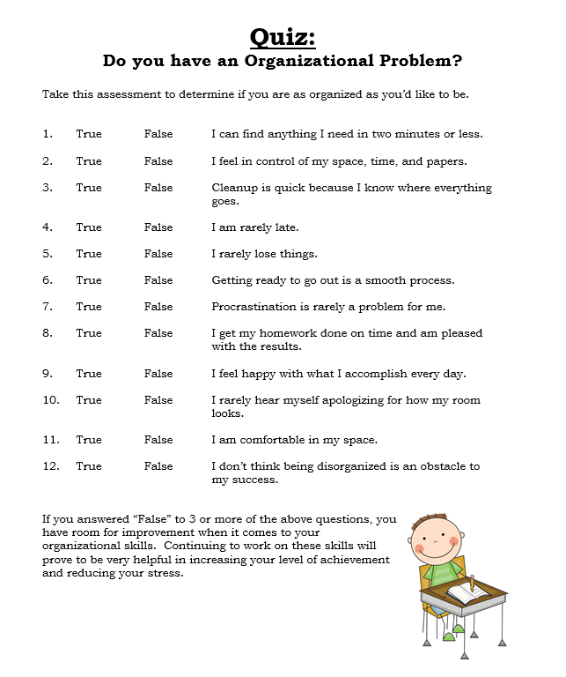

Slide 6
Organizational Skills: True or False?
Being organized is the same as being neat
FALSE… organization is not about how a space looks, but how it functions
Being organized is a talent you’re either born with, or not
FALSE… organizing is a learnable skill!
Organizing is about throwing things away
FALSE… you can keep EVERYTHING you want, and still get organized!

Slide 7
What needs to be organized in your life?
Space and physical possessions
Your time!
Tasks (such as your school assignments)

Slide 8
How do we work towards achieving better organization? Step 1: Analyze
Identify what’s working and what’s not
Identify what is most important about the space, assignment or task that you are organizing
Identify what the pay-off will be for you to get organized
Identify what the specific problem is
We are going to work through this using the template on your handout

Slide 9
Step 2: Strategize
Use the Kindergarten Model
Clear areas, zones or tasks broken down and clearly labeled so that there can be no confusion
Estimate the time it will take to do the organization
IMPORTANT to be realistic!
We are going to work through this using the template on your handout

Slide 10
Step 3: Attack
The approach that you use here will depend on which organizational problem you are “attacking.”
The options are:
Space or physical possessions (ie: your locker or bedroom)
An assignment/task (ie: an English essay)
Time (ie: within a day, week or a month)

Slide 11
Attacking a Space
Think “SPACE”
Sort → go through everything, and group similar items
Purge → get rid of duplicates, excess, undesirable items
Assign a Home → decide where the items you keep will “live”
Containerize → use containers to keep items separate
Equalize → maintain and update your system over time.

Slide 12
Attacking an Assignment/Task (1/2)
The key to organizing anything in your life is that it has to fit who YOU are! One person’s organizational system may not work for everyone!
Organize a Binder for each subject area:
Use one binder for each subject
Label sections if necessary (ie: notes, assignments, labs, etc)
Do not overload binders until the rings can barely close
Be sure to put pages in securely – don’t “shove it in and hope to find it later!”

Slide 13
Attacking an Assignment/Task (2/2)
Working on an assignment:
Write down the due date in your planner (whatever type of planner you choose to use!)
Read and clarify assignment expectations if necessary
Plan ahead so that the assignment is completed over several days, if necessary
Have your teacher check over a rough draft a couple days early, and use feedback to make necessary improvements
Keep final draft in a separate section of your binder for hand-in, or check and see if your teacher will accept an electronic copy, and hand it in that way.
Keep returned assignment with teacher feedback for exam review

Slide 14
Attacking Time
Think “WADE”
Write it down → put activities in planner
Add it up → estimate how long the activity will take
Decide when → designate when the task will be completed
Execute your plan → put your plan into action

Slide 15
Time Organization Challenges
Sometimes there just aren’t enough hours in a day to do everything. Consider:
Deleting the task – maybe it doesn’t take priority for the day or week
Delaying the task – can it wait for a later time? Be careful not to procrastinate too much
Diminish the task – how can you complete the task efficiently, but without a lot of time?
Delegate the task – can someone help you, or complete it for you (where appropriate)

Slide 16
Time Organization Challenges
Beware of:
PROCRASTINATION
Most people do not do their best work when working against the clock.
PERFECTIONISM
Delaying or not handing something in until it is “perfect” in your eyes typically leads to a poorer mark than if you had handed in your best work on time.

Slide 17
Choosing a Plan of Attack
Choose one of the three areas to focus on for your plan of attack:
Organizing a Space
Organizing an Assignment
Organizing your Time
You will set a goal for your preferred area using the SMART outline
Specific – what is your goal?
Measureable – how will you know when your goal is reached?
Abilities – what strengths do you have to within yourself to help you achieve this goal?
Resource(s) – what or who can you access for help?
Time – when would you like to have your goal completed?

Slide 18
In Conclusion
The time it takes to get organized is worth it! It will save you both time and stress in the long run!
You are never really “done” organizing your space, time or work. Good organization requires maintenance for it to be effective.

