Slide 1
RCHS PD Day
May 23

Slide 2
21st Century Competencies
Communication
Critical thinking
Collaboration
Character
Creativity
Culture
Computer Technology

Slide 3
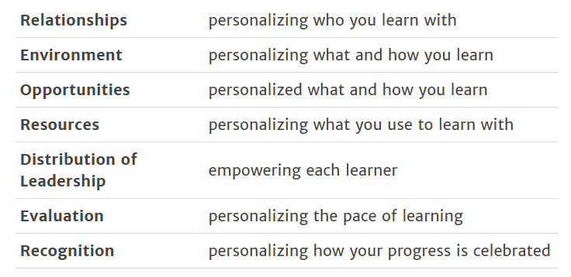
REORDER Document
What questions do you have?
What are you excited about?
What scares you?

Slide 4
Grit and Growth Mindset

Slide 5
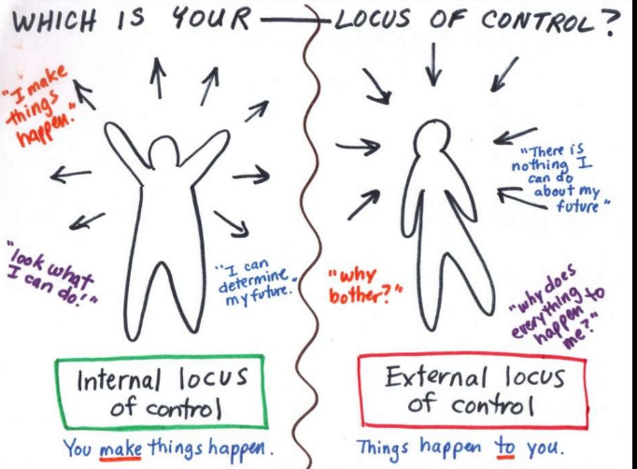
How do these relate to students? Teachers?

Slide 6
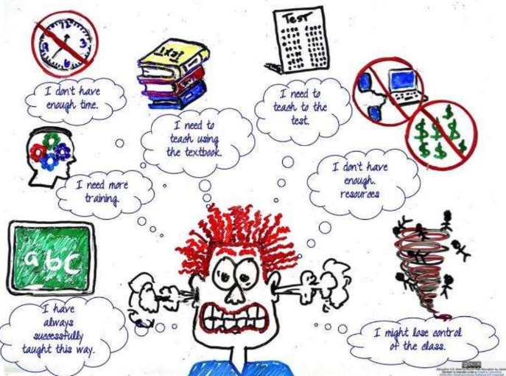
Mindsets and Teachers

Slide 7
Growth and Fixed Mindset Characteristics (Educator Specific)
Growth Mindset | Fixed Mindset

Slide 8
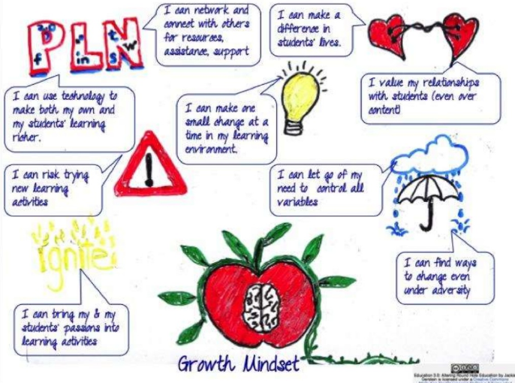
Reframing the Your Teacher Mindset
You can’t just decide you’re going to have a growth mindset, you have to do the work to figure out where you have a fixed mindset and how you can change it.

Slide 9
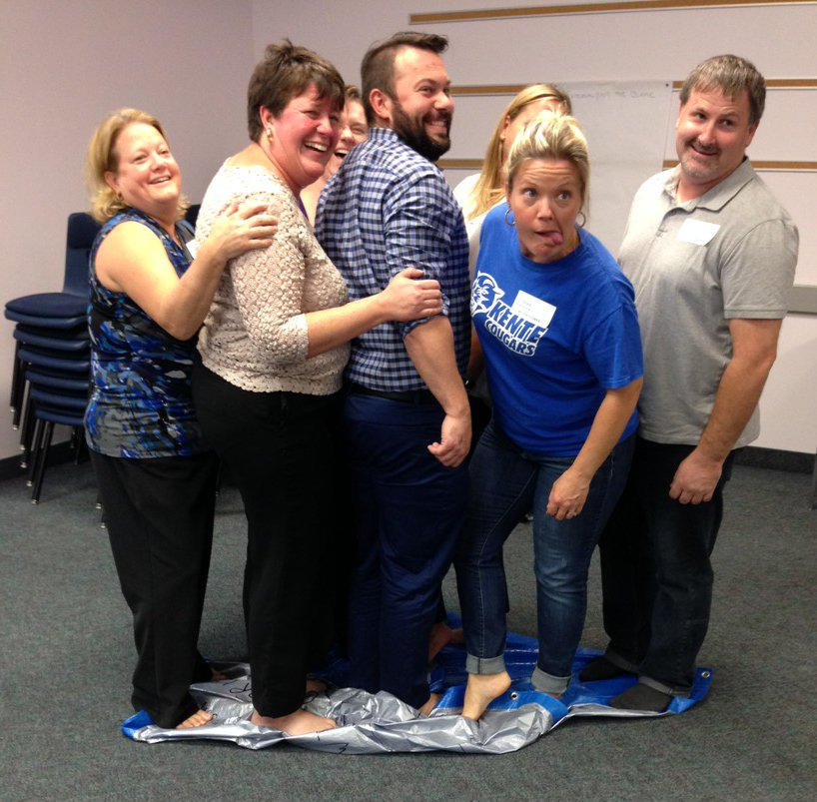
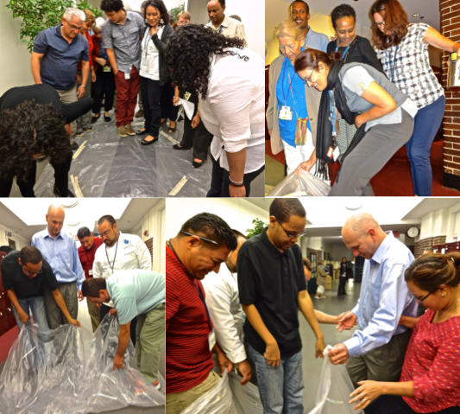
Flipping Our Collective Mindset – The Tarp Activity
Write all growth mindset characteristics on one side of the tarp.
Flip the tarp over and write all fixed mindset characteristics.
Lay the tarp on the floor, fixed mindset side up.
All staff stand on the tarp.
The tarp needs to be flipped over to the growth mindset side, without anyone touching the floor.
If anyone touches the floor, start over again.

Slide 10
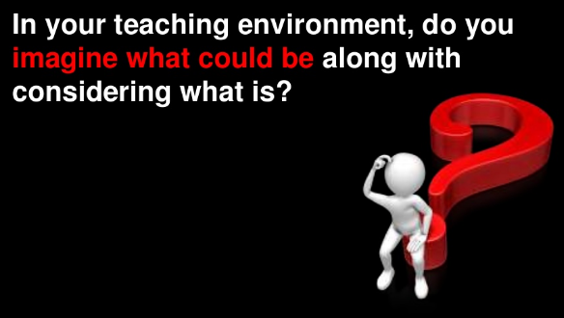
Questions to Consider…

Slide 11
Questions to Consider…

Slide 12
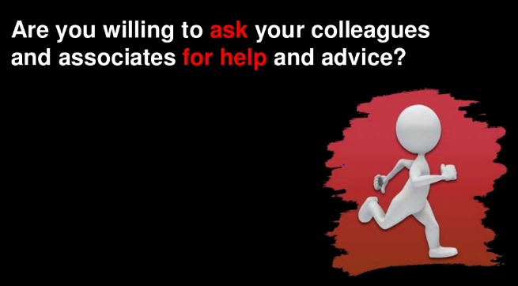
Questions to Consider…

Slide 13
Steps to Implementing PeBL
Learner Profiles
Flexible Seating
Self-Regulation
Strong classroom management and routines
High expectations
Excellent assessment practices
Highly planned and organized
Comfort with technology
Risk-taking environment
RELATIONSHIPS
PeBL

Slide 14
Personalized Goal Setting

