Slide 1
“Differentiation & Personalized Learning”
Facilitated by Melissa Lander
Melissa.lander@sunwestsd.ca

Slide 2
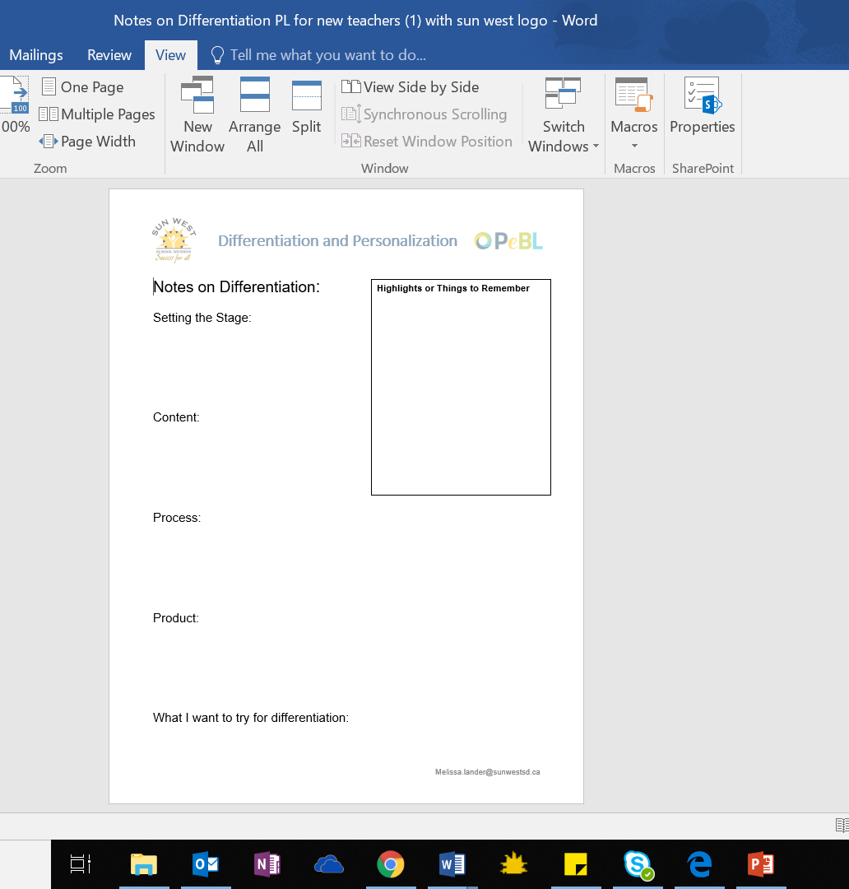
Note Taking Outline for Today

Slide 3
Differentiation = Good Teaching
Teach the kids we HAVE
No such thing as “average”
Responsive Teaching – not one size fits all
Varied approach to :
What students need to learn
How they will learn it
How they will demonstrate their learning

Slide 4
How to Differentiate
Setting the Stage
Role of Learner Profile
21st Century Skills
Three Ways to Differentiate
Content
Process
Product

Slide 5
Setting the Stage
Learner Profiles: Know your learners (and they must know themselves)
True colour, MI, Learning Styles, Preferences, Strengths, Weaknesses
Not a one off thing!
Build student agency https://resourcebank.ca/
21st Century Skills
Explicit instruction Flexible Learning enviro
Revisit DAILY – before and after activities
Common language
Comfortable to say “have it”
Pick a framework (SECRET, 7 Cs) Safe to take risks
Notes:
Mention this is pulling kids out of their "box" challenging them and growing strengths

Slide 6
Differentiate the CONTENT or the WHAT

Slide 7
Differentiate Content
Student interest
Pre-test for groupings (readiness, skills, diagnostic)
Learn profiles considered
Tiered content
Variety of materials to present content (different levels & styles)
Compacted (gifted/bright)
Pre-teaching (fill gaps)
Opportunities to enrich or re-teach
Vary methods for learning styles
Voice & Choice when possible

Slide 8
Differentiate the PROCESS or the HOW

Slide 9
Differentiate the Process
Small group instruction is your friend!
Pre-test for groupings (readiness, skills, diagnostic)
Learn profiles
FLEXIBLE groupings – never static
Summative to check in/group/regroup (E.g., exit slips)
Regular on-going assessment to inform your instruction/groups

Slide 10
Differentiate the Process
Assessment and instruction are inseparable.
Levelled or tiered activities
Guided Reading & Math (always with on-going assessment and flexible groups)
Stations or centres

Slide 11
Differentiate the Process
Cross curricular connections
Passion Projects/Wonder Time/Genius Hour or independent study options
Voice & Choice
Tic-Tac-Toe or Choice Boards, Learning Menus

Slide 12
Differentiate the PRODUCT

Slide 13
Differentiate the Product
Variety is the spice of life! ☺
Voice and Choice are KEY!
Expose students to a variety of tech and non-tech options

Slide 14
Differentiate the Product
Build capacity or experts in your class
Consider strengths and weaknesses
Have bright students build assessments or activities for others

Slide 16
So how do we morph into Personalized Learning and PeBL?
Notes:
Differentiation is PART of PeBL. Differentiation on steriods

Slide 17
iNACOL’s Must Haves for Personalized Learning
Student social and emotional involvement (meaningful, voice, choice)
Differentiated instruction
Immediate interventions
Flexible pacing
Individual student profiles (Learning Profiles)
Notes:
iNACOL is an international nonprofit transforming education to student-centered learning. We catalyze the transformation of K-12 education policy and practice to advance powerful, personalized, learner-centered experiences through competency-based, blended and online learning.

Slide 18
iNACOL’s Must Haves for Personalized Learning
Deeper learning and problem solving to develop meaning
Frequent feedback from instructors and peers
Outcome based learning
Anywhere, anytime learning
Performance-based assessments (project-based learning, portfolios, etc.)
Notes:
iNACOL is an international nonprofit transforming education to student-centered learning. We catalyze the transformation of K-12 education policy and practice to advance powerful, personalized, learner-centered experiences through competency-based, blended and online learning.

Slide 19
Two Key Considerations to Start:
FLEXIBLITY in everything
Involve kids in as much as possible (room design, content, process, product)

Slide 20
Notes:
We can also use reorder framework to move ourselves closer

Slide 21
How Does REORDER change the game?
Relationships
Developing positive relationships becomes a focus
KNOW your students (learner profiles)
Foster positive and open relationships between students, teacher, parents and the community.
Environment
Flexible learning environments
Places to stand, sit, lay
TEACH kids how to work in different areas
Help them find what works best
Safe to take risks & fail

Slide 22
How Does REORDER change the game?
Opportunities
Voice & Choice!
THEY are in control of their learning
Transfer of Responsibility
Resources
People, books, community, Etc.
I CAN statements – student-friendly language
Resourcebank.ca

Slide 23
How Does REORDER change the game?
Distribution of Leadership
We are all leaders
Failure is fine!
Evaluation
Expectations & outcomes shared BEFORE work done
No SET GROUPS ever
On-going assessment to drive teaching/learning
Reflection
Exit Slips

Slide 24
How Does REORDER change the game?
Recognition
Catch them “being good”
Weekly Kudos bags
Celebrate success!
Value Character as well as academics
Don’t forget about parents and community members

Slide 25
Pyramid of Growth

Slide 27
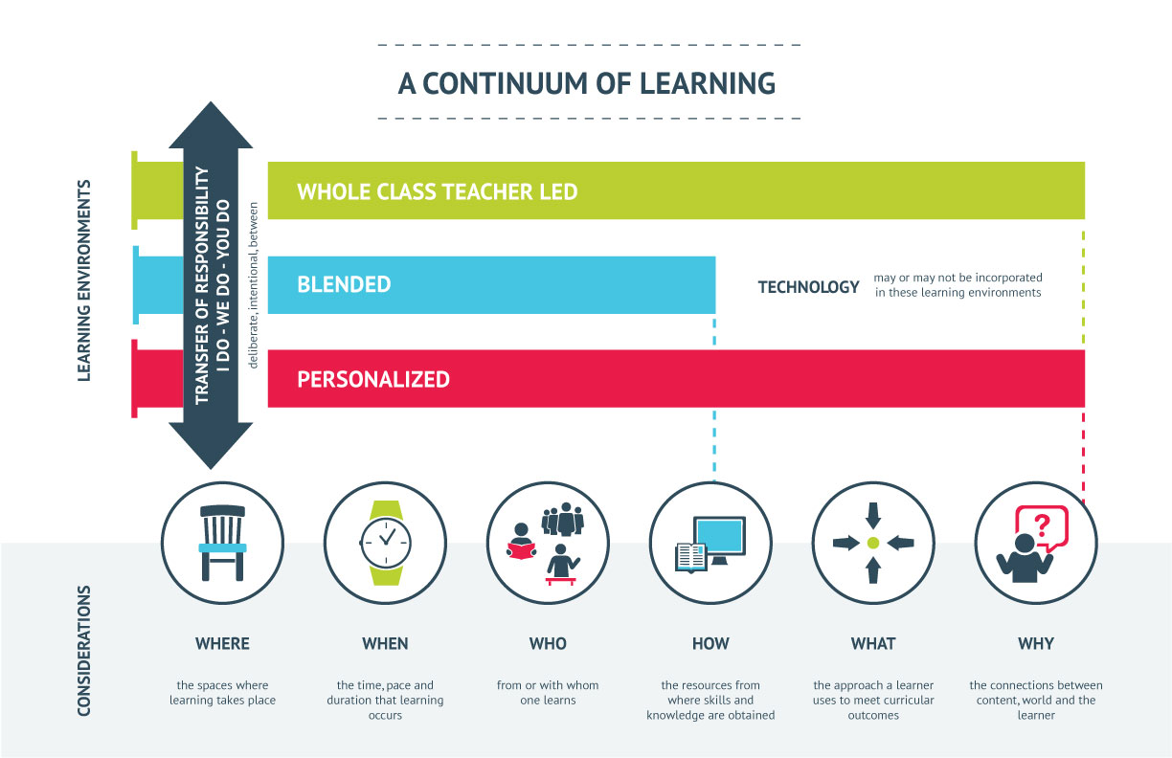
A Continuum of Learning
Notes:
Learning Experiences – many factors to consider – such as the 6 W's Where – space in which learning occurs – where do students need to be to do their best work? Alone? Together? Look/Feel? Outside of Classroom, etc., When – time, pace, duration of learning – goals? do students have choice in length? opportunities to extend or master outcomes? Who - with or from whom one learners. Do they work independently, in group, if group, what criteria – skill sets, interests, etc.? How – resources to where skills and knowledge are obtained. Do students use a wide variety of sources? Are demos necessary? Guest speakers? Field trip? Peers? etc. What – approach learners uses to meet curricular outcomes. can students tackle a problem, explore the research with big question, build something to demonstrate learning. (many strategies – problem based, inquiry based, design thinking ,case based, etc. Why – Student must realize why they are learning in order to develop connections with content, self and world.
All of these factors including various classroom learning environments – whole class, blended, personalized. Blended – educator and student share in decision making – where when how with whom – some student independence and voice. Student choice in what and why become more personalized – takes blended a few steps further where student drive their learning...
Technology can be involved but doesn't always have to be.
Building transfer of responsibility – shifts back and forth at all times. I do – We Do – You Do – allows for student voice.
Always think back to learner profiles –

Slide 28
What 1 thing will you try next week? What 3 things will you try next month? What is one thing you want to know more about? (Quiet Thinking Time)

Slide 29
Sharing & Questions

