Slide 1
Family Literacy & the PeBL Connection
Kelli Boklaschuk & Melissa Lander

Slide 2
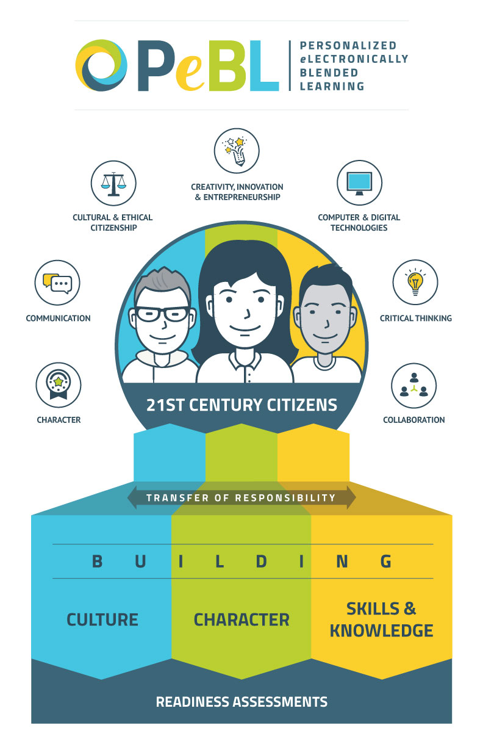

Slide 3
Reading is Queen! The home connection...
Notes:
Kelli

Slide 4
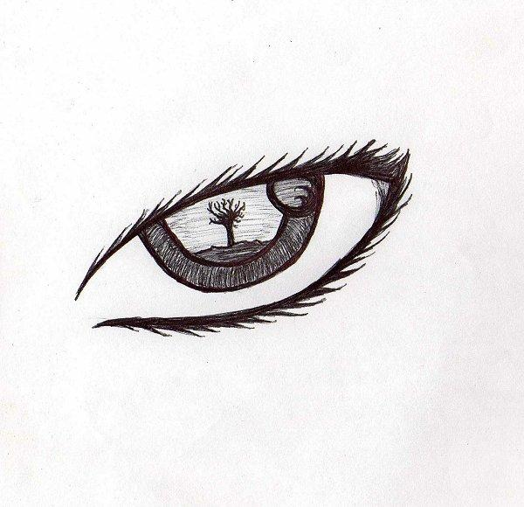
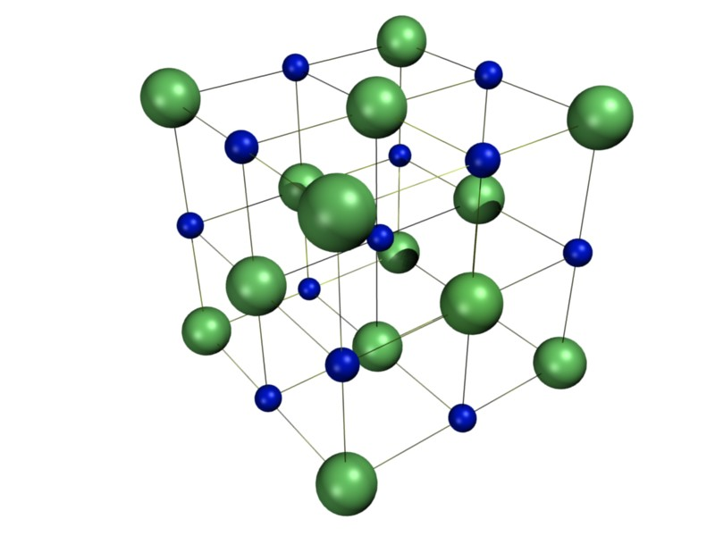
Where do you get the information to learn to read?
We use three sources of information to read:
Meaning (the message!)
Visual Information (the text)
Structure (what sounds right)

Slide 5
What do you need to learn to read?
Oral Language
Letter Sounds
Make & break words on the run
frequently used and strange words
How Books work

Slide 6
Oral Language
Talk, talk, talk
More talk at home, stories nightly, foam letters in the tub with sounds!)
Less screen time, more talking
Invite the child into authentic conversations that interest them (Learner Profile! - True Colours)

Slide 7
How Books Work
Don't go after too much at once
Model these when reading aloud to students
Point out the features of the book as you read Eg., why you change your voice when you see talking marks or ask kids why you took a little break (for a comma)
Ask kids questions about: Directionality, letter/word etc.

Slide 8
The Power of PROMPTS!
Visual info: Did it match or did you run out of/have extra words?
Meaning: Did that make sense? Can the picture help?
Structure: Does that sound right? Is that how someone would say that?

Slide 9
Fluency: The Struggle is Real!
MODEL, then have the child demo
Bouncing ball vs rolling ball
The finger is usually foe here! Get it out once they can match. (Unless coming to difficulty)
Record them to hear the difference! OR read to them robot-style then fluently; ask
Reading sounds like TALKING!

Slide 10
Self-Monitoring is Key
*Self-Correction is NOT a mistake
*Re-read & fix or confirm
*Cross-Check
Use all sources of information
This is why you need to prompt when correct too! Ask them to "check it " to confirm.
This builds good habits. Don't give them the word.

Slide 11
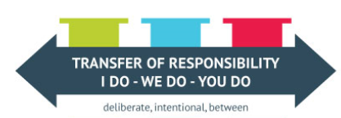
Read 20 minutes a night
You can read to them (I do)
You can share a book (We do)
They can read independently (You do)

Slide 12
It doesn't matter what they read as long as they are reading!!!

Slide 13
