Slide 1
Additional Student Programming and Classroom Supports
We are seeking some feedback from you.

Slide 2
Thinking ahead to 2019-2020
What are your student needs?
What classroom supports are needed? Do you have hotspots that need attention?
Are there areas where your Triad would like access additional support to assist with the leadership role in your school?
We have updated Form 210-23 Additional Student Programming and Classroom Supports and seeking your feedback.

Slide 3
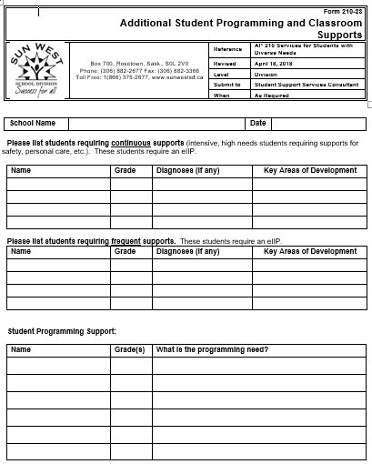
Student Programming
We have categorized your students according to three different support levels.
The top category identifies your intensive needs students requiring continuous supports throughout the day. You would be completing an Impact form for these students to determine key areas of development for their eIIP.
The middle category identifies your students requiring frequent, but not continuous, support. You would also be completing an Impact form for these students to determine key areas of development for the eIIP.
The bottom category identifies those students/classes where there might be a need for some extra supports will ensure success.

Slide 4
Learning Environment
Do you anticipate that you will need any changes to your learning environment for your student support students? An example of this might be calming room, additional bathroom space/design, or door on shelving.

Slide 5
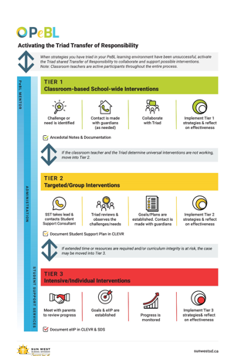
Classroom Supports
The leadership role of the Triad in your school is important for staff and students. However, there may be times when the Triad is not comfortable or familiar with taking the lead and will want additional Division supports.
Keeping in mind how we activate the Transfer of Responsibility so that the Triad supports staff and students, we have expanded the form to include school programming.
The chart on the following slide illustrates which member of the Triad will take the lead when considering additional student programming and classroom supports. The Classroom Teacher is integrated throughout; however, the role of the Triad is to consider who takes the lead in supporting students and teachers.

Slide 6
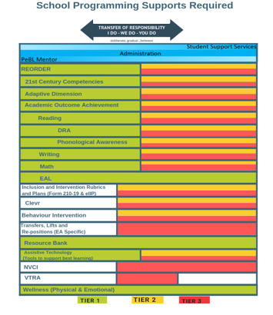
The dance of the Triad …
This graphic follows the Tier 1, 2, and 3 philosophy of Response to Intervention and demonstrates which Triad member may take the lead.
For each of the areas the PeBL Mentor, Administrator, and Student Support Teacher each play a leadership role.
Where the graphic is green for Tier 1, the PeBL Mentor leads with universal classroom supports that would be applicable to any learner.
Where the graphic turns to yellow and red, the Student Support Teacher would take the lead to ensure the students are receiving what is needed for targeted or intensive supports.
The Administrator is involved throughout the process.
You will notice that our lines do not line up and that there are some whitened out areas.
The areas whitened indicate that there isn’t a universal classroom approach for the PeBL Mentor to lead. These areas are only applicable for the Administrator and the SST to lead.
VTRA is lead entirely by the Administrator. The PeBL Mentors and SSTs do not have the training to lead.

Slide 7
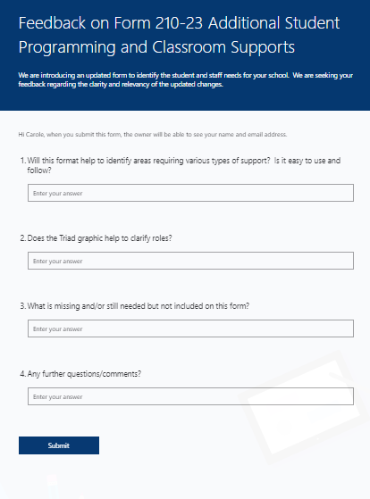
Seeking Feedback
We want to ensure that this updated form represents the needs-based model that we are trying to establish.
Use the following link to answer a few questions regarding our expectations and the clarity of the form.
https://bit.ly/2IdtUAf

Slide 8
Next Steps:
We will take all feedback collected until March 1st for consideration to a revised vision of the form. The final copy of the form will be sent to the Triad.
On March 14, 2019 in the afternoon we will ask the PeBL Mentor, Administrator and Student Support Teacher to work together in their Triad to have discussions regarding additional supports for students and staff. PeBL Mentors will have their Day 2 PeBL time and Admin/SSTs can book a sub, if required.
Completed forms will be picked up by your Student Support Consultant. Your Student Support Consultant will review your Impact forms regarding the students listed as requiring continuous and frequents supports from the first page of this updated form.
All forms are required back to the Consultant and Division Office by the Easter break so that EA allocations and other additional supports can be determined in a timely fashion.

