Slide 1
Upcoming PeBL Mentor and SST PD
April 10 – Writing PD (Day 2 afternoon)
May 24 – Math PD (Day 2 Afternoon)

Slide 2
Triad Meeting Thinking Ahead into Next Year March 14, 2019
Additional Student Programming and Classroom Supports

Slide 3
Thinking ahead to 2019-2020
What are your student needs?
What classroom supports are needed? Do you have hotspots that need attention?
Are there areas where your Triad would to like access additional support to assist with the leadership role in your school?

Slide 4
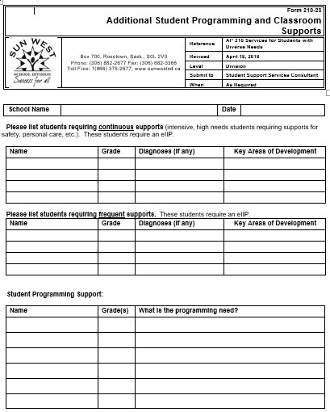
Student Programming
We have categorized your students according to three different support levels.
The top category identifies your intensive needs students requiring continuous supports throughout the day. You would be completing an Impact form for these students to determine key areas of development for their eIIP.
The middle category identifies your students requiring frequent, but not continuous, support. You would also be completing an Impact form for these students to determine key areas of development for the eIIP.
The bottom category identifies those students/classes where there might be a need for some extra supports will ensure success.

Slide 5
Students Requiring Continuous Supports
Indicate if additional supervision needed at recess &/or noon.

Slide 6
Students Requiring Frequent Supports

Slide 7
Student Programming Support
Where are the hotspots or pockets in your school requiring additional support?

Slide 8
Learning Environment
Do you anticipate that you will need any changes to your learning environment for your student support students? An example of this might be a calming room, additional bathroom space/design, or door on shelving.

Slide 9
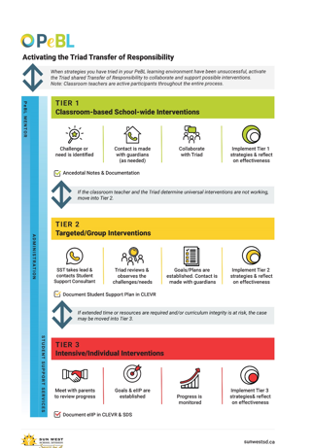
Classroom Supports
The leadership role of the Triad in your school is important for staff and students. However, there may be times when the Triad is not comfortable or familiar with taking the lead and will want additional Division supports.
Keeping in mind we activate the Triad Transfer of Responsibility to support staff and students, we have expanded the Additional Student Programming and Classroom Supports form to include school programming.
The chart on the following slide illustrates which member of the Triad will take the lead when considering additional student programming and classroom supports. The Classroom Teacher is integrated throughout; however, the role of the Triad is to consider who takes the lead in supporting students and teachers.

Slide 10
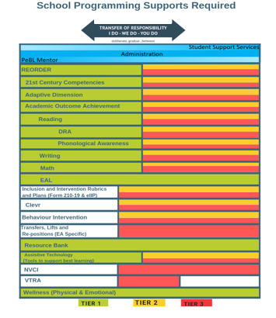
The dance of the Triad …
This graphic follows the Tier 1, 2, and 3 philosophy of Response to Intervention and demonstrates which Triad member may take the lead.
For each of the areas the PeBL Mentor, Administrator, and Student Support Teacher each play a leadership role.
Where the graphic is green for Tier 1, the PeBL Mentor leads with universal classroom supports that would be applicable to any learner.
Where the graphic turns to yellow and red, the Student Support Teacher would take the lead to ensure the students are receiving what is needed for targeted or intensive supports.
The Administrator is involved throughout the process.
You will notice that our lines do not line up and that there are some whitened out areas.
The areas whitened indicate that there isn’t a universal classroom approach for the PeBL Mentor to lead. These areas are only applicable for the Administrator and the SST to lead.
VTRA is lead entirely by the Administrator. The PeBL Mentors and SSTs do not have the training to lead.

Slide 11
Next Steps:
If you require additional assistance today, just give us a phone call. We have our cell phones turned on and able to provide support to your Triad.
Completed forms will be picked up by your Student Support Consultant. Your Student Support Consultant will review your Impact forms regarding the students listed as requiring continuous and frequents supports from the first page of this updated form.
Form 210-19 Inclusion and Intervention Rubric: Impact Form
Form 210-23 Additional Student Supports and Classroom Programming
All forms are required back to the Consultant and Division Office by the Easter break so that EA allocations and other additional supports can be determined in a timely fashion.

