Slide 1
Collective Responsibility & Co-Teaching
Kelli, Carole & Melissa

Slide 2
Go to www.menti.com
Code 435929
Notes:
Example poll – you can alter or make a new one for your school.
All the staff in my school understand and follow the cellphone use policy OR All the staff in my school understand and follow the same rules for the playground.

Slide 3
NORMS
Start on time; end on time.
Know what is expected of you and be prepared for meetings.
Stay on task and be an active participant.
No sidebars.
Teamwork with clear direction.
Plan breaks with a beginning time and an ending time.
Respect each other’s ideas and opinions, time, school culture and confidentiality.
Set cell phones on vibrate, and use them throughout the day in a professional manner.
Value honesty, trust, and humour in all we do.
Include follow-up to indicate success.
Our Collective
Responsibility
Notes:
Kelli – bring back what this group collectively decided on – let’s get aligned to be part of the presenation

Slide 4
We want to be ready for co-teaching
in our schools.

Slide 5
So what is
Collective responsibility?
All members of the school (including but not limited to administrators, teachers, counselors) accept responsibility for the students’ success or lack thereof.
Notes:
Melissa

Slide 6
My Kids
to
Our Kids
Notes:
Melissa -5 words or less snapshot of CR

Slide 7
How do we get ready for co-teaching?
Notes:
Carole – not just student support any more

Slide 8
Achievement
As a division collective, we believe all students can succeed at a high level following the PeBL philosophy using the
PeBL implementation process, the REORDER Framework and the Transfer of Responsibility.
Engagement
Well-being
Notes:
Kelli

Slide 9
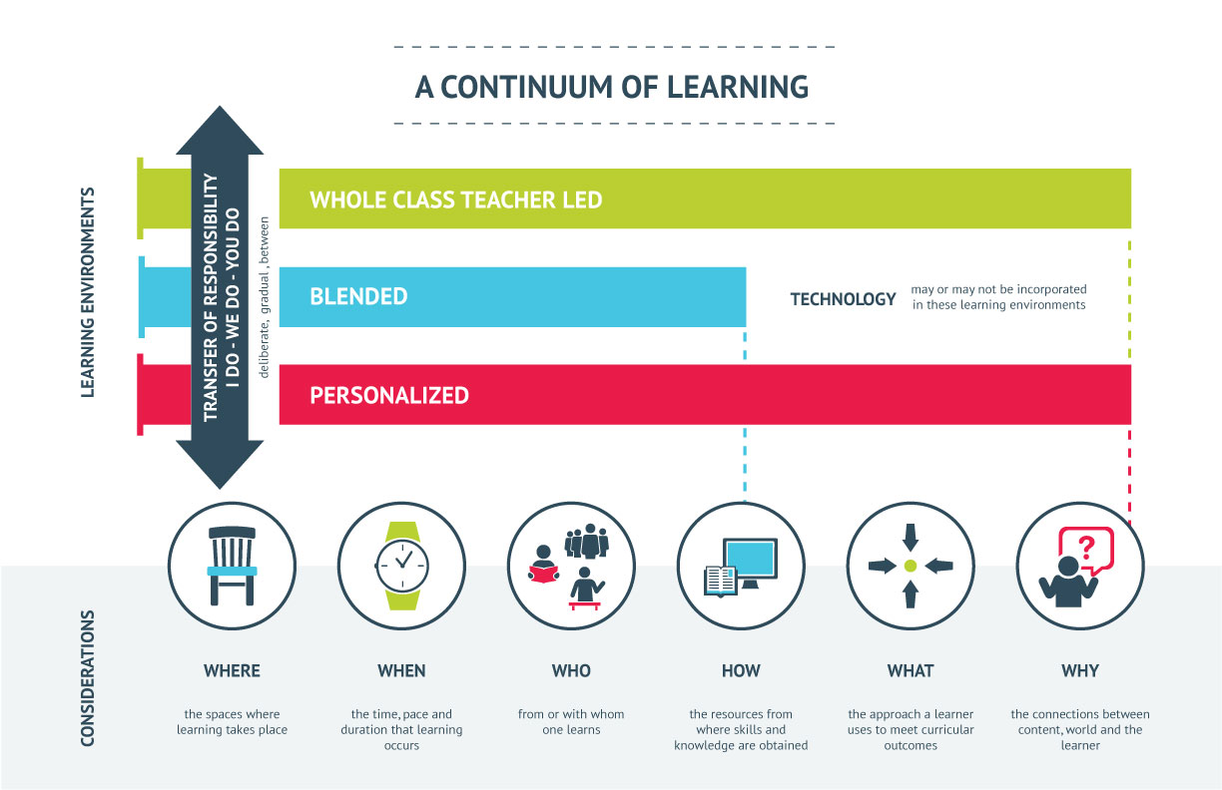
Notes:
Kelli

Slide 10
Poll Responses on
Collective Responsibility
Notes:
Choose one and reflect – How many can say yes? And those for you that say yes ……..Can you say yes for your entire school community?
Kelli – click to results from our poll
Collective responsibility doesn’t just happen – you need to make it happen

Slide 11
Does your school community collectively believe that all students can succeed at a high level following the PeBL philosophy using the PeBL implementation process, the REORDER Framework and the Transfer of Responsibility?
Notes:
Melissa - Loaded question - Quiet 2 minute Self –Reflection- Be honest – can we fully say this? How can we move towards this?
Which stakeholders need to move? How can you help move them? Jot yourself some notes for the next 2 minutes.

Slide 12
What would be people see, hear and feel to let visitors know that your school community believes in Success for All using the PeBL philosophy, REORDER and Transfer of Responsibility?
Notes:
Kelli - Turn & Talk – Pose question – What promise does your staff need to collectively make together to make this happen?
Is there value in having all staff believe in and promise to do this?

Slide 13
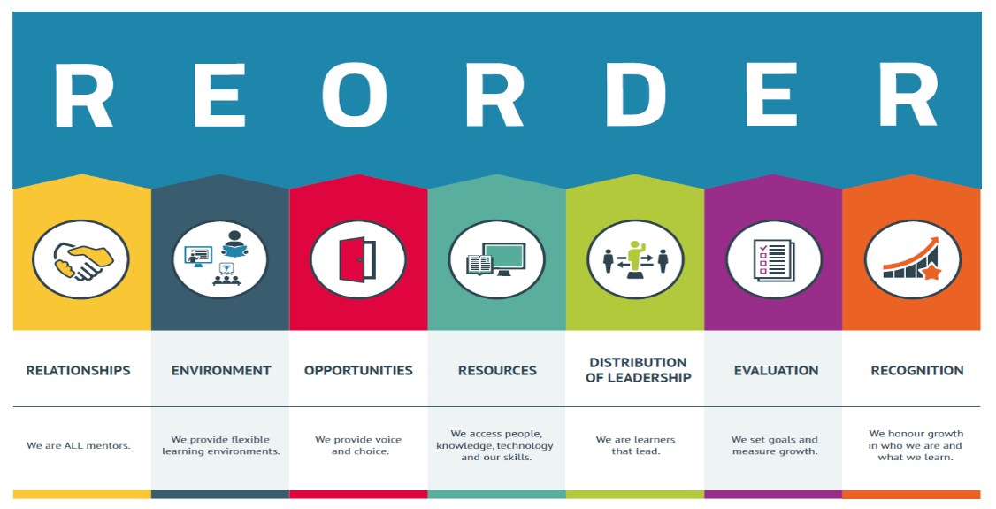
Success for All
Collective Responsibility
Notes:
Kelli - Your staff needs to believe in this for co-teaching or any teaching strategy to be successful.

Slide 14
“We may not get to decide which kids to serve, but we do get to decide the kind of climate in which we want to serve them.”
Culturize Page 15
Notes:
Carole – connection to our book study.

Slide 15
Every student needs a champion/mentor (Relationships)
High expectations for all (Recognition & Evaluation)
Carry the banner - Positivity & Growth Mindset (Relationships & Distribution of Leadership)
Be a merchant of hope (Relationships, Environment & Opportunities)
Notes:
Carole – connection to our book study.

Slide 16
Co-Teaching
“The essence of co-teaching is about building a professional relationship between the co-teachers, which is motivated by the drive to increase student achievement.”
Magiera, Simmons, Marotta, & Battaglia (2008).

Slide 17
Pockets of Collective Responsibility – may be ready for co-teaching
Notes:
Kelli – how we can transfer the responsibility.
Today we will show you how to identify those pockets that are ready – or how to get people ready for co-teaching if they are not already ready.

Slide 18
...can be a co-teacher?
Teachers
PeBL Mentors
Student Support Teachers
Administrator
Notes:
Melissa – it really can be anyone – think beyond student support

Slide 19
...can Support co-teaching
Librarians
Educational Assistants
Parents
Community members
Notes:
Melissa

Slide 20
Co-teaching Readiness Assessment Checklist
Co-teacher Interest
Administrator supports by providing time and resources
Co-teacher Collaborative & Flexible Mindset
REORDER Culture evident in both classrooms
Notes:
Melissa
-Refer to your handout – front page – just addressing the top part now
-You need to be SOLID on this checklist before you get moving – if not work on these things in your school to prepare.
*Give the SBAs the handout Co-Teaching Survey – guiding questions for readiness

Slide 21
Co-teaching Readiness Assessment Checklist
Risk Taking & Safe Environment (Trust)
Co-teachers/Students in both classes have similar understanding of 21 CC’s
Most students are able to self-regulate
Schedules are flexible and align
Notes:
Melissa

Slide 22
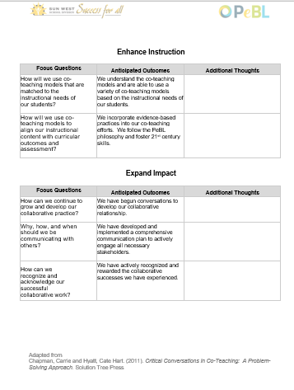
Co-Teaching Readiness
What are the critical conversations that need to happen between co-teaching partners?
Notes:
Carole - Staff MUST dialogue BEFORE the decision is even made to co-teach. It’s critical that they believe the same things and are on the same page.
Document – there are the conversations our teachers need to have
*Give the Co-teaching Survey

Slide 23
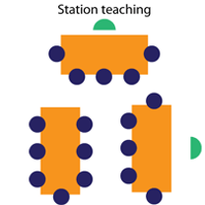
Turn & Talk:
What is the difference between the Mentorship & Co-Teaching Models?
Mentorship
Co-Teaching
Notes:
Melissa –Table talk What is the difference between the Mentorship Models and the Co-Teaching Models?
What do you see as the difference between the models?
Do you feel one supports the PeBL philosophy more than another?

Slide 24
The Process
<Critical Conversations>
throughout the process
Readiness Assessments
Planning
Instruction
Assessment
Reflection
https://www.solutiontree.com/free-resources/specialneeds/ccct
Notes:
Melissa - Suggested Purchase for all Triad members – on handout & key messages are on the back of your handout

Slide 25
What do we want our kids to know?
How do we know if they know it?
What do we do if they don’t learn it?
What do we do if they already know it?
Notes:
Melissa – continuous in co-teaching and all teaching

Slide 26
Readiness Assessments
(initial and ongoing)
Critical Conversations
1. Engage Partners (Collective Responsibility, Relationships & Distribution of Leadership )
Are we ready and committed to co-teach?
What might our shared vision be?
Notes:
Kelli

Slide 27
Planning for Instruction (ongoing)
Critical Conversations
2. Enhance Instruction (Opportunities, Resources, Distribution of Leadership, Recognition)
What are you going to do together that is better than what you could have done individually?
Notes:
Carole

Slide 28
Planning & Assessment (ongoing)
Critical Conversations
3. Examine Data: (Evaluation; Resources, Opportunities)
How will we use data in our co-teaching to improve instruction and learning?
Notes:
Melissa

Slide 29
Reflecting (ongoing)
Critical Conversations
4. Expand Impact (Relationships, Environment, Opportunities, Resources, Distribution of Leadership, Evaluation, Recognition)
What might add value to our instruction and co-teaching implementation? (where do we go from here?)
Notes:
Kelli

Slide 30
What is the SBA Role in Co-teaching?
The plans should include:
Co-teaching Walkthrough (review & reflect)
Time for collaboration and planning (flexible use of time)
Transfer of responsibility
Sharing and involvement with the outcomes/I cans
Students have voice and choice in the planning
Notes:
Melissa – refer to rest of the front of your handout – this is YOUR role.
You need to carve out time to make this happen well at ALL stages. Not just the actual teaching.

Slide 31
What is the SBA Role in Co-teaching?
The plans should include:
PeBL Planning Template (Resource Bank)(including 21 CC’s)
Ensure that the co-teaching has a larger impact than what they would do if they were not co-teaching
Accountability
Notes:
Melissa finish the role
***Give the walk through checklist – you can do this with a regular walk through
You do the first page front/back; teacher complete the last page.
Review the walk through – Do you have 2 or more staff members ready to do this? Can you target them to use as a model example.

Slide 32
https://www.youtube.com/watch?v=hrprg1r7kSs
Complete the Walkthrough Checklist for the teachers in the video.
Notes:
Carole - Complete the black & white copy of the walkthrough
Talk about it at your table for a few minutes.

Slide 33
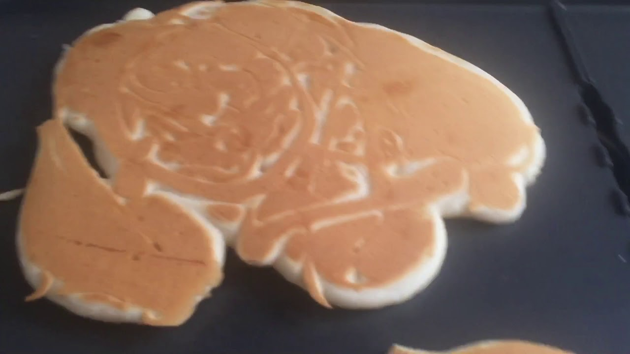
The First Pancake
Notes:
Melissa - it may be a bit messy, but it still tastes good and fills you up and does the job. It’s really ok if it’s not perfect.

Slide 34
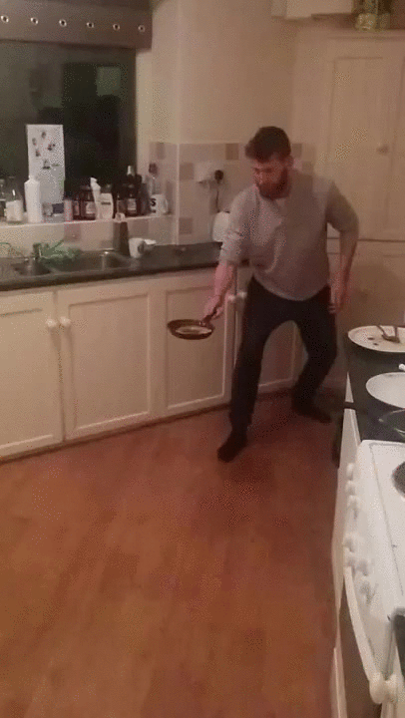
Over Time…
Notes:
Kelli – but over time with collective responsibility you will achieve either in small pockets or school-wide Success for All.

