Slide 1
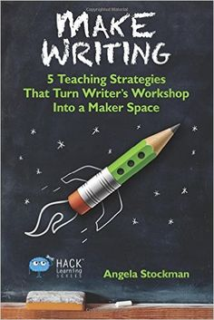
Maker Spaces a strategy to inspire Writing
Angela Stockman

Slide 2
Maybe the Problem Isn't The Writer...
Notes:
-maybe it's how we are defining and teaching writing
-give them flexible learning environments – up and move etc
-ask your kids! LISTEN to them
-retool writer's workshop

Slide 3
Motivation is Key to Writing!
Need to know your students (Learner profiles)
Need opportunities to write judgement free
Practice! Make it no big deal

Slide 4
Motivation is Key to Writing!
Authentic Audience – Answer the "WHY"
Model and be explicit!
Make it FUN!
This is our way to help make thinking visible. We need it!

Slide 5
What if my school doesn't have a maker space?

Slide 6
Myths & Worries
It's all about technology
It has to be a whole room
It's expensive
I Need to be “techie” or “sciencie” to do this
I don't have enough room
I don’t have enough money
I don't know how to make things

Slide 7
Truths & Reality
You can have a maker space without technology
It can be a tiny corner in your room
It can even be a mobile cart
You can do it cheap and cheerful with a trip to the dollar store
No previous experience required – build capacity in students and invite "experts"

Slide 8
Hack 1
Live in the We-Do for awhile
Make writing physically and collaboratively
Makes it safe
Makes it Fun
WE DO

Slide 9
Consider launching writer's Workshop with a bit making instead of words.

Slide 10
"When resistant writers are encouraged to make and share tangible things that matter to them – things that they enjoy designing and developing – writing is almost always a necessary and valued part of the process."
Make Writing, Page 16
Notes:
Things that matter – writing becomes part of the process and is more valued.

Slide 11
What would you rather be doing right now if you could do anything other than writing?
Ask reluctant writers this
Notes:
Turn & Talk – think of a reluctant writer you know – what would s/he say? How could you use that to draw out their interests to get them making – and then eventually writing?!

Slide 12
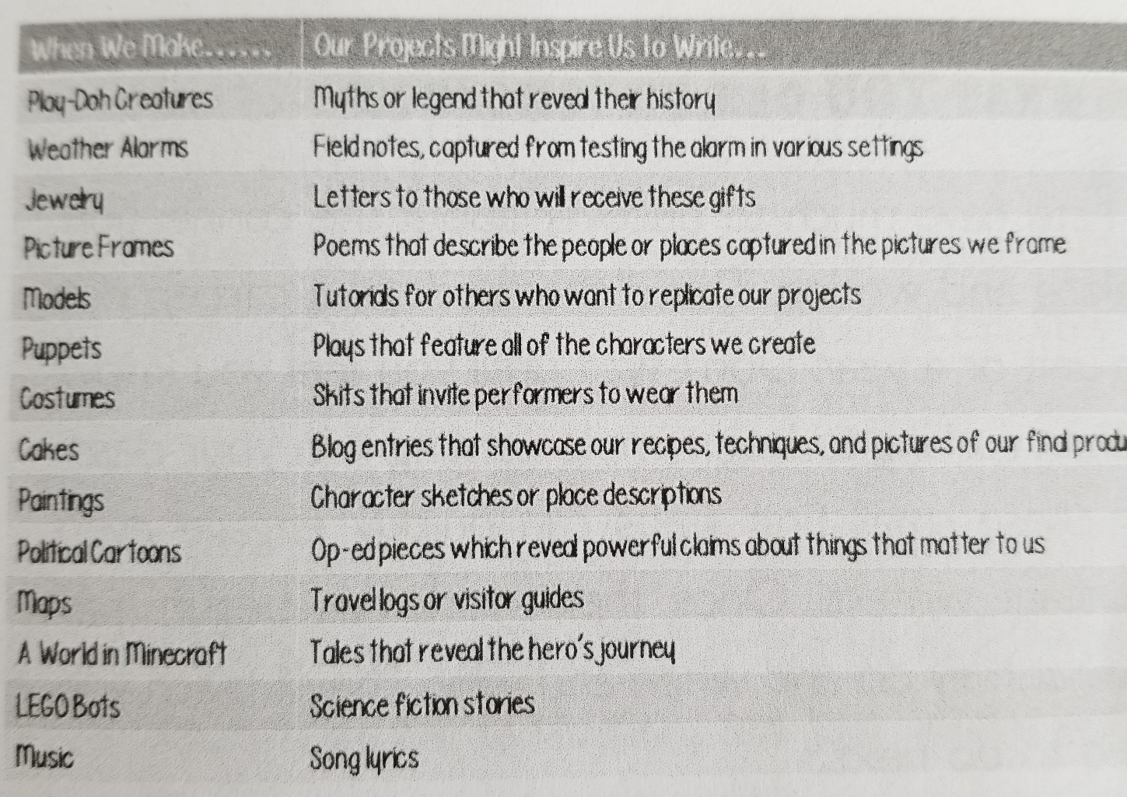
Make Writing, Page 19
Notes:
Copy this for everyone
Table talk – can you think of a few others? Add them and share out to the big group.

Slide 13
*Survey your kids *Invite them to build before they write or write about what they are building *replace graphic organizers with sticky notes *Make time for exhibition, not just celebration
Try This...
Make Writing, Page 20-21
Notes:
Graphic organizers are like fill in the blanks – static – sticky notes let kids be more flexible and creative – thinking can change,
Show off the process not just the product

Slide 14
Remember not all writers are makers...consider it an invitation, not an expectation. Our Learners need diverse tools and processes!
Let them lead if they are ready!

Slide 15
Hack 2
Remake your space
Design with making in mind
Can be cheap, cheerful & in a corner!

Slide 16
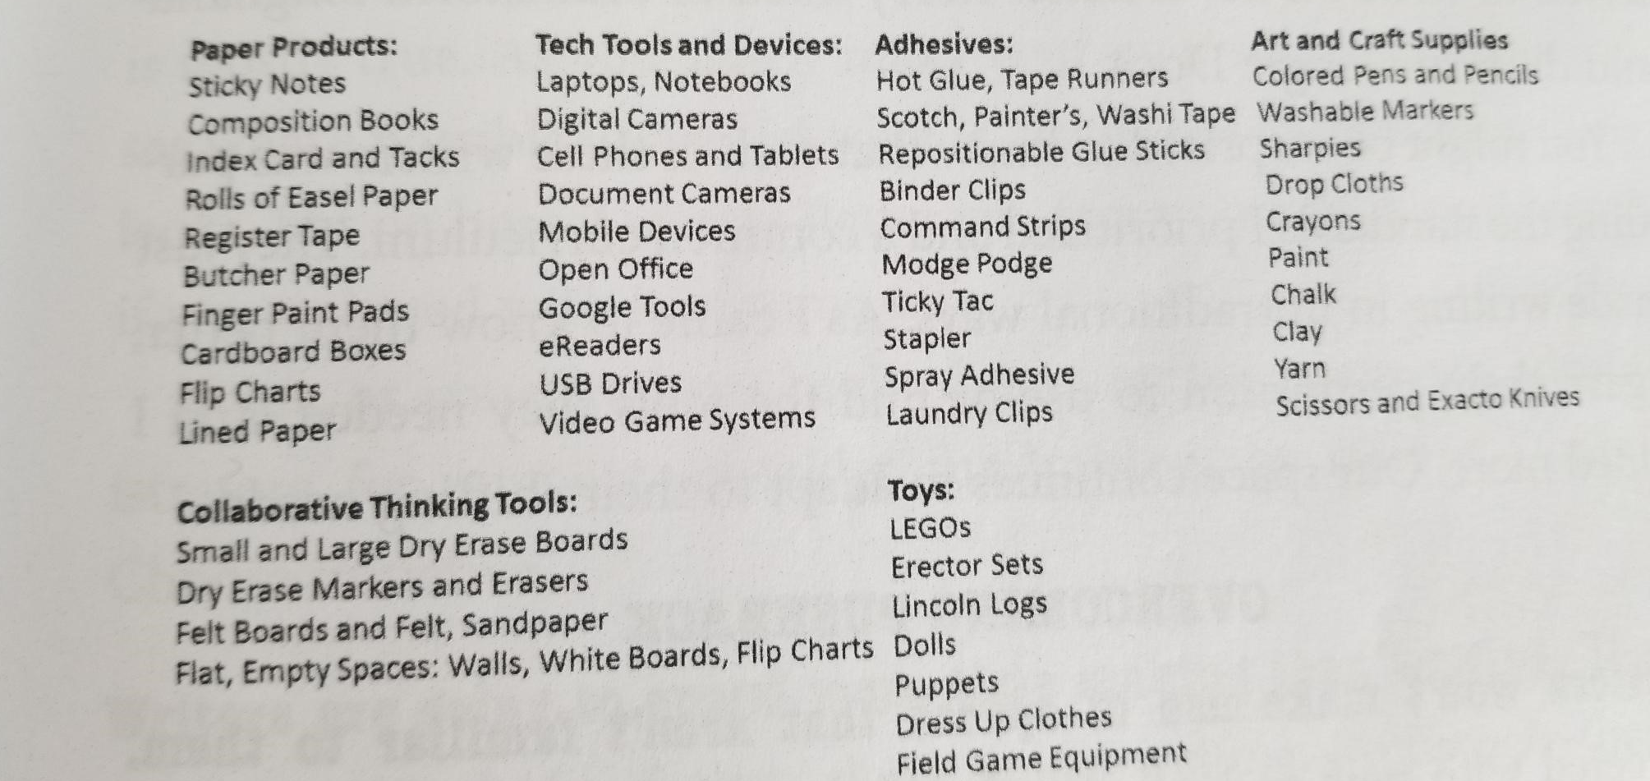
Notes:
Copy this
Beautiful junk
Dont' forget about coding hour of code and scratch! Lots of help in RB for this

Slide 17
Try This...
*Make a centre or cart *Provide containers *HAve spaces for collaboration and independent work
*Set up a spot for writers to share their work *Use your walls as tools *Make an inspiration board
Make Writing, Page 37-40

Slide 18
Hack 3
Teach them to tinker
Risk free
Fail safe
Play!

Slide 19
The Writing Process in not Always Linear! Get Messy – Tinker! Encourage Flexible thinking
Notes:
Timelines & conferencing

Slide 20
When we make writing...WE TINKER *tear things down *Break them apart *Build *Test *Rebuild *Make writing moveable, slicing and moving
Notes:
Editing and revising

Slide 21
How do you Tinker with Writing?
* Introduce Tinkering Routines (p. 57-65)
*Show how to tinker (P. 53-56)
MODEL
Notes:
12 tables Model, Routine 1 and Routine 2 – copy for groups – give 5 min to read and then summarize and share it back with the main group.

Slide 22
Try This...Blueprint for Implementation
*Explore many models and mentor texts *Teach how to commit ethical Creative theft
*Set up a spot for writers to share their work *Use your walls as tools *Make an inspiration board
Use Mini Lessons & Modelling throughout
Make Writing, Page 65-67

Slide 23
Hack 4
Keep it real
Connect kids to authentic audiences
Give them purpose or answer the "WHY?"
Notes:
Expand the buddies role-writing or maker buddies instead of just reading buddies! (Also coding!)

Slide 24
*Help kids choose topics that matter *Teach to engage audiences they want to influence *Teach to seek feedback *Carve out time for exibition at all stages
Try This...
Make Writing, Page 73 to 75

Slide 25
Hack 5
Hack your curriculum!
Writing is just not for ELA Class.
Recruit your fellow teachers

Slide 26
*Define your purpose *Share your vision with stakeholders *Outcomes are the guide not the commander *Voice, Choice & Transfer of Responsibility remain key *Track growth & outcomes *reach way beyond ELA – Writing should be happening everywhere
Try This...
Make Writing, Page 83 to 86

Slide 27
Contest! Win Microbits for your school Tweet “How my school would use Microbits to make writing”
Follow and tag @Landermrs & @Kellibok
Use the tags #makewriting #sunwestpebl #SunWestSD207
Notes:
3 to give away – will chose with the largest impact
Courtesy of ICT – Information & Communication technology council
Involve kids for bonus marks!
Announced May 24th.

Slide 28
Go Make Writing!

