Slide 1
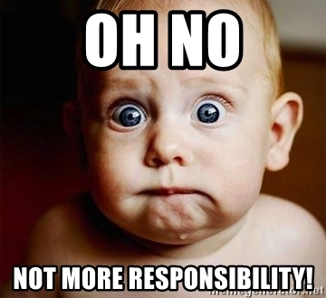
Notes:
MeIissa:
I’s not just yours anymore. It is your staff’s responsibility also.

Slide 2
Collective Responsibility
Looking Deeper with School Based Administrators
Notes:
Melissa

Slide 3
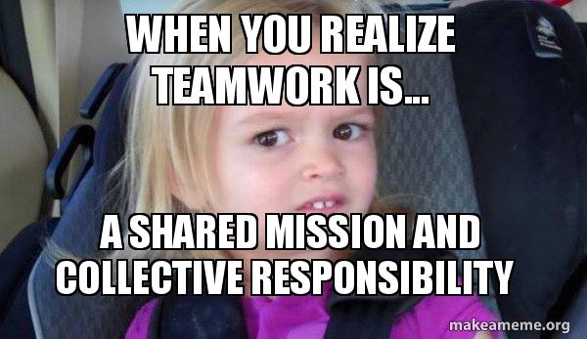
To Frame your
thinking today…
Professional community in the literature variously refers to the actions of teachers who have the capacity to generate a group identity based on shared values about teaching and student learning that foster professional growth and interdependence (Achinstein, 2002; Bolam et al, 2005; Preskill & Torres, 1999)
Notes:
Melissa: Remember “pancake girl” and that this is a work in progress where the process is more important than the product.

Slide 4
Professional Learning Communities
Notes:
Carole:
It is our collective responsibility to ensure that all teachers have signed up for a PLC and engaged in the process. Within the PLC realm but also within the school realm. Consider sharing time at staff meetings.

Slide 5
So … What is Collective Responsibility?
My Kids to Our Kids
All members of the school (including but not limited to administrators, teachers, counselors) accept responsibility for the students’ success or lack thereof.
Notes:
Carole

Slide 6
https://vimeo.com/218044920
Notes:
Melissa; Time Bomb

Slide 7
Why Do Our Kids Need Us Now More than Ever? Why we need PeBL and Success for All …
There are almost 3 million high school drop-outs in Canada. (2001 Canada Census)

Slide 8
Why Do Our Kids Need Us Now More than Ever? Why we need PeBL and Success for All …
Students who fail school are three times more likely to be unemployed, and twice as likely to be working poor.

Slide 9
Why Do Our Kids Need Us Now More than Ever? Why we need PeBL and Success for All …
Half of single moms did not complete high school.

Slide 10
Why Do Our Kids Need Us Now More than Ever? Why we need PeBL and Success for All …
Children born to poverty are five times more likely to live in poverty as an adult.

Slide 11
Why Do Our Kids Need Us Now More than Ever? Why we need PeBL and Success for All …
High school dropouts are 50% more likely to be arrested, and 63 times more likely to be incarcerated.

Slide 12
Why Do Our Kids Need Us Now More than Ever? Why we need PeBL and Success for All …
Each year of schooling prior to age 35 increases life span by two years.

Slide 13
Why Do Our Kids Need Us Now More than Ever? Why we need PeBL and Success for All …
Female dropouts will live an average of 10.5 fewer years than females who graduate from high school.
Male dropouts will live an average of 13 fewer years than males who graduate from high school.

Slide 14
Why Do Our Kids Need Us Now More than Ever? Why we need PeBL and Success for All …
If Canada increased its high school graduation rate by 1% the estimated savings would be over $7.7 billion each year. (National Post and CBC News)

Slide 15
Pitch It! Start with the Why
Commercial
Infomercial
Book or Story
Picture
Video
Other
Group Activity to help clarify your thinking about why Collective Responsibility is so important for our students.
You have 5 minutes….. Design a commercial/pitch for staff, parents, and/or students
Notes:
Carole – we need to have high expectations for all students. (emotional connections)
5 minutes to make
5 present
Melissa share her experience with the Kindergarten picture? Which students are we going to fail?

Slide 16
What are your priorities for Collective Responsibility?
What is priority for beginning of the year?
Notes:
Melissa:
Refer to the back of the page from the handout from last meeting.
What needs to happen before the school year starts? What can wait?
High school – cell phone, learner profiles
Elementary – playground rules, learner profiles
Wait? Snow forts/snow balls; using data from assessments

Slide 17
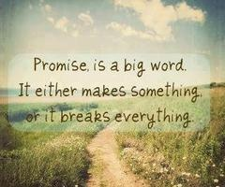
Our Promises
Brainstorming
What my school needs collective responsibility for
Make a list
Narrow it down to one to try to focus on during your next staff meeting or PD
Notes:
Melissa - Handout
5 mins

Slide 18
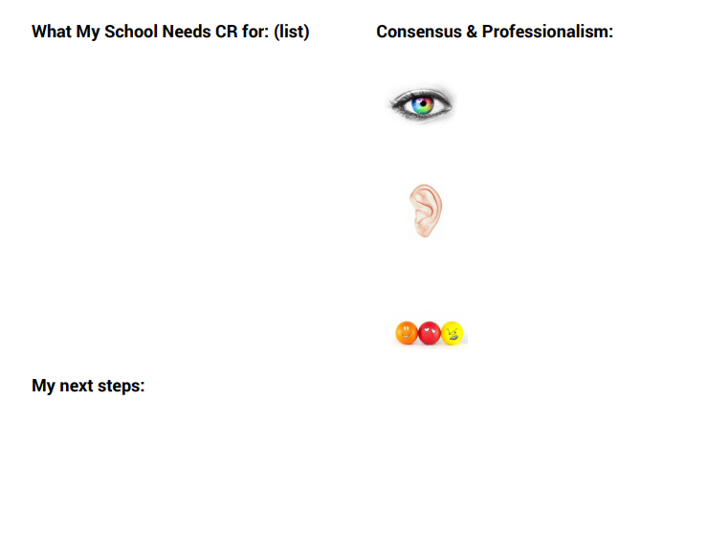
Look at What Your School Needs
What Collective Responsibility needs are:
Immediate
For the Beginning of a the new school year
Can wait until after the new year starts
Finish your next steps
How will you lead consensus?
Notes:
Melissa
Sometimes it might just be a conversation. Sometimes it may be you making a decision and sharing it. Sometimes you will have to go through the process.
Note: always have what is best for our kids leading the process. It is not based upon popularity.

Slide 19
Practice Time!
Choose one of the topics from a list at your table.
The principal whose topic is chosen will be the SBA; there will be four other perspectives at your table. If you don’t have a role, then be yourself ☺
Arrive at consensus!
Notes:
Melissa
Four roles to align with Muhammad: Believer, Fundamentalist, Survivor, and Tweener
10 minutes

Slide 20
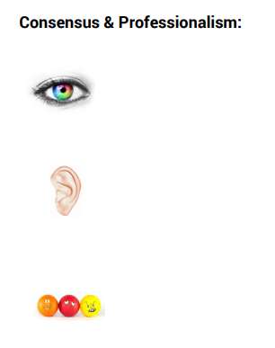
Communicating Consensus
To reach consensus someone may have to give in to their beliefs and support what the group collectively decides. As a professional, this is what we do.
The question should always be, not who/what is popular but WHAT IS BEST FOR OUR STUDENTS?
Once consensus has been determined, how will you ensure that it is being followed?
What do you do with any staff who may be undermining the group consensus?
Notes:
Melissa
Fill out the form
Talk to first two points
Discuss the last two points at their table.
5 min - As a professional you may not get what you were hoping for but if it the consensus of the group you must follow and support it
What will you do, if one of your staff undermines the consensus?

Slide 21
