Slide 1
Physical Education 20 & 30 Professional Learning
June 12, 2019
Miles Bennett, Melissa Lander, Kelli Boklaschuk
Notes:
Melissa - Opportunity to reflect/build something new – grow professionally – reset
Filter expectations back into younger grades in the gym – big picture
*Stickies on tables yellow and blue
*Names of Schools on tables'
9-9:35

Slide 2
Agenda: Morning
Case Study Task 1
Ministry Information/Summary
Case Study Task 2
The PeBL Connection
Time Guidelines
Notes:
Melissa 9:35-9:40

Slide 3
Agenda: Afternoon
Case Study Task 3
Fit Stats Integration
Resources (Resource Bank, Ministry, Skill Lab, Others)
Planning Time & Collaboration
Notes:
Melissa 9:30 to 9:35

Slide 4
Welcome & Introductions
Name
School
What you are looking forward to this summer
Notes:
Melissa & Miles 9:40-9:55

Slide 5
Case Study – Task #1
Each paragraph describes in practical terms what each Outcome is about in Physical Education 30. There are 10 Outcomes in total. Name and describe what you think each Outcome is about.
Notes:
Miles -Read case study in Moodle – Miles will make handout
Complete task 1 on sheet - try to figure out outcomes;
30 min 20 to read/work it out – 10 to share out
9:55-10:25

Slide 6
Ministry Information
Notes:
Melissa 20min total
10:25-10:45

Slide 7
Guilding Principles of Ministry K-12 Curriculum Development
Consult with stakeholders, partners, parents, groups, subject matter experts in development.
1
Ensure curricula meets the needs of all students.
2
Provide ongoing supports to teachers.
3
Notes:
Melissa

Slide 8
Ministry Process
Updated Drafting
Finalized Curricula
Implementation Vision Meetings
Implementation Working Team
Full implmentation next school year!
Reference Committee Meeting
Writing Teams Meetings
Pilot Teacher Meetings
Vetting (SPEA, SK Outdoor Ed & Enviro Assoc., First Nation & Métis Elders)
Notes:
Melissa
Lloyd Tulp from OHS Pilot teacher
Miles Bennett – Implementation Working Team

Slide 9
Broad Areas of Learning
LifeLong Learners
Sense of Self, Community and Place
Engaged Citizens
Notes:
Melissa

Slide 10
Cross-Curricular Competences
Developing Thinking
Developing Identity and Interdependence
Developing Literacies
Developing Social Responsibility
Notes:
Melissa

Slide 11
Ministry Physical Education K-12 Aim
…support students in becoming physically educated individuals who have the understandings and skills to engage in movement activity, and the confidence and disposition to live a healthy, active lifestyle.
Notes:
Melissa

Slide 12
Physical Education K-12 Goals
Active Living
Skillful Movement
Relationships
Notes:
Melissa

Slide 13
Notes:
Melissa Refer to pages 15-17 of PE 20 and PE 30 - INQUIRY
Inquiry learning provides students with opportunities to build knowledge, abilities and inquiring habits of mind that lead to deeper understanding of their world and human experience. The process provides opportunities for students to become active participants in a collaborative search for meaning and understanding.

Slide 14
An Effective Physical Educaction Program
Physical literacy
Meaningful contexts, key/big ideas, and questions/inquiry
Learning strategies
Meeting students’ needs
Well-planned
Outcomes based
Notes:
Melissa Refer to page 19 of PE 20 and PE 30
There are six characteristics emphasized in physical education curriculum that are components of an effective physical education program. Student learning is supported by a program that:

Slide 15
Ministry's Definition of Physical Literacy
…the ability and motivation to capitalize on our movement potential to make a significant contribution to our quality of life.
Notes:
Melissa Refer to page 19 of PE 20 and PE 30
Physical literacy is the ability and motivation to capitalize on our movement potential to make a significant contribution to our quality of life.
Ability refers to the development of movement skills and patterns to enable an individual to participate in a wide range of physical activities.
This includes the knowledge and understanding about movement and the physical and mental health benefits of an active lifestyle in a variety of environments.
Motivation refers to an individual’s enthusiasm for, enjoyment of, and self-assurance in adopting physical activity as an integral part of life.

Slide 16
Remember The Adaptive Dimension
All students will work toward the achievement of the provincial outcomes. Some students, however, will require additional supports. Effective instruction, including the use of the Adaptive Dimension, will support most students in achieving success.
Notes:
Melissa Refer to page 5 of PE 20 and PE 30
A descriptor of the Adaptive Dimension has been included in the renewed curricula. The Adaptive Dimension refers to the concept of making adjustments to any or all of the following variables: learning environment, instruction, assessment and resources. Adjustments to these variables are intended to make learning meaningful and appropriate and to support achievement. Within the context of the Adaptive Dimension, curricular outcomes are not changed; adaptive variables are adjusted so that the curricular outcomes can be achieved.
As well, Meeting the Needs of All Students (refer to page 18 of PE 20 and PE 30), highlights the importance of providing an inclusive environment for all students to participate in physical education.

Slide 17
Physical Education 20 Synopsis
Students will:
continue to develop their understanding of physical literacy;
explore health- and skill-related fitness through a variety of indoor and outdoor physical activities;
investigate how nutrition, mental health and a physically active lifestyle support personal well-being;
engage in service learning; and,
explore topics of personal interest relevant to Physical Education 20.
Notes:
Melissa Refer to page 6 of PE 20
This synopsis can be used as a course syllabus or a descriptor for course selection. Also included on page 6 are credit requirements for graduation: students are required to take one compulsory health education or physical education course at the secondary level.

Slide 18
Physical Education 30 Synopsis
Students will:
continue to develop their understanding of physical literacy;
through a leadership role, explore opportunities to support lifelong physical activity;
investigate the effects of body management activities on the well-being of self and community;
examine how nutritional choices and psychological factors can impact participation in physical activities;
engage in service learning; and,
explore topics of personal interest relevant to Physical Education 30.
Notes:
Refer to page 6 of PE 30
This synopsis can be used as a course syllabus or a descriptor for course selection.evel.

Slide 19
Outcomes
Define what students are expected to know, understand and be able to do by the end of a grade or secondary level course in a particular area of study.
All outcomes are required.
Provide direction for assessment and evaluation, and for program, unit and lesson planning.
Notes:
Melissa Refer to page 22 of PE 20 and PE 30 Outcomes:
focus on what students will learn rather than what teachers will teach;
specify the skills, abilities, knowledge and/or attitudes students are expected to demonstrate;
are observable, assessable and attainable; and,
are supported by indicators which provide the breadth and depth of expectations.
Can outcomes be combined for planning?
Yes, outcomes are often intended to be taught in an integrated or holistic manner. When students are engaged in inquiry learning, for example, the questions they pose will typically lend themselves to making connections within and across areas of study.
Please note the statement, “All outcomes are required” is not accurate for PAA.

Slide 20
Indicators
Representative of what students need to know and/or be able to do in order to achieve an outcome.
Teachers must comprehend the set of indicators to understand fully the breadth and the depth of learning related to a particular outcome.
Teachers may develop indicators that are responsive to students’ needs, interests and prior learning.
Teacher-developed indicators must maintain the intent of the outcome.
Notes:
Melissa Refer to page 22 of PE 20 and PE 30 The set of indicators for an outcome:
provides the intent (breadth and depth) of the outcome;
tells the story, or creates a picture, of the outcome;
defines the level and types of knowledge required; and,
is not a checklist or prioritized list of instructional activities or assessment items.
Indicators represent ways in which students might be asked to demonstrate achievement of an outcome. Teachers may develop indicators that are responsive to students’ needs, interests and prior learning, but those teacher-developed indicators must be reflective of and consistent with the breadth and depth that is defined by the given set of indicators.

Slide 21
Indicators are not a checklist or prioritized list of instructional activities or assessment items.
Indicators represent ways in which students might be asked to demonstrate achievement of an outcome.
Teachers may develop indicators that are responsive to students’ needs, interests and prior learning, but those teacher-developed indicators must be reflective of and consistent with the breadth and depth that is defined by the given set of indicators.
Notes:
Melissa

Slide 22
Within curricula, the terms “including”, “such as” and “e.g.,” serve specific purposes:
Including prescribes content, contexts or strategies that students must experience in their learning, without excluding other possibilities.
Such as provides examples of possible broad categories of content, contexts or strategies that teachers or students may choose, without excluding other possibilities.
E.g. offers specific examples of what a term, concept or strategy might look like.
Notes:
MelissaRefer to page 22 of PE 20 and PE 30
Activty – can you find one example of each of the above in PE 20 or 30?
(5 min)

Slide 23
Notes:
MelissaRefer to Page 23 PE 20 *HANDOUT WITH NOTES
The outcomes in this curriculum contribute to the development of the K-12 physical education goals.
General Statements:
PE 20 and PE 30 are parallel in structure addressing similar topics but in different ways.
PE 20 is focused on the individual student; PE 30 is focused on leadership and lifelong fitness.
A student can progress from PE 9 to Wellness 10 to PE 20 and 30 and address similar topics but the content will be different.
There is not an intent to be in the classroom for over half of the course. The majority of the content can be addressed through physical activity.

Slide 24
Notes:
Melissa HANDOUT WITH NOTES
Refer to Page 23 PE 30
The outcomes in this curriculum contribute to the development of the K-12 physical education goals.
PE 30 is focused on leadership and lifelong learning.

Slide 25
PE 20 and PE 30 are parallel in structure addressing similar topics but in different ways.
PE 20 is focused on the individual student;
A student can progress from PE 9 to Wellness 10 to PE 20 and 30 and address similar topics but the content will be different.
There is not an intent to be in the classroom for over half of the course.
PE 30 is focused on leadership and lifelong fitness.
The majority of the content can be addressed through physical activity.
Notes:
Melissa

Slide 26
Break Time!
Notes:
Break 10 min
10:45-10:55

Slide 27
Case Study – Task #2
How can I best teach these curriculum at the same time?
Notes:
Miles
Table talk 5 min share 5 min (Volunteers)
*Make sure have handout with notes
10:55-11:05

Slide 28
The PeBL Connection
It's not a "Thing" it is our educational philosophy
Notes:
Kelli 11:05-11:20 - 15 min

Slide 29
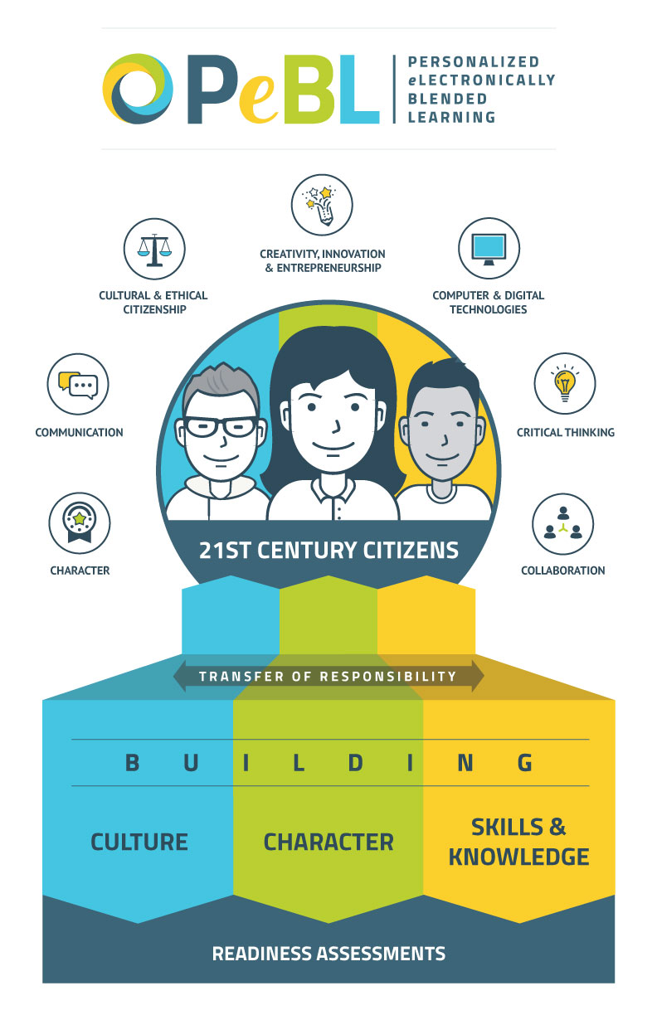
Notes:
Those concerns are valid and deserve to be answered.
So we have developed something to help us do just that. PeBL. In honour of our visual learners, we have captured PeBL – its goals, terminology and processes – in this graphic.
As you can see, everything points upward to our ultimate goal; to grow strong, competent and successful 21st century citizens. People who have the skills, knowledge and attitudes to excel in all aspects of their life.
So how do we do that? And what does it look like in our schools one year later? Today we are going to share with you some of the tools and examples of our progress.

Slide 30
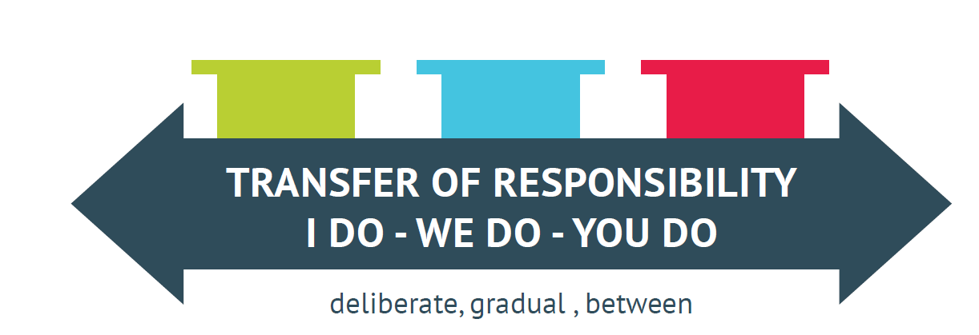
Transfer of Responsibility
Notes:
We believe that with PeBL – a deliberate and systematic progression designed to engage our learners in their own learning – that we can address many of those fundamental challenges in our system.
We are advocates for student driven learning and have familiarized ourselves with the research that affirms that with voice and choice, comes engagement. With personalized learning comes, notably higher success rates.
(do you want the research in here?)
But we know that when ppl hear TOR, they often get nervous. What if my child doesn’t have the tools to manage those additional responsibilities? How will they know what choices to make? And what is the role of the teacher anyway? Does this mean my child is being taught by a computer? Are they just working alone in the corner of the room? And if they are left to their own devices, are they just fooling around with their friends? And from the educator’s point of view, there are a host of questions around additional responsibilities? Resources… supports. This sounds like a greater, not lesser work load!

Slide 31
Notes:
So lets focus in on the bottom half of that graphic illustrates our processes… the activities that we are undertaking to move down the PeBL path and to create exceptional, personalized learning experiences.
We believe we need three fundamentals in place:
Consistent culture building activity: geared towards creating a shared vocabulary and expectations around innovation, tolerance and relationships.
A focus on character building: All participants in the school and surrounding environment must understand and be engaged in self-regulation, and self awareness among many other 21st century skills and attitudes.
A combination of traditional and non-traditional instructional strategies that allow learners to build skills and knowledge in the way that best suits them. While traditional forms of instruction may be the most effective tools in some circumstances and for some learners, a PeBL-driven environment provides student V/C in what, where, when and from whom learning occurs. While expanding our thinking in regards to S&K building is critical, we are going to focus today on the elements of character and culture building in our schools. And certainly throughout our time this morning, you will see how Skills and knowledge is in fact inextricably connected to all else. or…. We know that each learner, educator, school and community is at a unique place on their PeBL journey and after year one of systematically growing our PeBL-related processes, we have much to celebrate and share in the areas of culture and character.

Slide 32
How does P.E. Connect with the PeBL Philosophy?
Yell out your answers!!!

Slide 33
Notes:
First let’s dig into what we mean when talk about character building.

Slide 34
Notes:
And while character building is critical ground work required to move down the PeBL path, we must also have culture that embraces change and recognizes differences in learners and their needs.

Slide 35
Notes:
And to help us make sense of all those culture related factors, we have modified and adopted a framework called REORDER that was originally developed by the British educator Dan Buckley.
According to REORDER, the 7 facets of culture building include:
Relationships, environment, opportunities, resources, distribution of leadership, evaluation, and recognition.
We do not presume that this framework is an exhaustive list of considerations, but just one way to help us organize our thoughts and be intentional about our actions.
Again, here it is important that we clarify that not all of the activities that we are about to talk about are “new” or “recently introduced”. Many of these great practices have been working well in our schools – and have no doubt been present in yours - for years. One of the most notable benefits of launching PeBL has been the ways in which we have come together – at multiple levels of the organization – to share and collaborate on existing best practices. It has been an excellent reminder of how we are all learners, with something to learn and something to contribute.

Slide 36
We are all mentors.
RELATIONSHIPS
Notes:
So it is fitting that the first R brings us to relationships. As we explore and redefine relationships in a PeBL environment, we begin to access and share knowledge in new and innovative ways. Not only our teachers, but our peers, other staff members, our parents and our community become an integral part of our learning.

Slide 37
We provide flexible learning spaces.
ENVIRONMENT

Slide 38
We provide voice and choice.
OPPORTUNITIES
Notes:
Here is where there is much overlap with the third pillar of skills and knowledge. Here is where we begin to consider the ways in which we facilitate learning…
Do we practice a mix of instructional strategies and practices that address diverse learning needs? Do we create meaningful ways to challenge those who excel and clarify for those who might struggle. Opportunities to catch and engage those kids who might otherwise fall through the cracks? Opportunities to push motivated learners to the edges of their potential?
Again, here we know that teachers have been taking steps to personalize the learning for years. By talking about it, by sharing strategies for blended learning, project and inquiry based learning and we can begin to round out the options in any given school or classroom.
And it is here that we can start to address the teacher workload situation…. (KB - if you don’t address it here, i don’t see any other place to reconnect to the opening slides.) Through collaboration, new ideas are generated, resources are shared, support becomes accessible. And although we readily acknowledge the front end work to implement these new ideas is heavy, our teachers will speak to the efficiencies gained, the benefits fo doing this work so that they can direct those ready to work independently to the appropriate supports and then focus their time on the learners who need more one-on-one time.

Slide 39
We access people, knowledge, technology and our skills.
RESOURCES

Slide 40
We are learners that lead.
DISTRIBUTION OF LEADERSHIP

Slide 41
We set goals and measure growth.
EVALUATION

Slide 42
We honour growth in who we are and what we learn.
RECOGNITION

Slide 43
Notes:
And while character building is critical ground work required to move down the PeBL path, we must also have culture that embraces change and recognizes differences in learners and their needs.

Slide 44
Transfer of Responsibility
Notes:
We believe that with PeBL – a deliberate and systematic progression designed to engage our learners in their own learning – that we can address many of those fundamental challenges in our system.
We are advocates for student driven learning and have familiarized ourselves with the research that affirms that with voice and choice, comes engagement. With personalized learning comes, notably higher success rates.
(do you want the research in here?)
But we know that when ppl hear TOR, they often get nervous. What if my child doesn’t have the tools to manage those additional responsibilities? How will they know what choices to make? And what is the role of the teacher anyway? Does this mean my child is being taught by a computer? Are they just working alone in the corner of the room? And if they are left to their own devices, are they just fooling around with their friends? And from the educator’s point of view, there are a host of questions around additional responsibilities? Resources… supports. This sounds like a greater, not lesser work load!

Slide 45
See?

Slide 46
You're doing it!

Slide 47
Service Hours
PE 20 Service Learning
Students will explore the goals of physical education through service learning: active living, skillful movement and relationships.
PE 30 Leadership through Service Learning
Students, in a leadership role, will explore the goals of physical education through service learning: active living, skillful movement and relationships.
How much time should this involve at L20 and L30?
Notes:
Melissa & Miles
11:20 15 min – come to consensus about how much time for 20 and 30
Same or different? FIRST
Then how many hours? Write 20 on one sticky and 30 on the other - yellow/blue
While Wellness 10 is more wide open and provides students opportunities to do other activities not related to physical activity, PE 20 and PE 30 Service Learning concentrates on fitness related volunteering like coaching, rodeo, and cultural events.
PE 30 Students are still involved in service learning in physical activities but take more of a leadership role within the activities.

Slide 48
What does 10 hours of instruction actually MEAN
Notes:
11:35 (Miles for 5)

Slide 49
Time Guidelines
How should we divide up the course hours between the outcomes?
Considerations:
Keep in mind this must include students' needs
Will look this look the same for each student?
Notes:
Miles & Melissa 11:40-12 – do 20 and 30
Use the handout with outcomes/notes to rough out a plan – use as a guideline to assist in planning

Slide 50
Notes:
12-12:30

Slide 51
Time Guidelines
How should we divide up the course hours between the outcomes?
Considerations:
Keep in mind this must include students' needs
Will look this look the same for each student?
Notes:
Miles & Melissa
12:30 – 12:40 (if no decision – we will make one and share it out)
Don't need to be exactly the same, but similar is good – this can be ongoing PLC work

Slide 52
Case Study – Task #3
Most likely you will be teaching these classes together. The 20 curriculum has some similarities and some differences to the 30. Examine the Outcomes in each curriculum and compare and contrast the Outcomes.
Notes:
Miles
12:40 – 1:10
20 min – then share for 10

Slide 53
Assessment – how do we put a value on each outcome?
Kids need to know how first
Notes:
1:10-1:40 Table talk 15/20–share out

Slide 54
Fit Stats Integration
Demo by Miles
How Can I Integrate?
Try It!
Notes:
1:40-2:20

Slide 55
Self Directed Study
What could this look like?
How could I assess it? (Vanessa Lewis)
Take a Risk
First pancake
PLC Work?
Student Driven!
Notes:
2:20-2:25 Creative lic.
PE 20 Students are given topic ideas but are free to choose one of their own. Students are required to create a tool to show others what they have learned.
PE 30 Much like PE 20, students select a topic related to the course but look at it from a leadership or lifelong perspective.

Slide 56
Resources
Textbooks (ones we currently have)
Resource Bank Group – Share
Skill Lab Demo
Notes:
2:25 –2:45

Slide 57
Resources
Build out the Moodle Course TOGETHER
PLCs
Ministry Resources
Notes:
2:25 –2:45
Ministry resources - Listed on curriculum website
More to come: Nutrition; Blackboard

Slide 58
Planning Time & Collaboration
Notes:
Build your syllabus and assessment breakdown
Build moodle course/quizzes
Work in fit stats
Join RB group

