Slide 1
Big idea: Where to next?
Continuum of Learning and Collective Responsibility
Staff PeBL Workshop

Slide 3
Complete the True Colours Test
Do you agree with your colours?
Where do you think your colleagues might fall?

Slide 4
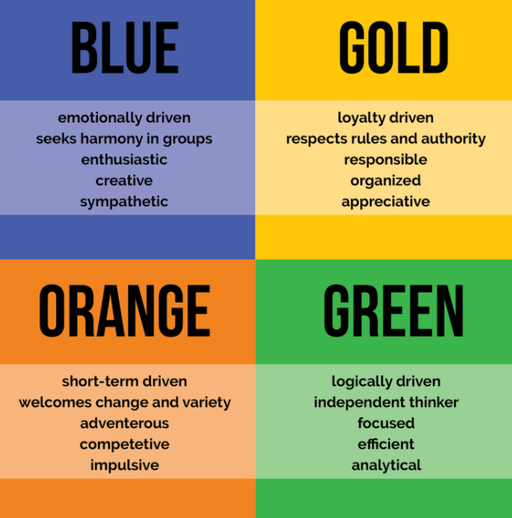
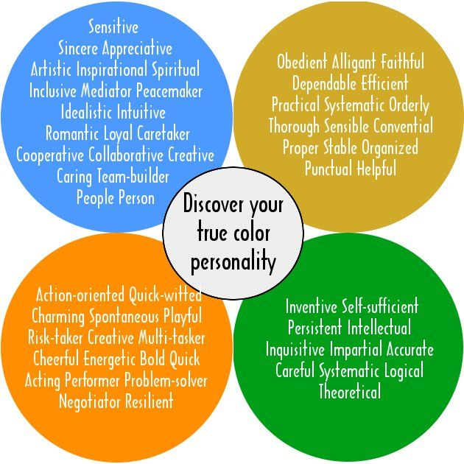

Slide 5
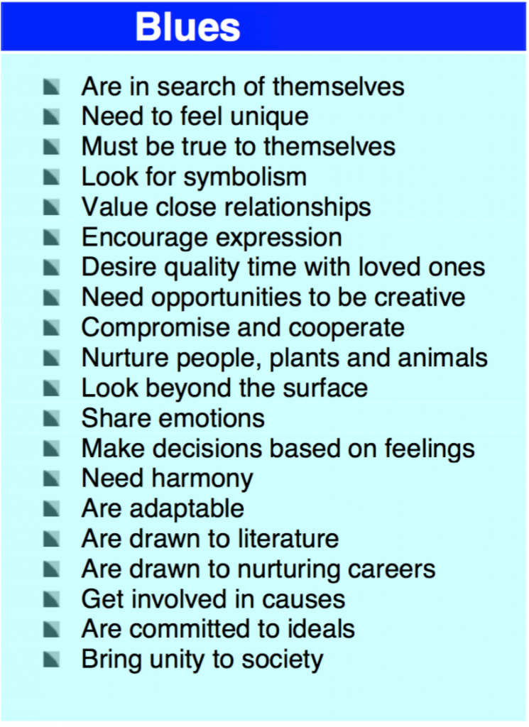

Slide 6
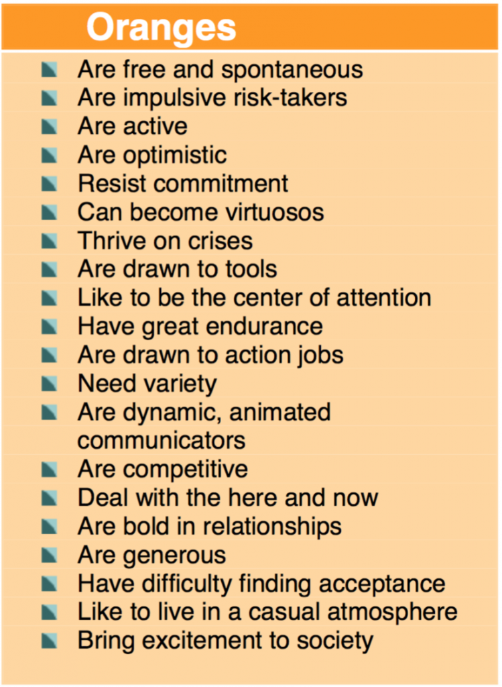

Slide 7
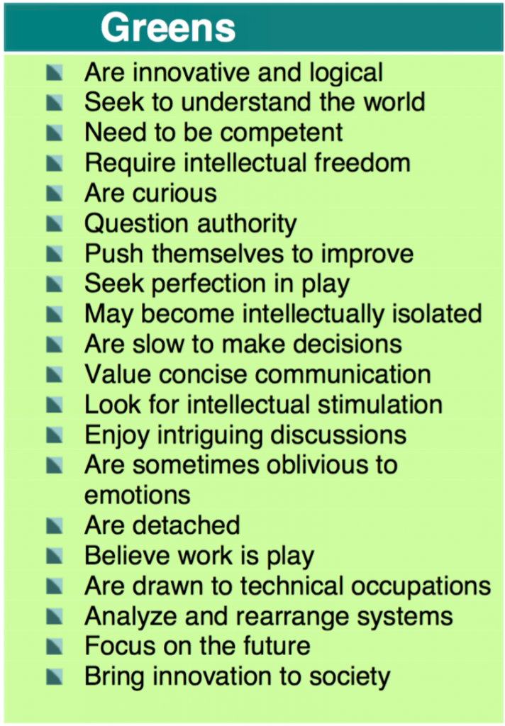

Slide 8
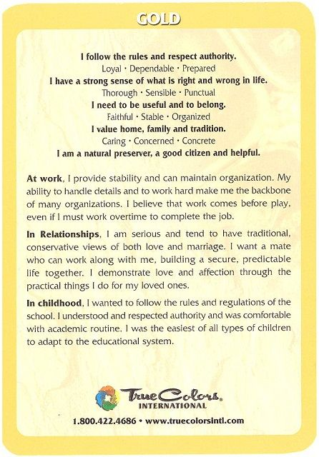
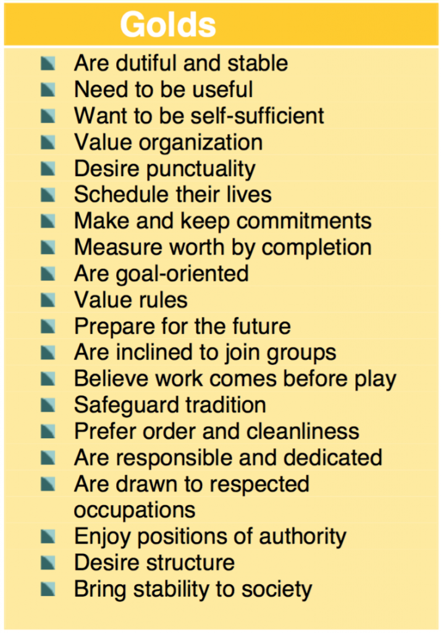

Slide 9
Guess the Colours of the Group Members

Slide 10
How do you work/learn better together?
Needs
Strengths
Frustrations
More…

Slide 11
Now that we know how to work better together….

Slide 12
Learning Continuum video
https://www.youtube.com/watch?v=r-E1sOQpldE&t=2s
Fill in the Continuum of Learning chart

Slide 13
Collective Responsibility article
Yes! Important!
? I have a question about this

Slide 14
How Does Our school Measure up?
Fill in the chart

Slide 15
SO, Where to next?
Work through Collective Responsibility charts
One group member record in Group Booklet, to be handed in

