Slide 1
2019-2020 PLC Leader Training
June 21, 2019
Notes:
Kelli

Slide 2
Questions
Write down questions you have or some that you anticipate getting from your team members.
1 question per sticky note
Notes:
Kelli
On sticky notes
Let’s build FAQ’s
Carole and Vanessa Organize into theme

Slide 3
Overview of the Day
Introductions
Video
Who is in the room?
Why - Collective Decision
What - Definition
Who - Your team
When - What does this look like?
How – Let’s figure this out together
Resources/Supports
Plan for first meeting – Ready to get started
Notes:
Kelli

Slide 4
Video Set the Stage
We will show this video to all Sun West teachers/admin before you move into your PLC Groups
Notes:
Kelli

Slide 5
Who is in the room?
Let’s find out….
Why is this important?
Notes:
Kelli

Slide 6
Notes:
Kelli
Start with something light but interesting and gives me a chance to get to know you and vice versa.
Do the quiz- it is printed

Slide 7
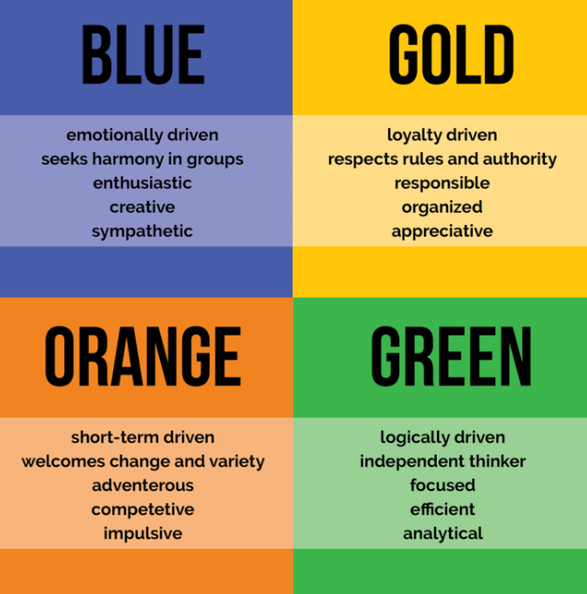
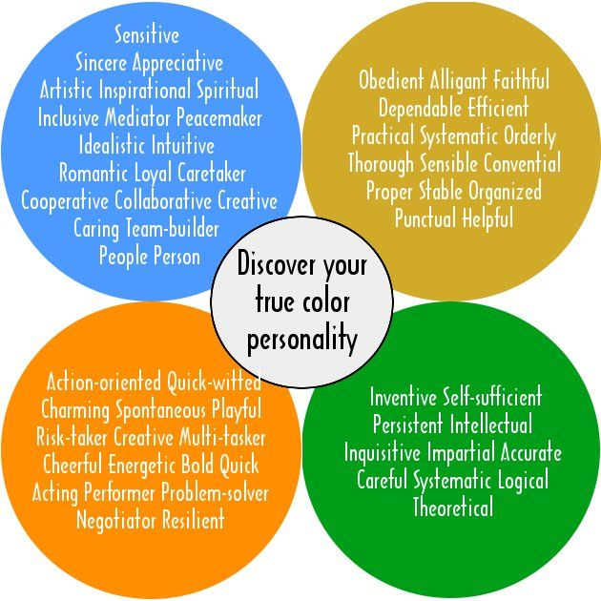
Notes:
Kelli

Slide 8
On a piece of paper write down your favorite and second favorite shape from those shown below.
Which two APPEAL to you most.
https://bit.ly/2H1W7Zg
Notes:
Kelli

Slide 9
OUR BIG IDEA
Why PLCs in Sun West?
Our view
Notes:
Kelli

Slide 10
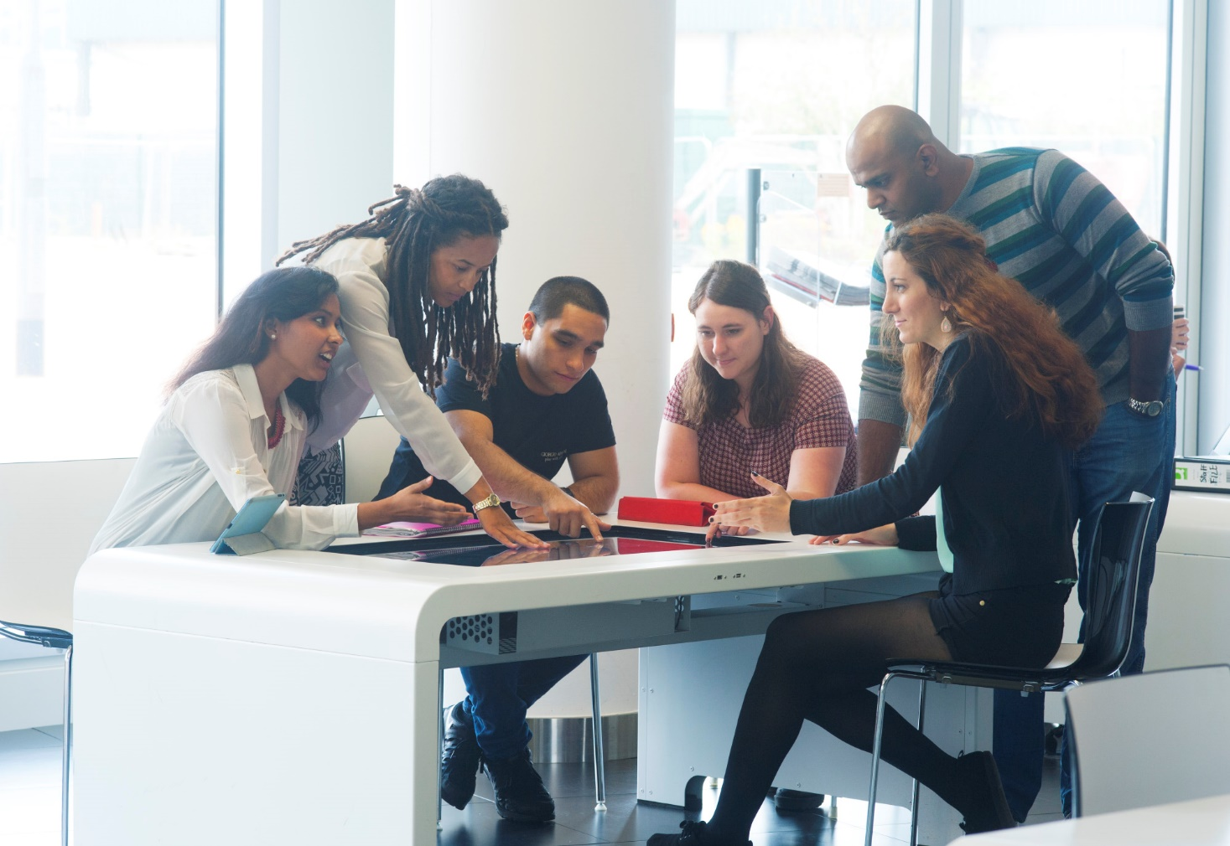
OUR BIG IDEA
Why PLCs in Sun West?
YOUR view
Notes:
Kelli
On chart paper with your table group
Share our
Consensus

Slide 11
OUR BIG IDEA
What are PLCs in Sun West?
Our definition
Notes:
Kelli – PLC on line looks different

Slide 12
OUR BIG IDEA
What are PLCs in Sun West?
YOUR definition

Slide 13
How to define a concept….
Notes:
Kelli
Hand out

Slide 14
Your Turn
Name it – We have already
What category does PLC fall into?
At your Tables Groups:
Define Sun West PLCs by…
Notes:
Category together – Collaboration?
Share out

Slide 15
Your Turn
Name it – We have already
What category does PLC fall into?
What are the Qualities, Traits & Properties?
Write a short & clear definition
At your Tables Groups:
Define Sun West PLCs by…

Slide 16
WHO:THE TEAM – Bringing the Team Together
Sun West
Teachers/Admin
Sun West
Teachers/Admin
PLC Leader
You
Notes:
Kelli

Slide 17
Teams
5-10 Members
Most of your team members chose your PLC as their 1st choice
1 Leader
PLCs with multiple leaders
Smaller groups within a PLC
Notes:
Kelli

Slide 18
Role of the PLC Leader or Facilitator???
Facilitator
Guide team towards setting norms
Guide team towards setting goals
Communicates with the team/Division
Ensures that the team documents work in the Resource Bank
Let’s talk accountability
Other?
Notes:
Kelli

Slide 19
When
iLearn August 27th | September 27th | October 15th | March 9th | May 19th
Overview for all Sun West Teachers/Admin Move into PLCs for the Afternoon | Full Day Face-to-Face in Rosetown | P.M. Only either online or working afternoon | Full Day Face-to-Face in Rosetown | Short Online Meeting Review/Reflection
Goals Achieved
Notes:
Kelli

Slide 20
How
Does this all work?

Slide 21
How
Dividing into Smaller PLCs if Needed
If you have a large number of teams members and multiple Leaders. Step 1 is to figure out how to divide into smaller teams (Max 10 members).
What could be the ways to do this?
Who is in the room
Take some time to get to know each other. True Colours document and Psychogeometrics test can be the ice breaker. It will also help to know how to work better together.
Setting Norms
What is a Norm and why do you need them? How do you develop them?
Setting Goals
Goals for the PLC, smaller teams within a PLC must be set. It is important to consider that the goals must be able to be achieved during PLC work time as well as be personalized for the needs of the team members
Communication
What does this mean?
How does it happen?
Next Steps
Plan for the first meeting
Are you ready?
Notes:
Kelli

Slide 22
How
Dividing into Smaller PLCs if Needed
If you have a large number of teams members and multiple Leaders. Step 1 is to figure out how to divide into smaller teams (Max 10 members).
What could be the ways to do this?
Who is in the room
Take some time to get to know each other. True Colours document and Psychogeometrics test can be the ice breaker. It will also help to know how to work better together.
Setting Norms
What is a Norm and why do you need them? How do you develop them?
Setting Goals
Goals for the PLC, smaller teams within a PLC must be set. It is important to consider that the goals must be able to be achieved during PLC work time as well as be personalized for the needs of the team members
Communication
What does this mean?
How does it happen?
Next Steps
Plan for the first meeting
Are you ready?

Slide 23
Dividing into Smaller Groups
Grade Levels?
Topics of Interest?
Expertise?
Top 3 on Sticky Notes
Consensus on how team is divided
Communicate to Division how you divide up
Leaders share areas of interest/expertise/need
What questions do you ask?

Slide 24
How
Dividing into Smaller PLCs if Needed
If you have a large number of teams members and multiple Leaders. Step 1 is to figure out how to divide into smaller teams (Max 10 members).
What could be the ways to do this?
Who is in the room
Take some time to get to know each other. True Colours document and Psychogeometrics test can be the ice breaker. It will also help to know how to work better together.
Setting Norms
What is a Norm and why do you need them? How do you develop them?
Setting Goals
Goals for the PLC, smaller teams within a PLC must be set. It is important to consider that the goals must be able to be achieved during PLC work time as well as be personalized for the needs of the team members
Communication
What does this mean?
How does it happen?
Next Steps
Plan for the first meeting
Are you ready?

Slide 25
How
Dividing into Smaller PLCs if Needed
If you have a large number of teams members and multiple Leaders. Step 1 is to figure out how to divide into smaller teams (Max 10 members).
What could be the ways to do this?
Who is in the room
Take some time to get to know each other. True Colours document and Psychogeometrics test can be the ice breaker. It will also help to know how to work better together.
Setting Norms
What is a Norm and why do you need them? How do you develop them?
Setting Goals
Goals for the PLC, smaller teams within a PLC must be set. It is important to consider that the goals must be able to be achieved during PLC work time as well as be personalized for the needs of the team members
Communication
What does this mean?
How does it happen?
Next Steps
Plan for the first meeting
Are you ready?
Notes:
Melissa

Slide 26
Norms
Why norms?
What are they?
Process of developing them – Collectively developing/owning/believing in them
Accountability of norms – What does this look like and who is responsible
Notes:
PG 16

Slide 27
Norms Video
Solution Tree – Are we a Group or a Team?
Notes:
Video 31:07 - 35:43

Slide 28
Let’s Build Norms Together
What’s best for kids?
It’s not about us, it’s about them!
Notes:
Melissa
Activity: Review Norms Handouts and go through process. With a partner at your tables. Ask Questions for clarification.
Talk to your group about what happens when you break norms?

Slide 29
How
Dividing into Smaller PLCs if Needed
If you have a large number of teams members and multiple Leaders. Step 1 is to figure out how to divide into smaller teams (Max 10 members).
What could be the ways to do this?
Who is in the room
Take some time to get to know each other. True Colours document and Psychogeometrics test can be the ice breaker. It will also help to know how to work better together.
Setting Norms
What is a Norm and why do you need them? How do you develop them?
Setting Goals
Goals for the PLC, smaller teams within a PLC must be set. It is important to consider that the goals must be able to be achieved during PLC work time as well as be personalized for the needs of the team members
Communication
What does this mean?
How does it happen?
Next Steps
Plan for the first meeting
Are you ready?
Notes:
Carole

Slide 31
SMART Goals
Why SMART goals?
What is/are your team goal(s)?
Process of developing them – Collectively developing/owning/believing in them
Consider adaptive dimension – meet the needs of all
Accountability of Goal(s) – What does this look like and who is responsible
Notes:
Carole

Slide 32
Smart Goals Video
Solution Tree – The Shared Foundation
Notes:
Carole Video 21:04-24:27

Slide 33
PLC Definitions of SMART
S – Success for All, Academic Achievement, Engagement & Well-being
M - How do you know you’ve reached your goal?
A – What’s the plan?
R – Keep your goal(s) reasonable
T - Target Date May 19, 2020
Notes:
Carole

Slide 34
Anticipate Your Goals
Build an Example that interests you

Slide 35
How
Dividing into Smaller PLCs if Needed
If you have a large number of teams members and multiple Leaders. Step 1 is to figure out how to divide into smaller teams (Max 10 members).
What could be the ways to do this?
Who is in the room
Take some time to get to know each other. True Colours document and Psychogeometrics test can be the ice breaker. It will also help to know how to work better together.
Setting Norms
What is a Norm and why do you need them? How do you develop them?
Setting Goals
Goals for the PLC, smaller teams within a PLC must be set. It is important to consider that the goals must be able to be achieved during PLC work time as well as be personalized for the needs of the team members
Communication
What does this mean?
How does it happen?
Next Steps
Plan for the first meeting
Are you ready?
Notes:
Kelli

Slide 36
Transportation - Provided
Provided and Recommended
Registration will be included in iLEARN sign up form
Sign up for each PLC day will take place
Notes:
Kelli

Slide 37
Communication
Communicate with Kelli
Communicate with Team
Resource Bank Group?
Email Group?
Posting of Norms
Posting of Goal(s)
Collaboration
Notes:
Kelli

Slide 38
Resources/Support
Sun West Division Supports
Superintendents, Consultants, Coaches, Outside Experts
Team Members
Support each other & collaboration
Resource Bank Group
A Place to collaborate/ communicate/ stay organized/ find resources
Other Sun West Teachers
Networking/ resources
Notes:
Kelli

Slide 39
Resource Bank PLC Leader Group
Discussion Area
Documents for your 1st meeting
Notes:
Demo - big groups make ONE – and all be administrators
Show supports in discussion
Show places to get group pic
Show how to invite people
Show how to make folders/save items you need from our group to yours
Copyright – What to do

Slide 40
Setting up your Resource Bank Team
Melissa Lander with Support from Tech Coaches

Slide 41
How
Dividing into Smaller PLCs if Needed
If you have a large number of teams members and multiple Leaders. Step 1 is to figure out how to divide into smaller teams (Max 10 members).
What could be the ways to do this?
Who is in the room
Take some time to get to know each other. True Colours document and Psychogeometrics test can be the ice breaker. It will also help to know how to work better together.
Setting Norms
What is a Norm and why do you need them? How do you develop them?
Setting Goals
Goals for the PLC, smaller teams within a PLC must be set. It is important to consider that the goals must be able to be achieved during PLC work time as well as be personalized for the needs of the team members
Communication
What does this mean?
How does it happen?
Next Steps
Plan for the first meeting
Are you ready?

Slide 42
First Meeting Plan – iLearn - August 27th P.M.
Part 2 - Overview
Part 3 – Let’s get PLCing
Part 1 – for all Sun West Teachers/admin
Norms: Develop & Consensus
RESOURCE BANK Group
Smart Goals: Discuss, develop, document
Next steps: Get going? Is there time on Day one?
Divisional Supports needed?
In Between: Communication/Agenda for face-to-face meeting
Set the stage video
Why: OUR why Division What: Our Definition
What: Our Definition
When: Dates
Divide PLC into smaller teams
(if over 10 members)
Who is in the room? True Colors?
Why: Review/Clarify OUR why
What: Review/Clarify Our Definition
When: Review Dates
Notes:
Vanessa Review ensure everyone is comfortable with Checklist

Slide 43
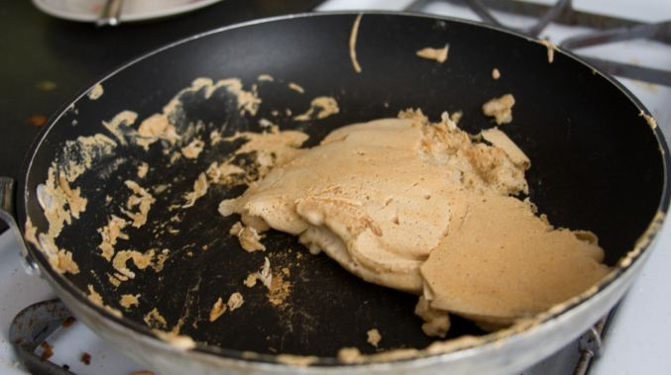
This is like the making your first pancake…….
Notes:
Carole

Slide 44
Review Questions
Do you have the answers you need?
We will send these to you in an email!
Notes:
Melissa/Vanessa/Carole/Kelli On sticky notes
Can you answer the questions now?
Provide the list of answers in resource Bank folder

Slide 45
ARE YOU READY?

Slide 46
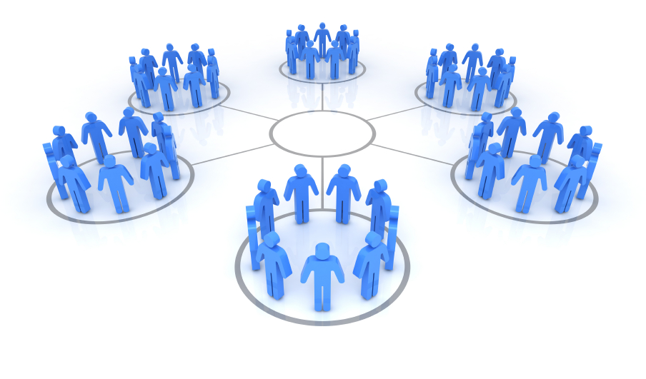
THANK YOU!
Melissa, Carole, Vanessa & Kelli

