Slide 1
Ordering Transcripts

Slide 2
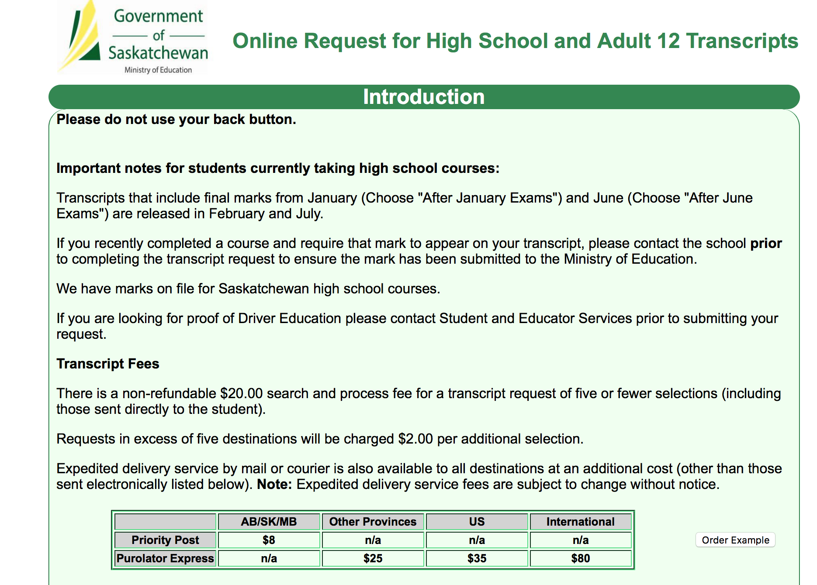
https://www.k12.gov.sk.ca/etranscript/

Slide 3
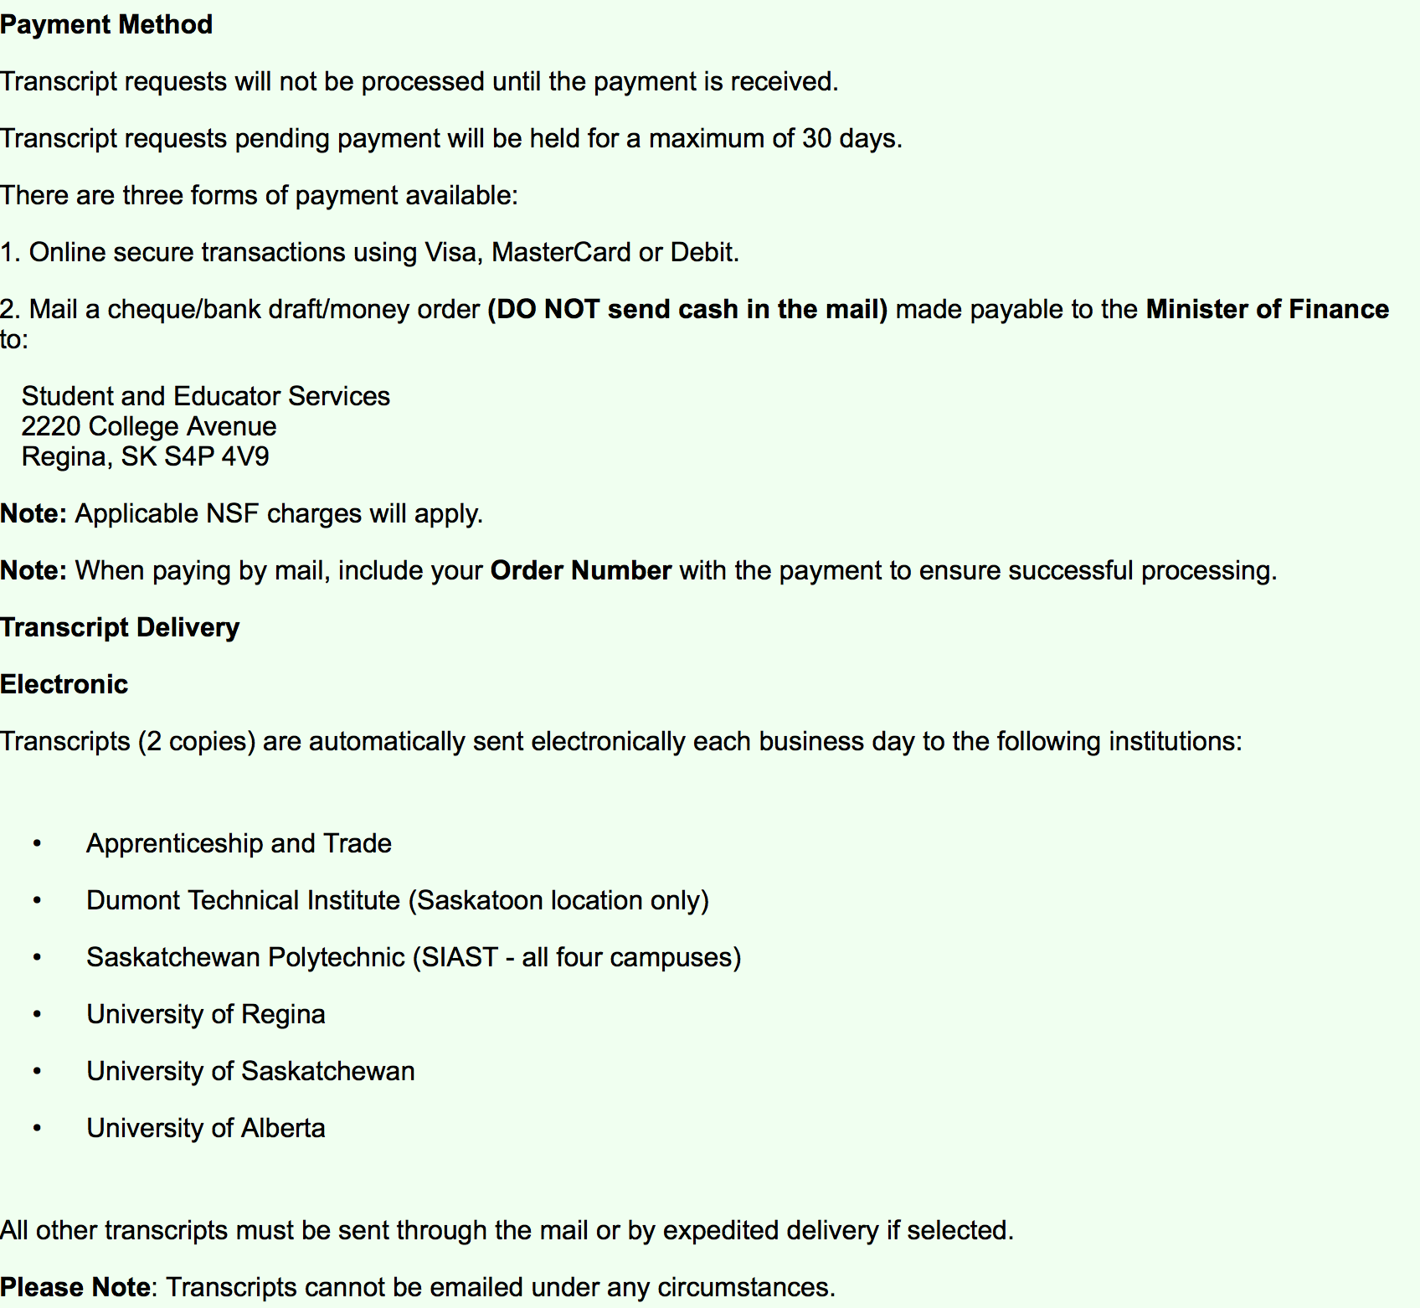
You will need a credit card for ordering

Slide 4
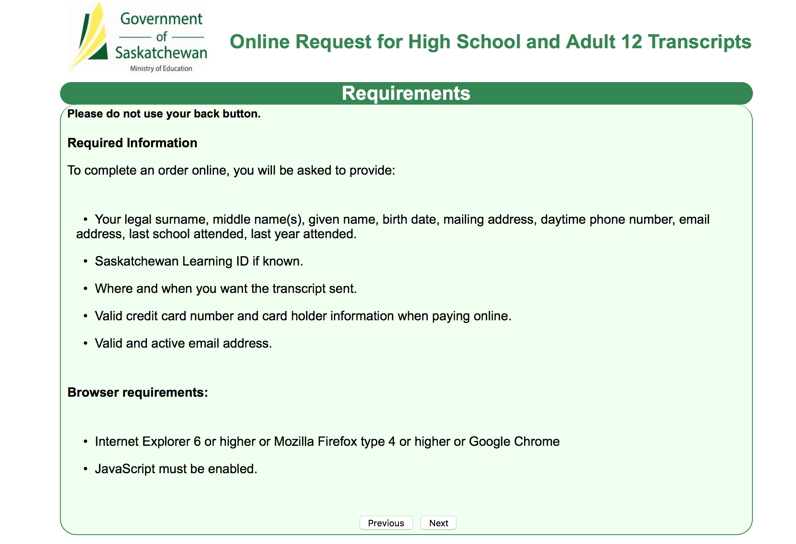
Requirements
(use google chrome as browser)

Slide 5
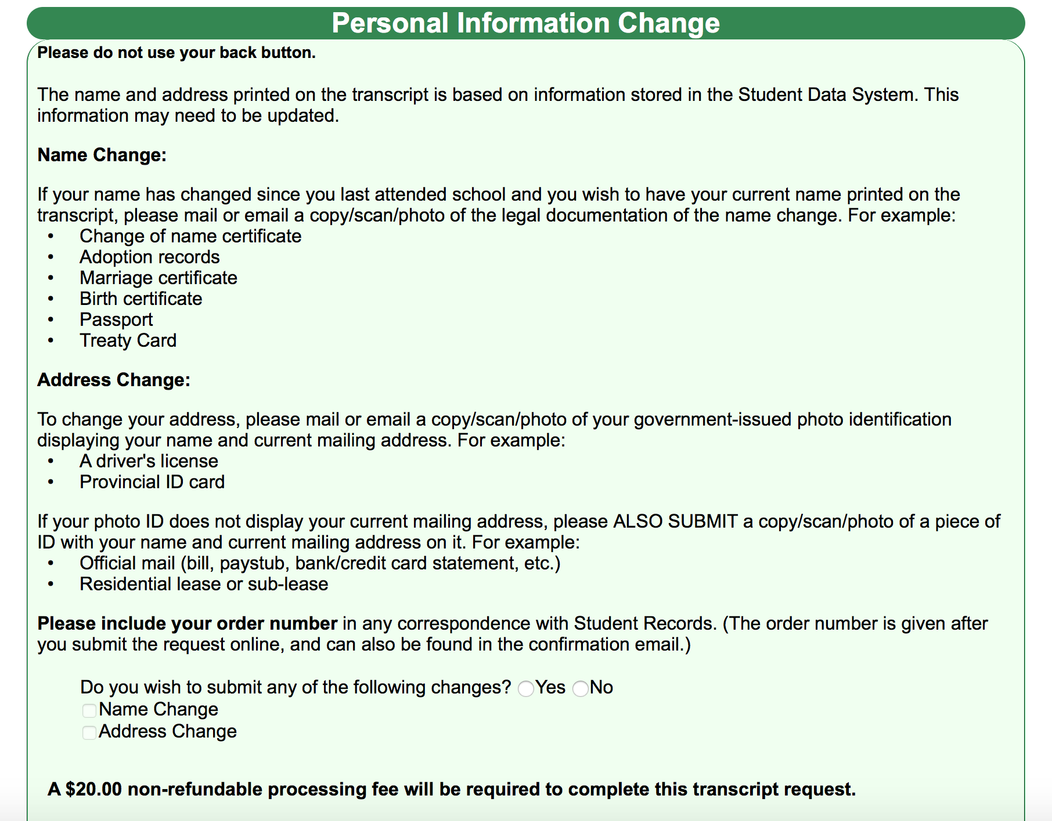
Name change
-you will probably need to click “no” here

Slide 6
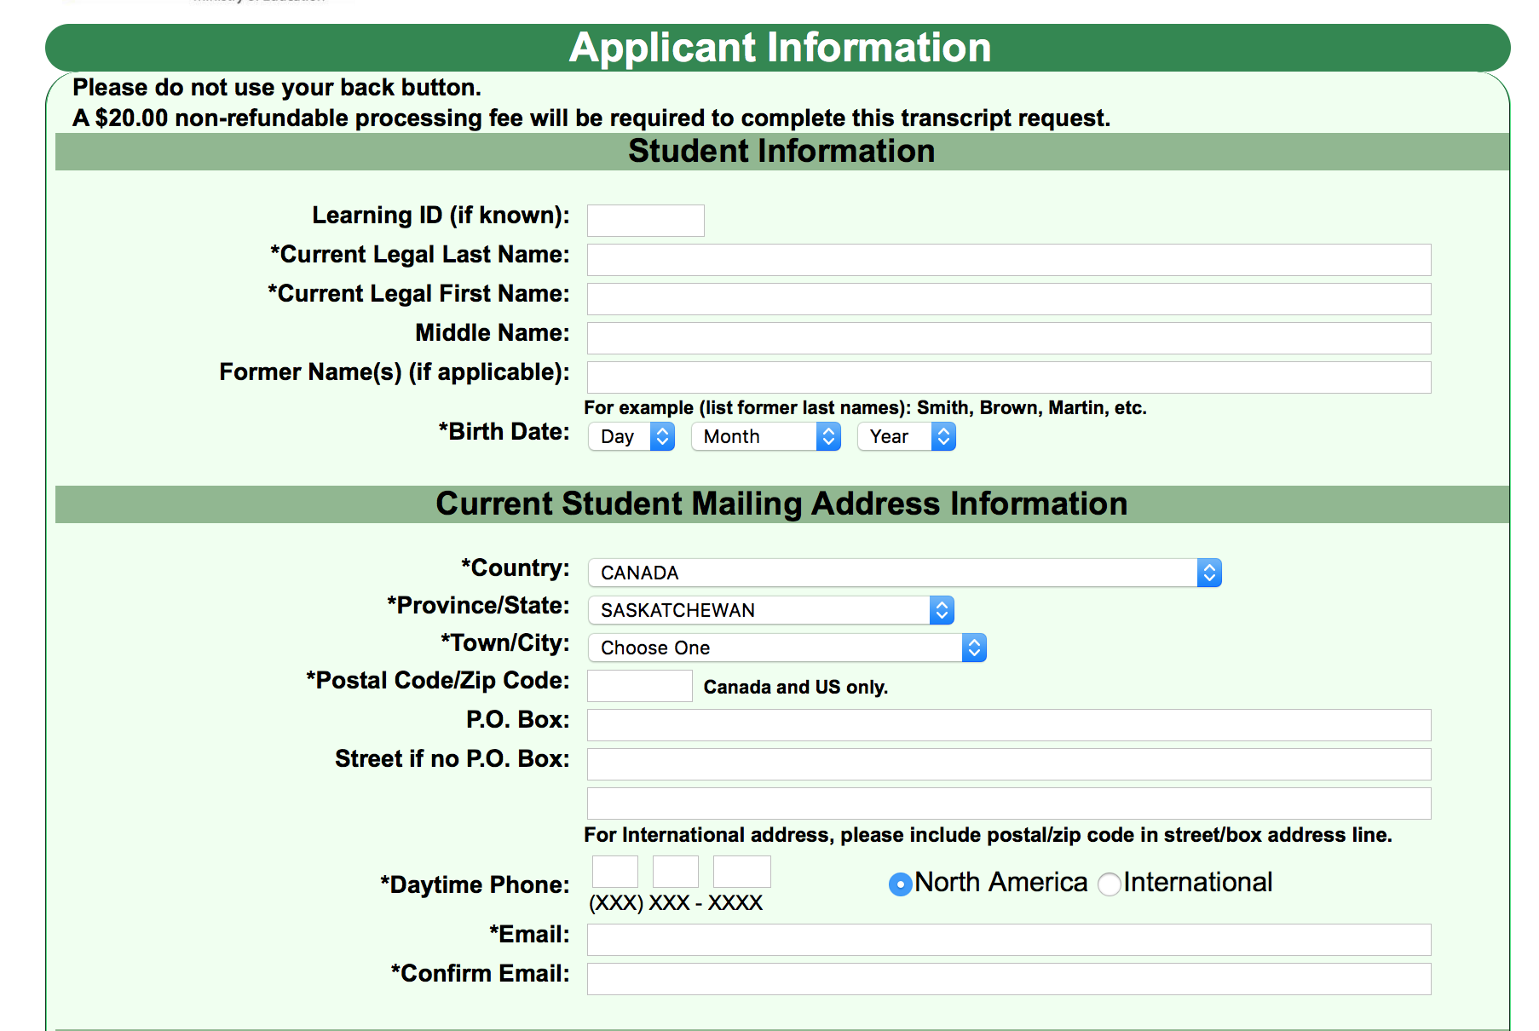
Applicant information

Slide 7
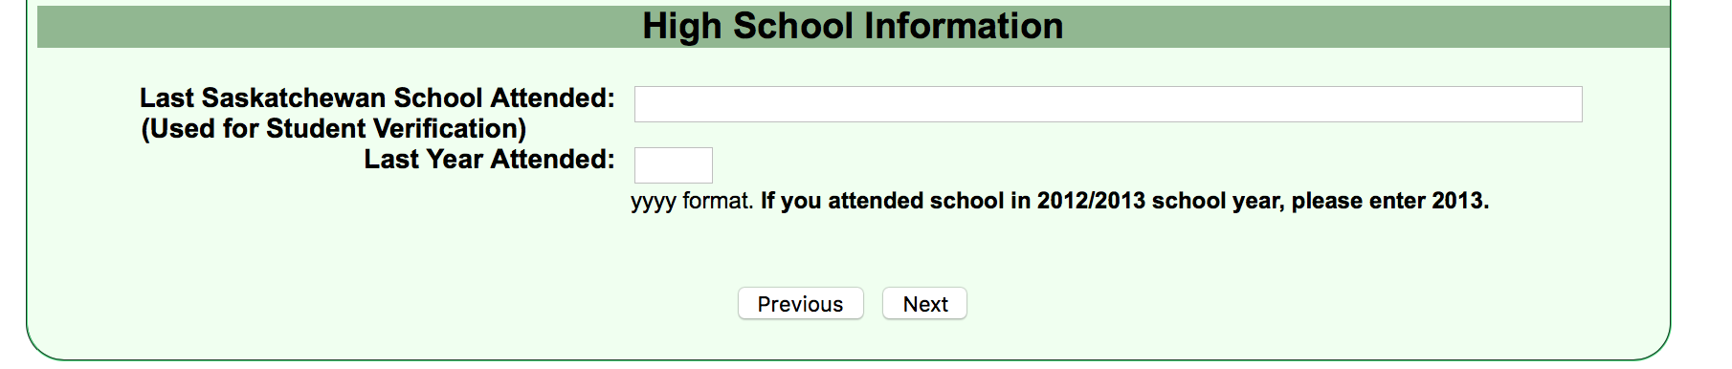
High school info
-for last year attended please use the year you will graduate for this section

Slide 8
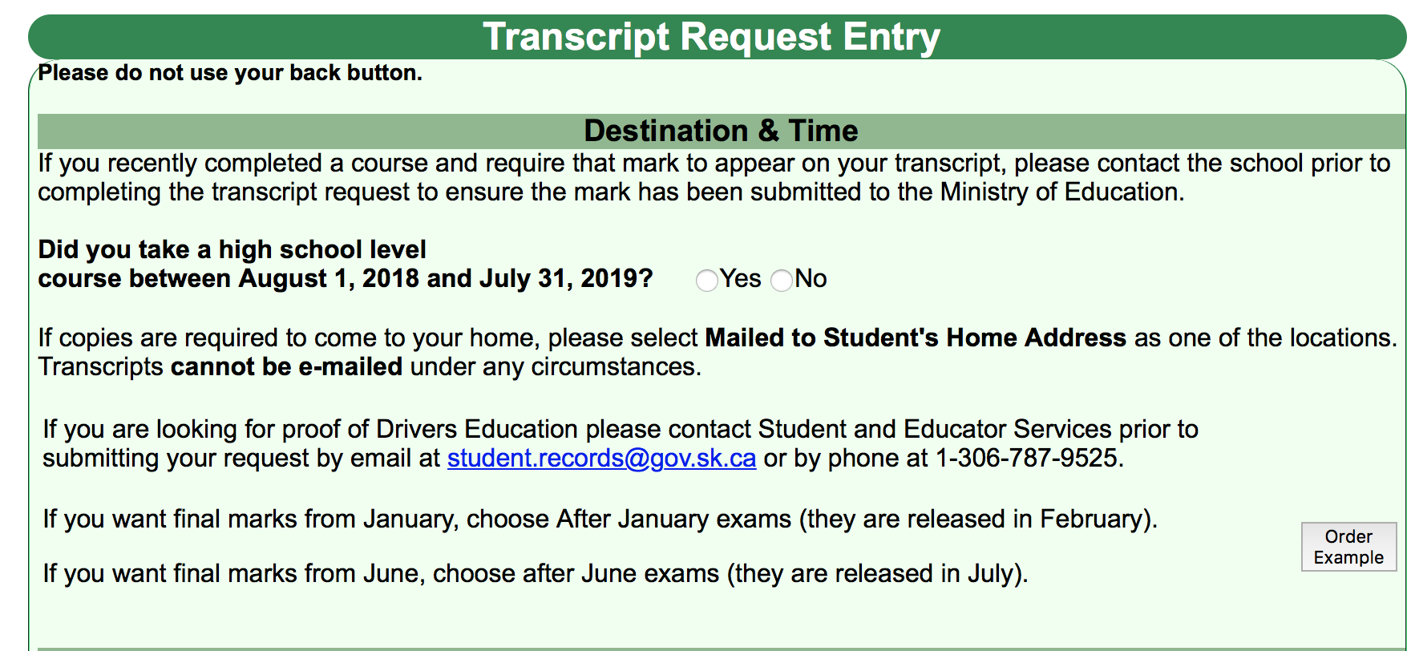
You will need to click yes here if you are taking a class this year and are graduating this year

Slide 9
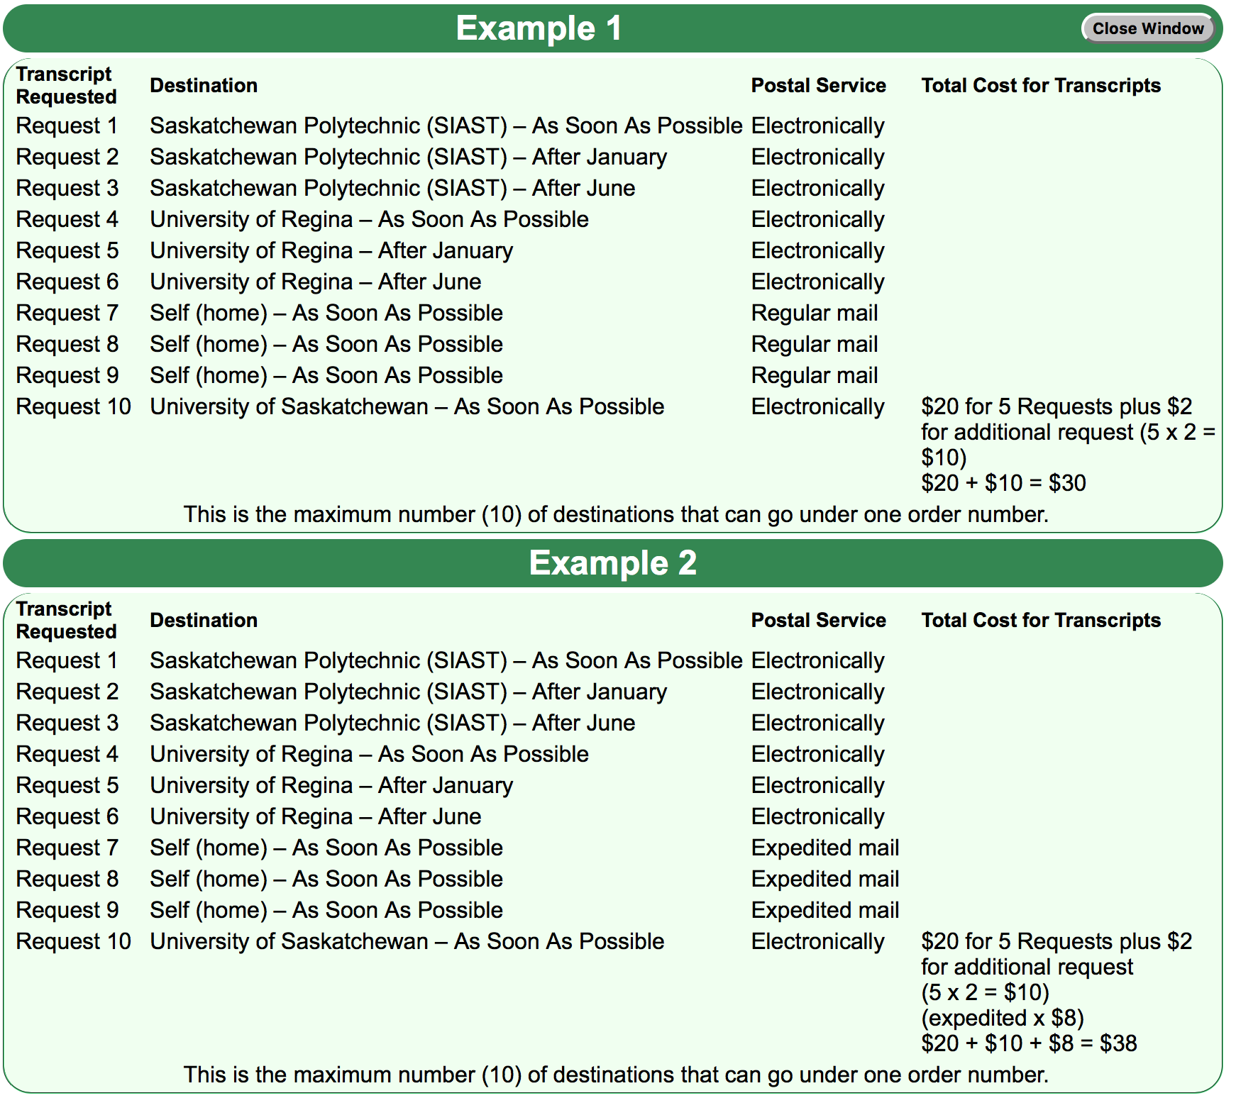
Order example

Slide 10
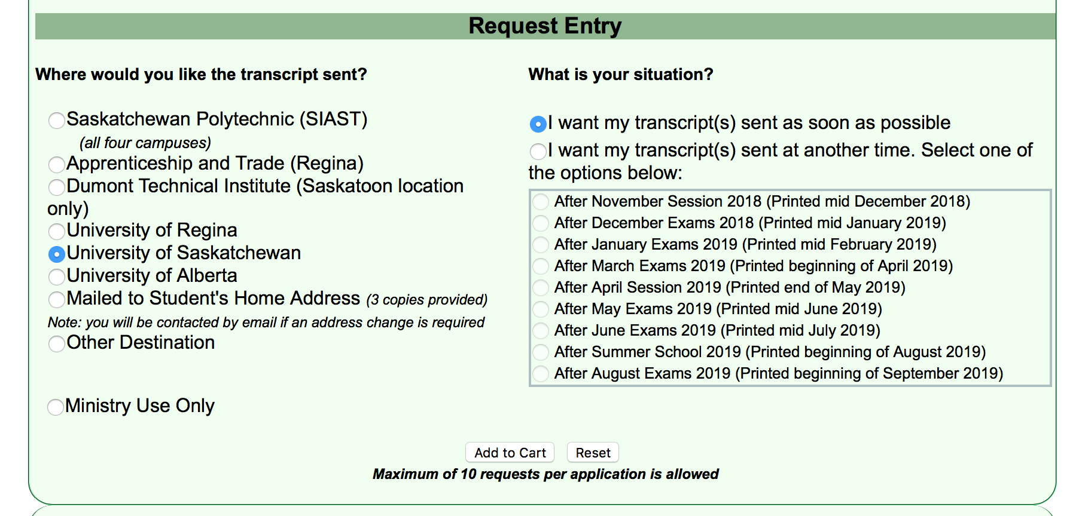
U of s order example
-3 need to be sent.
-now
-after jan
-after june
-add to cart each time

Slide 11
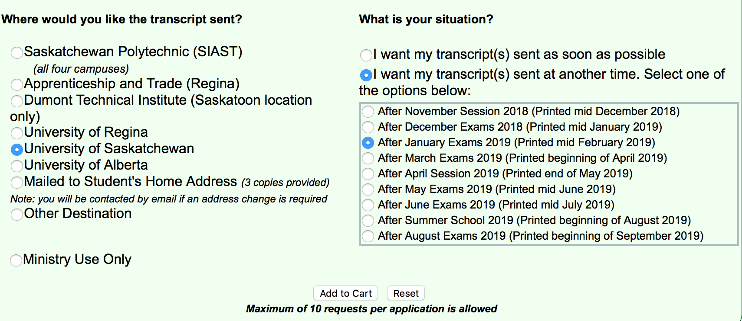
After jan

Slide 12
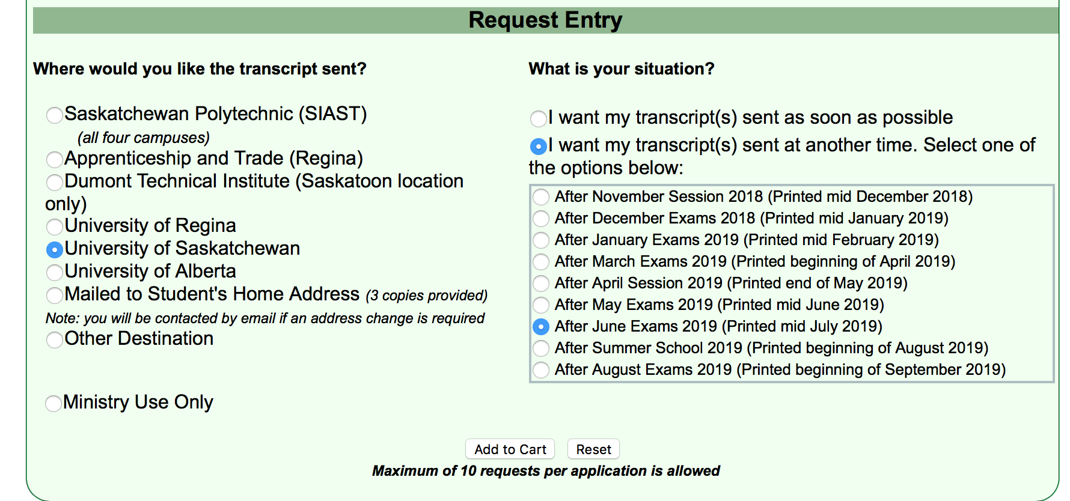
after june

Slide 13
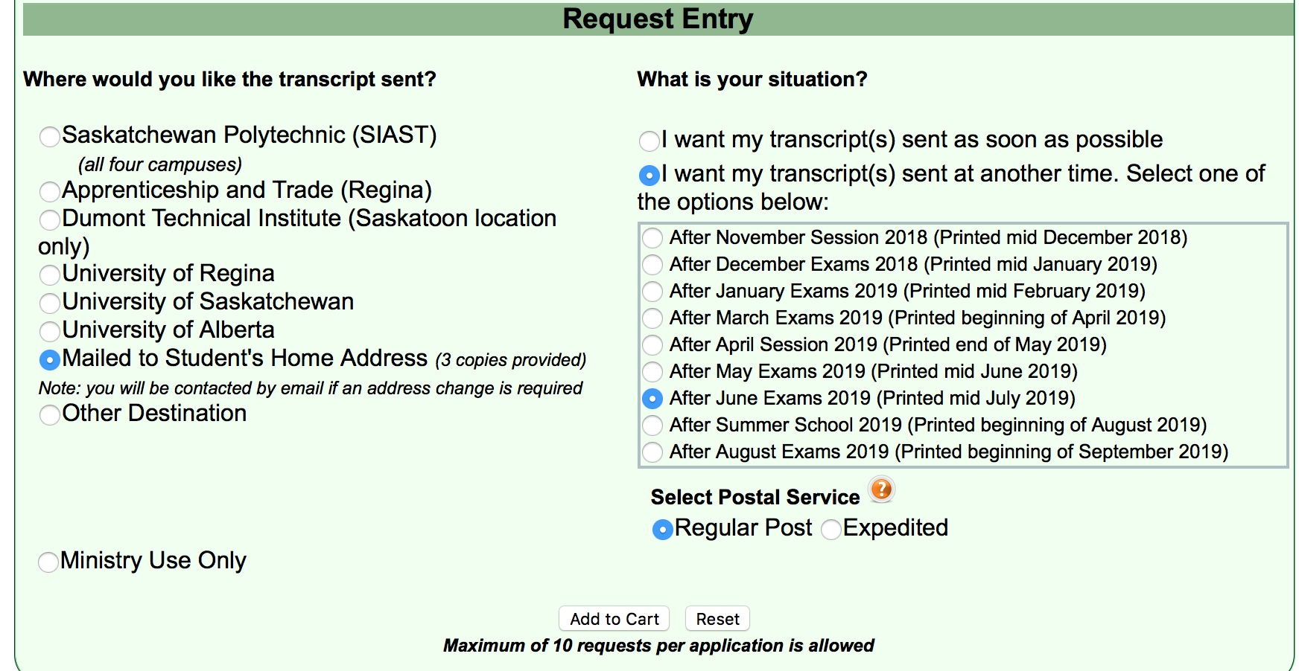
Mail to self (after june only!)

Slide 14
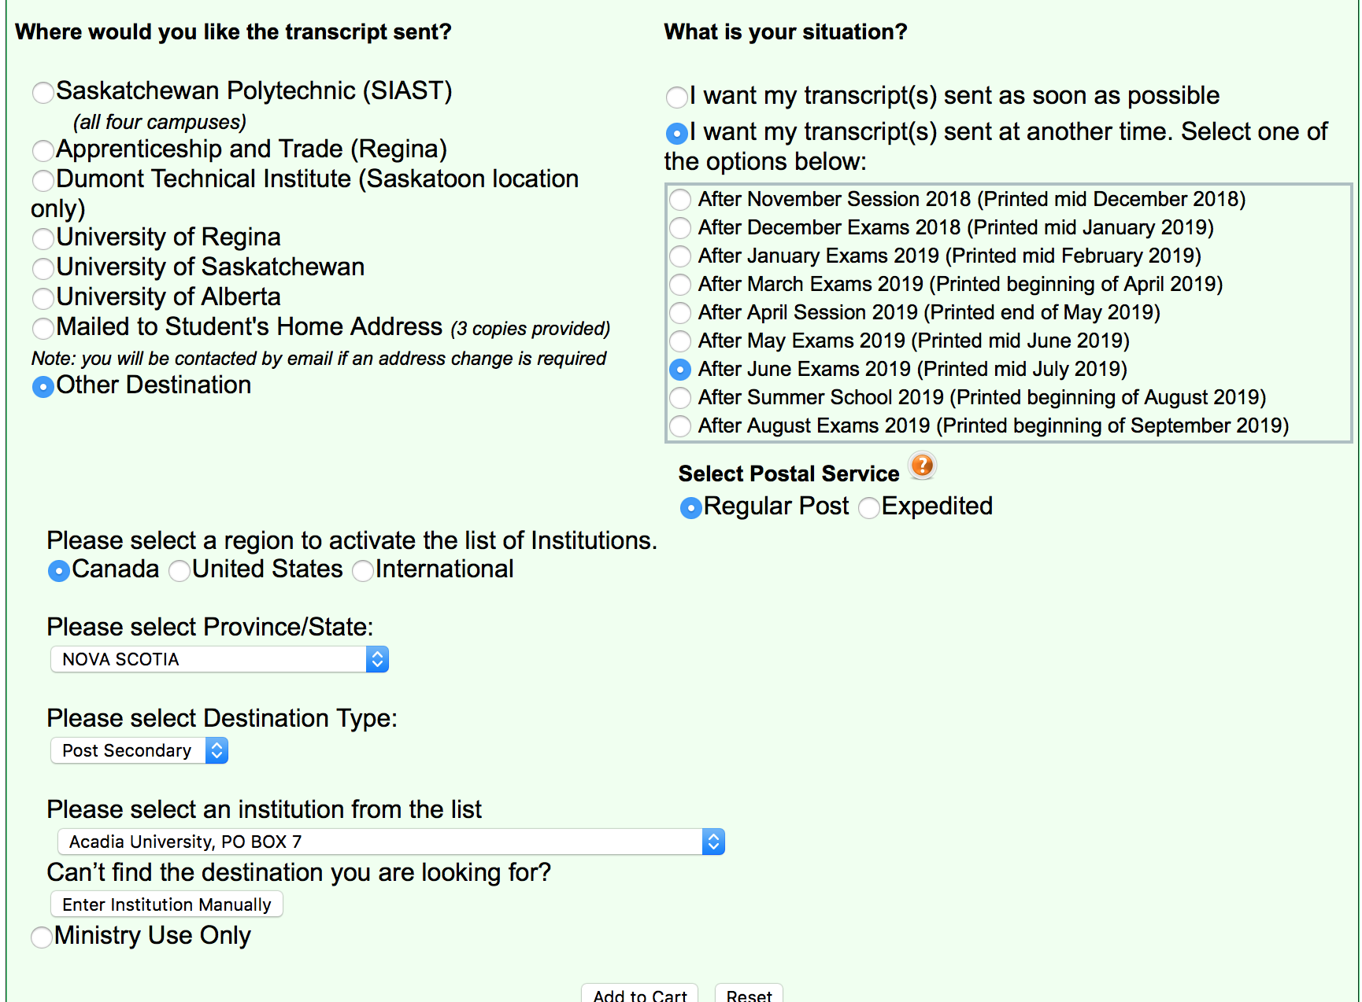
Other location

Slide 15
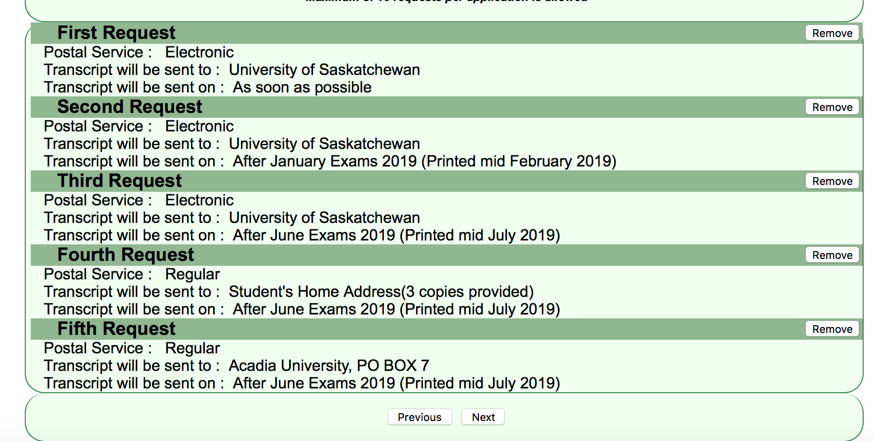
Cart summary
-if all is correct hit next to enter payment information

