Slide 1
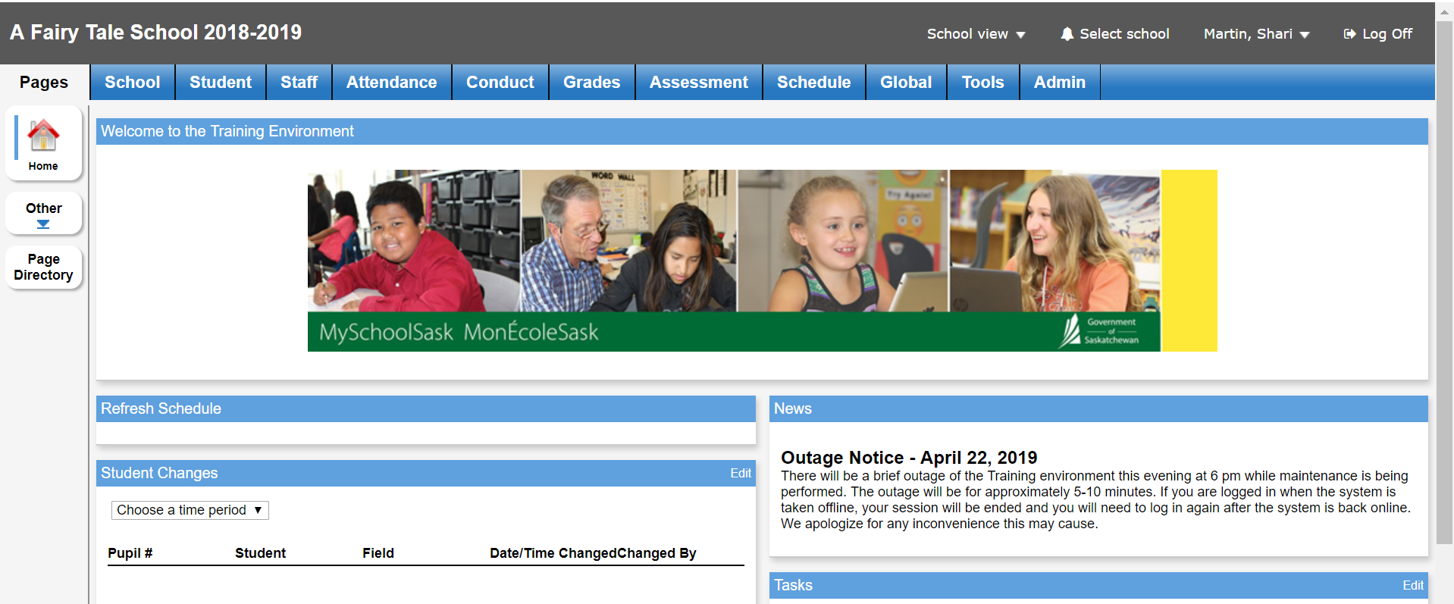
This Photo by Unknown author is licensed under CC BY-SA-NC.
MSS TRAINING ENVIRONMENT https://training.myschoolsask.com/aspen
Please login prior to session start time :-)
Notes:
Welcome

Slide 2
MySchoolSask School Lead Training Principals and Teachers
June 6, 2019
Notes:
Shari Welcome to the My SchoolSask Implementation Overview for School Lead Teachers and Principals. As you know from the overview video, this day is the accumulation of a lot of planning and work on behalf of the province and the division MySchoolSask Team. Today we are introducing you to the training environment to give you an opportunity to see the potential of the new student information system and how it works. Today will be the first of several face to face planning days for you as teachers and administrators.

Slide 3
Agenda
Welcome and Overview
Staff View Setup and Navigation
Attendance
Provincial Rubric, Report Cards, Student and Family Portals
Teacher Gradebook
LUNCH
Teacher Gradebook continued
Wrap Up and Next Steps
Notes:
Shari
Review Agenda Remember to set up the parking lot activity
Shari
Our agenda today is as follows:
We have not indicated coffee breaks, but our hope is to show you the function of a section and then give time for questions and for you to practice as we work through the various topics.
Our agenda today is ambitious and is intended to expose you to the workings of MySchoolSask. I want to thank Sondra who will be leading much of the portal exploration and Vanessa, who has worked very hard with Sondra to ensure the training environment is up and running. Sondra entered the Fairy tale school and its various students and teachers and is still here with us having survived the first data validation last week. Vanessa is trying to pack as much as she can into this week having her oldest son graduate on Friday and planning and leading two days of training sessions. Vanessa has diligently worked through all the aspects of MySchoolSask, taking copious notes and viewing and reviewing the training videos from our online sessions. She is amazing and was also responsible for putting together the Powerpoints we are using today
You will notice we have two flip charts set up at front and another on your left, my right side of the room. You have sticky notes on the tables. Please write down your questions and then place on the parking lot. If we don't have time to answer them today, we will definitely send out a Q and A page following this workshop.

Slide 4
Sun West School Division MySchoolSask Division Team
Shari Martin
Vanessa Lewis
Sondra Potratz
Linda Klassen
James Lowe
Notes:
Shari Last Fall, when the announcement was made about adopting MySchoolSask by the Fall of 2019, School divisions were asked to create a division leadership team to help plan, lead and steer the implementation for their division. Sun West's division team is comprised of Shari Martin, Vanessa Lewis, Sondra Potratz, Linda Klassen and James Lowe. this team participated in 5 weeks of training where each week they learned about a he requirements of the implementation and worked to develop a plan for each aspect presented to them.
I have already thanked Vanessa and Sondra and their large roles in today's training. Linda is the handbook guru, having compiled these binders for you and then flying off to New York leaving us behind. She is just freshly back from her trip, so make sure you work her hard as she is likely running on minimal sleep after being in the Big Apple. We will have to keep topped up on coffee!
James Is not here today, but he is as you know the technical computer expert of the group and we are proud to say has been assisting the provincial third party integration group in finding their way. Selfishly it's because we want to make sure all the different apps we use that currently work with power School also work with mySchoolSask!

Slide 5
Sun West MSS Team – Advisory Team
Secretaries
Wendy Clayton
Jodi Seibold
Lisa Prestley
Principals and Vice Principals
Aaron Bieberdorf
Leia Hey
Arlene Low
Walter Wood
Teachers
Danielle Jamieson
Crystal Johnson
Notes:
Shari
Part of the Sun West plan is to create an advisory team consisting of stakeholders from the various staff that will be using MSS. A call went out and as always, Sun West teachers, admin and secretaries responded favourably and expressed interest and willingness to help lead this initiative. Volunteers who weren't selected to be on the division advisory team, also had the opportunity to get involved by being part of their school team by volunteering to be a school lead.
The advisory team participated in an overview of the new system in November and a train the trainer week long training in March. We very much appreciate members of our Advisory Team being here today to help facilitate our learning.

Slide 6
The way we do things now
Engagement
The Change Management Cycle
Adoption
Reinforce
Trial
The Adoption Curve
Train/Support
Understanding
Time
Educate
Awareness
Communicate
The way we do things now
Notes:
Shari You will remember the Adoption Curve from the introductory video. we are still very much at the beginning of this journey but please note that increase time and increased engagement on the axis is required for this change to take effect. It will not be overnight.
But as we know, even if a change is needed and agreed upon, there are still many things to consider when introducing a change. This diagram shows the progression from the way an organization currently does things to the awareness and understanding phase. These initial phases are followed by the trial phase where learners are experimenting and learning about the new system and then adoption. finally after using the new program, it will replace the system we currently have and become the "new" way we do things
At all times during this adoption cycle, it is important to communicate, educate, train/support and reinforce learning and use
Sun West has a plan in place to address all parts of the adoption curve and if you are a member of the MySchoolSask group in the Resource bank, you are already aware of communications and have worked to view and educate yourselves about the new system.

Slide 7
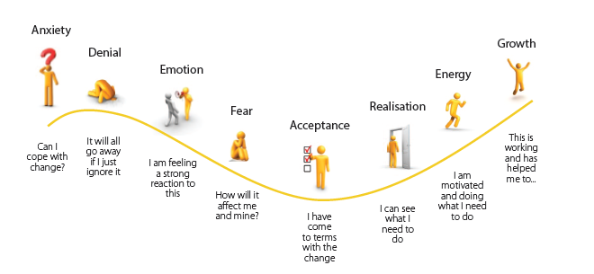
Change Management Cycle
Notes:
Shari In addition, to thinking about how to manage and plan for a change, we must realize that anytime we are faced with change, we may experience different reactions and emotions and start and progress at different stages and at different times . You may experience several of these feeling as we work through the examples today and just acknowledging that we have these feelings when learning is important and that they are part of the cycle of adopting something new.

Slide 8
Change Management Cycle
Notes:
Shari In addition to the emotions you will experience, you may note that the feelings can pull you towards certain paths , some that are more positive than others.
We learned in the introductory video that the amount of time a learner may spend in each stage may vary depending on prior experiences, acceptance of risk and personality type , the trick is to remain moving through the stages and not to become stuck in any one stage. Being aware of the stages and self reflecting on your location within the stages is an important.
It is also important to realize that it is perfectly normal to have a variety of emotions towards the change at any given time and the most important focus is a to ensure you are progressing or on a path that is leading to one's learning to work in a new situation or a new way of being or being stuck - either disillusioned or hostile where you commit to the old ways and attempt to undermine the new.

Slide 9
MySchoolSask (MSS) Overview
Notes:
Shari When I first heard the news of the new system, I , like many other educators in the province, was excited a choice had been made. The excitement quickly turned to disappointment that it wasn't the system we were familiar with and the realization that we will have to learn a new system and also while learning work to guide teachers and schools on their journey of learning. I could have been overwhelmed them and o some days, our team might feel overwhelmed as it is a big learning curve for us and we know for all the schools. The pay off is that this new system being adopted provincially will provide consistency for teachers, students and their families as there will only be one student information system to learn how to use and information about student will be shared quickly and virtually should students move from one school to another within the province.
This is the end vision and we need to keep that in our view.

Slide 10
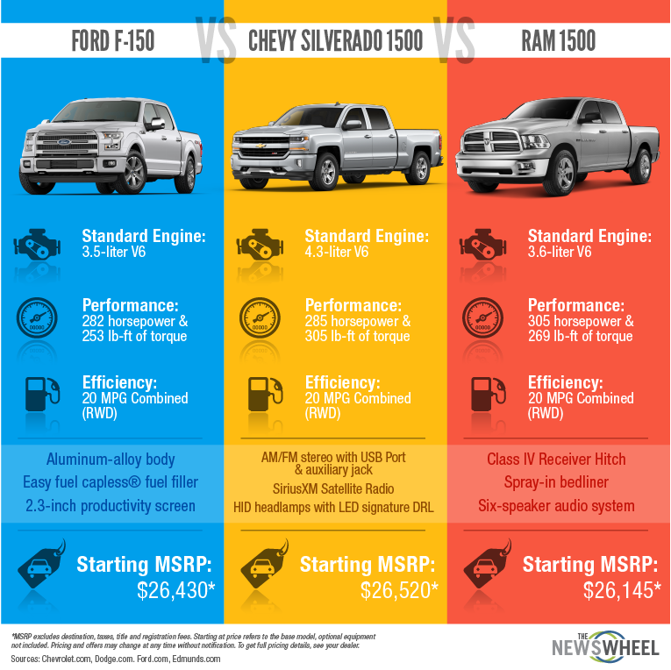
Notes:
Our team rationalized that some of us have been through this before wit Power School. Back when Sun West became a division and 6 divisions came together, we all had different ways of doing things, used different software to record attendance and marks and some of us even were strictly paper based. We implemented power School and PowerTeacher and amid all the bumps we have progressed to where we are today.
Our journey might be a bit easier this time. some of us are experienced, we have better internet bandwidth and all of us have the common experience of using a single student information system. We are all starting at the same place. Yesterday I compared the change to being given a new phone – You may be very familiar with an I phone and its functions, or an android. But give us another brand and we may not be as capable at using it until we have a chance ot practice, experiment, make mistakes and learn form them. I may not be as capable as I was with a phone I was more familiar with. Do they do the same things YES!
Today I am going to liken the change between shopping for a vehicle ...

Slide 11
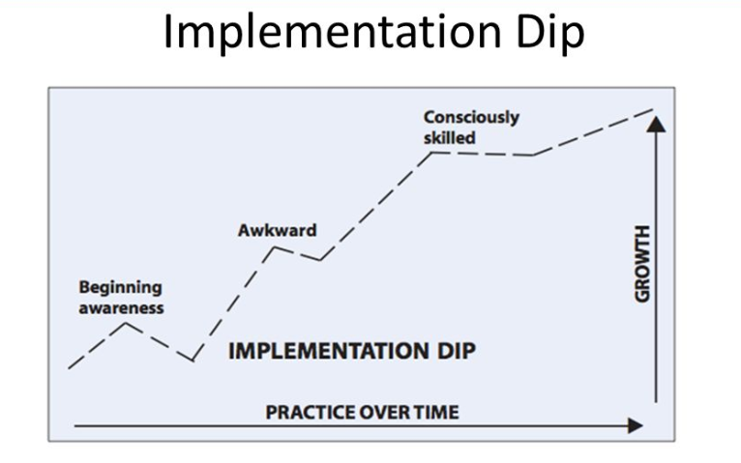
Implementation Dip
Notes:
Shari This drop in effectiveness is called an implementation dip and I thought this diagram says it best.
So, If you thought you were going to walk away from this session and be completely trained and capable in how to use MySchoolSask, I am sorry you will be disappointed. The training is the next few days is intended to provide and overview and introduce you to the system, so you have the big picture. the filling in of details is done with practice and time.
We are comfortable with this happening at different paces for students and encourage them to have GRIT when learning. We need to remember that we as adult learners may also need more time and learn differently.

Slide 12
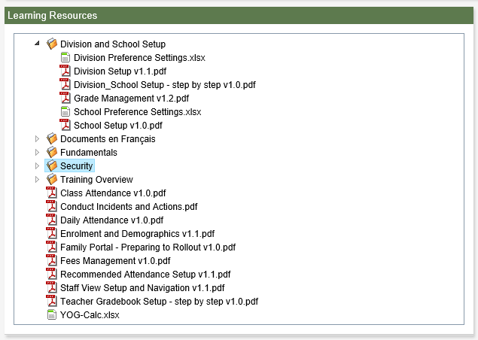
Resources to Support MSS Training and Implementation
Resource Bank (join today!)
Communications Bulletins
Fundamentals Video
Overview Video
Rover Videos
Learning Resources (to come)
Notes:
Vanessa
Because we know that everyone learns differently, we have planned our implementation to have face to face opportunities, online support videos and step by step instructional booklets
If you haven't already joined the MySchoolSask page on the Resource bank, we invite you to sign up as this is where our resources will be housed. Once you start using MyschoolSask, step by step resource booklets and help guides are also located within the platform and are a click away. (Note: the L1 Station within MySchoolSask will be the location in which all updated copies of any MSS resource booklets will be housed. We are thinking we may not include these in the resource bank as the intent is for teachers to be able to receive updated supports within the MSS platform.)

Slide 13
MySchoolSask Language
MSS Terminology
Standard vs Outcome
Primary
Secondary
Transcript
Notes:
Vanessa Direct them to the page in the binder Review specific MSS terminology
See Glossary – some helpful terms. The above are the ones we noticed meaning something slightly different than what we understand them to be in other contexts.
ex. Standard is equivalent to our Saskatchewan Outcome term. Primary – The “home” or base school of record Primary Student – Student who have a primary or base relationship with the school Secondary – The secondary or “non base” school where the student is cross-enrolled. Secondary student – Students who have a secondary (non-base) relationship with the school.

Slide 14
Privacy of Data
Notes:
Vanessa Brief discussion of importance of privacy in this training environment…be sensitive, responsible, and professional.
Please be aware there is sensitive information within the training environment. Real student and staff information is available to make this training environment more authentic. Please ensure privacy protocols.

Slide 15
MSS TRAINING ENVIRONMENT https://training.myschoolsask.com/aspen
Notes:
Vanessa A training environment will be available for our school leads to explore.
We have created a 43rd sun West School, A Fairy Tale school to assist us in this process and to demonstrate different functionalities of the program.
In order to support our learning today, we were reflecting on how our Advisory Team learned in the online trainings sessions. Based on our reflections, we feel it would be best if we demonstrate some examples on the overhead then allow for some time to explore and experiment and then ask questions. So, as we are showing things, please watch the demo. You are welcome to refer to your binders and make notes as we are going along, but please hold off on practicing until we work through the demo. Following the demo, we will have time to play and explore and discuss together (Similar to Ido, We do, You do model)
Feel free to experiment! This is a training environment. It is OK to make mistakes – that is where the learning happens! Also, please be aware the training environment isn't fully operational (for good reason) - not all outcomes are loaded, email functionality has not been connected yet, as we learned in our advisory team training, there are a few areas which will not behave as expected but will be fixed and ready for go live, etc.)
Please don't let this worry you. We will work through things together.

Slide 16
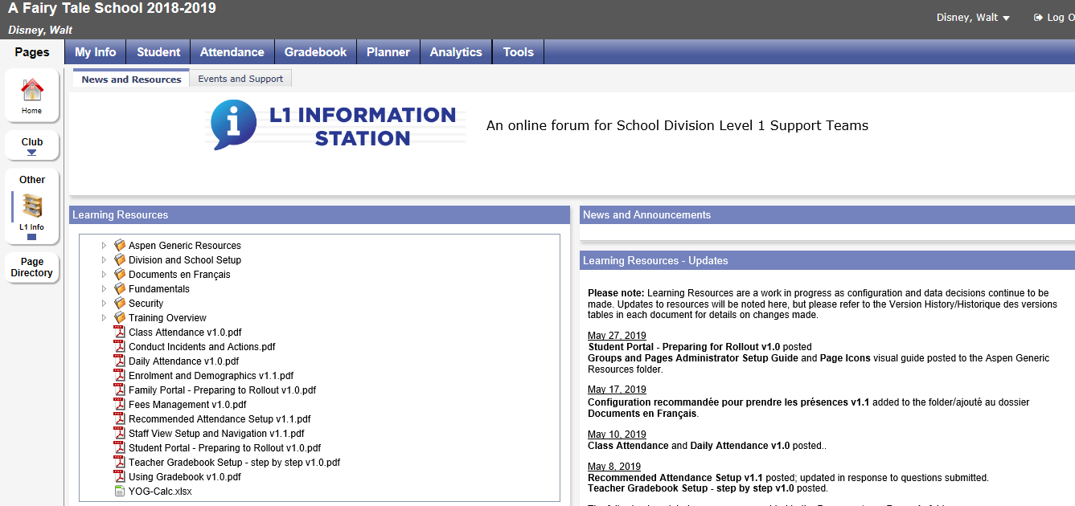
Adding L1 Information Station
Notes:
Vanessa Many of the guides we are using come from the L1 Information Station These will be updated periodically by the Ministry and MSS – always look for the most current version. They will prove helpful as we navigate MSS together.
You have been provided with a printed copy. Feel free to make jot notes in the binder as we work through the demos, but please, again, watch the demo before trying to practice yourself. Thanks!

Slide 17
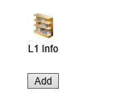
Adding L1 Information Station
Notes:
Vanessa You can add the L1 station to your profile easily. To add: Main Landing Page Click on Page Directory Click on L1Info Click on Add Now it should appear under Other
(Could also demonstrate live and show how to add/remove, etc.)

Slide 18
Overview of Training Environment (Fundamentals February 2018 v1.0)
Overview and Refresh of Training Environment
Introduction and Recap of Fundamentals
Notes:
Vanessa (Login to Vanessa MSS for this part) Overview a few highlights to RECAP FUNDAMENTALS….
List of a few areas to recap: ___Show single login and benefits of different views all in one place, ___Show a few different views as I have Division, School, Staff, etc. One login!!!
Note: Fundamental Video included things like:
- Users Login (username) and temporary password as supplied by school division.
On initial login, users will be required to change the temporary password: Minimum Length is 8 At least 1 number At least one symbol
Can’t contain login, first name, middle name, last name, date of birth, personal id, or sequential numbers or letters
- Should have been prompted to change password and security questions. - Talk a bit about roles and security – what you can see depends on roles – show different views – division, school, staff, etc.

Slide 19
Staff View Setup and Navigation (April 2019 v.1.1)
User Preferences
Teacher Classes Widget
Navigation Tools
Help, Menus, Icons
Field Sets, Queries, Filters
Reports and Extracts
Emails and Rosters
Notes:
Vanessa (log into FairyTale School) (with Aaron planning to demo field sets/queries/filters/reports)
For the next portion of the agenda, we will primarily be working with Staff View Setup and Navigation document from the L1 Station and also available in your binder.
Go into Fairytale School (Staff View – Walt Disney or Mickey Mouse)
Our goal is to demonstrate a few details on the screen then allow you some time to explore. Demo (Note: We won't touch too much on details of Attendance or Gradebook YET as this will be coming – just some info on key navigation features when viewing MSS from Staff View):
Landing Page Set Preferences - talk briefly about teach tab and info within – mention Gradebook will be explored in more detail later). Used to personalize MSS.
Teacher Classes Widget – appear on our landing page. Talk about the fact most information is set up by the province for more global info. Some information can only be viewed depending on your assigned role within MSS. Talk about Date, Classes (and blue hyperlink), Attendance, Grades, Email, etc.
Navigation Tools - Talk about Top Tabs and Side Tabs and Leaves. It is best to navigate using the links within. Do not use refresh button or forward/back buttons, etc. Help, Menu, Icons – are found above the field set of information in the active pane. They are the same regardless of the top tab the user has created. Show that we can find HELP on various pages. Menu Buttons and Menu Tools. Field Sets, Queries, Filters, Reports, etc.: Review Filters, Field Sets, Sorts, Quick Charts, etc. Email: Not set up yet but you can send emails to entire class. Students will be bcc'd. Teachers also have an option to include parent/guardian contacts for their students providing parents have primary email and receive email checked on their details. Rosters: Basically clicking on any blue hyperlink in the Teacher Classes widget on the landing page will take the teacher to the class roster. OR go to Gradebook>Roster Shows enrolled students by default.
Demo then time to pause and practice.

Slide 20
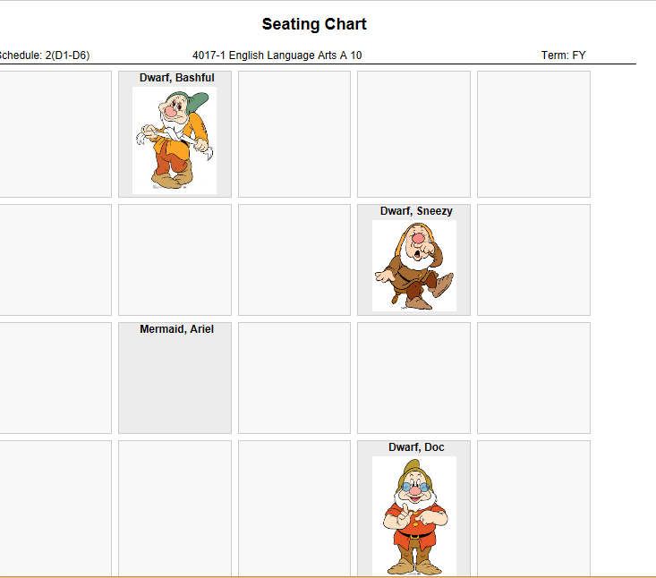
Class Attendance (May 2019 v.1.0) and Staff View Setup and Navigation (April 2019 v1.1)
Class Attendance
Seating Chart
Notes:
Vanessa
There are a couple of different ways to take attendance and use the seating chart. We will demonstrate a couple of options then you will have time to explore. Pages 14 and 15 of Staff View Setup and Navigation
Demo then time to pause and practice.

Slide 21
Teacher Gradebook (May 2019 v1.0 and Using Gradebook (March 2019 v1.0)
Overview
Notes:
Vanessa We will now share an overview of the Teacher Gradebook before we begin demoing and practicing with it.

Slide 22
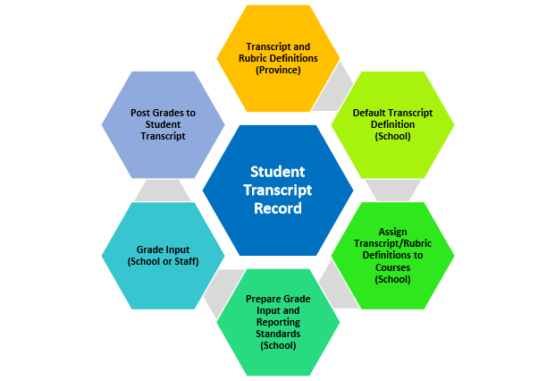
Transcript Cycle
Notes:
Shari In the Overview Video, we referred to ‘terminology’ specific to MSS. We will Student Transcript Cycle, but really, the details as how to set it up apply more to the school level than to us as Teachers. Transcript: The student Transcript Record is at the centre of the Transcript cycle. The record contains the student achievement for the current year and previous years.
Transcript & Rubric Definitions – set by the Province. Transcript definitions define the columns that are displayed in the grade input screens (which we will see in school view and in our Teacher Gradebooks). Rubric definitions define the learning outcomes that may be assessed and the performance scale that is being used. Default Transcript Definition (school) is set at the school level. Whatever the default transcript definition is set to is the one attached to any new courses brought into the school. Assign Transcript/Rubric Definitions – assigns to courses in your school, depending on the columns you want to appear. For example, if you assign a transcript definition of Quarterly, no school exam will not present a bucket for a school exam mark to be entered. Prepare Grade Input and Reporting Standards – again done at the school level. Is the process of brining the learning outcomes into the grade input screens to allow teachers to report…. Grade input and posting – is the process of entering grades, comments, work habits, then posting them to create a transcript file for the students.

Slide 23
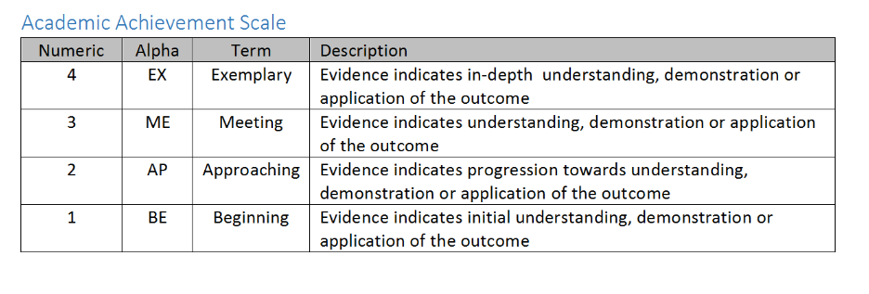
Common Provincial Rubric
Notes:
Shari Participants from 22 school divisions came together on April 4 & 5, 2019 to collaborate regarding gradebook and reporting.
• The group discussed and agreed upon the following:
o 4 levels of academic achievement, with levels 3 & 4 “at grade level”
o Alpha and numeric options for the agreed-upon grade scale
o The group discussed reporting practices in grades 10-12.
o This discussion was not intended to change current practice towards outcomes based reporting.
o The group will share and review outcomes developed in courses where outcomes do not currently exist.

Slide 24
Notes:
Shari A common scale for “additional grade scale terms” was also adopted

Slide 25
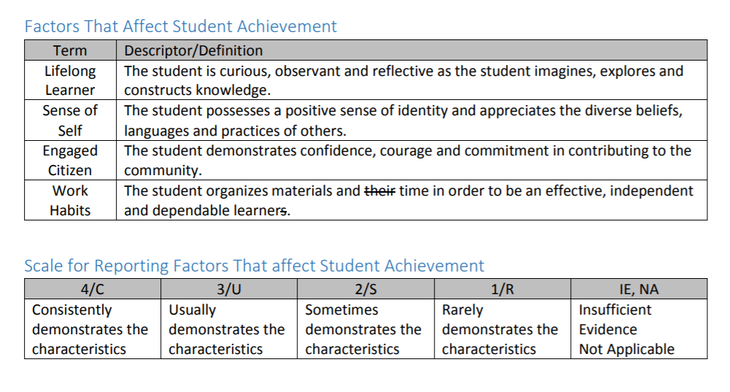
Notes:
Shari
• The group discussed and agreed upon a common set of factors to report non-academic achievement. These are the broad goals of learning found in the front of every Saskatchewan curricula and school division If desired, divisions will have the ability to describe the factors that could contribute towards these areas. For instance, if a division values and uses the 21st century skills and competencies, like we do at Sun West, we will decide how these areas will inform the four areas being assessed.
We will not be speaking much about this change today, but know that we have plans to address the change with teachers and what it means for assessment

Slide 26
Family Portal
Notes:
Shari Similar to Power School, MySchoolSask will have a family portal. Training on how to set up the portal and instructions for parents as well as a video on how to use the portal will be created to assist schools in training students and their families.
Blackboard Training Video: https://ca-lti.bbcollab.com/collab/ui/session/playback/load/96b58c918f064634920112bf942f77e1
We will work collaboratively as a school division to determine how best to roll out the Family Portal. It will be closed at the beginning of the school year until we become more comfortable as Teachers with MSS.

Slide 27
Teacher Gradebook (May 2019 v1.0 and Using Gradebook (March 2019 v1.0)
Gradebook preferences
Gradebook: linking classes, grade calculation weights, categories, reporting standards.
Creating Categories and Assignments
Entering Assignments and Scores
Posting Grades
The Planner
Tools Tab
Class Pages
Notes:
Vanessa (with help from all!) We will do our best to cover information in these areas today in order to become more familiar with the MSS Gradebook. Again, Please have “Using Gradebook” document from L1 Station or binder accessible.

Slide 28
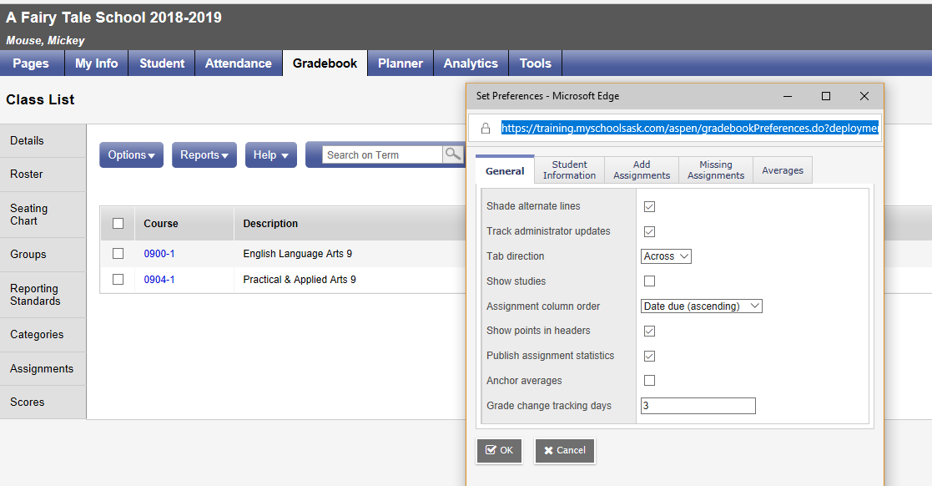
Preferences
Notes:
Vanessa (with help from all – Walter plans to help demo gradebook as well) We will walk together through some steps involving Gradebook Preferences Pages 6 through 10 of Using Gradebook Handbook

Slide 29
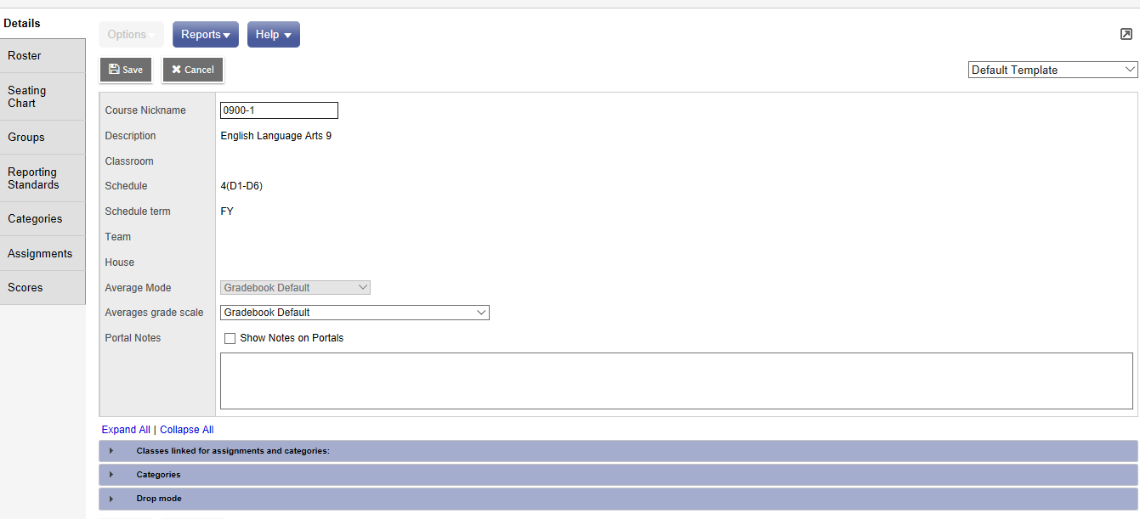
Gradebook: Linking Classes, Grade Calculations, Categories , Reporting Standards
Notes:
Vanessa (with help from all, Walter plans to help demo gradebook as well) Demo: Pages 10 through middle of 13
There are videos on Blackboard in Training to help with Gradebook if needed (they are long and were the ones shared with the Advisory Team, but sections may be useful if needing live demos. https://ca-lti.bbcollab.com/collab/ui/session/playback/load/6be6965a35fc4447bc9b3456e806446c
https://ca-lti.bbcollab.com/collab/ui/session/playback/load/58d09e45b43e4703a079a7491656ef93

Slide 30
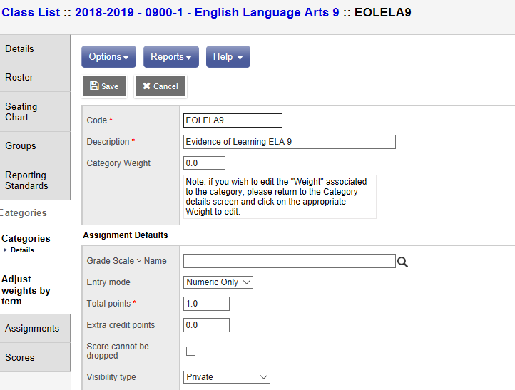
Creating Categories & Assignments
Notes:
Vanessa (with help from all, Walter plans to help demo gradebook as well)
Pages 13-26
Categories: I prefer the second option Gradebook TT>Select a Class>Categories Side Tab (then maybe show how to go in the other way and make changes?) Note: Must create Categories (or buckets) prior to adding assignments.
Assignments: Assignments can be created in various ways within our Staff View (as with most functions within MSS, there are various ways of doing things). Single assignments can be added as can multiples.
Note: Traditional View is looking at the Transcript Definition. The Standards View is looking at the rubric.

Slide 31
Entering Assignments & Scores
Notes:
Vanessa (with help from all; Walter will help demo gradebook as well) Can enter grades by standard, by student, by assignment, etc. In training environment: Two sets of rubrics set up – one with a rating scale 100 points, one with 4 points in training environment. Attach a rubric with *SK and an elementary rubric with 4 point scale (and correct terms) for elementary rating scale. This will allow us to report on outcomes.

Slide 32
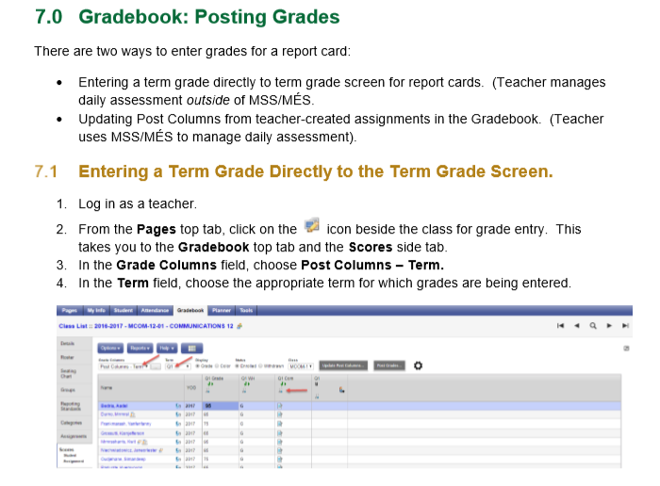
Posting Grades Reports
Notes:
Posting Grades – a process (similar to 'submitting' grades in Power School)

Slide 33
The Planner & Tools
Notes:
Planner is actually fairly simple and intuitive.
Automatically gets populated as you add things to your Gradebook. No need for double entering, etc. Once more familiar with MSS, it will be fairly easy for teachers to navigate and use. - can show/hide courses - can view day, week, month depending on preferences
- can add assignments right from the planner if you prefer – takes you back to the same window as earlier (you do have to pick the class)
- can add appointments
A version of planner will be available for students/parents to view in portals, etc. Not printable or emailable.

Slide 34
Groups & Pages
Notes:
There is a lengthy document in the L1 station regarding Groups and Pages. Provide a basic overview Engage in conversation around how this might be utilized
Allow some practice time

Slide 35
Parking Lot
Notes:
Review Parking Lot Items

Slide 36
Wrap-Up and Next Steps
Notes:
Discuss next steps and determine supports needed.

