Slide 1
MySchoolSask School Lead Training Principals and Teachers
iLearn Session – August 27, 2019
Notes:
Welcome to the MySchoolSask School Lead Training
Today's agenda is set up to review some processes and to highlight the supports we have available for working with your staff to lead them in MSS training. We will be posting the powerpoint on the Resource bank and feel free to download and edit/change the powerpoint to suit your needs at the school
As we learn together, we are hoping school leads and advisory team will help us by SHARING successes and challenges with us so we can all keep everyone in the loop.
Preparing for today, we realize staffs across the division are at different places in their rollout, so we realize

Slide 2
Agenda
Welcome
Overview and Recap
MSS LIVE signin
Staff View Setup and Navigation
Attendance
Provincial Rubric, Report Cards, FASA
Teacher Gradebook
Help Process
Parking Lot
Wrap Up and Next Steps
Notes:
Review Agenda Remember to set up the parking lot activity

Slide 3
The way we do things now
Engagement
The Change Management Cycle
Adoption
Reinforce
Trial
The Adoption Curve
Train/Support
Understanding
Time
Educate
Awareness
Communicate
The way we do things now
Notes:
You will remember the Adoption Curve from the introductory video and from the June training. we are smoving into the trial and the adoption phase of this journey, but please note that we still need increased time and increased engagement on the axis is required for this change to take effect. It will not be overnight.
But as we know, even if a change is needed and agreed upon, there are still many things to consider when introducing a change. This diagram shows the progression from the way an organization currently does things to the awareness and understanding phase. These initial phases are followed by the trial phase where learners are experimenting and learning about the new system and then adoption. finally after using the new program, it will replace the system we currently have and become the "new" way we do things
At all times during this adoption cycle, it is important to communicate, educate, train/support and reinforce learning and use
Sun West has a plan in place to address all parts of the adoption curve and if you are a member of the MySchoolSask group in the Resource bank, you are already aware of communications and have worked to view and educate yourselves about the new system.

Slide 4
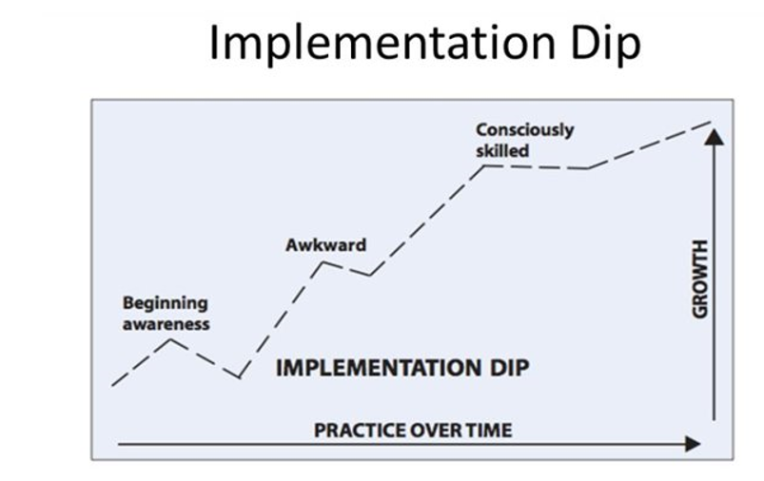
Notes:
Looking at this implementation dip, with the MSS lens, it is true...we are solidly in the awkward phase! This is, interestingly enough, the time when many new initiatives get abandoned by individuals and organizations. This is impoortant to remember that practice over time will help and having grit and a growth mindset as we work to learn the changes. The good news is we don't have to be stuck in this phase as with increased practice over time, we will experience growth and success and move to becoming more skilled. We recognize students need this support and we as learners need that too!
Remember, even if a change is needed and agreed upon, like MSS, this is still a change and the progression from the way an organization currently does things to a new way of operating will always follow this implementation dip where things seem awkward and unnatural and we yearn for the old and comfortable way of doing things. As we perseverethrough this phase, we progress form the unconsciously skilled to the consciously skilled phase.

Slide 5
Power School to MSS
Power School available for reference purposes until October 2019
Notes:
Available for Reference – till October. This is good for reference purposes which will be good for teachers. Feel free to go in and look at your classes from last year, see what you did for S1, S2, Yearlong courses in terms of Categories and Assignments. Just, DO NOT CHANGE anything in Power School

Slide 6
Power School to MSS
MySchoolSask Communication
Notes:
Principals learned on Friday that we have a communication for parents regarding this change and what to expect. This should be shared in the first newsletter or during Parent night.

Slide 7
Resources to Support MSS Training and Implementation
Resource Bank (join today!)
Communications Bulletins
Fundamentals Video
Overview Video
Rover Videos
Ongoing Updates
Sun West Advisory Team
Sun West School Leads
Sun West Division Office L1 Team
Notes:
In June, you would have viewed the Fundamentals Video, had access to MSS Communication Updates, and received school level training from your school leads.
Reminder: If you haven't already joined the MySchoolSask page on the Resource bank, we invite you to sign up as this is where our resources will be housed. Once you start using MyschoolSask, step by step resource booklets and help guides are also located within the platform and are a click away. (Note: the L1 Station within MySchoolSask will be the location in which all updated copies of any MSS resource booklets will be housed. We thought everyone could add to their profiles but this doesn't seem to be the case. As such, we will be adding pertinent information and updates to our Resource Bank We are thinking we may not include these in the resource bank as the intent is for teachers to be able to receive updated supports within the MSS platform.)

Slide 8
MySchoolSask Language
MSS Terminology
Standard vs Outcome
Primary
Secondary
Transcript
Notes:
Review specific MSS terminology
See Glossary – some helpful terms. The above are the ones we noticed meaning something slightly different than what we understand them to be in other contexts.
ex. Standard is equivalent to our Saskatchewan Outcome term. Primary – The “home” or base school of record Primary Student – Student who have a primary or base relationship with the school Secondary – The secondary or “non base” school where the student is cross-enrolled. Secondary student – Students who have a secondary (non-base) relationship with the school.

Slide 9
MSS LIVE
Notes:
We are all learning in this new MSS LIVE environment (no longer in training!).
This is will be OK. Just a reminder that data is real and changes we make are real! If unsure of something, please ask and we will figure things out together.
To allow time to practice, family portal will not be open for a while...October roll-out
AS WELL, we have taken every precaution we can think of right now to ensure Secretaries are setting up schools properly. However, this is new to all of us and there could be challenges as we learn this new system and gain a better understanding of how all of our setup choices impact all aspects of the program – including gradebook. As such, TEACHERS PLEASE BACKUP your grades in some fashion - daybook/excel/or whatever works for you. Just be sure you keep record – just in case!
IF PRACTICING in LIVE – and experimenting with entering grades, just don't SAVE/POST as that will send it to the transcript.
AGAIN, WE ARE LIVE – but this is OK. Just PROCEED CAREFULLY!

Slide 10
Family Portal
Notes:
As we mentioned in June, MySchoolSask will have a family portal for students and parents.
To give teachers time to learn how to use MSS, the family portal will not be opened up or activated until teachers are ready and the data they are entering is displaying correctly. Roll out and Training information on how to set up the portal and instructions for parents as well as a video on how to use the portal will be created to assist schools in training students and their families.
We will work collaboratively as a school division to determine how best to roll out the Family Portal. It will be closed at the beginning of the school year until we become more comfortable as Teachers with MSS.
We expect the portal to be opened in October

Slide 11
Privacy of Data
Notes:
Brief discussion of importance of privacy in this LIVE environment…be sensitive, responsible, and professional.
We care able to help each other as we learn this new program, but we must be very careful to follow privacy protocols when dealing with live and unscrambled data. This is extremely personal and sensitive information.
AGAIN, proceed carefully with caution.

Slide 12
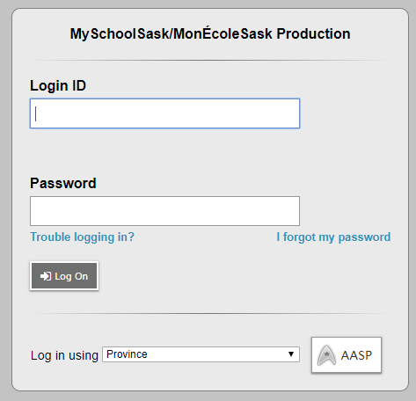
MSS (LIVE!) https://myschoolsask.ca/aspen/home.do
This Photo by Unknown author is licensed under CC BY-SA-NC.
IF FIRST TIME IN:
Go to LIVE MSS link Begin by: Login using: Sun West SD 207 Click on AASP THEN
sign n to Microsoft using usual Username and Password
Notes:
Welcome

Slide 13
Staff View Setup and Navigation (April 2019 v.1.1)
User Preferences
Teacher Classes Widget
Navigation Tools
Help, Menus, Icons
Field Sets, Queries, Filters
Reports and Extracts
Emails and Rosters
Notes:
Can show the Training Video as a refresher. Under Resource Bank, MSS Group, Video Folder, Staff View Setup and Navigation Orientation Video. Keep in mind, this involved the steps when we were in the TRAINING environment. We are now LIVE so some options are different. This will provide teachers with an overview, however, as not too much has changed. Biggest Change from training video to LIVE: Teachers will NOT have to change their password in LIVE environment as James has done an amazing job of signing us up with single signin.
NOTE: This video does not include any details on the extras you can do in staff view and navigation so feel free to take some time to demo field sets/queries/filters/reports if you wish.
Information Handout on Resource Bank (and in lead Binder): Staff View Setup and Navigation document available in your lead binder.
Goal is to demonstrate a few details using videos and/or your own live demo then allow teachers time to explore.

Slide 14
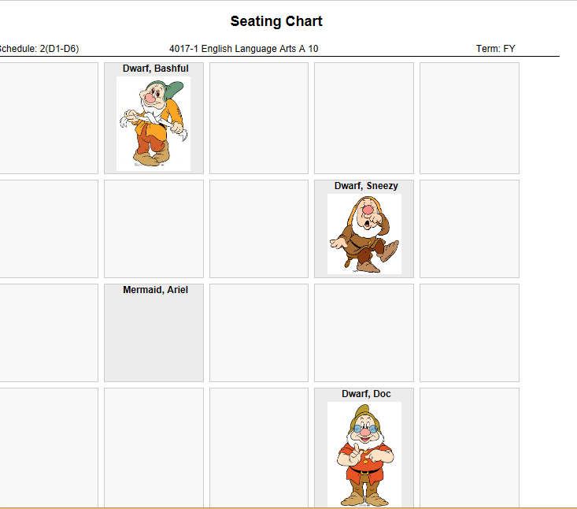
Class Attendance (May 2019 v.1.0) and Staff View Setup and Navigation (April 2019 v1.1)
Class Attendance
Seating Chart
Notes:
Can show the Training Video as a refresher. Under Resource Bank, MSS Group, Video Folder, Attendance and Seating Chart Video. Keep in mind, this involved the steps when we were in the TRAINING environment. We are now LIVE so some options are different. This will provide teachers with an overview, however, as not too much has changed.
Notes: There are a couple of different ways to take attendance and use the seating chart. We will demonstrate a couple of options then you will have time to explore.
Information Handout on Resource Bank (and in lead Binder): Can also reference Pages 14 and 15 of Staff View Setup and Navigation
Demo then time to pause and practice.

Slide 15
Notes:
Because Sun West is also working to adopt the common provincial 4 point rubric and replace the 5 point rubric previously used by Sun west. Administrators received this powerpoint which details the background behind the switch and explains the rubric and how it will be used. This should be shown to staff to explaint he why behind the switch.

Slide 16
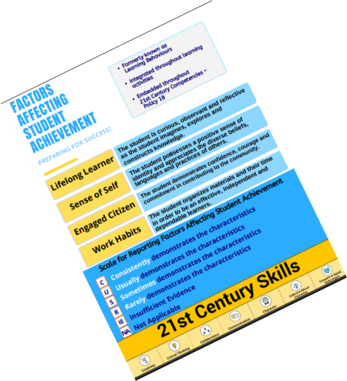
Notes:
2 page handout explaining the new rubric – academic scale 1-4 and also FASA Factors Affecting Student achievement.
This should be shared with families as well to explain the transition to the provincial rubric.

Slide 17
FASA and GRADEBOOK
Elementary and Mddle Level FASA: FASA Class has been added and wil be assigned to a homeroom/desginated teacher.
Collaboration at school level will be needed as to process.
High School FASA: FASA Rubric has been added to the the traditional high school transcript definition for each course.
Each teacher will be able to report on FASA elements
Notes:
Great opportunity for schools to disucss their collaborative practices regarding students and their progress at non academic but very important skills. In some schools, techer steams meet to collaboratively assign a mark depicting the student achievment in all subjcts.. One per student per reporting period.

Slide 18
Gradebook
Notes:
We will now take some time to explore teacher gradebook. Many of the concepts are similar to Power School. The "How to Do" pieces are a little different, however.

Slide 19
Teacher Gradebook (May 2019 v1.0 and Using Gradebook (March 2019 v1.0)
Gradebook preferences
Gradebook: linking classes, grade calculation weights, categories, reporting standards.
Creating Categories and Assignments
Entering Assignments and Scores
Posting Grades
The Planner
Tools Tab
Class Pages
Notes:
We will share an overview of the Teacher Gradebook before we begin demoing and practicing with it. Keep in mind, this video was made in TRAINING and there have been changes to given features since then. As such, please to not focus in on the details, use this video as an OVERVIEW of what gradebook can do. The basics are here – the details will come as we become more familiar with the environment and create more specific how-to's that are responsive to needs/questions of teachers. (If not using the video, the slides below might be used as a starting point before showing your LIVE demo – whatever works!!) Can show the Training Video as a refresher. Under Resource Bank, MSS Group, Video Folder, Using Gradebook: Basic Overview – SWSD Training

Slide 20
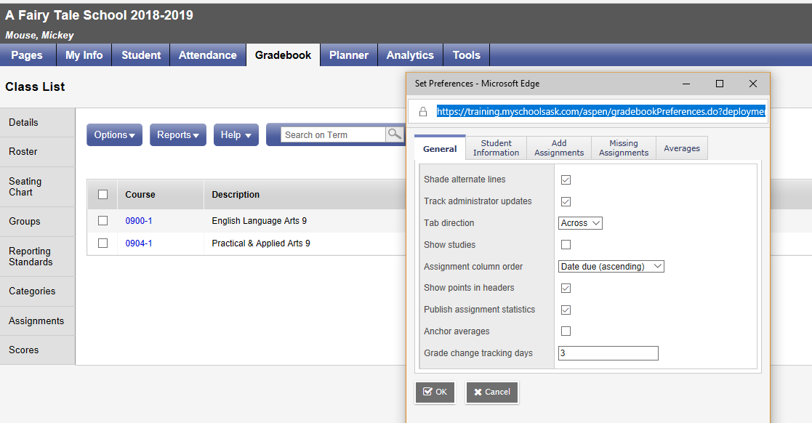
Preferences
Notes:
We will walk together through some steps involving Gradebook Preferences Pages 6 through 10 of Using Gradebook Handbook

Slide 21
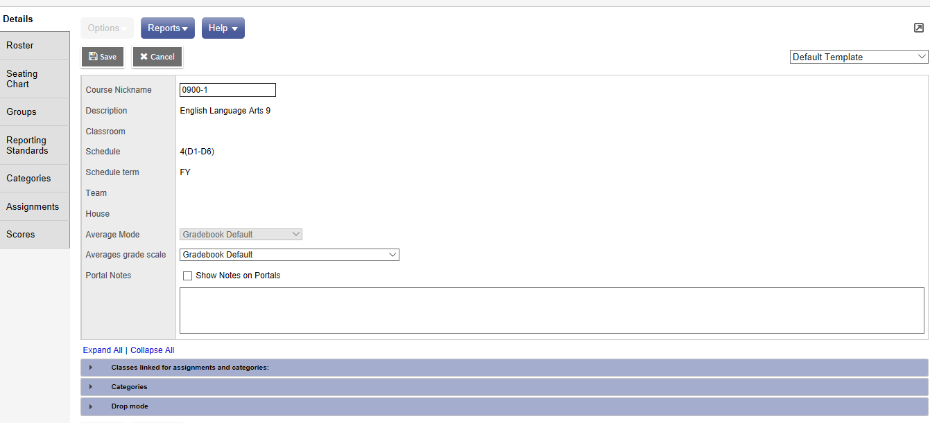
Gradebook: Linking Classes, Grade Calculations, Categories , Reporting Standards
Notes:
Pages 10 through middle of 13 of Using Gradebook There are videos on Blackboard in Training to help with Gradebook if needed (they are long and were the ones shared with the Advisory Team, but sections may be useful if needing live demos. Not sure if you will want to use these or not but available for reference.) https://ca-lti.bbcollab.com/collab/ui/session/playback/load/6be6965a35fc4447bc9b3456e806446c
https://ca-lti.bbcollab.com/collab/ui/session/playback/load/58d09e45b43e4703a079a7491656ef93

Slide 22
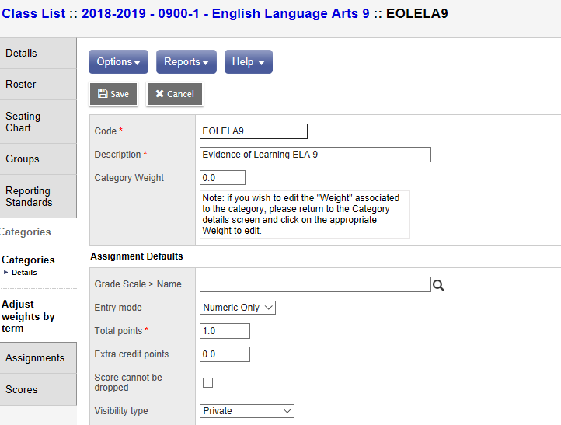
Creating Categories & Assignments
Notes:
Pages 13-26 of Using Gradebook
Categories: I prefer the second option Gradebook TT>Select a Class>Categories Side Tab (then maybe show how to go in the other way and make changes?) Note: Must create Categories (or buckets) prior to adding assignments. DIFFERENCES BETWEEN K-9 and 10-12 K-9: Maybe one Category such as Evidence of Learning as reporting Outcomes Based
10-12: Reporting traditionally and will use FASA outcomes at reporting periods. (There is an option for outcomes and FASA but if more than one teacher at the school, we will have to look at what this would mean).
Assignments: Assignments can be created in various ways within our Staff View (as with most functions within MSS, there are various ways of doing things). Single assignments can be added as can multiples.
Note: Traditional View is looking at the Transcript Definition. The Standards View is looking at the rubric.

Slide 23
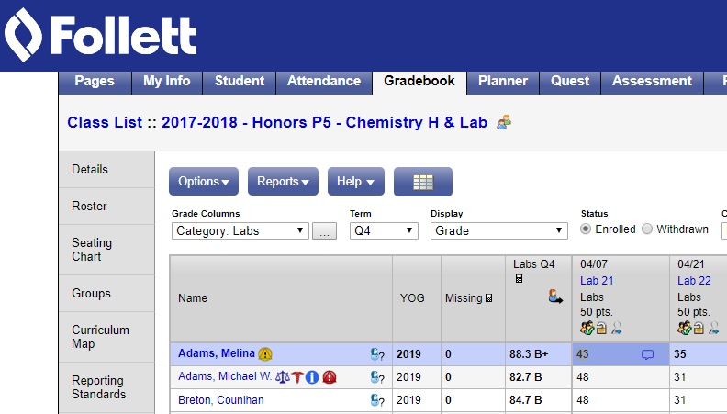
Entering Assignments & Scores

Slide 24
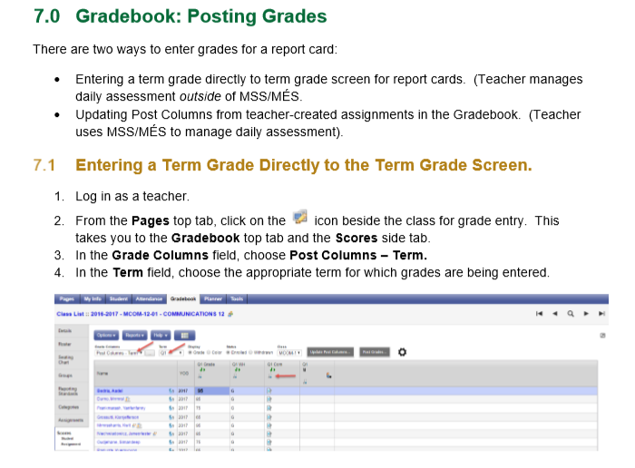
Posting Grades Reports
Notes:
Posting Grades – a process (similar to 'submitting' grades in Power School)
This will happen closer to report card time. DO NOT POST when you are experimenting with Categories and Assignments and ENTRIES in the LIVE environment. You will POST actual data closer to report card time.

Slide 25
The Planner & Tools
TOOLS: SPECIAL CODE vs. FOOTNOTES
Excused
Incomplete Missing Late
Notes:
Planner is actually fairly simple and intuitive.
Automatically gets populated as you add things to your Gradebook. No need for double entering, etc. Once more familiar with MSS, it will be fairly easy for teachers to navigate and use. - can show/hide courses - can view day, week, month depending on preferences
- can add assignments right from the planner if you prefer – takes you back to the same window as earlier (you do have to pick the class)
- can add appointments
A version of planner will be available for students/parents to view in portals, etc. Not printable or emailable. (AGAIN, this will not happen till in live environment. For now, secretaries know how to print student schedules).

Slide 26
Groups & Pages
Notes:
There is a lengthy document in the L1 station regarding Groups and Pages (It is now added to Resource Bank) These features can come...not really required for Day 1. Provide a basic overview Engage in conversation around how this might be utilized
Allow some practice time

Slide 27
Help Process
Notes:
Processes for Internal Help
Classroom Teacher – Troubleshoot
School Teacher Lead – to support classroom teacher then, if needed, send information into the Division Lead if further help is required (processes to follow) Division Lead – will try to troubleshoot then will go through HEAT if needed Provincial Lead – HEAT request

Slide 28
Parking Lot
Notes:
Review Parking Lot Items

Slide 29
Wrap-Up and Next Steps
Notes:
Discuss next steps and determine supports needed.
Collaboration Plan to support one another moving forward.

