Slide 1
PeBL Reflection and Sharing 2018-2019
My Year and Alignment Plans

Slide 2
Writing Alignment
What is the purpose?
When I met with my teachers I shared this purpose:
We will have a clear alignment plan K-12 with teacher input for ELA. Teachers will know the components of ELA they are responsible for and what skills students will have as they move to the next grade year.
Who is involved?
Ownership is key!!
I met with my SST and ELA teachers K-9 (I am 10-12).
Roles and responsibilities…
I invited teachers to take part and used PeBL sub time to meet with them.
I shared my draft of the alignment plan from our meetings in Rosetown.
Teachers brought their current ELA unit/year plans and together we co-created the alignment plan.

Slide 3
What to consider…
When we were creating our alignment plan we had to consider:
How are we following the PeBL philosophy?
What student support needs must be considered?
What order will we teach all of the different aspects of the plan?
How does grammar, spelling, printing and handwriting fit?
How do technology skills and research skills fit?

Slide 4
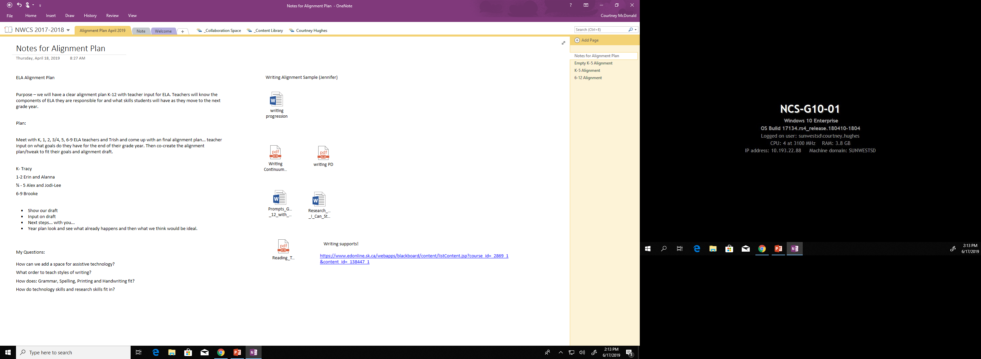
Resources
What resources did we use?
I will share these with you ☺
ELA Hub!
Sun West Tech Continuum

Slide 5
Time to investigate!
Please go to our PeBL Mentors OneNote and follow these steps…
PeBL Mentors OneNote
Collaboration
TRAID Retreat 2018
Reading Writing Alignment
You will see both a K-5 and 6-12 plan…
NWCS K-5 Alignment Plan
NWCS 6-12 Alignment Plan
As well as…
Tools/Resources
While you investigate…
Think about what aspects you might use in your own school’s alignment plan ☺.
Ask me any questions!
Provide feedback by completing my feedback form!

Slide 6
Thank you for time!
If you have any questions regarding writing alignment please email me at any time:
Courtney.mcdonald@sunwestsd.ca

