Slide 1
PeBL Mentor Reflection
Nikki Francoeur
June 19, 2019
nicole.francoeur@sunwestsd.ca
Notes:
I will discuss how our year went with the way we ran our projects/new schedule. I will share how we created cross curricular projects and incorporated the transfer of responsibility.

Slide 2
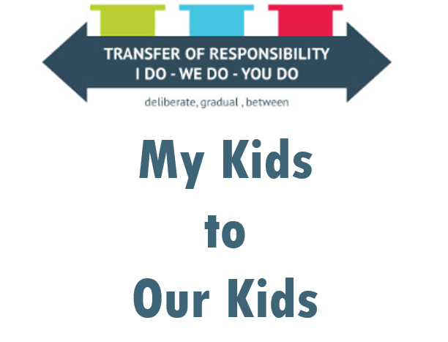
Collective Responsibility
Notes:
We agreed to meeting and making decisions together. We met at the end of the day each day for 10 minutes to discuss things and make decisions as a team.
We agreed to use choice boards in projects.
We agreed to use I do, We do, You do in our teaching.

Slide 3
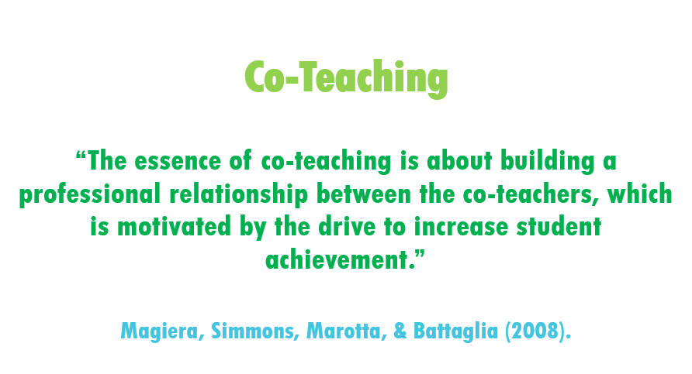
Co-Teaching
Notes:
This year, all staff were co-teaching grades 1-9.
Another teacher and I taught Math 1-9, in two different blocks (1-5 and 6-9). We also had three teachers (two half time and one full time) teaching ELA in similar blocks of time.
Co-teaching has been awesome as it allows for us to brainstorm, collaborate, and grow together. It also is a challenge as you are working with teachers that have different teaching philosophies and ways of doing things.

Slide 4
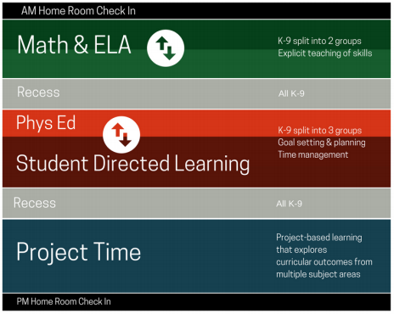
New Schedule
Highlights with our new schedule:
Project Time included cross-curricular and cross-grade projects to cover the outcomes
Self-Directed Time

Slide 5
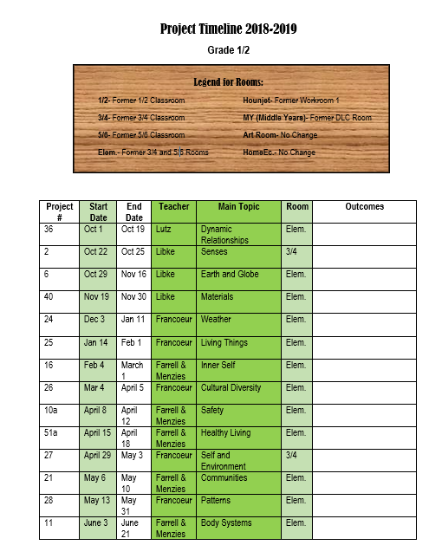
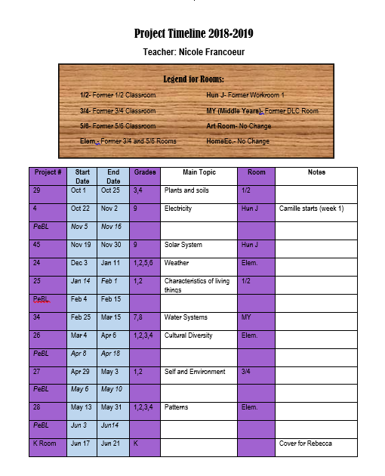
Projects
Notes:
We had made project schedules for each grade grouping and teacher to keep track of what they are learning/teaching.
Here is an example of mine (note: I am also PeBL Mentor so I have that built into my schedule) and the Grade 1/2 schedule.

Slide 6
Reflection on Project
Transfer of Responsibility
Use of Choice boards
Timelines of projects- we will be changing timelines
From different lengths to one month long
Less cross-grade
Continue cross-curricular
Engaging and authentic learning in projects
Kids favourite part of the day was projects! Parents and students often shared how engaged they were in the topics.
Notes:
In each of our projects we used the transfer of responsibility. This is something we will continue to use next year with the students. Some projects were very “I do” driven based on readiness and content, some were “we do”, and some students were on a “you do” path.
We used the ELA and ART choice boards in our projects. These can be found in the Resource bank.
Timelines on projects- we will be changing the timelines of the projects next year. This year they were all different lengths and grades together which was very hard to schedule and was very inconsistent for our students, teachers, and parents. Next year we will have cross-curricular month long projects. There will be less cross-grade groupings (hopefully going back to this in year or two as it was so beneficial for the mentorships and relationships among the students).
Projects were amazing!! For most kids, it was their most favourite part of the day.

Slide 7
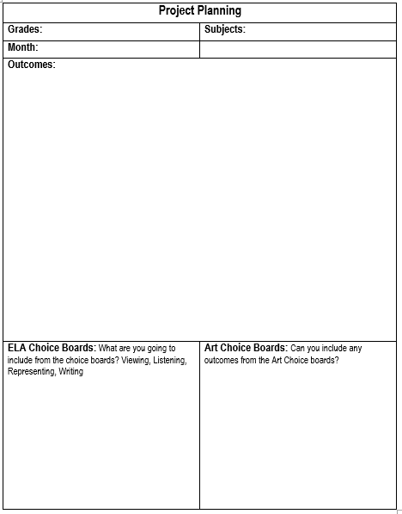
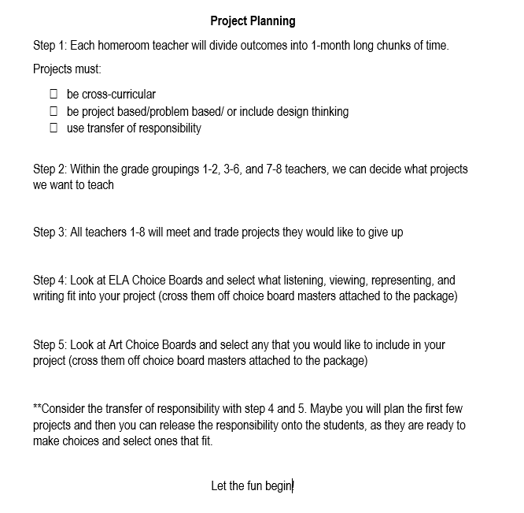
Projects
Notes:
Here is the project template and instructions that the K-8 teachers received for project planning next year. This can be found in the resource bank.

Slide 8
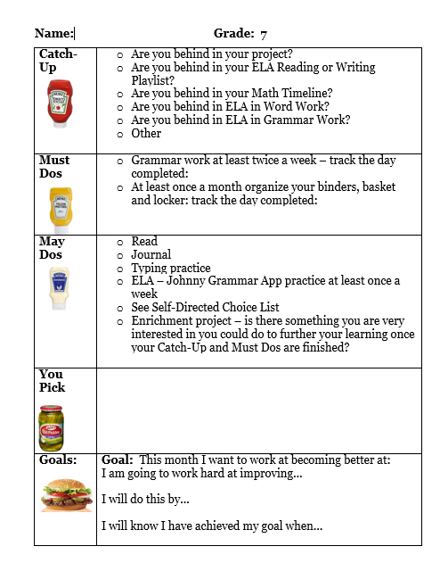
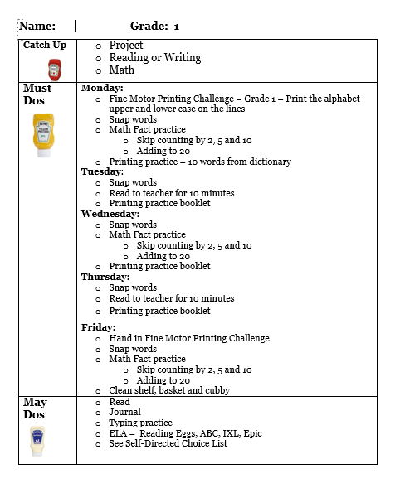
Self-Directed Time
Notes:
Self-directed Time was another great thing we had this year. Here are a couple examples showing different grades and readiness.
It was a great for students to fill in gaps, complete enrichment tasks and projects, and work on any skills they needed to improve.
We used the transfer or responsibility to determine what the must dos needed to be on each students sheet. These examples can be found in the resource bank.

Slide 9
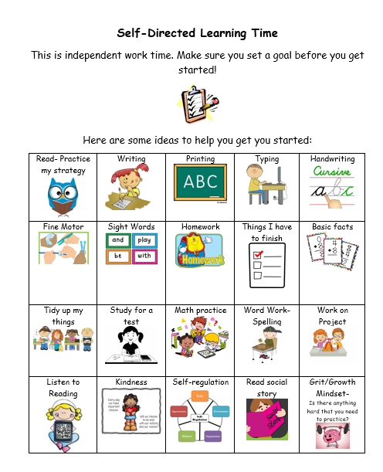
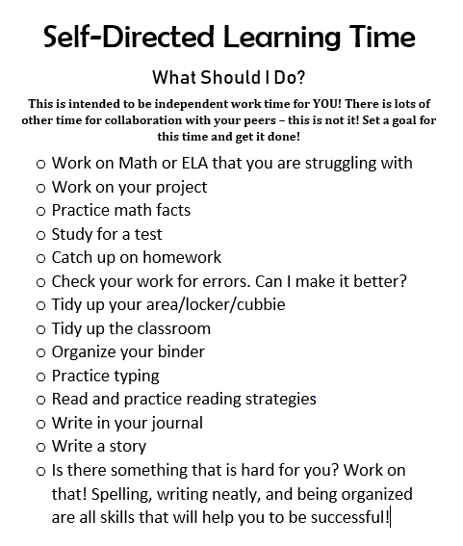
Self-Directed Time
Notes:
For the May dos we created option sheets to give choices to select from.

