Slide 1
November Project
Song Analysis
Notes:
Created by: Sandra Lutz (Kenaston School)

Slide 2
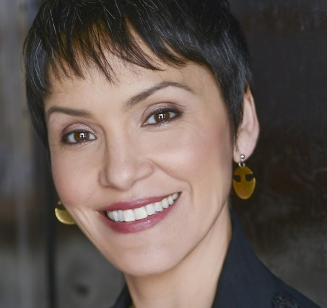
For the rest of the day, we will be looking at the some of the songs written and performed by Canadian artist Susan Aglukark.
Susan is Inuit and a popular recording artist.
She was born in Churchill, Manitoba and raised in Arviat, NWT (now in Nunavut)
Susan Aglukark
Notes:
Created by: Sandra Lutz (Kenaston School)

Slide 3
Susan is proud to be a role model for Aboriginal and Inuit youth
Susan sees herself as delivering a universal message of self-respect and strength
Susan speaks of hard things she has gone through in some of her songs- a cousin’s suicide and the sexual abuse she experienced as a child.
The majority of her music speaks of strength and the ties that we have between all of us.
Susan has won three Juno awards and received the Order of Canada in 2005 and the Governor Generals Lifetime Artistic Achievement Award in 2016
Notes:
Created by: Sandra Lutz (Kenaston School)

Slide 4
Song Analysis
While we study her songs today, we are looking for two things:
What do you think the song is about?
What part of First Nations history or experience is Susan possibly describing? Why do you think this?
I also want you to reflect:
What message do you hear? What speaks to you about this song?
Notes:
Created by: Sandra Lutz (Kenaston School)

Slide 5
Let’s Listen Together:
O Siem
Have your copy of the lyrics as you listen
Let’s analyze and see if we can guess the meaning of her song
Notes:
Created by: Sandra Lutz (Kenaston School)

Slide 6
PAUSE: You Do
If you would like to split from the group at this point, you will need to:
Outline a plan for the rest of today and tomorrow that will show how you plan to meet this criteria:
find the messages and understand the content of a written work (song, play, poetry) a First Nations artist has produced and relate it to the history of the First Nations experience in Canada
Show this plan to the teacher while the rest of the class is completing their partner activity (up next)
Notes:
Created by: Sandra Lutz (Kenaston School)

Slide 7
Let’s Listen in Partners:
I’ll pick partners with popsicle sticks
Hina Na Ho (Celebration)
Have your copy of the lyrics as you listen
Analyze with your partner and see if you can guess the meaning of Susan’s song
We will discuss your thoughts as a group after you are done.
Notes:
Created by: Sandra Lutz (Kenaston School)

Slide 8
Try it on your own (I Do)
Pick 1-3 of the songs Susan has performed and analyze them. Choose from list provided
You can write, type, or record your response.
Please hand in your responses to your teacher.
You have the rest of today and tomorrow to finish your analysis
Notes:
Created by: Sandra Lutz (Kenaston School)

Slide 9
Try it on your own (We Do)
You may complete the I Do task, or make a plan to meet the outcome in a different way:
You need to show that you can: find the messages and understand the content of a song(s) a First Nations artist has produced and relate it to the history of the First Nations experience in Canada
Please submit this plan to Mrs. Lutz for approval within 15 minutes.
Please hand in your responses to your teacher.
You have the rest of today and tomorrow to finish your analysis
Notes:
Created by: Sandra Lutz (Kenaston School)

Slide 10
Early Finishers:
If you finish early, I would like you to find a way to share the links you notice between the Jigsaw learning you did and the song analysis we are completing.
How is Susan sharing the Aboriginal experience?
What parts is she describing?
How do her songs relate to history of the First Nations experience in Canada?
This is a way for you to earn a possible 4!
Notes:
Created by: Sandra Lutz (Kenaston School)

