Slide 1
November Project
Treaty Relationship: I Do
Notes:
Created by: Sandra Lutz (Kenaston School)

Slide 2
Sask. Social Studies: Ch. 2
We will be completing a jigsaw (not a puzzle!)
You will complete work in one group, and then be split into different groups to share that work with other students from the class
You will be learning about treaties and it’s impact on Canadian identity.
Notes:
Created by: Sandra Lutz (Kenaston School)

Slide 3
Part One Instructions:
You will work with your group on the section of the textbook assigned to you.
Together, you will create a one-page summary of this section so each of you can teach some of your other classmates about this section.
The summary can include charts, diagrams, pictures, and/or words.
This one-page summary should give your classmates a good understanding of what this section was about, without them needing to read the textbook.
You each must be able to use this one-page summary to teach another group of your classmates about this section.
Notes:
Created by: Sandra Lutz (Kenaston School)

Slide 4
Your group must work together- you all need two jobs. Work together to plan the jobs needed to:
read and learn the information
create your one-page summary
You MUST have a job to help with each of these.
Once you have created your job plan and filled in the chart, you will share it with the teacher. You may then begin your learning!
Don’t forgot to use Office Lens! It works best with hard copies of a book, not the e-text.
Notes:
Created by: Sandra Lutz (Kenaston School)

Slide 5
You will have the rest of today to complete Part One.
Please email (or give your teacher) your one-page summary.
We will have copies printed for your classmates for tomorrow.
Be ready to share your one-page summary with a small group of students!
Notes:
Created by: Sandra Lutz (Kenaston School)

Slide 6
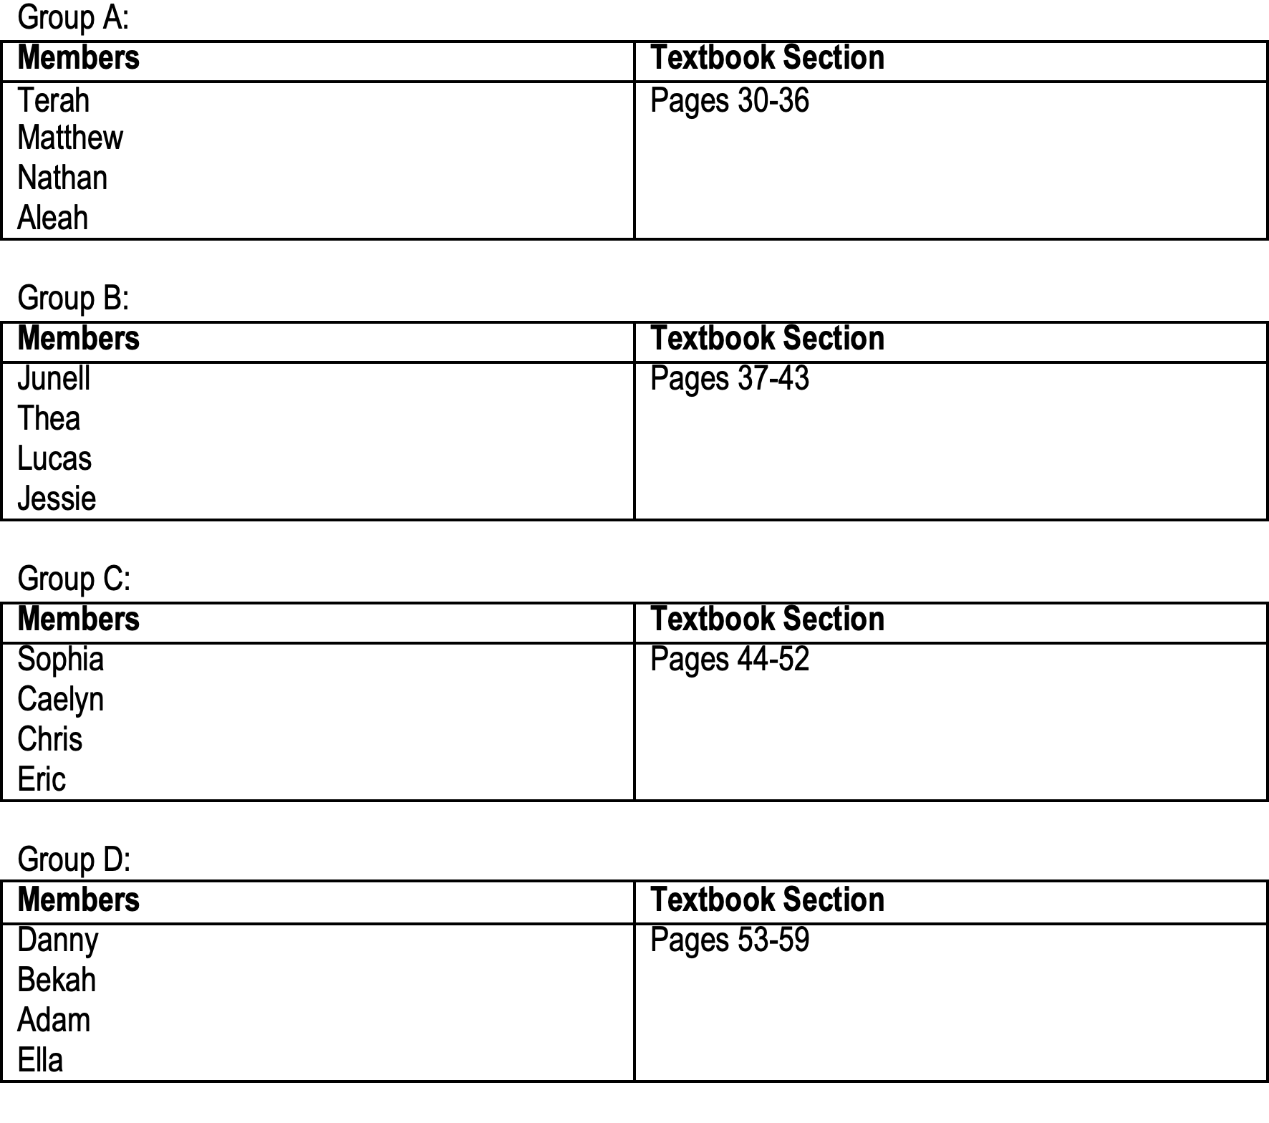
Notes:
Created by: Sandra Lutz (Kenaston School)

Slide 7
Let’s get to it!
Notes:
Created by: Sandra Lutz (Kenaston School)

Slide 8
Day 2: Part Two
You will be creating new numbered groups today to share your information (see below).
One member from each group will be joined to make a new group (every group will have an A, B, C, or D member).
You will each present your one-page summary to your group, in alphabetical order (A first, then B, followed by C and then D).
You will be given up to ten minutes to present the information your group put into the one-page summary.
Please give a copy of your one-page summary to each of your group members.
When everyone has taken their turn to teach their group members, you will each complete a 3-2-1 to be handed in to your teacher. This can be done in writing or orally.
Notes:
Created by: Sandra Lutz (Kenaston School)

Slide 9
3-2-1
This is how I will tell you learned about Canadian identity in relation to the treaty relationship. A one-sentence answer will not cut it!
You can complete this by writing, typing, or orally recording your response. This must be submitted to Mrs. Lutz.
Notes:
Created by: Sandra Lutz (Kenaston School)

Slide 10
3-2-1
3: Record 3 things you learned about treaties and the treaty relationship
2: Record 2 things you learned:
Unfilled aspects of the treaty
The land entitlement process
1: Describe 1 thing you think everyone in Canada should know or do based on what you learned from this chapter (this is your chance for a level 4):
Notes:
Created by: Sandra Lutz (Kenaston School)

Slide 11
Part Two Jigsaw and 3-2-1
You have until recess to complete this.
Notes:
Created by: Sandra Lutz (Kenaston School)

