Slide 1
Final Presentation
Grade 7
Notes:
Created by: Sandra Lutz (Kenaston School)

Slide 2
Item One: Timeline
Your display must include a timeline
What do you know about timelines?
Must include key dates
Must be in chronological order
It’s the sequence of events
Usually has a long bar- vertical or horizontal
Key dates and events are joined to this bar, in order, by lines or dots
Notes:
Created by: Sandra Lutz (Kenaston School)

Slide 3
Example Timelines
Notes:
Created by: Sandra Lutz (Kenaston School)

Slide 4
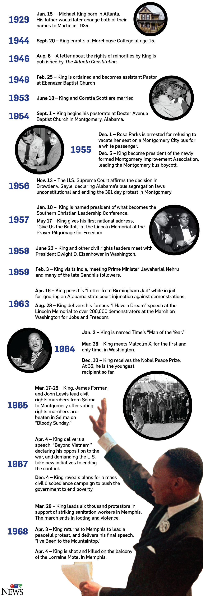
Examples continued
Notes:
Created by: Sandra Lutz (Kenaston School)

Slide 5
Let’s Practice
Create a quick timeline, as a class, of the birthdays of all Grade 7 students
Notes:
Created by: Sandra Lutz (Kenaston School)

Slide 6
Item Two: Maps
You must include a map, that you have created, in your display. It needs to connect to the event you studied.
What are the key elements of a map?
Legend
Title
Direction (compass)
Scale (if known)
labels
Notes:
Created by: Sandra Lutz (Kenaston School)

Slide 7
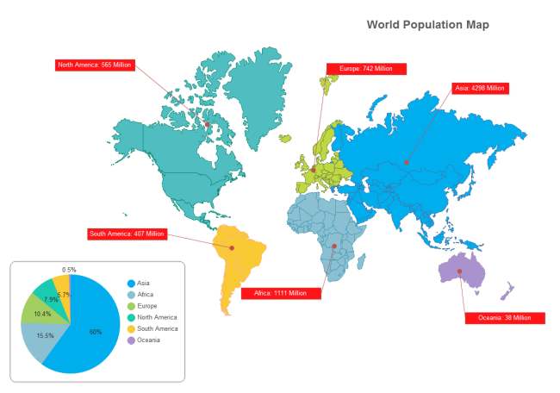
Example Maps
Each of these maps are missing one or more key elements. What are they?
Notes:
Created by: Sandra Lutz (Kenaston School)

Slide 8
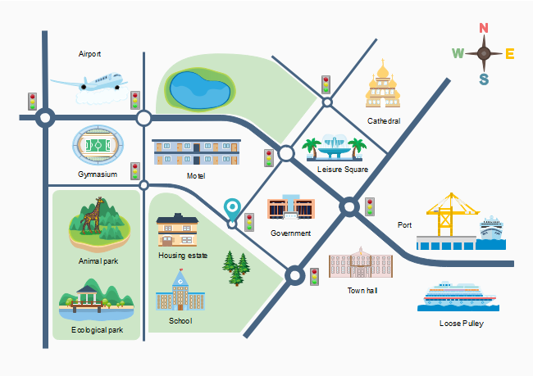
Example Maps
Each of these maps are missing one or more key elements. What are they?
Notes:
Created by: Sandra Lutz (Kenaston School)

Slide 9
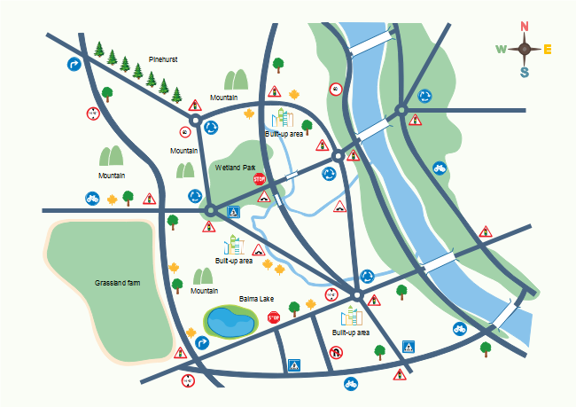
Example Maps
Each of these maps are missing one or more key elements. What are they?
Notes:
Created by: Sandra Lutz (Kenaston School)

Slide 10
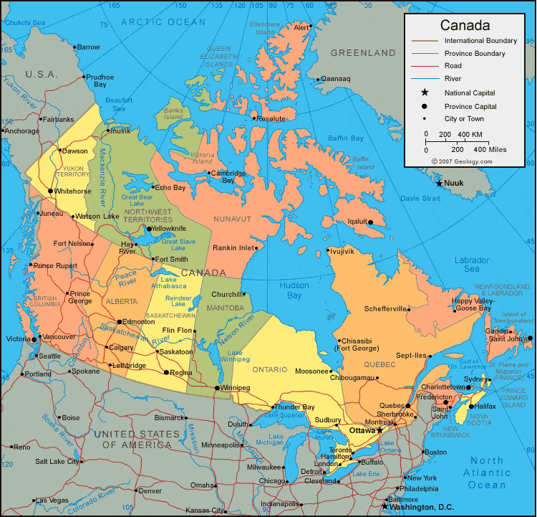
Example Maps
Each of these maps are missing one or more key elements. What are they?
Notes:
Created by: Sandra Lutz (Kenaston School)

Slide 11
Item Three: Display
Your display is more then just a poster.
It includes more then one element- not just pictures, but a variety of items. Your display might include:
Pictures
Photographs
Videos
Maps
Timelines
Artifacts
Activities for those looking at your display to do (a puzzle of a picture, for example)
A model
Costumes
Diagrams
Charts
Text
Titles and subheadings
Etc.!
Notes:
Created by: Sandra Lutz (Kenaston School)

Slide 12
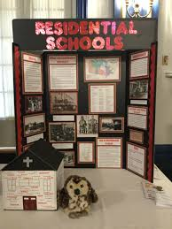
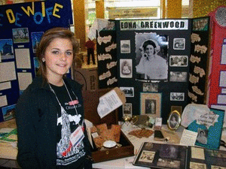
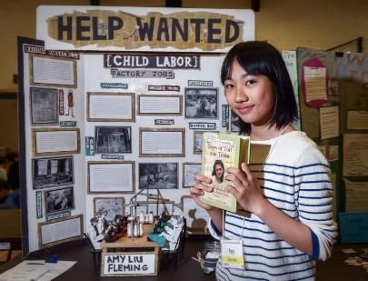
Example Displays
Notes:
Created by: Sandra Lutz (Kenaston School)

Slide 13
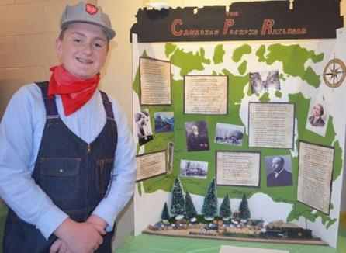
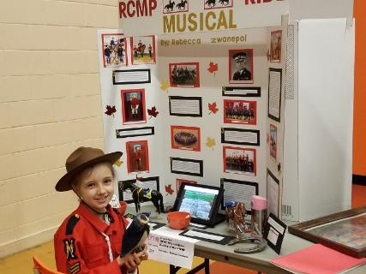
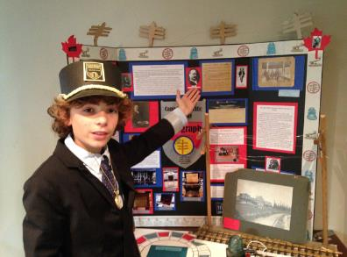
Example Displays
Notes:
Created by: Sandra Lutz (Kenaston School)

Slide 14
Citations
You must include a Works Cited on the back of your display
You must use in-text citations
Notes:
Created by: Sandra Lutz (Kenaston School)

Slide 15
Final Presentation
On November 25th, we will be setting up your displays for everyone to look at and learn from.
You will fill out this form with things you learn.
Notes:
Created by: Sandra Lutz (Kenaston School)

