Slide 1
Final Presentation
Grade 8
Notes:
Created by: Sandra Lutz (Kenaston School)

Slide 2
Item One: Graphics
What are graphics?
Visual images or designs
Any type of image
Photographs, diagrams, symbols, maps, drawings, etc.
Notes:
Created by: Sandra Lutz (Kenaston School)

Slide 3
Item Two: Statistics
What are statistics?
Collecting, organizing, displaying, analyzing data
Describe, compare, and relate things
Usually using numbers to compare and analyze data/things
Notes:
Created by: Sandra Lutz (Kenaston School)

Slide 4
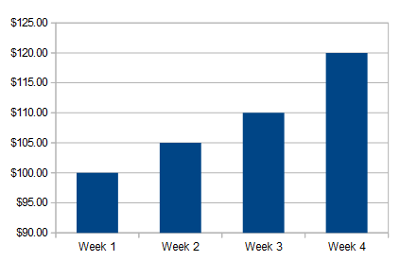
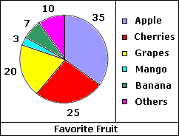
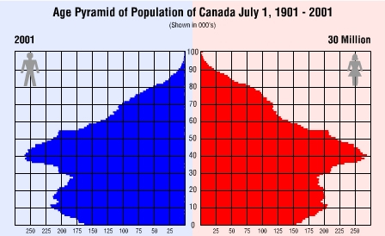
Statistic Examples
Notes:
Created by: Sandra Lutz (Kenaston School)

Slide 5
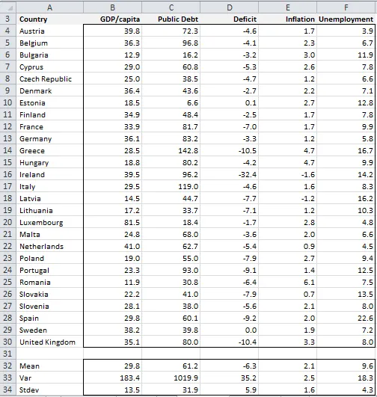
Statistic Examples
Notes:
Created by: Sandra Lutz (Kenaston School)

Slide 6
Item Three: Multimedia Presentation
What is a multimedia presentation?
Look at multimedia in two parts:
MULTI- more than one
MEDIA- form of media
It’s using a combination of text, sounds, graphics, videos, animations, etc. to present information
The information is presented through an electronic format
Notes:
Created by: Sandra Lutz (Kenaston School)

Slide 7
Beyond PowerPoint
While PowerPoint is great, you can branch out!
Try:
Prezi
iMovie
Others- What do you know of?
You will not be penalized for using PowerPoint; however, it won’t earn you a 4 in the area of creating a multimedia presentation unless you do some stellar work in this format!
Notes:
Created by: Sandra Lutz (Kenaston School)

Slide 8
Citations
You must include a Works Cited on the back of your display
You must use in-text citations
Notes:
Created by: Sandra Lutz (Kenaston School)

Slide 9
Final Presentation
On November 25th, we will be setting up your multimedia presentations for classmates to watch and learn from.
You will fill out this form with things you learn.
Notes:
Created by: Sandra Lutz (Kenaston School)

