Slide 1
ELA and Arts Ed. Choice Boards for Cross-Curricular Project Based Learning
Nicole Francoeur and Sandra Lutz

Slide 2
Why Choice Boards?
New schedule
Great way to add ELA and Arts Ed. into projects while allowing for choice

Slide 3
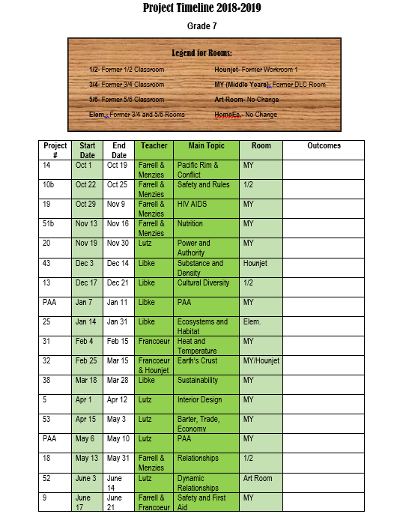

Slide 4
ELA Outcome Placement Chart

Slide 5
ELA Outcome Placement Chart

Slide 6
ELA Outcome Placement Chart

Slide 7
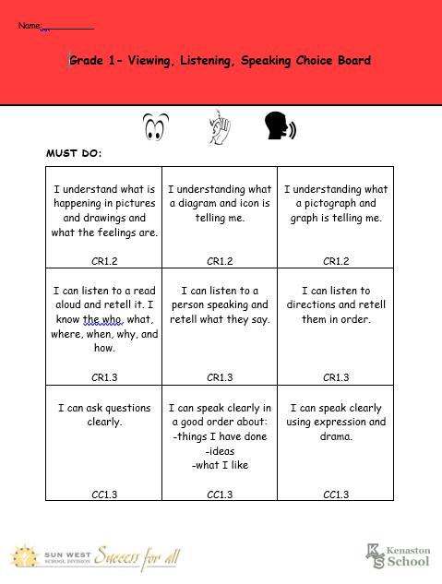
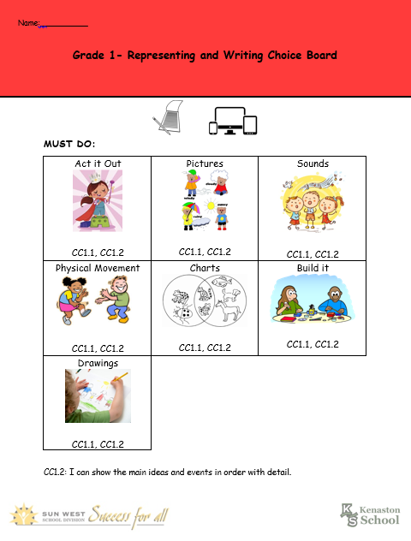
Grade 1 ELA Choice Boards

Slide 8
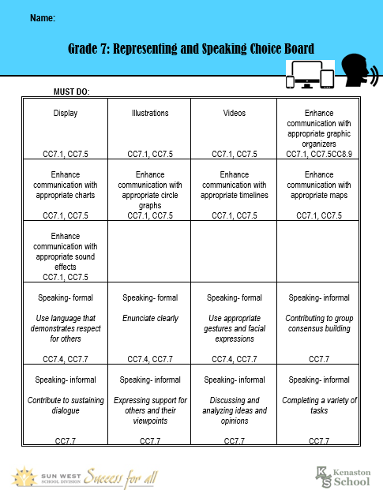
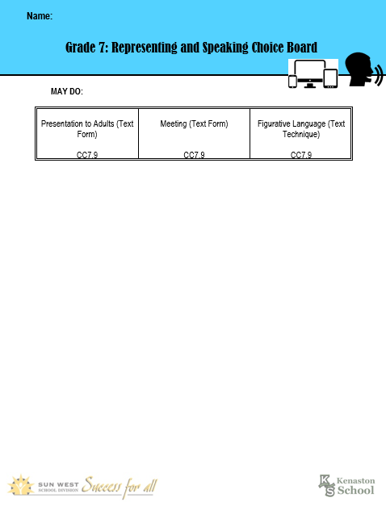
Grade 7 ELA Choice Boards

Slide 9
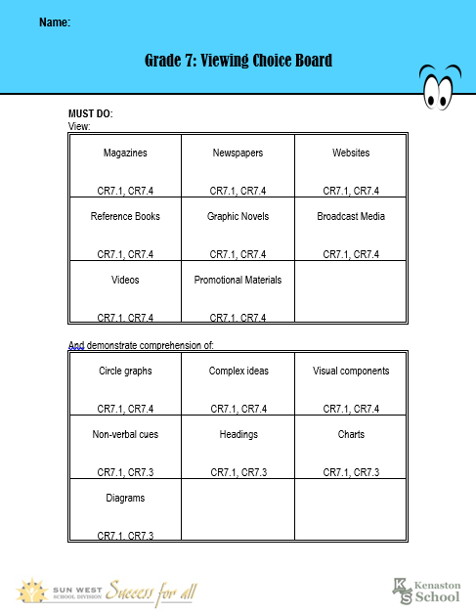
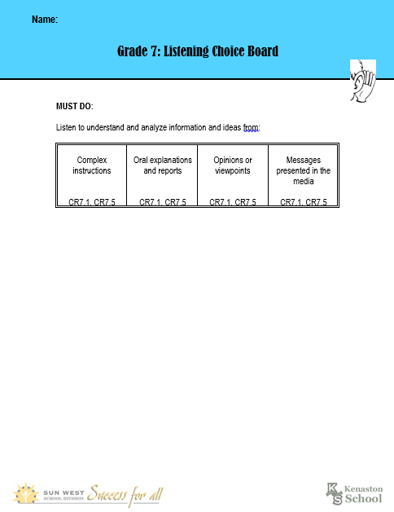
Grade 7 ELA Choice Boards

Slide 10
Grade 1 Arts Ed. Choice Boards

Slide 11
Grade 7 Arts Ed. Choice Boards

Slide 12
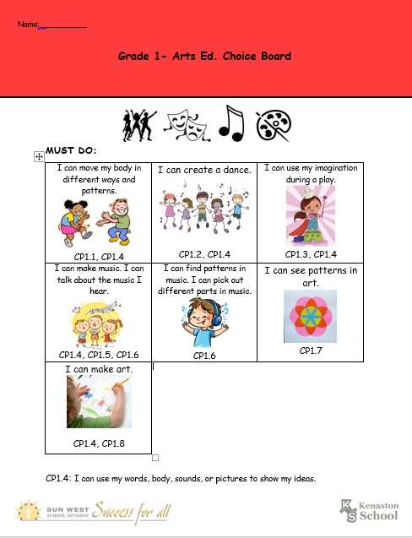
Grade 1 Student Example
Project on Senses:
SE1.1 - I can find out about human and animal 5 senses.
SE1.2 - I can search and find out how humans and animals use their 5 sense.

Slide 13
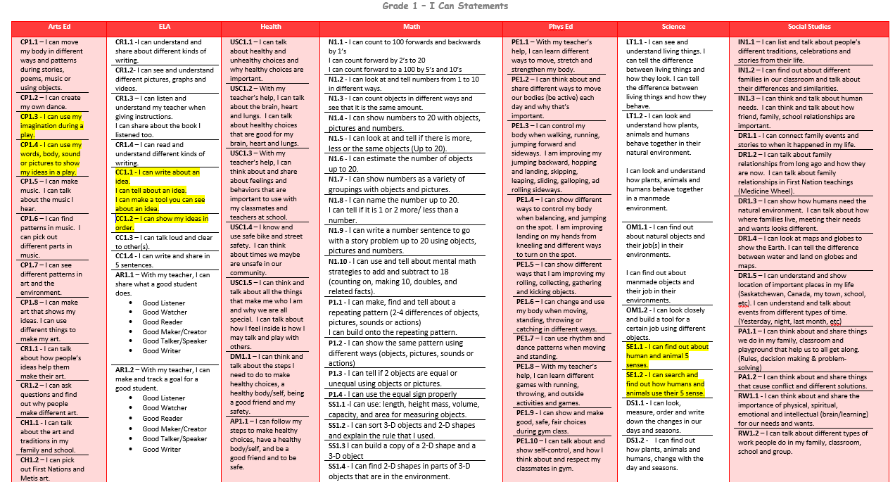

Slide 14
Grade 7 Student Example
Project on Ecosystems
and Habitats:
IE7.1 - I can understand and connect areas of Indigenous knowledge and how they view ecosystems.
IE7.2 - I can observe, illustrate and dig deeper and understand how food webs, populations and community interact within a local ecosystem.
IE7.3- - I can understand and see the importance of the flow of biogeochemical cycle (water, carbon, and nitrogen) and energy through ecosystems.
IE7.4 – I can dig deeper and understand how humans and natures can change ecosystems. I can make plan on how to reduce human impact on ecosystems.

Slide 15
