Slide 1
Mathematics at Sun West
The BIG Picture
Notes:
Kelli housekeeping and welcome and talk communication

Slide 2
We acknowledge that it sits upon Treaty Six Territory and the School Division is the beneficiary of this peace and friendship treaty.
Treaty Six encompasses the traditional territories of the Cree, Dene, Nakota, Saulteaux and Ojibwe and the homeland of the Métis Nation. We are dedicated to ensuring that the spirit of Reconciliation and Treaty Six is honoured and respected. This acknowledgement also reaffirms our relationship with one another.

Slide 3
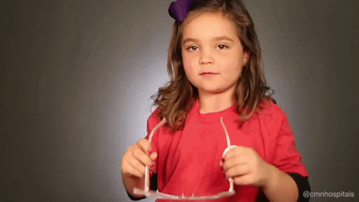
Goal: A New Lens
Overlay what you learn today onto what you currently do.
Use this to fill in gaps and improve existing programming.
Notes:
Kelli 5

Slide 4
Our Learning Journey...
The Structure of a Successful Math Class
Outcome Based Math Essentials
Surface, Deep & Transfer Learning
Measuring our Impact (John Hattie)
Metacognition
More on Number Talks
Assessment
(The struggling student & closing gaps infused throughout)
Notes:
Kelli 2 mins

Slide 5
Look For These Icons…
Item being discussed is on your Checklist .
There is a handout in your package to accompany this.

Slide 6
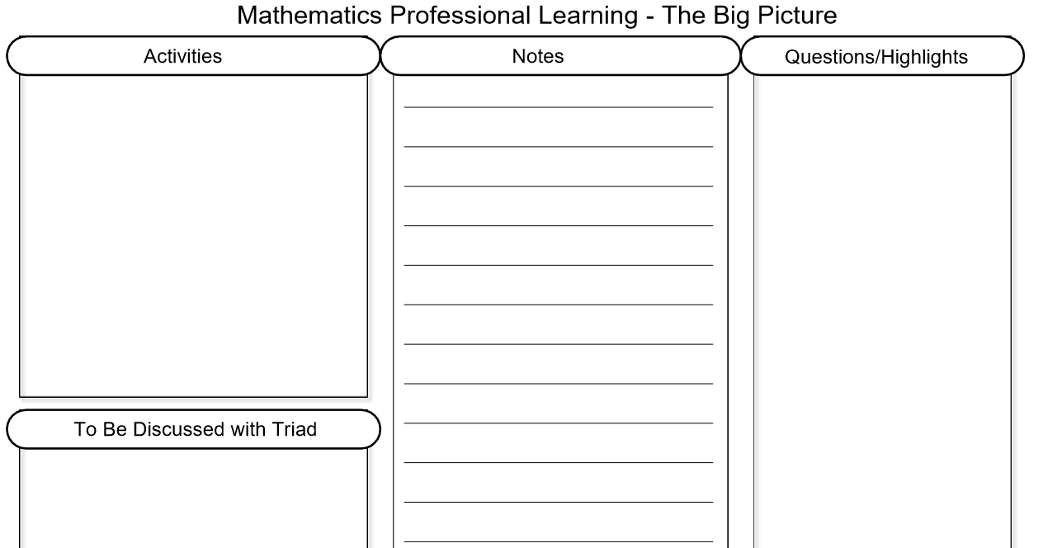
Note Taking Template & Today’s Handouts
Notes:
Kelli 2 mins

Slide 7
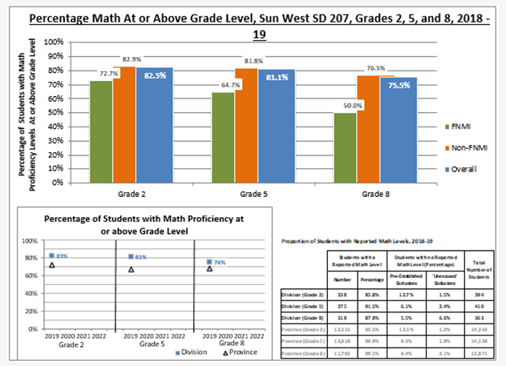
Sun West’s Success in Mathematics to Date
ESSP Math Outcome: By June 30, 2020, 80% of students will be at or above Grade level in reading, writing, and math.
Notes:
Vanessa(Vanessa will find and print out school specific Math result charts to lead into the table talk on the next slide – JAN 24 PM – DONE!)
Last year when we presented, the Math results were “coming soon”. We have since participated in the Provincial Math Assessment and have some initial data to share with you. The Mathematics Number strand is a key measure identified in the ESSP Reading, Writing and Math at Grade Level Outcome. The goal is for at least 80% of Grade 2, 5, and 8 students to be at or above grade level as determined by provincial rubrics by June 2020. Students with an understanding of the number strand outcomes become flexible and confident with numbers and can transfer abilities to more abstract problems. In general, Sun West students exceeded the math benchmarks as compared to grade level cohorts across the province. Grade 2's – 82.5%, Grade 5's at 81.1% and Grade 8's at 75.5%. Our division continues to look into trends and supports for math data in order to support individual student achievement in our classrooms. This school year, there is a focus on Math Professional Learning (starting in December) in the areas of outcome based math, number talks and math alignment planning. First year of data but are excited to see that Grade 2's and Grade 5's have already achieved the provincial goal – hopefully trend continues this school year.

Slide 8
Table Talk
Why do you think we have these results overall?
Look at your specific school results. Do they match?
Notes:
Vanessa 7 minutes

Slide 9
Before We or YOU Begin...
Notes:
Kelli connect back Readiness assessments 1 minute

Slide 10
Teaching Math Using the Big Ideas
helps students gain a deeper understanding of math concepts
helps students build connections that allow them to use math more effectively in their daily lives
helps the student build a resource bank and a growth mindset
helps the teacher to be more aware of the strategies each individual student uses and then allows the teacher to guide the student to deeper understanding
Notes:
Marion

Slide 11
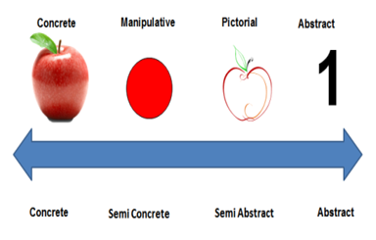
Know Your Students
What are the student’s strengths and needs?
What level of “deeper understanding” are they able to achieve?
Based on their cognitive/language abilities, what will they actually use in their daily lives?
Where are they, and what level can they reach, in the continuum from concrete to abstract?
So… what supports will they always need?
Notes:
Marion 5

Slide 12
The Importance of Knowing your Students CODE cc573b49
Explain the importance of why we must know our students, and have our students know themselves to your staff before we can teach effectively. How would you appeal to staff to ensure they take the time needed to do this?
or
What information do you need to know about students in order to teach them best? Why is this so important?
Notes:
Melissa
Introduce Work time in afternoon
Jot your thoughts for X min – answer in the PM
Consider your collective agreements in you building about integration of learner profiles.

Slide 13
Website or App
Use Sun West credentials
Flipgrid.com
CODE cc573b49
Respond with school mate!
Notes:
Show site and how to respond!
Melissa 10

Slide 14
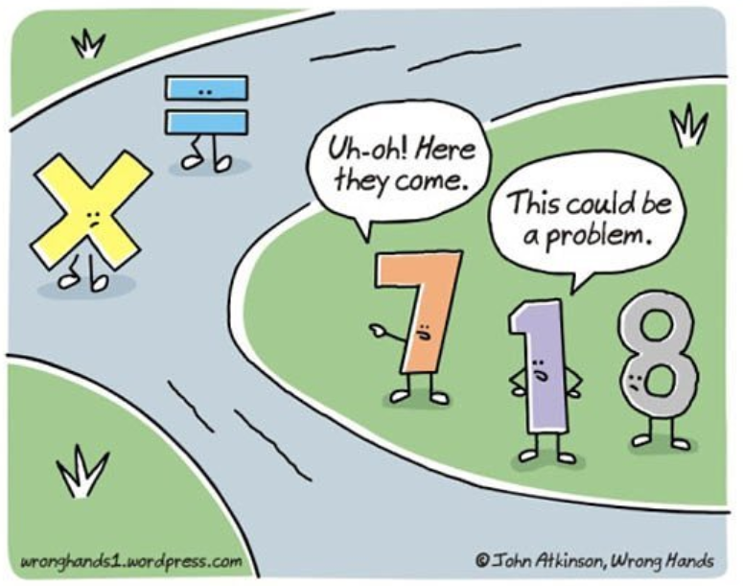

Slide 15
Mapping the Math Brain
Common Myths:
Math abilities are a by-product of intelligence
Math is a right hemispheric task
Language is in the Left Hemisphere
Math is in the Right Hemisphere
Boys outperform girls in math
Math is independent of language
Skills needed for math:
Working memory skills
Executive functioning skills
Language and verbal retrieval skills
Visual-spatial skills
Notes:
Anne

Slide 16
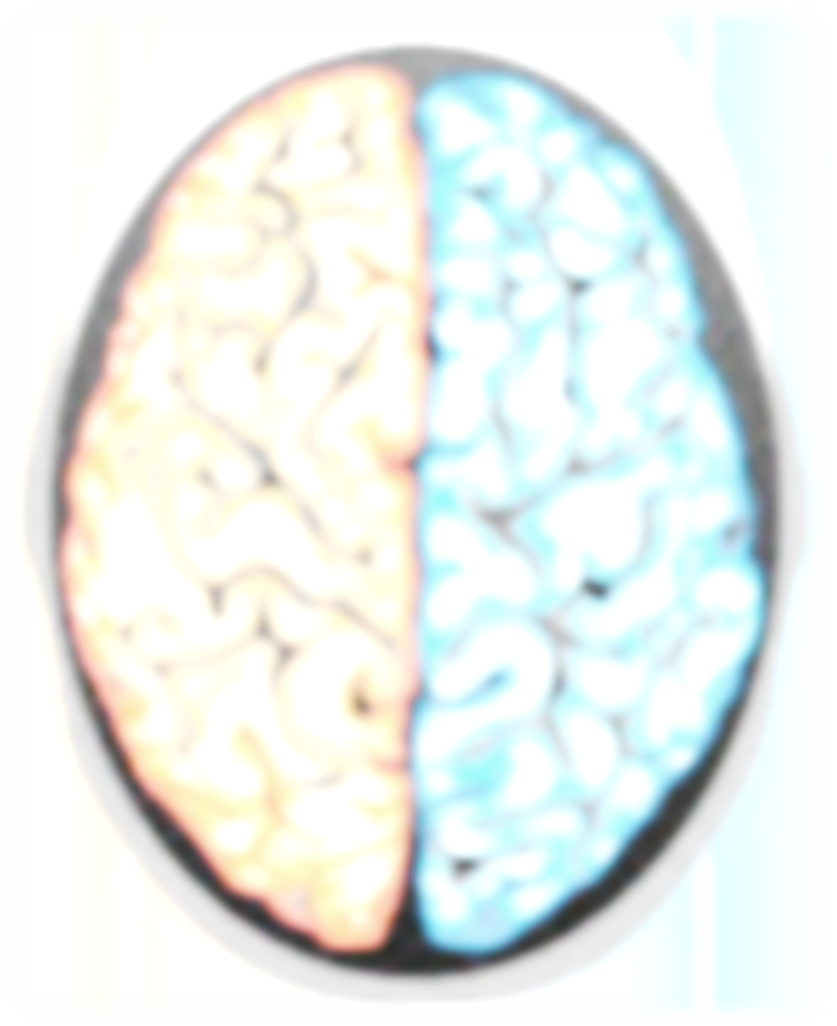
*Triple Code Model (processing networks): formatting numbers in the brain
1 & 2
(Working Memory & Executive Functioning)
Verbal Code
Left hemisphere
Automatic retrieval of over learned facts
automatic over learned rote verbalizations
Addition & Multiplication Facts
Magnitude Code
Right hemisphere
Quantitative number comparisons
Inferior parietal region in tertiary zones of both hemispheres
3 (Phonological Loop)
Procedural/Visual-Verbal Code
Left & right occipital-temporal regions
Visual Sketch Pad
Numbers represent fixed symbols
4 underlying concepts in order to learn:
Classification
Ordering
1-1 correspondence
Conservation (volume quantities constant despite spatial differences)
Regrouping Skills & Long Division
*See Handout for
Math-learning examples
4 (Visual Sketchpad)
Notes:
Anne
1) Verbal Code - numbers are encoded as sequences of words (twenty-four instead of 24). - Dehaene & Cohen, 1997
Left perisylvan region of temporal lobes.
No need to understand quantitative concept.
Main strategy used by younger children learning basic math facts (two plus two equals four)
Critical for memorization of over-learned facts, such as multiplication facts (nine times nine equals eighty-one).
(2) Magnitude Code - numbers are encoded as analog quantities. Allows for value judgements, such as “9” is bigger than “4”. (Chocon, et al, 1999)
Bi-lateral inferior parietal lobes.
Allows for semantic understanding of math concepts and procedures.
Allows for the evaluation of the plausibility of a response.
(9 X 4 = 94)
Allows for the transcoding of more challenging tasks into palatable forms of operations.
(15 percent of 80 becomes 10 percent of 80 plus half the value)
(3) Procedural Code - numbers are encoded as fixed symbols representing a quantity of some sort, and sequenced in a particular order. ( 24 instead of twenty-four). - Von Aster, 2000
Bi-lateral occipital-temporal lobes.
Critical for number identification skills.
Circuitry involves the syntactical arrangement of numerals. Our internal number line.
Critical in the execution of mathematical procedures for equations not committed to rote memory (e.g. subtraction with regrouping).

Slide 17
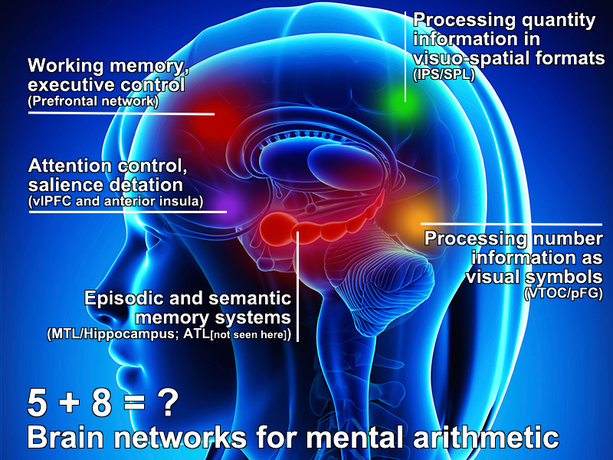
1 & 2 (Working Memory & Executive Functioning)
4 (Visual Sketchpad)
3 (Phonological Loop)
Notes:
Anne

Slide 18
Doing Simple Math Fast is a Major Brain Stimulant
Activate!
Notes:
Anne 6

Slide 19
Notes:
Melissa 5:12 – We are going to ask you how to squash math anxiety. Consider this as you watch.
6 minutes

Slide 20
Math Anxiety – Let's Talk About It...
How can we set our classrooms to squash math anxiety?
Consider things like:
Negative self-talk
Teacher or parent attitudes
Culture – mistakes, learner profiles
Timed tasks
Support
Brain breaks, games
Growth Mindset
Notes:
Melissa

Slide 21
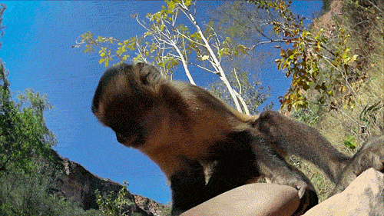
Your Turn!
Create a Top 10 List of ways to squash Math Anxiety!
Notes:
Vanessa
5
+
5 minute break
5 to share
Each table shares one idea
10 am should be done this section

Slide 22
The Structure of a Successful Math Class
The Big 5 of Math Instruction
Notes:
Kelli

Slide 23
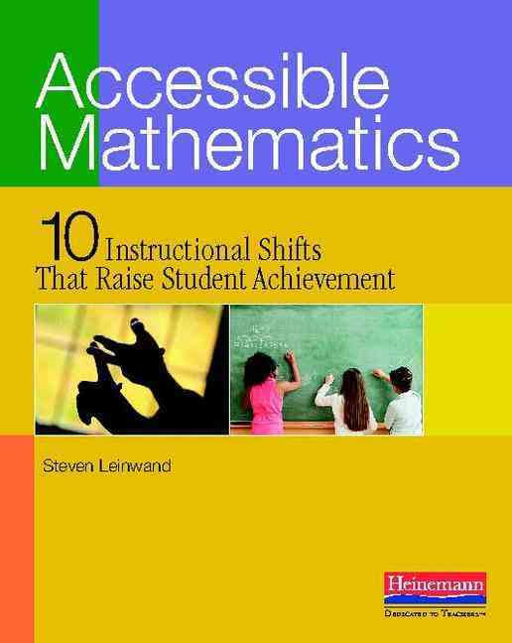
Professional
Learning
Resource
https://tinyurl.com/MathPDBook
Notes:
Melissa 2

Slide 24
Instruction Matters!
Each class should include these elements:
Notes:
Kelli

Slide 25
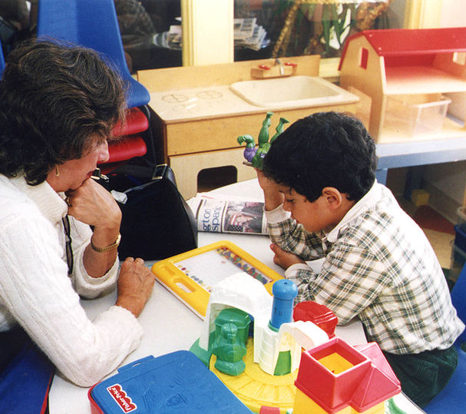
Instruction Matters!
Each class should include these elements:
Mixed review practice – cumulative
Mental Math or Number Talk
New Concept introduction or reinforcement
Outcome based math work time
Reflection and Assessment/exit to plan for instruction
Notes:
Kelli 1
#¾ can math rotations

Slide 26
The Big 5 for a Math Class
Warm up
Mixed Practice
Cumulative Review
Mental Math
Games
Number Talks
New Concept
New
Reinforcement
WHY
Outcome Based Math
Student Centred
Outcome focused
Reflection & Assessment
Exit slips for concepts or skill
Inform instruction
Encourage Metacognition
Opportunities for surface, deep and transfer learning
Notes:
Big 5 poster
M 2
New concept/outcome based – can be part of rotations
Whole class or small group.

Slide 27
Thinking Time!
What could a schedule for the Big 5 look like in a classroom?
With your school partner, break down the five sections of a class with estimated times for each section based on your school's schedule. Keep this. We'll revisit this later and share them.
Notes:
M 5

Slide 28
Example Schedule (FLEXIBLE)
Mixed review practice – cumulative (5-10 min)
Mental Math or Number Talk (5 min mental math; 15 min; number talks - 3 days per week)
New Concept introduction or reinforcement (25-45 min 3 & 4 – new concept and work time)
Outcome based math work time
Reflection and Assessment/exit to plan for instruction (5 min)
Notes:
M 12 for entire section
Put this up as they discuss schedule

Slide 29
Cumulative Review
Big Idea #1
Notes:
Kelli

Slide 30
Mixed Practice – Cumulative Review for EVERYONE
Starts the class with work and sets the routine and tone for all math classes
Consider having students do this as they enter
Builds mastery
Refreshes older concepts and primes for new learning
Ensures foundational concepts are not forgotten
Notes:
M

Slide 31
Mixed Practice – Cumulative Review for EVERYONE
Builds mental math skills
Builds confidence
Provides information on who may still need to grasp a concept (reteaching, small group lessons)
Do it – then mark it together (or use something like Nearpod or Kahoot to see results)
Opportunity for a real world connection
Notes:
M

Slide 32
Grade 6 Example
Possible Routine:
Students enter and get their warm-up notebooks
Students work independently on the questions as everyone arrives
Students finish the questions
Correct the questions together or another form of correction
Clarify misconceptions
Get formative data (from tests or thumbs up etc.) for re-teaching
6 x 7
What number is 1000 less than 18,734?
About how much is 29 cents and 32 cents?
What is one tenth of 450?
Draw a picture of one and two thirds.
Estimate the weight of the ______(something in the room) in Kg.
Notes:
M Struggling kids – first three questions easy and they do those.

Slide 33
Grade 2 Example
Possible Routine:
Students enter and get their warm up wipe boards
Students work independently on the questions as everyone arrives
Students finish the questions
Correct the questions together or another form of correction
Clarify misconceptions
Get formative data (from tests or thumbs up etc.) for re-teaching
What is the difference of 9 and 5?
What number is the same as 5 tens and 7 ones?
What number is 10 less than 83?
Draw a 4-sided figure and all of its diagonals.
About how long is my pencil in cm?
Notes:
M

Slide 34
Keep in Mind...
These questions can be made up on the fly
You can have students make questions for the warm-up based on their current outcomes
Use foundational concepts for this! You want to build mastery and make sure they don't have the luxury of forgetting concepts as they move to new ones.
Notes:
M

Slide 35
Keep in Mind...
This doesn't need to take up a lot of time.
Should be based ON THE KIDS, needs & outcomes!
This will serve to deepen understanding.
Notes:
M

Slide 36
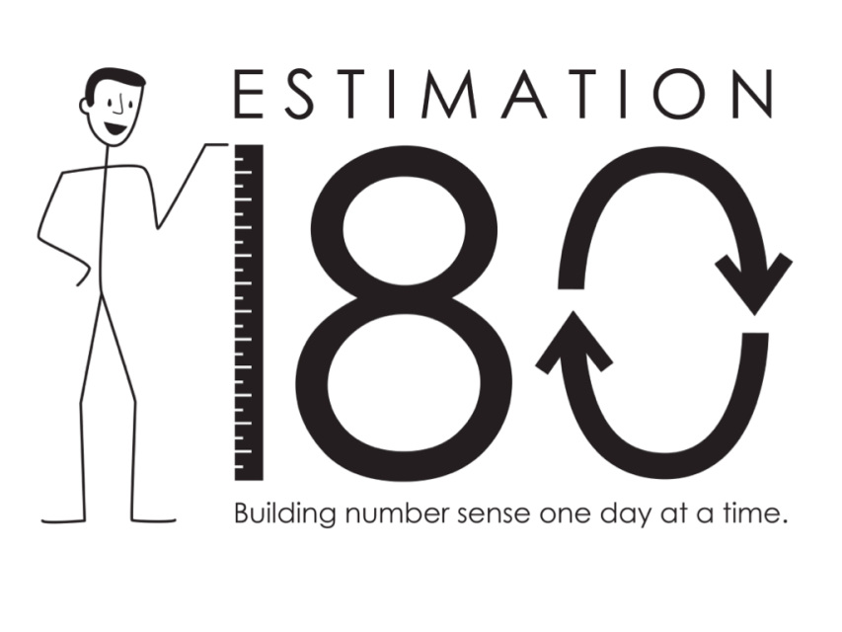
Estimation & Measurement
Try to include these daily
This will help develop number sense
Ask ALL the questions!
How much?
How big?
How far?
How many?
How do you know?
Why?
Notes:
M 10

Slide 37
Open-Ended Questions
Features of open- ended questions:
There is no fixed answer (many possible answers)
Solved in different ways and on different levels (accessible to mixed abilities)
Empower students to make their own mathematical decisions and make room for own mathematical thinking
Develop reasoning and communication skills
Marian Small website: http://www.onetwoinfinity.ca/
Notes:
Carole

Slide 38
Parallel Tasks
Parallel Tasks are sets of tasks with the same mathematical foundation but allow for different developmental levels.
Consider student readiness to engage in the concept.
Think of similar contexts but create the task with a different developmental readiness expectation.
The tasks are similar enough to have the same follow up conversations.
Choice 1: Create a word problem that could be solved by multiplying two one-digit numbers.
Choice 2: Create a word problem that could be solved by multiplying two numbers between 10 and 100.
Notes:
Carole 5

Slide 39
Your Turn! Create a cumulative review to start a class for a specific grade of your choosing with your school partner.
Share your review with another set of partners at your table and explain why you selected these questions.
About 5 questions
Foundational items
Estimation & Measurement
Load today's learning
Many entry points (Open ended)
Notes:
Carole & Melissa 10
Chart Paper & Markers - Group leaders self identify, once in a group focus in on a grade. Sharing – pick one item and share why you included
Mike & Ashley to create video with examples. Ensure there are high school examples.

Slide 40
What Are You Thinking?
Mixed Cumulative Review.
How might your school use this to further mathematical understanding?
Notes:
Melissa 1
Introduce this as an afternoon activity

Slide 41
Mental Math & Number Talks
Big Idea #2
Notes:
Kelli

Slide 42
Mental Math for Everyone!
Mental Math
Explicitly teach strategies
Builds speed and fluency
Builds community and risk taking
Improves accuracy
Frees up thinking space
Make it fun – Games!
Builds foundations
Number Talks
Build fluency
Build community and risk taking
Praises understanding > memorization
Common sense = number sense
Improves accuracy
Fun!
Builds foundational skills
Teaches flexibility in thinking
Explains a variety of strategies
Notes:
M

Slide 43
Mental Math Intervention
Mental Math requires:
Knowledge of facts
Mental calculation
Flexible reasoning
Working Memory
Notes:
Tammy
Knowledge of facts with conceptual understanding as well as rapid recall/automaticity – NOT memorized facts
Working memory – can do many automatic tasks at one time but only ONE non-automatic task
Symptoms of weak conceptual understanding:
- Student ‘has it one day, gone the next’
- student limited to strategy that is not efficient and may not be consistently accurate
- student ‘going through the motions’ but not making connections to other mathematical concepts
- behavioural symptoms

Slide 44
Mental Math Intervention – Formative Assessment
Identify skills and concepts where student demonstrates levels of mastery and proficiency:
- Conceptual understanding
- Fluency
- Efficient strategies
- Flexibility
….and then begin intervention at the next skill or step in the skill progression.
Notes:
Tammy

Slide 45
Mental Math Intervention
Instruction must be explicit and systematic
Multi-sensory
Knowledge
Application/ Automaticity
Concrete
Pictorial/Representational
Symbolic
Developing fluency
Explicit and systematic instruction
During effective intervention, students talk about their understanding and reasoning, perform skills, do “think alouds”, and receive immediate feedback. Manipulatives and models play a key role in helping students understand concepts.
Notes:
Tammy

Slide 46
Basic Fact Mastery
Mastery of a basic fact means that a student can give a quick response (in about 3 seconds) without resorting to inefficient means.
Memorization, or ‘passive storage’ of facts does not promote conceptual understanding or application to related concepts.
Notes:
Tammy

Slide 47
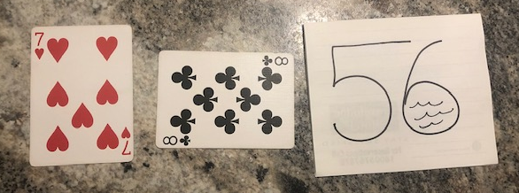
Basic Fact Mastery
It is by far more effective for students to be able to rapidly recall a fact because of repeated experiences with reasoning strategies.
Drill (repetitive non-problem-based activity) is appropriate only once students are effectively using reasoning strategies that demonstrate consistent and accurate conceptual knowledge but have not yet achieved automaticity (retrieval within 3 seconds).
Some students may occasionally require a ‘hook’, but should not rely on this strategy for large quantities of facts.
Notes:
Tammy 7

Slide 48
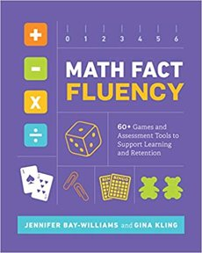
Professional
Learning
Resource
https://tinyurl.com/MathPDFluency
+
Resource Bank sites
Notes:
M

Slide 49
Fluency – Accurate, Efficient & Flexible
Counting
Objects
Mentally
Deriving
Reasoning based on known facts
Mastery
Efficiently produces answer
Notes:
M

Slide 50
Strategies Play List (You can watch during work time!)
Videos to support each of the strategies listed, so don’t worry if you don’t know what they mean!
This is in your handouts!
This is in the Resource Bank PD so you can click the links instead of typing them in.
Notes:
Show in RB PD

Slide 51
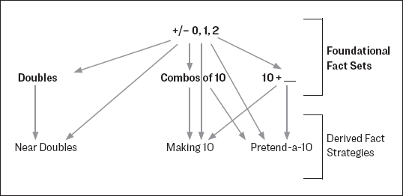
Foundational Facts must Precede Derived Facts (E.g., doubles before near doubles)
Addition
First teach 0, 1, 2 (foundational basics starting point)
Next doubles, combos of 10 and 10 + ___ (foundational set based on first basic facts )
Then near doubles, making 20, pretend a 10 (reasoning strategies based on the first two sets)
Move to “trickier” facts
The remaining facts can be derived from the foundational ones using strategies and reasoning.
You need something to work with!
Notes:
M
Addition – one more/less facts – connect to counting and number lines etc

Slide 52
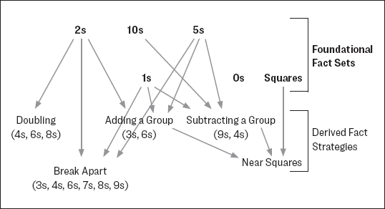
Foundational Facts must Precede Derived Facts (E.g., doubles before near doubles)
Multiplication
First teach 2, 10, 5 (foundational basics starting point)
Next 1s, 0s, squares (foundational set based on first basic facts )
Then doubling, adding a group, subtracting a group (reasoning strategies based on the first two sets)
Then break apart and near squares (reasoning strategies based on the first two sets)
The remaining facts can be derived from the foundational ones using strategies and reasoning.
You need something to work with!
Notes:
M
Addition – one more/less facts – connect to counting and number lines etc

Slide 53
Foundational Facts must Precede Derived Facts (E.g., doubles before near doubles)
Multiplication
First teach 2, 10, 5
Next 1s, 0s, squares
Then 4, 6, 8 (doubling)
Then 3 (adding a group), 6 this way too
Then 9 (subtracting a group) 9 this way too
Then 7, 8 (break apart) and others
Then Near Squares
The remaining facts can be derived from the foundational ones using strategies and reasoning.
You need something to work with!
Notes:
M
Addition – one more/less facts – connect to counting and number lines etc

Slide 54
Foundational Facts Take Away…The Bottom Line
Don’t Just Go in Order…Have a Plan of Attack
Teach Strategies Explicitly & Practice Purposefully

Slide 55
Thinking Time! How could this information be used to help build fact fluency in your school?
Addition
Multiplication
The reaming facts can be derived from the foundational ones using strategies and reasoning.
You need something to work with!
Notes:
M
Start this activity –finish in the afternoon.
Addition – one more/less facts – connect to counting and number lines etc

Slide 56
Two Other Considerations
Timed
Timed tests do not assess fluency
Practice
Kids need substantial & ENJOYABLE practice!
Can cause anxiety!
Notes:
M
Connects to anxiety movie

Slide 57
How Can You Assess Fluency Then? Chapters 6 & 7 of “Math Fact Fluency”
Systematic Observations
Interviews
In the moment
One-on-one
Two-prompt protocol (E.g., what is 4 x 5? How did you figure it out?
Etc.
Mastery Foundational Facts Record
Fluency Rubrics
Journals
Fact Checks (E.g. 4 + 4 = ___ then check: I counted, I used a strategy, I just know)
Charting Progress
Self-Assessments & Reflections
Easy vs hard facts
Strategies that work
Notes:
Vanessa or Melissa
30 second conference – Eg. X 2 – ask 3 questions, move on.
Copies of fluency rubrics in notes

Slide 58
Let’s Play!
Go Fish for 10s
Ace = 1; queen=0 – remove kings & jacks
Shuffle & deal 7 cards
Play “go fish” but asking for cards to make groups of 10. E.g., If I had a 6, I would say “do you have a 4?”
Sum War
Ace = 1; queen=0 – remove kings & jacks
Split the deck
Each Player turns over 2 cards and says the sum. If both correct the one with the highest sum gets the cards.
If one wrong – other gets the cards; both wrong – back in the deck.
Two group members – play
Others observe & make notes – strategies used (you can ask), skills being built, how this promotes fluency, possible issues, how could a teacher observe, etc.
Notes:
M
Fractions-can be any skill
Activity 5
10 for the talking

Slide 59
Share Your Experience
What did you learn (or observe about learning) through play today?
Further reflection (after lunch)
Notes:
M
2 tables get together- stand and share.
5 minutes
11 AM

Slide 60
Remember Number Talks? (Shauna George & Brianne Denning)
Notes:
Kelli to introduce
15 minutes

Slide 61
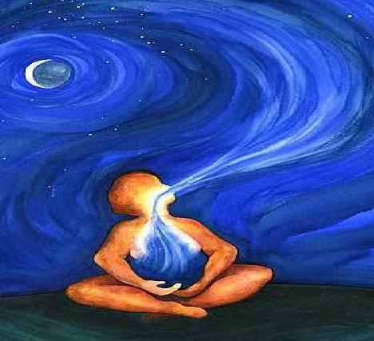
2 Minute Breathing Bubble
https://resourcebank.ca/courses/two-minute-breathing-bubble/view

Slide 62
A New Concept Daily
Big Idea #3
Notes:
Kelli

Slide 63
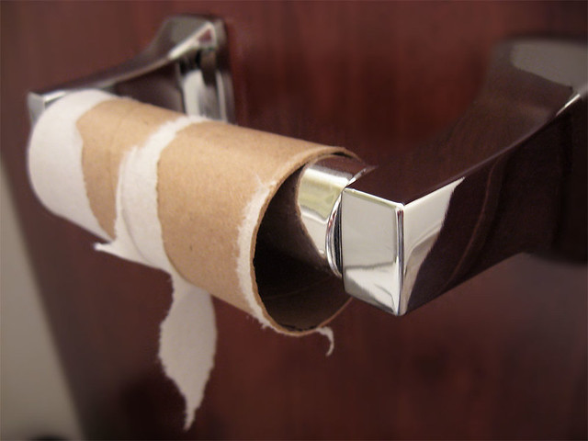
The New Concept! (or reinforcement of a concept)
Kids can handle a new concept daily!
Build a Culture of – "it’s ok if you don’t get it today; you’ll see it again"
SHOW the concept if possible. E.g, circumference = Pi x D - 3 diameters and a bit (3.14…).
Even if working on other concepts all should be exposed.
Small group or full class
This Photo by Unknown author is licensed under CC BY-SA.
Notes:
M
Show them with a toilet paper roll and some string!
Give Melissa toilet paper roll and string

Slide 64
Example of Instruction
Distributive Property
Start by showing something simple they already know
3 (1 + 2)
3 (3)
9
Then show using the "new way". You can name it now or later...
3 (1 + 2)
(3 x 1 ) + (3 x 2)
3 + 6
9
Do this with a number of examples
Get THEM to make one...once they agree it works, then you can show them with variables etc.
Notes:
M
Chart Paper

Slide 65
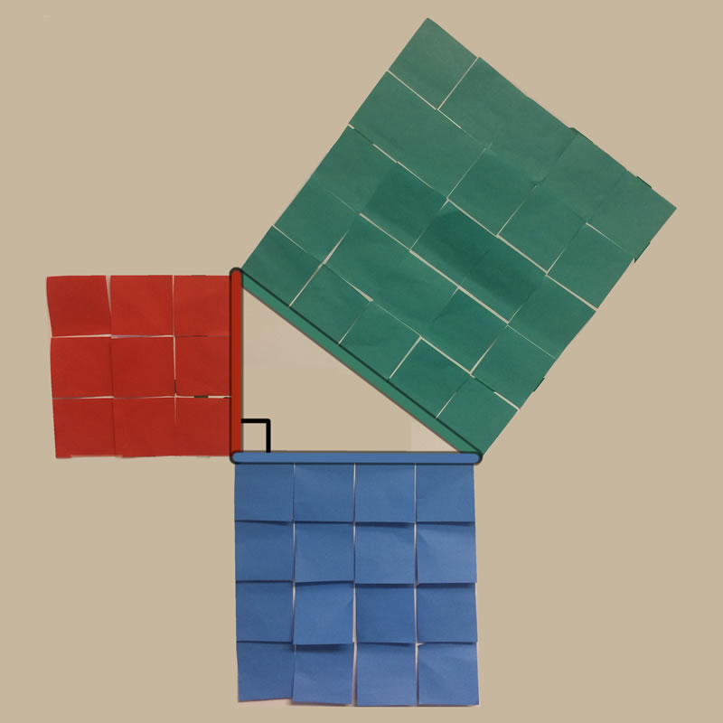
Example
THINK – how could you use post-it notes to prove Pythagorean Theorem?
Scaffold/different entry points
Notes:
M 10
Example – why Pythagorean theorem works – draw right angled triangle the size of post it notes….4 by 3….make the squares out using post its….the hypotenuse will be 25 post its!
Different groups would be given different levels of information
Scaffold supports

Slide 66
Activity – Your Turn! Choose one.
Borrowing or Carrying
Explain how borrowing or carrying works to students.
Make sure you explain WHY it works this way.
Make a connection the process or steps involved if possible.
Surface Area of a Cylinder
Explain why we get the surface area of the sides of a cylinder by multiplying Pi by the height.
Make sure you explain WHY it works this way.
Make a connection the process or steps involved if possible.
Or Share your favourite “why” example
Notes:
M
Mike & Ashley record
-time at tables to pick one and try it – share a few examples with the group
-bring toilet paper rolls, scissors – rulers
15minutes

Slide 67
The Big 5 for a Math Class
Warm up
Mixed Practice
Cumulative Review
Mental Math
Games
Number Talks
New Concept
New
Reinforcement
Full group or small group
Outcome Based Math
Student Centred
Outcome focussed
Reflection & Assessment
Exit slips for concepts or skill
Inform instruction
Encourage Metacognition
Opportunities for surface, deep and transfer learning
Notes:
Kelli

Slide 68
Outcome Based Math Essentials
Big Idea #4 – Targeted Practice/Instruction
Notes:
Kelli

Slide 69
The “Must Haves” of Outcome Based or Competency Based Math
Students
Know what outcome they are working on, set learning goals & know what understanding looks like (and doesn’t)
Have voice, choice & flexibility in how they meet an outcome
Work at their own pace
Can write assessments as many times as they wish
Notes:
Kelli
Review graphic (follow along)

Slide 70
The “Must Haves” of Outcome Based or Competency Based Math
Students
Can challenge the test
Take ownership of their learning
Work towards mastery
Move forward when they demonstrate mastery
Track their growth
Notes:
Kelli

Slide 71
The “Must Haves” of Outcome Based or Competency Based Math
Teachers
Provide voice and choice for students​
Provide direct & explicit instruction as needed​
Provide re-teaching as needed​
Check in often with formative assessment​
See students daily
Notes:
M

Slide 72
The “Must Haves” of Outcome Based or Competency Based Math
Teachers
Guide students based on their readiness and the transfer of responsibility
Provide meaningful on-going feedback
Involve students in assessment
Provide opportunities for full class, small group and individual instruction and activities
Provide opportunities for surface, deeper and transfer learning
Notes:
M 5

Slide 73
Why Outcome Based Math?
Table Talk
Discuss the “why” or reason to use outcome based math in your school.
How would you explain the “why” to a new teacher in your building?
Notes:
Kelli
If your school isn’t doing this, it needs to be discussed with your triad.
5
Share with table
Discuss in afternoon

Slide 74
Why Outcome Based Math?
Horizontal Tracking of Outcomes Avoids Gaps in Learning
Notes:
Kelli

Slide 75
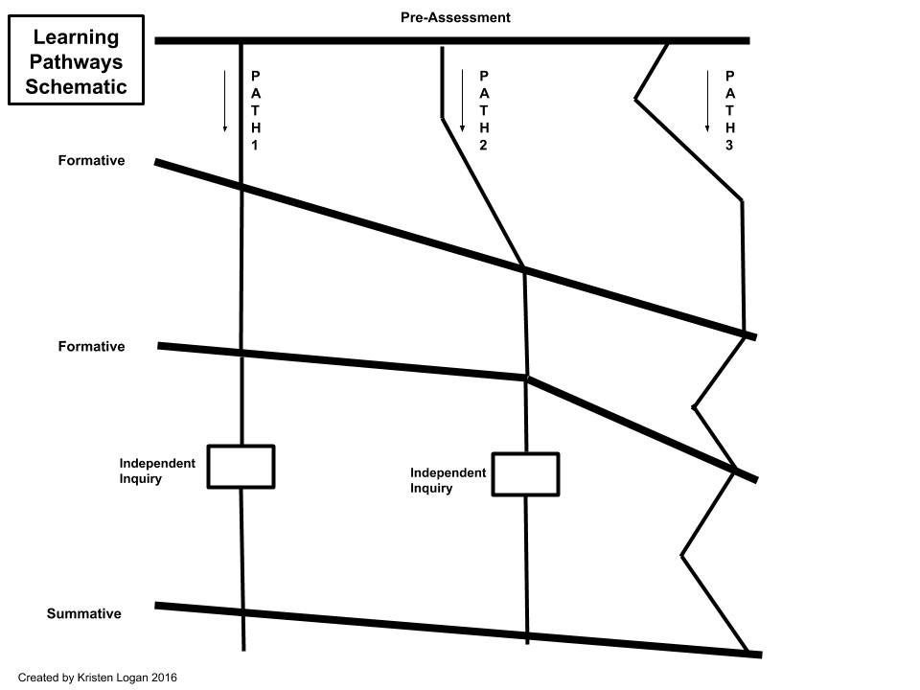
Consider these pathways for Outcome Based Math
Notes:
M or V

Slide 76
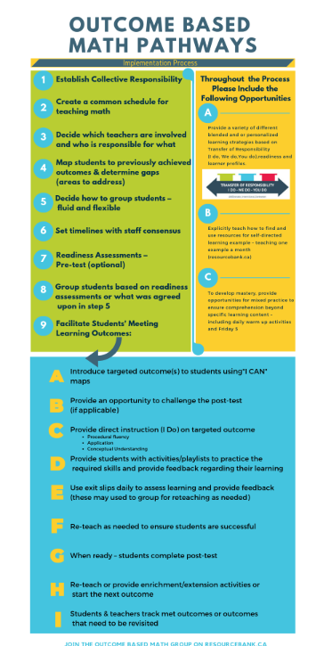
Notes:
Kelli
Entire PD built this graphic you could use with your staff

Slide 77
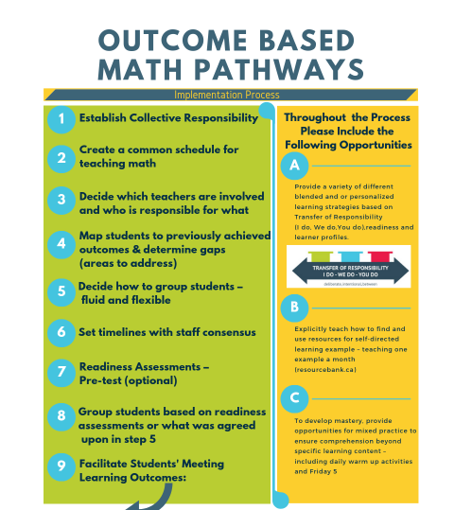
Notes:
Kelli

Slide 78
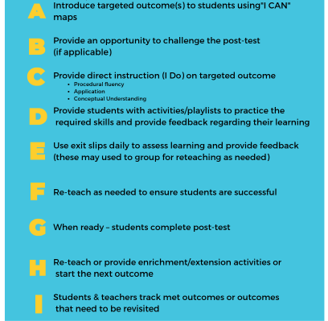
Notes:
Melissa

Slide 79
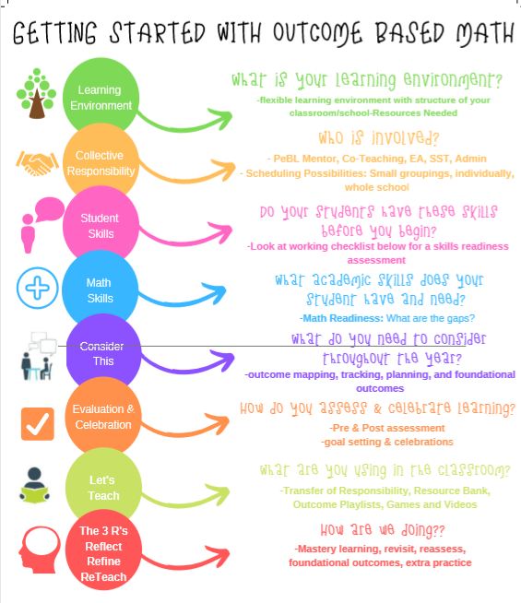
Notes:
Don’t read this – skip to next
Created by PeBL outcome based math team last year

Slide 80
Notes:
Melissa

Slide 81
Notes:
Kelli

Slide 82
School Math Continuum & Alignment Plan (OneNote)
Notes:
Kelli
Introduce

Slide 83
This Photo by Unknown author is licensed under CC BY-SA-NC.
Notes:
12-12:45
Feel free to start working whenever

Slide 84
Review Checklist
Day 1 work time checklist
Notes:
KElli 5

Slide 85
Work Time!
Let’s apply what we’ve learned
Notes:
30
Prepare and hand carousel charts

Slide 86
Carousel Activity –What are you using?
Games
Playlists
Processes for Math Rotations/Outcome Based Math
Pre & Post assessments (school developed)
Digital Technology Tools
Notes:
Kelli explains 15 - 3 minutes per bullet
1, 3 , 5 bullets will have two table groups working together
Check marks if your idea is already there
Add timer

Slide 87
Work Time!
Let’s apply what we’ve learned
Notes:
work until 2

Slide 88
Game Break!
100 MILLION Dollar Pyramid!
Math
Vocabulary Builder
Notes:
Melissa
2:15

Slide 89
Example
Difference
Square
Exponent
Graph
Ruler
Celsius
Quarter

Slide 90
Play & Calculate How Much Money Your Team Earned!
Sum
Decimal
Acute Angle
Equilateral Triangle
Fraction
Ratio
Rhombus
Quadrilateral
Kilometer
Notes:
111, 111, 111 is the goal!

Slide 91
Play & Calculate How Much Money Your Team Earned!
Sum ($1)
Decimal ($10)
Acute Angle ($100)
Equilateral Triangle ($1000)
Fraction ($10 000)
Ratio ($100 000)
Rhombus ($1 000 000)
Quadrilateral ($10 000 000)
Kilometer ($100 000 000)
Notes:
111, 111, 111 is the goal!

Slide 92
Work Time!
Let’s apply what we’ve learned

Slide 93
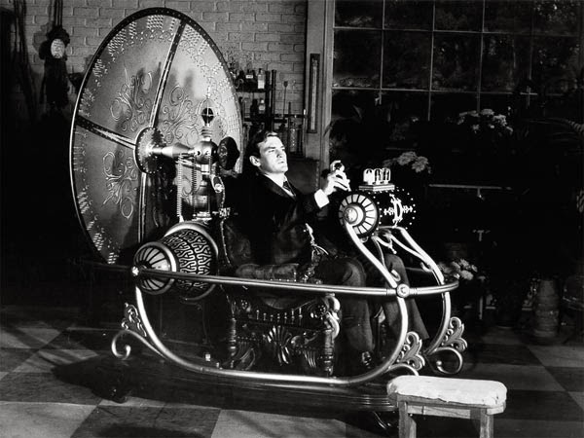
Day 2 Preview
Outcome based math
Resources
Surface, deep and transfer learning
Metacognition
Assessment/reflection
Alignment plans
Notes:
3:05

Slide 94
Thank You!
Exit Survey: https://tinyurl.com/tdptas8
Mileage Form
Safe Travels Home
Day 2 Math PD: Feb 27th
PLEASE CAR POOL!!!!
Notes:
3:15

