Slide 1
Mathematics at Sun West
The BIG Picture
Notes:
Kelli housekeeping and welcome and talk communication

Slide 2
Day Two
Let the fun continue…

Slide 3
Goal: A New Lens
Math Workshops April 24 Grades 1-5
or May 8
Grades 6-9
Overlay what you learn today onto what you currently do.
Use this to fill in gaps and improve existing programming.
Notes:
Kelli – idea of full day PDs any staff member can sign up for using their PD Funds. April 24 & May 8

Slide 4
Look For These Icons…
Item being discussed is on your Checklist .
There is a handout in your package to accompany this.

Slide 5
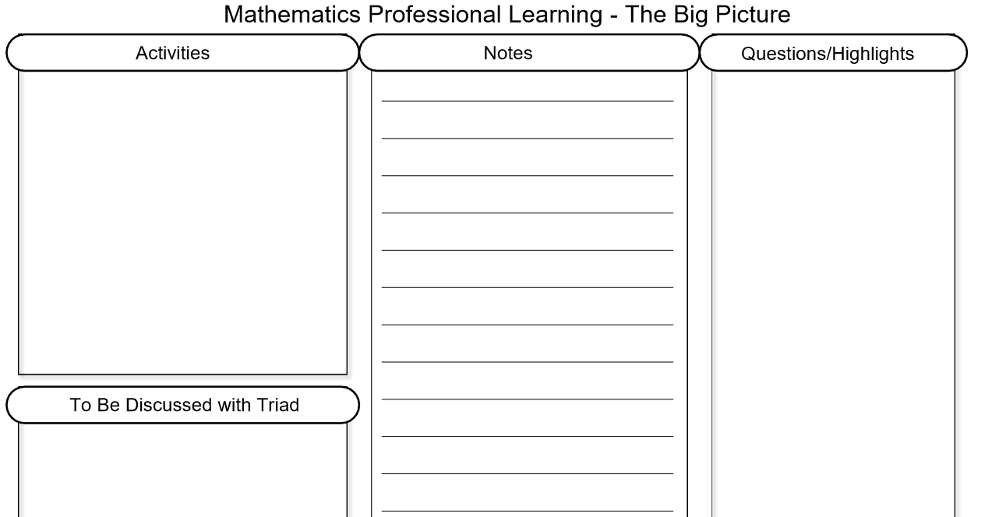
Note Taking Template & Today’s Handouts
Notes:
Kelli

Slide 6
The Big 5 for a Math Class
Warm up
Mixed Practice
Cumulative Review
Mental Math
Games
Number Talks
New Concept
New
Reinforcement
Full group or small group
Outcome Based Math
Student Centred
Outcome focussed
Reflection & Assessment
Exit slips for concepts or skill
Inform instruction
Encourage Metacognition
Opportunities for surface, deep and transfer learning
Notes:
M

Slide 7
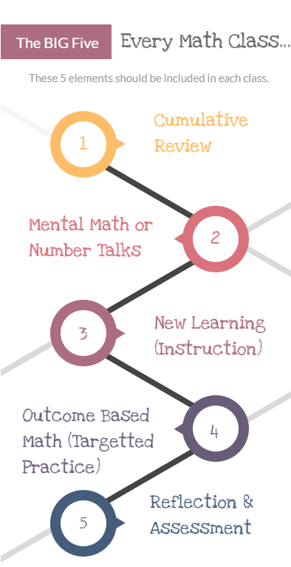
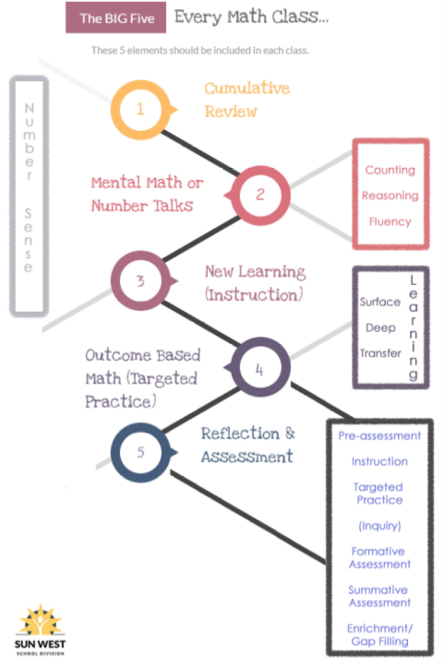
Notes:
M

Slide 8
Outcome Based Math Essentials
Big Idea #4 – Targeted Practice/Instruction
Notes:
K

Slide 9
Notes:
K

Slide 10
The “Must Haves” of Outcome Based or Competency Based Math
Students
Know what outcome they are working on, set learning goals & know what understanding looks like (and doesn’t)
Have voice, choice & flexibility in how they meet an outcome
Work at their own pace
Can write assessments as many times as they wish
Notes:
K Review graphic (follow along)

Slide 11
The “Must Haves” of Outcome Based or Competency Based Math
Students
Can challenge the test
Take ownership of their learning
Work towards mastery
Move forward when they demonstrate mastery
Track their growth
Notes:
Kelli

Slide 12
Notes:
M

Slide 13
The “Must Haves” of Outcome Based or Competency Based Math
Teachers
Provide voice and choice for students​
Provide direct & explicit instruction as needed​
Provide re-teaching as needed​
Check in often with formative assessment​
See students daily
Notes:
M

Slide 14
The “Must Haves” of Outcome Based or Competency Based Math
Teachers
Guide students based on their readiness and the transfer of responsibility
Provide meaningful on-going feedback
Involve students in assessment
Provide opportunities for full class, small group and individual instruction and activities
Provide opportunities for surface, deeper and transfer learning
Notes:
M 5

Slide 15
Day 1 Connection: Why Outcome Based Math?
Discuss the “why” or reason to use outcome based math in your school.
How would you explain the “why” to a new teacher in your building?
Notes:
Kelli
Discuss your why

Slide 16
Why Outcome Based Math?
Horizontal Tracking of Outcomes Avoids Gaps in Learning
Notes:
Kelli 1

Slide 17
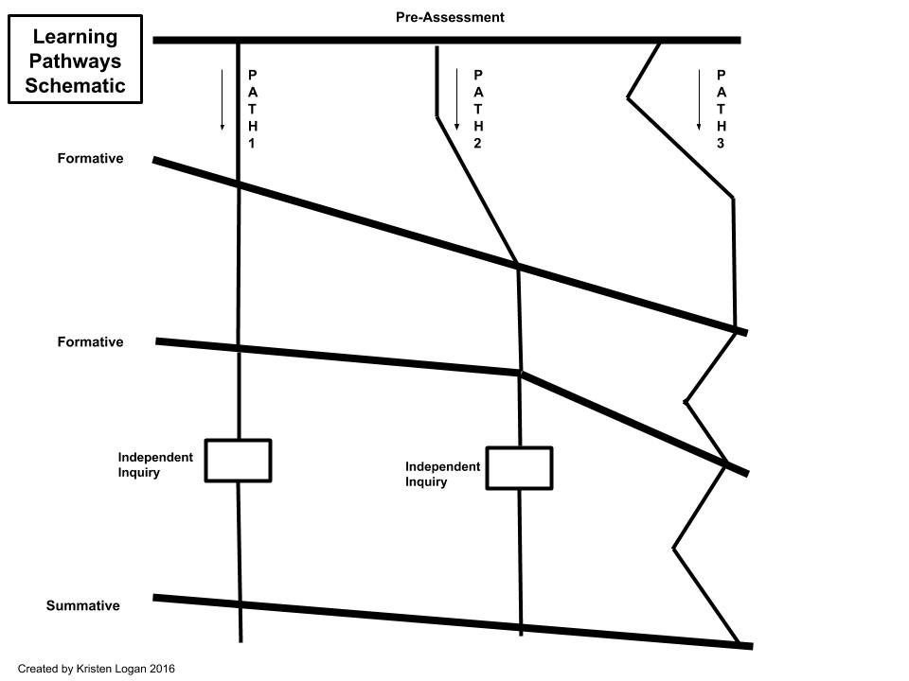
Consider these pathways for Outcome Based Math
Notes:
M (paths) V (assessments – more formative after each zag), K (tie it) *change paths - ask to draw on the zags on handout

Slide 18
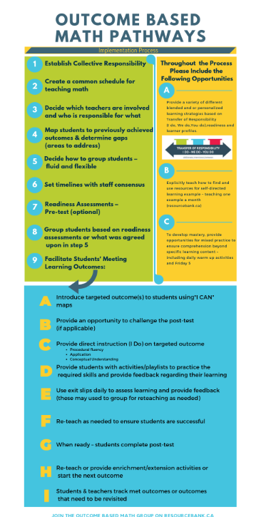
Notes:
Kelli
Entire PD built this graphic you could use with your staff

Slide 19
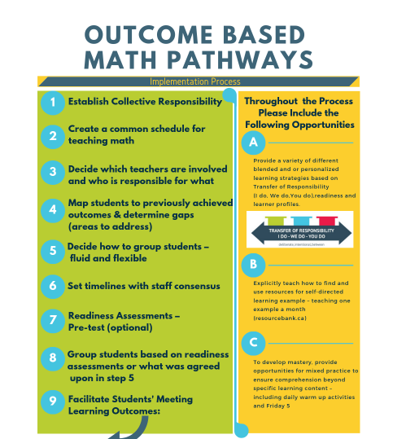
Notes:
Kelli 3

Slide 20
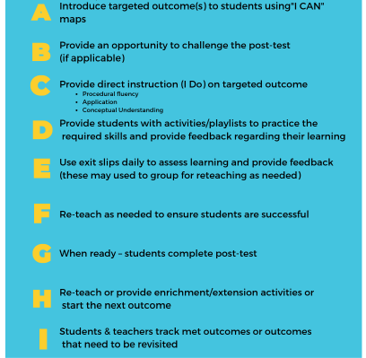
Notes:
Melissa 3

Slide 21
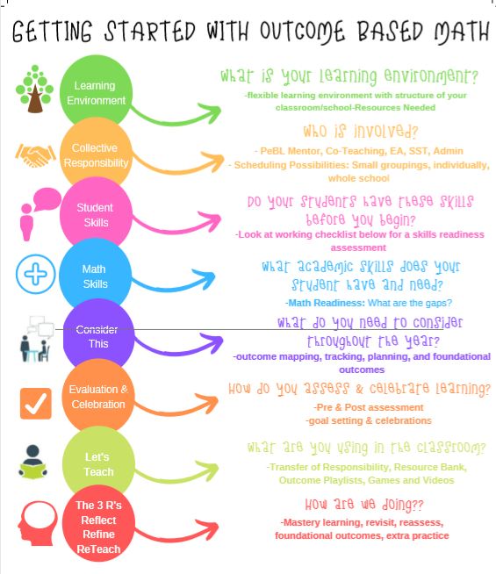
Notes:
Don’t read this – skip to next
Created by PeBL outcome based math team last year

Slide 22
Notes:
Melissa 3

Slide 23
Notes:
Kelli 3

Slide 24
Practical Tips & Supports Group Activity
Group leaders: Bekki (Learning Environment), Shauna (Collective Responsibility), Kristin (Student Skills), Nichole (Math Skills), Nicki (Consider This), Leanne (Evaluation, Celebration), Brianne (Let’s Teach), Stephen (3 Rs)
Notes:
K
15
Groups report – Mike & Ashley create a document and video for each group/bubble
10 AM At this point

Slide 25
Learning Environment
Bekki’s Team

Slide 26
Collective Responsibility
Shauna’s Team

Slide 27
Student Skills
Kristin’s Team

Slide 28
Math Skills
Nichole’s Team

Slide 29
Consider This
Nicki’s Team

Slide 30
Evaluation & Celebration
Leanne’s Team

Slide 31
Let’s Teach!
Brianne’s Team

Slide 32
3Rs Reflect Refine Reteach
Stephen’s Team

Slide 33
10:00 AM - 5 Min Break
Notes:
10AM

Slide 34
Throughout the process...
Notes:
K

Slide 35
Throughout the process...
Explicitly teach how to find and use resources for self-directed learning for example – teaching one example a month (resourcebank.ca)
Notes:
K 3

Slide 36
Mixed Review...Mixed Assessment
To develop mastery, provide opportunities for mixed practice to ensure comprehension beyond specific learning content – including daily warm up activities and Friday 5.
Notes:
M

Slide 37
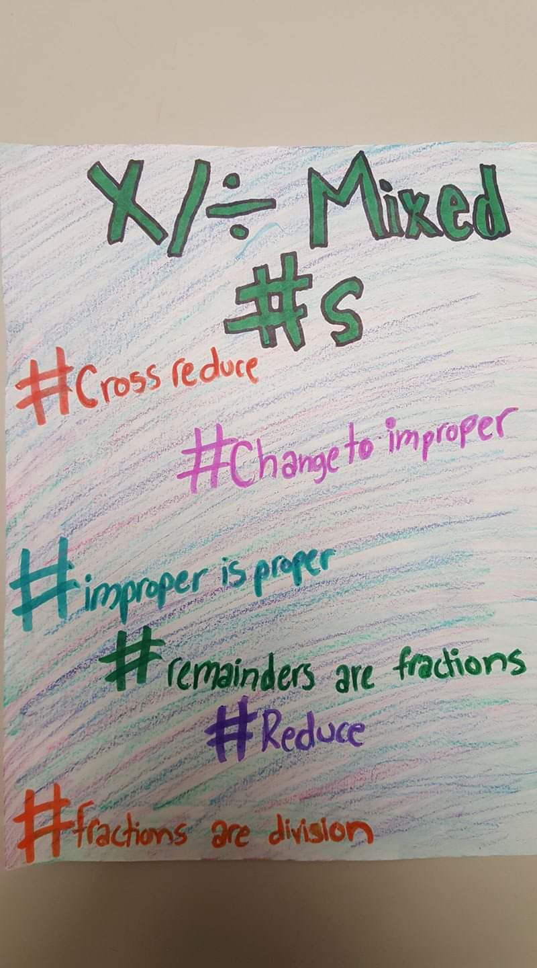
Activity
Create a #hashtag that summarizes the connection between cumulative review, and mixed practice!
#outofcontext
Notes:
M – each school makes a hashtag – write it on the wipeboard!
5

Slide 38
Activity - Outcome Based Math
Task 1
Create a diagram to explain where outcome based math fits into PeBL.
Task 2
Make a short advertisement to promote outcome based math.
Task 3
Reflect on why you feel this type of learning would work at your school. What are your next steps?
Task 4
What is the role of the SST, PeBL Mentor, Principal, Teacher and Student in Outcome Based Math?
Notes:
K & M – we will share these out this afternoon - jot your ideas/start now
Start now for a bit….decide where to start - finish in the PM
5

Slide 39
My Favourite Math Resources

Slide 40
Mathletics…Did You Know?
Rich Tasks by Dr. Marian Small (videos to support teacher)
New Problem Solving Activities now available
Overall SK assessments (identify outcomes met and not)
Specific outcome assessments
New games for fluency – multiplication & addition/subtraction

Slide 41
Mathletics…Did You Know?
More for early learners (stories, videos, interactives)
Printable booklets for learning and review for skills
Live Mathletics for fluency practice (can set levels)
Student reports with strengths and weaknesses
Contact Pamela for info/demo
Pamela.telen@3plearning.com

Slide 42
Learn 360 Demonstration
https://tinyurl.com/Learn360Math
Link on My Favourite Math Resources Handout
Notes:
M
Give Demo PM explore interactives and videos
10

Slide 43
My Favourite Math Resources
resourcebank.ca
Outcome Based Math Group
Playlists, activities, games, enrichment
Tracking Resources, DLC Blended Math (527)
Notes:
Reminder – SHOW the group here.
Melissa - Show how to save resources to the resource bank
5

Slide 44
Notes:
M – time to explore? And remind how to save. 15

Slide 45
Teacher Created Resources
1. Nichole Ness Bredy (Eaton) – Math games (examples & paper copies)
2. Emily Knowles (Elizabeth) - Middle years grade alike resources and math assessments to monitor students
3. Nicole Francoeur (Kenaston) - Math Playlists with Transfer of Responsibility (I do, we do, you do)
4. Shauna George (Loreburn) - Locally developed math for grades 2-5
5. Bekki Burton (WAS) - Math Picture Books
6. Tracey Urich (DLC) - Math Wild Card resources
7. Jaclyn Moore (RCHS) - Playlists in H.S.
8. Leanne Heath (Lucky Lake) - Locally developed math pre-assessments & Playlists
Notes:
Kelli - Nichole, Leanne, Emily, Nikki, Tracey, Bekki etc….Possibly 5 things – 5 people – visit 3 min and rotate.
SST and PM split up and each pick 3 to visit
KELLI UPDATE

Slide 46
Activity – Answer Garden
Based on your exploration of resources in the Resource Bank, Learn360 & from your colleagues….what are your favourite math resources?
Please add at least THREE answers.
https://answergarden.ch/1090271
Notes:
K &M (one open up and one explain) 5
Open answer garden on projector so people can see the answers as they appear.
Complete this.

Slide 47
Surface, Deep, Transfer
John Hattie
More on Big Ideas #1-4
Notes:
Kelli 1

Slide 48
Video: What is Visible Learning For Mathematics?
https://youtu.be/uXVT7tTeKXY
Notes:
K 5 min 11 sec

Slide 49
Effect Size (Impact)
Effect size - measures the impact of educational initiatives on achievement.
Typically range in size from -0.2 to 1.2, with an average effect size of 0.4.
Notes:
V
1.2 Effect size for Jigsaw

Slide 50
Effect Size (Impact)
0.4 is the “hinge point” - having a ‘greater than average influence’ on achievement
0.2 - small impact or effect
0.4 – medium impact or effect
0.6 – large impact or effect
Notes:
V

Slide 51
Effect Size (Impact)
Intellectual maturation of students - 0.0 to 0.15
Average teacher effects - 0.2 to 0.4.
GOAL - 0.4 - 0.6 or more = HIGH IMPACT.
Notes:
V
Intellectual maturation of students leads to effect sizes of between d=0.0 to d=0.15 as revealed from studies with no or limited schooling. Basically means how students achieve if nothing is done to them in terms of schooling.
High Impact – looking for what has the greatest influence on student learning.

Slide 52
Activity John Hattie – Visible Learning Site
https://tinyurl.com/SWHattie
Find one impact size that surprises you and one that supports your thinking.
Share at your table.
0.4 – hinge point https://www.visiblelearningmetax.com/Home/Survey
Notes:
Melissa & Vanessa 0.4 is the hinge point – the relationship between two variables. Activity for Participants. M&V will show the website and explain the activity.
15

Slide 53
Professional
Learning
Resource
https://tinyurl.com/MathPDHattie
Notes:
M

Slide 54
Surface, Deep & Transfer Learning
Notes:
M

Slide 55
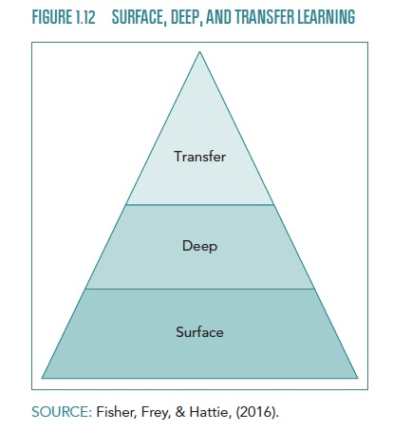
Surface Learning
New learning
Build initial understanding of concepts, skills and vocabulary
Labels, and procedures are explicitly introduced to give structure to concepts.
Notes:
M

Slide 56
Surface Learning
Does not mean superficial learning – depth is just not there yet.
It can be complex
Not about rote learning and blindly following algorithms
Notes:
M

Slide 57
Deep Learning
Make connections, apply and practice procedural skills
Consolidating understanding of concepts and procedures
Notes:
M

Slide 58
Deep Learning
Move to deeper levels when they plan, investigate and elaborate
Begin to make generalizations
Notes:
M

Slide 59
Transfer Learning
Apply the concepts
Little teacher assistance
Notes:
M

Slide 60
Transfer Learning
Students take control of their learning
Apply their thinking to new concepts and situations
Notes:
M 10

Slide 61
Balancing Surface, Deep & Transfer Learning
http://players.brightcove.net/268012963001/default_default/index.html?videoId=5117712626001
Notes:
M
5 min 25 sec

Slide 62
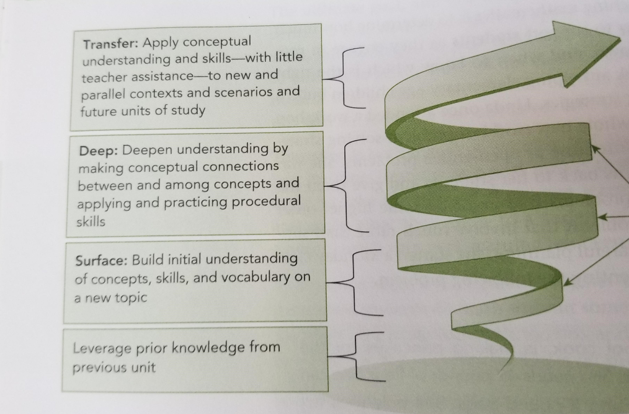
Non-Linear
Students can be at any level at any time.
Notes:
Kelli ToR connection
From Visible Learning for Mathletics (Hattie)

Slide 63
What they know
What they need to know
Notes:
K (ties to previous)

Slide 64
Notes:
Noon

Slide 65
Metacognition
A tool to get them there…
A strong consideration
0.69 effect size
Notes:
12:45
K 1
0.4 is the hinge point

Slide 66
Math is...
Memorization
Blindly following algorithms
Problem Solving
Critical Thinking
Common Sense
Notes:
M

Slide 67
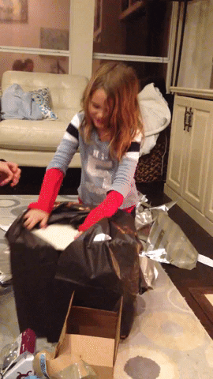
Metacognition… Give your kids this gift too!
It benefits them too!
Don’t make them wait to learn about metacognition.
0.69 effect size
Notes:
Melissa

Slide 68
Strategies that Support Metacognition
Number Talks
Notice & Wonder
Math Journals (no erasing!)
Problem Solving (Problem of the Week)
Collaboration
Thinking Aloud
(Sentence frames handout)
Notes:
M
Show waterloo's problem of the week. https://resourcebank.ca/courses/math-problem-of-the-week
Handout sentence frames that can build metacog http://resources.corwin.com/sites/default/files/Figure_4.7.pdf

Slide 69
Problem of the Week
Grades 3/4, 5/6, 7/8, 9/10 & 11/12
Subscribe!
Problem & Solution (a week apart)
Problem of the month. (11/12)
Past problems & Solutions available
February Monthly Must!
Also – Math Circles (gr. 6+), Math Frog games/sheets, real world math & contests

Slide 70
Problem Solving - 0.61 Impact
Explicitly Teach…
Understand the problem
Make a plan
Solve it
Reflect & evaluate
Notes:
M
Understand – what type of problem (some, some more , groups of – teach the language) what do I know, need to know; predict or estimate a reasonable answer
Plan, what strategy works in this case E.g., draw it, mental math, number line, count on, 10 frames, fact families, manipulatives, do an easy version of the question, arithmetic, algebra
Solve it – show your thinking; work the problem
Reflect – does this make sense? Reasonable? Can I check it somehow? E.g. read the subtraction question backwards to make it addition and check it. Did you include units or a final statement?

Slide 71
Problem Solving - 0.61 Impact
Type of problem (some & some more; some and some less; groups of; splitting things up) *teach the language)
What do I know?
What do need to know?;
Predict or estimate a reasonable answer
Notes:
m

Slide 72
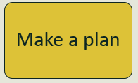
Problem Solving - 0.61 Impact
What strategy works in this case?
draw it
mental math
number line
count on
10 frames
fact families
Manipulatives
do an easy version of the question
algebra
Notes:
m

Slide 73
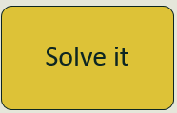
Problem Solving - 0.61 Impact
Follow your plan
Show your thinking
Work the problem
Notes:
m

Slide 74
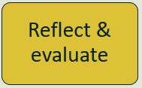
Problem Solving - 0.61 Impact
Ask:
Does this make sense?
Is this reasonable?
Can I check it somehow? (E.g. read the subtraction question backwards to make it addition and check it.)
Units
Final statement if needed
Notes:
m

Slide 75
Rich Tasks & Problem Solving - Mathletics
Did you know you have access to Rich Tasks by Dr. Marian Small in Mathletics?
(access via Resource Hub on Mathletics…select library)

Slide 76
DEEP STRATEGY - Ask – How Did You Solve That?
Encourage students to be aware of WHY they solved a question a certain way.
This makes them think DEEPLY.
Let them find what works best for THEM.
E.g., 28 + 25 = HOW did you solve this and why?
Impact for Discussion is 0.82
Notes:
M
The power of WHY versus the answer

Slide 77
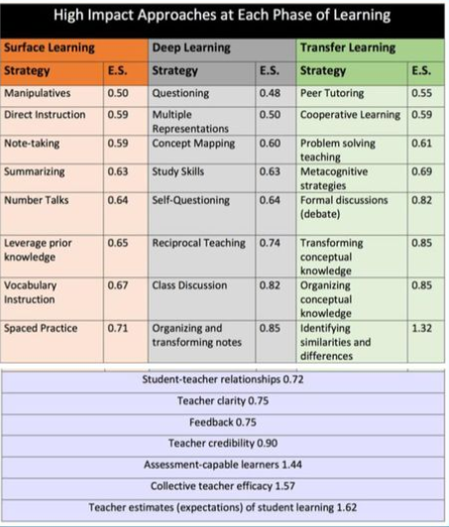
Two Content Layout with Table
Notes:
M
Examine with your school and talk. 10 min What is there and what ISN’T THERE (math minutes)

Slide 78
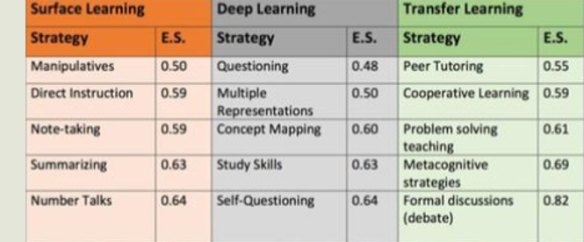
Do you think Number Talks is in the Proper Column?
Think, Pair, Share
Notes:
M
Food for thought

Slide 79
Strategies
Which strategies are currently being used in your school?
Which strategies should be being used in your classrooms & why?
Notes:
2 min to jot ideas here

Slide 80
Thinking Time…
How can surface, deep and transfer
learning be personalized
(student-directed)?
Notes:
Kelli 5
Graphic org with 3 columns. 5 min jot ideas

Slide 81
Activity – Apply Surface, Deep & Transfer Learning (student-directed)
Outcome
Select a specific outcome for a grade of your choice in Math.
Surface Learning
Describe 1 example of surface learning activities you could do to learn that concept.
Deep Learning
Describe 1 example of activities you could use to move learning from surface to deeper levels.
Transfer Learning
Describe 1 strategy you could use to move learning from deep to transfer learning.
Chew on This…do you think you could move learning from Surface to Transfer without Deep Learning?
Notes:
M – 10
Group leader self identifies – per table
Do this in a student directed manner!
Do on template paper and tape them up around the room.

Slide 82
Supports for Surface, Deep & Transfer Learning
Handouts to Support Your Work
Checklist for contribution to group work
Prompts for challenge and discussion (can use for number talks too)
Prompts for self reflection
Sample language frames for math
https://tinyurl.com/corwinsupports
Notes:
M

Slide 83
Sample of Corwin Supports
Notes:
M 3

Slide 84
The Big 5 for a Math Class
Warm up
Mixed Practice
Cumulative Review
Mental Math
Games
Number Talks
New Concept
New
Reinforcement
Full group or small group
Outcome Based Math
Student Centred
Outcome focused
Reflection & Assessment
Exit slips for concepts or skill
Inform instruction
Encourage Metacognition
Opportunities for surface, deep and transfer learning
Notes:
K

Slide 85
Reflection & Assessment
Big Idea #5
http://players.brightcove.net/268012963001/default_default/index.html?videoId=5117777016001
Notes:
K
Video 7 min

Slide 86
Supports
Notes:
K 9

Slide 87
Provincial Supports https://tinyurl.com/ministrymathsupports
Help Me Talk About Math (Gr. 1)
Parent Pamphlets (Gr. 1-9)
Sample Outcome Questions/Assessments
Rubrics (Gr. 1 to 9 Number Strand Only)
Sun West Moodle Gr. 2, 5, 8
more to come
Notes:
M and V

Slide 88
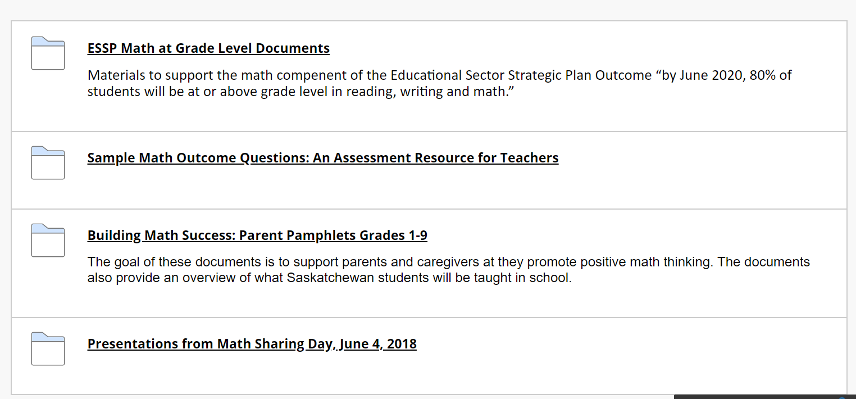
https://tinyurl.com/ministrymathsupports
Notes:
V ESSP Math at Grade Level Documents Folder - Eligible students for Math Outcomes -FAQ's
-Prompts by Grade Level -Grade 2, 5, 8 Math Exemplars Sample Math Outcome Questions: An Assessment Resource for Teachers - provides possible questions, sample responses and rubrics for classroom instruction and assessment. - not mandatory can be used for before/during/after instruction and as formative or summative assessments. - using this resource provides only one of many forms of evidence teachers collect to report on student achievement of an outcome – this is primarily written response. Building Math Success: Parent Pamphlets Grade 1-9 -designed to support parents/caregivers as they promote positive math thinking. Presentations from Math Sharing Day – June 2018 -For reference.

Slide 89
Sample Math Outcome Questions: An Assessment Resource for Teachers
possible questions, sample responses and rubrics for instruction and assessment.
not mandatory.
support the teaching and learning of mathematics.
can be adapted by teachers to meet the individual needs of their students.
can be used before, during and/or after classroom instruction as formative or summative assessment(s).
is designed to elicit responses that inform teachers’ understanding of the skills and concepts that students need to know, understand and are able to do.
Notes:
V

Slide 90
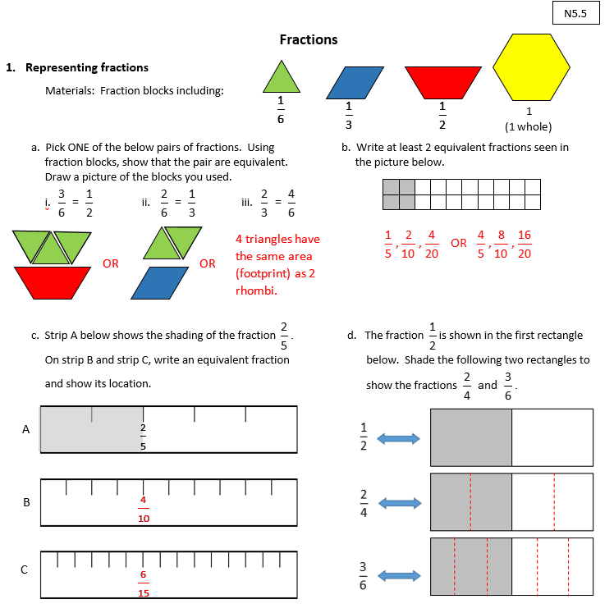
Sample Math Outcome Questions: An Assessment Resource for Teachers
Each set of sample questions has 3 main components.
Sample questions
Answer key
Rubric
Notes:
V

Slide 91
Development Progress
Grade | Outcomes Completed to date | Outcomes completed by June 2020 | Notes
9 | 5 of 15 | 10 of 15 | Remaining completed in fall 2020
7 | 5 of 18 | 15 of 18 | Remaining completed in fall 2020
5 | 8 of 19 | 19 of 19 | Completed by June 2020
3 | 4 of 12 | 8 of 12 | Remaining completed in fall 2020
1 | 5 of 18 | TBD | Complete by December 2020
Notes:
V Keep investigating as there could be new updates all the time.

Slide 92
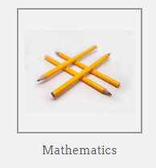
Sun West Curated Math Supports
Notes:
V and/or Melissa Mathematics Hub then navigate to math Assessment. Curated information which MAY help support you and our math teachers at various grade levels. This will continue to evolve Feel Free to add!

Slide 93
1:50 - 5 Min Break
Notes:
10AM

Slide 94
Readiness Assessments & Tracking Growth
Measuring Success
Notes:
2 pm
V 1

Slide 95
Readiness Assessments
Know your students!
Don't force this.
Can provide great information!
This Photo by Unknown author is licensed under CC BY-NC-ND.
Notes:
V

Slide 96
Readiness Assessments
Search “prepostmath” in Resource Bank
Are you using something else?
Notes:
V Do this and show them what to expect.

Slide 97
Mapping Learning & Identifying Gaps
In Resource Bank:
I CAN Maps for outcomes
Tracking for math outcomes
This Photo by Unknown uthor is licensed under CC BY-NC.
This Photo by Unknown author is licensed under CC BY-NC-ND.
Notes:
V or M Search " I can" and you should see a resource titled "Math I Can Statements K-9" Tracking Math – 5 stars for rating if needed. Math Skills Grade 1-9 Tracking Sheet for Outcomes by Strand

Slide 98
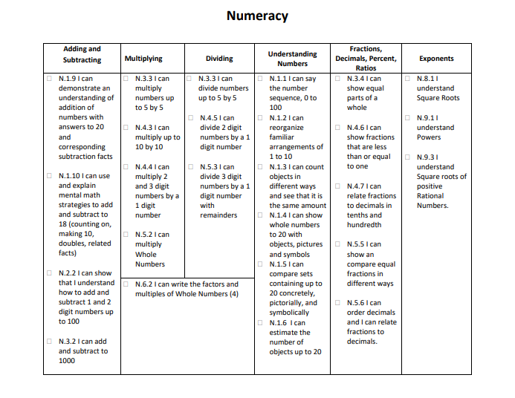
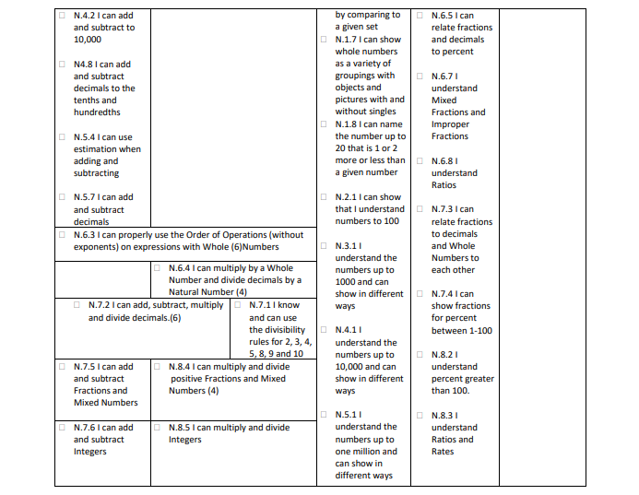
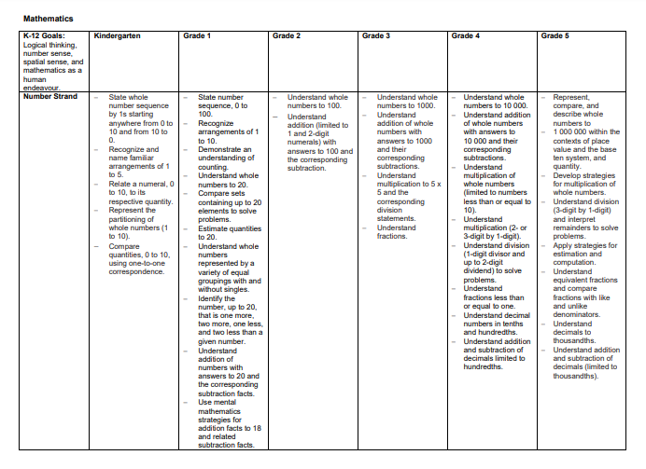
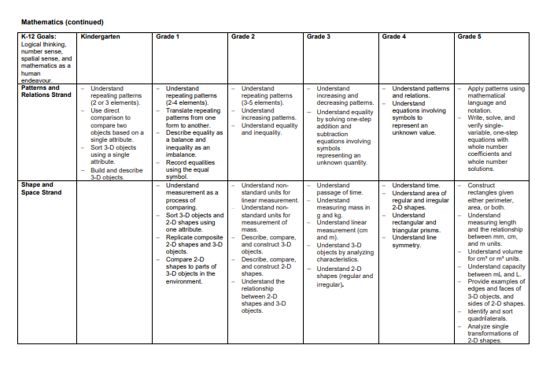
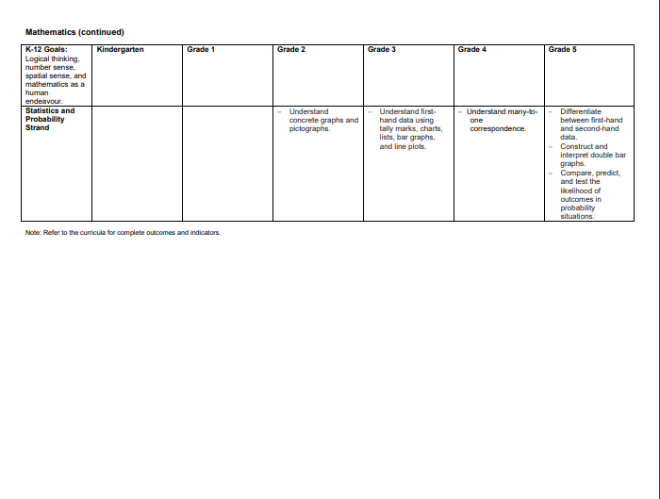
Identify Gaps in Skill Progression
Sun West Resource Bank
Outcome Based Math Tracking Pages
Saskatchewan Curriculum
Additional Resources
Summarized Outcomes Across Areas of Study for K-5
Notes:
Kelli
Other sources – Ministry Rubrics

Slide 99
Developmental Continuum
Notes:
Tammy Based on Skills

Slide 100
Responsive Math Instruction
Notes:
Carole

Slide 101
Coming Soon – High School Modified Supports!
Math 21 Supports
Blends Foundations & Workplace outcomes
Also – Science & ELA 11 supports are coming
Assessments, activities, lessons, etc.
Notes:
Tammy & Arlene

Slide 102
Mathletics Pre & Post Assessments
Add to your Checklist
Search “Mathletics Assessment”
in Resource Bank
Notes:
M- In RB Search “Mathletics Assessment”

Slide 103
Reflection & Assessment
Exit question or reflection based on 21CC
Gauge understanding and next steps for students
Can inform instruction groupings for next day
Builds student voice – they felt heard and responded to
(Corwin handout on Sentence Frames)
Notes:
M 3
Give this http://resources.corwin.com/sites/default/files/Figure_4.7.pdf
I discovered from . . . that . . . What strategies worked well for me? What strategies did not work for me? What should I do next time? Do I need some help for next time?

Slide 104
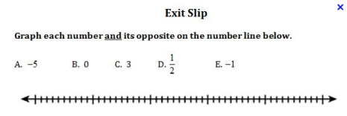
Facilitate Students' Meeting Learning Outcomes
Use exit slips daily to assess learning and provide feedback (these may used to group for reteaching as needed)​
Notes:
M

Slide 105
4 Point Help Scale
Reflection or Exit Slip
Notes:
M 5
https://conniehamilton.net/product/tomorrows-help-scale-version-2/ free download from Connie Hamilton

Slide 106
Assessment in Math
Our goal is to know more about our students' mathematical understanding.
How are they thinking about math?
This Photo by Unknown author is licensed under CC BY-ND.
Notes:
V A successful Math Learner
Understands math concepts
Does math quickly and accurately
Solves math problems in a variety of ways
Works at math positively and productively In math, spotting when students answer correctly is relatively easy compared with understanding the reasons behind their errors. When a student gives a correct response, we assume he/she understood the problem – this may or may not be correct. He/she may have gotten to the right answer but for the wrong reason. Knowing more about understanding helps to support ALL learners and provide interventio to students who are struggling.

Slide 107
Formative Assessment - Correcting
What is the purpose of correcting?
What needs to be corrected by the teacher?
Ideally, how should correcting happen in your classrooms?
Notes:
K Activity 7
– Do in your school - Coming to consensus – use stickies – 3 charts – group answers/put on top or close to it.

Slide 108
Summative Assessment
Evaluating the learning
Summative- assessment OF learning
Places a value (grade, level) on learning
Usually covers larger areas of content than formative (full outcome)
Formative- assessment FOR learning
Notes:
V
Mark = formative; Grade=summative
(formative=assessment FOR learning)

Slide 109
Summative Assessment
Be Flexible
Leave room for student voice and choice & creativity
Ensure it is accurate
Try to make it authentic
Formative can be summative
Notes:
V

Slide 110
Summative Assessment
Ensure there is feedback & improvement before final submission (0.75 Impact)
Like formative - summative should used to inform instruction.
Identify gaps
Offer insights
Notes:
V 5

Slide 111
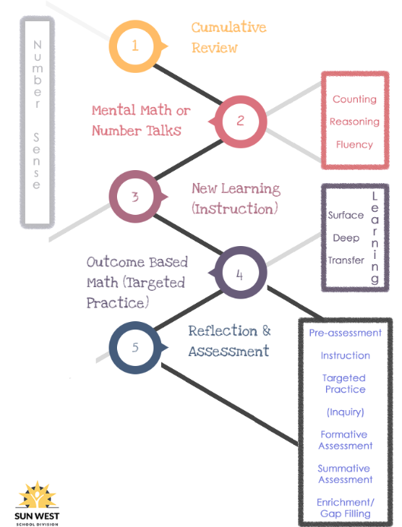
Notes:
M

Slide 112
What do we do if we are not having an impact?
https://uk.sagepub.com/en-gb/eur/know-your-impact-when-to-assess-what
Notes:
M
2 or 3 minute video

Slide 113
Other Considerations
Things to ponder...
Notes:
K1

Slide 114
What Works in READING Can Help in Math Too!
Read the problem aloud.
Asks questions the way you would with reading comprehension (E.g., what do you know? What is happening?)
Request them to justify…how do they know?
Focus on how they explain their answer more than if it is right or wrong
Notes:
M

Slide 115
Use RICH Language
Show all the different ways to say and show numbers and concepts
Use proper terminology
E.g., 4.5 is NOT 4 point 5.
Math word walls – or include in your existing word wall.
Flexibility
Pyramid Game from Day 1
Notes:
M
Connect to our pyramid game last day

Slide 116
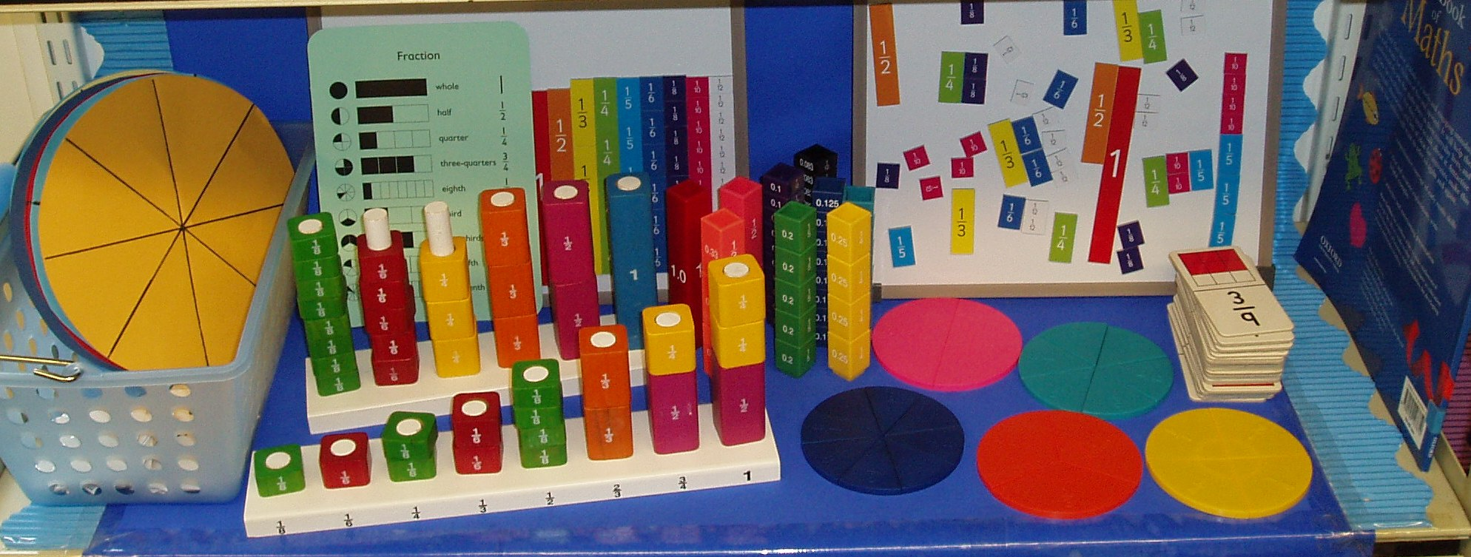
Make the Abstract CONCRETE
Draw it
Picture it
Use manipulatives
Number lines
Bar models
Scales
Notes:
M

Slide 117
The Power of “Drawing It Out” Tap into Visual, Auditory & Kinesthetic Styles
Notes:
M -8
2 min videohttps://www.edutopia.org/video/powerful-effects-drawing-learning

Slide 118
Together or Apart?
Come Together as a Class to...
Work Individually or in Small Groups to...
Warm Ups
Number Talks
Cumulative Mixed Reviews/
Assessments
New Instruction (or small group)
Problem of the week discussion (or small group)
Reflection/Exit Slips
Complete outcome activities
Collaborate on tasks/activities
Problem of the week work
Peer tutoring
Reteaching (small group)
New Instruction (small group)
Notes:
M
Handout

Slide 119
Review the Checklist
Day 2 Checklist
Notes:
Kelli 3

Slide 120
School Math Continuum & Alignment Plan (OneNote)
Notes:
Kelli
Review

Slide 121
Work Time!
Let’s apply what we’ve learned

Slide 122
Break! Share your Advertisements

Slide 123
Activity - Outcome Based Math
Task 1
Create a diagram to explain where outcome based math fits into PeBL.
Task 2
Make a short advertisement to promote outcome based math.
Task 3
Reflect on why you feel this type of learning would work at your school. What are your next steps?
Task 4
What is the role of the SST, PeBL Mentor, Principal, Teacher and Student in Outcome Based Math?
Notes:
Start now for a bit….decide where to start - finish in the PM

Slide 124
Break! Share your Advertisements

Slide 125
Work Time!
Let’s apply what we’ve learned

Slide 126
Break! Share Your OBM Diagrams!

Slide 127
Activity - Outcome Based Math
Task 1
Create a diagram to explain where outcome based math fits into PeBL.
Task 2
Make a short advertisement to promote outcome based math.
Task 3
Reflect on why you feel this type of learning would work at your school. What are your next steps?
Task 4
What is the role of the SST, PeBL Mentor, Principal, Teacher and Student in Outcome Based Math?
Notes:
Start now for a bit….decide where to start - finish in the PM

Slide 128
Break! Share Your OBM Diagrams!

Slide 129
Work Time!
Let’s apply what we’ve learned

Slide 130
Break! Share Your Reflection
How will this work at your school?
What are your next steps?

Slide 131
Activity - Outcome Based Math
Task 1
Create a diagram to explain where outcome based math fits into PeBL.
Task 2
Make a short advertisement to promote outcome based math.
Task 3
Reflect on why you feel this type of learning would work at your school. What are your next steps?
Task 4
What is the role of the SST, PeBL Mentor, Principal, Teacher and Student in Outcome Based Math?
Notes:
Start now for a bit….decide where to start - finish in the PM

Slide 132
Break! Share Your Reflection
How will this work at your school?
What are your next steps?

Slide 133
Work Time!
Let’s apply what we’ve learned

Slide 134
Break! Share Your Roles
What is the role of the
SST, PeBL Mentor, Principal and Teacher
In your plan?

Slide 135
Activity - Outcome Based Math
Task 1
Create a diagram to explain where outcome based math fits into PeBL.
Task 2
Make a short advertisement to promote outcome based math.
Task 3
Reflect on why you feel this type of learning would work at your school. What are your next steps?
Task 4
What is the role of the SST, PeBL Mentor, Principal, Teacher and Student in Outcome Based Math?
Notes:
Start now for a bit….decide where to start - finish in the PM

Slide 136
Break! Share Your Roles
What is the role of the
SST, PeBL Mentor, Principal and Teacher
In your plan?

Slide 137
Work Time!
Let’s apply what we’ve learned

Slide 138
Thank you!
Notes:
Kelli

Slide 139
Before You Go…
Mileage Forms
Exit Survey: https://tinyurl.com/swmathday2
Upcoming Math Workshops
April 24 – Grade 1-5
May 8 – Grade 6-9
Personal PD
Registration information will be out in the Friday File
Book in Triad meeting
SBAs will receive an overview of this day in early April
Notes:
Kelli 5

