Slide 1
Phase II PLCs Facilitator Discussion/Training
May 5, 2020
10 a.m.

Slide 2
Agenda
Vision | Supports | Overview | Checklist | Next
Key Messages | Co-Facilitators Superintendent(s) Consultant(s) Tech Coaches Resource Bank | First Meeting Considerations | Getting Ready to Proceed | What Comes Next
Ready to Proceed

Slide 3
Video: https://sway.office.com/v6NFksJVam5eVQGT?ref=Link

Slide 4
OUR BIG VISION
Developing support networks for teachers while we are working away from school buildings.
Developing resources that you may need when students return to school with gaps in their knowledge.
Looking to the future by helping to address the work-life balance.
Making plans for online learning should it have to continue in the fall.

Slide 5
Review Topics
Phase II PLC | Invited PLC Facilitators | Superintendent Supports
Tech Pathways 10-12 | Stephen Hadden | Darren
PAA | Blair Smadu Tavis Lehman Rietta Frick-Davis | Darren & Vicki
Sr. Wellness/P.E. | Miles Bennett Mitch Wintonyk | Vicki
FNMI Protocol/PD/Integration | John McPhee | Kelli
Gender & Diversity Studies | Shannon Peardon | Kelli & Carole
Resource Bank Champions/Trainers | Melissa Lander, | Kelli
Arts Ed – Art Appreciation | Aaron Moore, Eli Dingle, | Vicki & Shari
Band | Morgan Dingle | Kelli & Shari
Sr. Math – Phase 2 Outcome based shift & PBL | Tracey Uhrich, James Walker, | Kelli & Darren
Sr. Social – Phase 2 Outcome based shift & PBL | Karen Blackwell Jones, Kolin Walters, | Kelli & Shari
Sr. ELA – Phase 2 Outcome based shift & PBL | Heather Philips, Jenn Loken, Renee Harrison | Kelli & Shari
Sr. Sciences – Phase 2 Outcome based shift & - PBL | Dan Krause, Brent Larwood, | Kelli & Shari

Slide 6
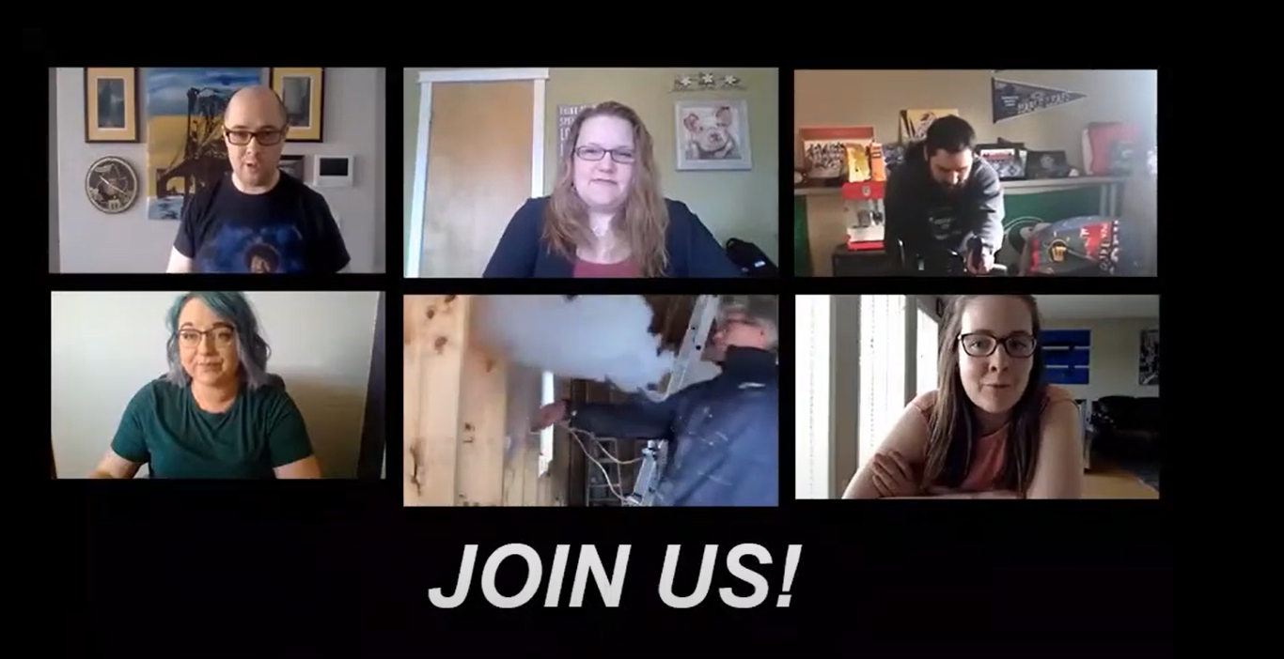
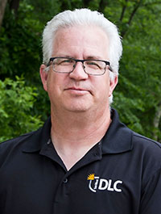
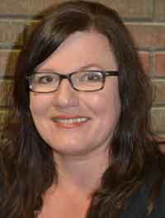
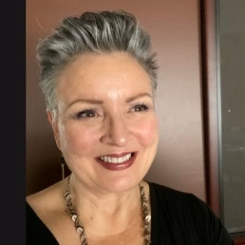
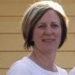
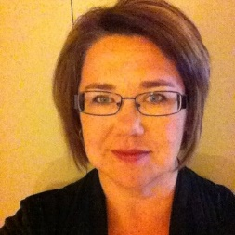
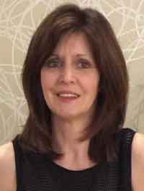
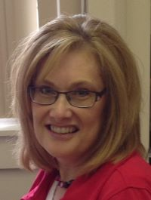
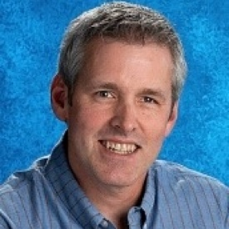
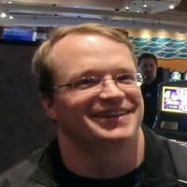
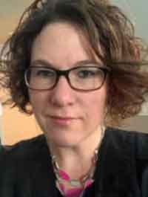
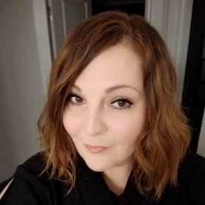
THE TEAM Roles
Superintendent(s)
Consultant(s) & Tech Coaches
Co-Facilitators

Slide 7
Supports
Co-Facilitators
Communicate/Meet with Superintendent(s) – provide update
Lead online meetings
Support Team by documenting goals and activities of the PLC
Superintendent(s)
Provide division vision
Work with co-facilitators to develop considerations and goals for PLC work
Attend meetings where possible
Communicate PLC goals to other Superintendents
Consultant(s)
Content support in the areas of curriculum, instruction, assessments & student support lens.
Tech Coaches
Technical supports
Create Microsoft Teams for each PLC
Add members to each PLC
Resource Bank
Access to resources to support PLC work
Platform to house resources and content
Groups can be used for PLC work
Your PLC Attendees
Some members may be idea generators
Some may be full time members
Some may be part-time members
Your TEAM!

Slide 8
Checklist- https://tinyurl.com/PhaseIIPLCs
First Phase II PLC Meeting
(Starting May 13)
Initial Discussion & Considerations Meeting
(Between May 6 – May 12)
Welcome
Vision – Superintendent – Review Key Messages
Needs, possibilities & Considerations
Discussion
Potential Member roles (Idea generator, full member, part-time member, other?)
Facilitator Next Steps
Get to know your Team - How we work and learn best
Norms (Don't spend too much time on this, but the value in setting norms will be very useful)
Who/What are our supports?
Review and Clarify our WHY (goals) for PLCs based on initial meeting discussion
Discussion
What are your timelines?
Next Steps

Slide 9
What comes after Your Initial Discussion & Considerations Meeting (Between May 6 – May 12)….
An Email to All Sun West Teachers will go out May 12th:
Inviting teachers to join Phase II PLCs
Teachers will have access to a SWAY website with descriptions of the PLCs and the intro video
https://sway.office.com/v6NFksJVam5eVQGT?ref=Link
Kelli will email list of those that have joined your PLC

Slide 10
Next Steps
Collaboration with Superintendent(s) & Co-facilitator
Goals & Considerations
Set up initial discussion meeting (Between May 6 – 12)
Date, time and link to Teams meeting
Meeting discussion topics
Email your team (ASAP)
Use the provided (Will email today) email list and personalize email template

Slide 11
Next Steps
Review Checklist
Review FAQ

Slide 13
THANK YOU!

