Slide 1
Assessment Feedback Webinar #2
Sun West - Kelli Boklaschuk, Melissa Lander & Vanessa Lewis
http://www.free-powerpoint-templates-design.com
Notes:
K
V – add link to webinar https://resourcebank.ca/authoring/3508-assessment-webinar-series-from-sun-west/view

Slide 2
Assessment Feedback Series
 | Feedback
 | 1 in 4 Rule Student Reflection & Assessment
 | Webinar #1
 | Feedback continued
 | Use Tech Tools Strategically Peer Feedback & Assessment
 | .
 | Webinar #2
 | Feedback continued
 | Recognize Busy Work “Show Me Your Best Work”
 | Webinar #3
 | Distance Learning
 | Formative & Summative Assessment
 | Webinar #4
Notes:
k

Slide 3
Past & Future Episodes...
https://tinyurl.com/assessmentSW
Notes:
k

Slide 4
G
OAL
OF LEARNING
...take students from what they currently know to what they need to know.
Assessment has a role to play in this journey by structuring the pathway.
Notes:
V

Slide 5
0.73 effect size
Notes:
v

Slide 6
Assessment Process
Set the Stage for Success
Set Success Criteria together as a class. Build a rubric together if appropriate.
Set learning goals. Share examples and non-examples. Clarify – How do you know you met the outcome?
The Learning Loop
Students receive instruction as needed. They reflect on their learning, and the plan is adjusted accordingly. Learning is monitored by teacher and student. Knowledge and skills are developed and refined.
Learning Outcome
Success Criteria
Readiness Assessments
Formative Loop
Summative
Share & Discuss
Existing Knowledge & Skills
The End?
Share the outcome with students in language they can understand. Discuss it and ensure it is fully understood.
Examine Learner Profiles.
Students and teachers reflect on what is already known, what skills they already have and what tools they have to learn this outcome.
Clarify – What do you need to do your learning?
Based on the level of understanding students either enrich/extend learning, move to the next learning outcome, or return to the learning or formative loop.
Notes:
M – basic – refer to video 1

Slide 7
Feedback Video from Edutopia
Notes:
k

Slide 8
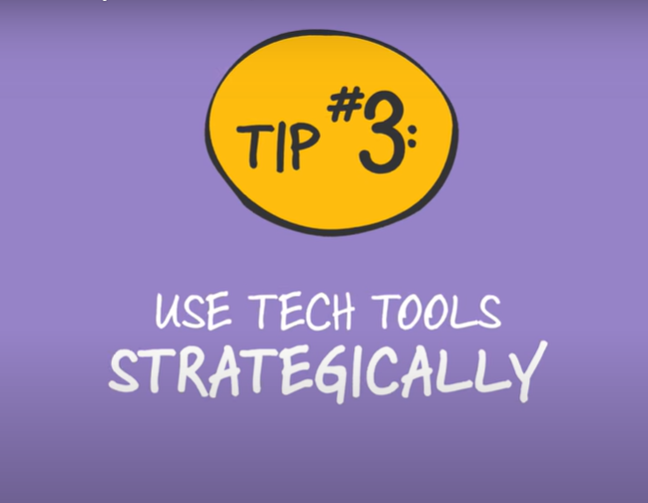
Notes:
V - Tools in RB- formative and summative collections

Slide 9
I've used tech tools to assess student learning...
Yes
No
Notes:
K
V - poll

Slide 10
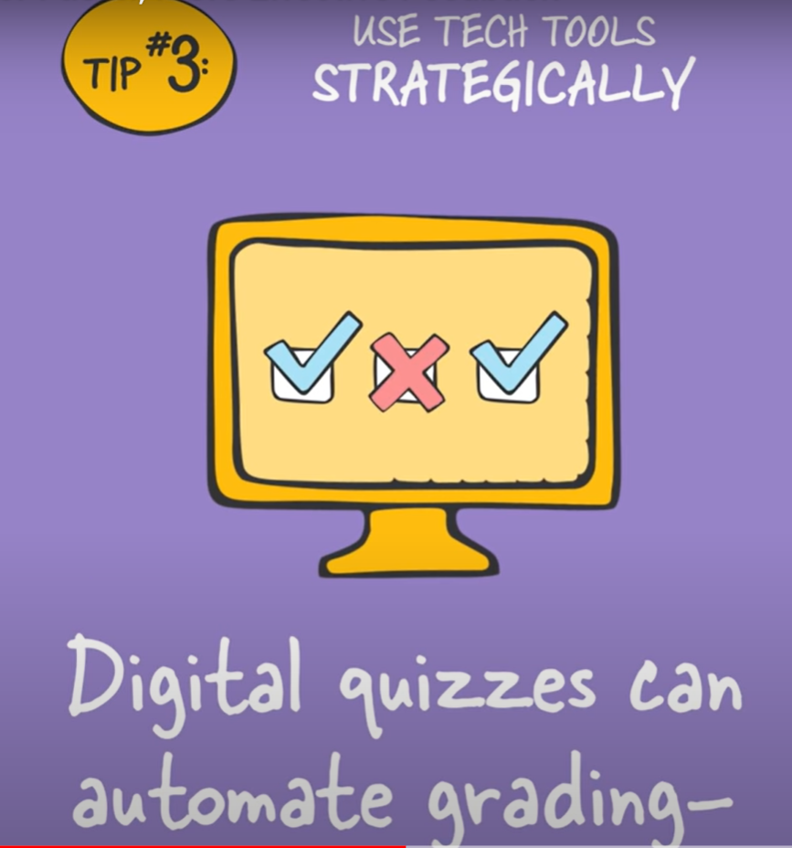
Notes:
v

Slide 11
Notes:
v

Slide 12
Notes:
Mathletics assessments!

Slide 13
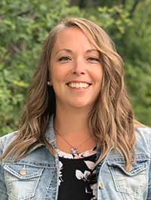
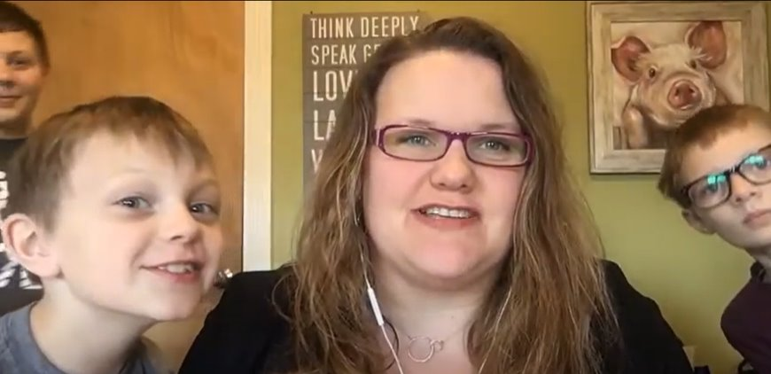
Sun West Teacher Tips
Notes:
K - teachers

Slide 14
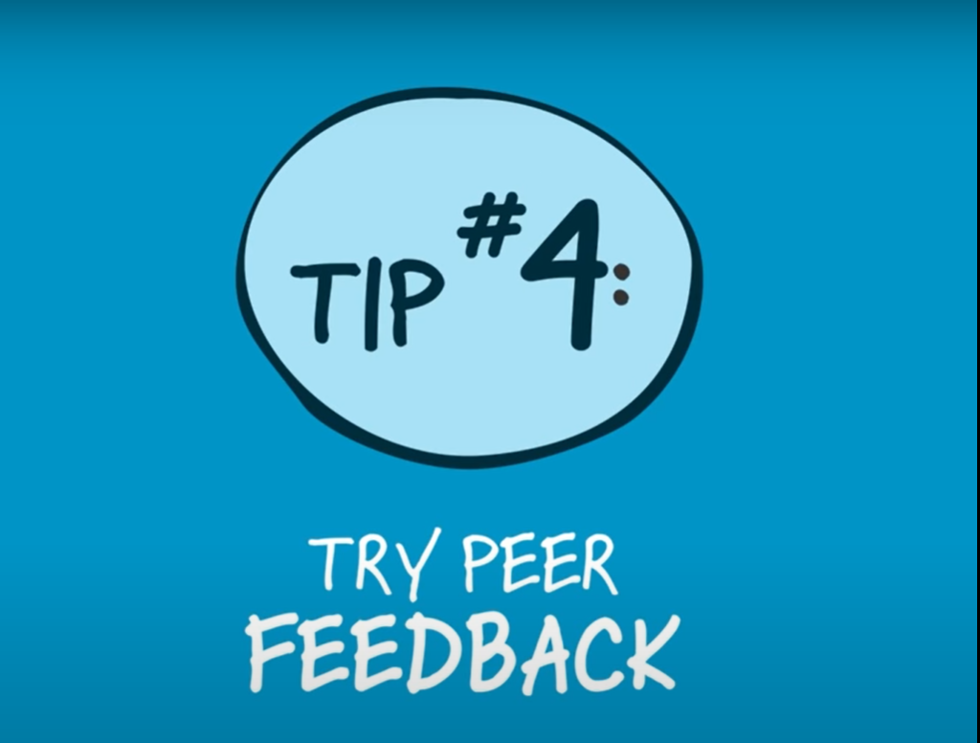
Notes:
M

Slide 15
I've used peer feedback to support assessment...
Yes
No
Notes:
K
V poll

Slide 16
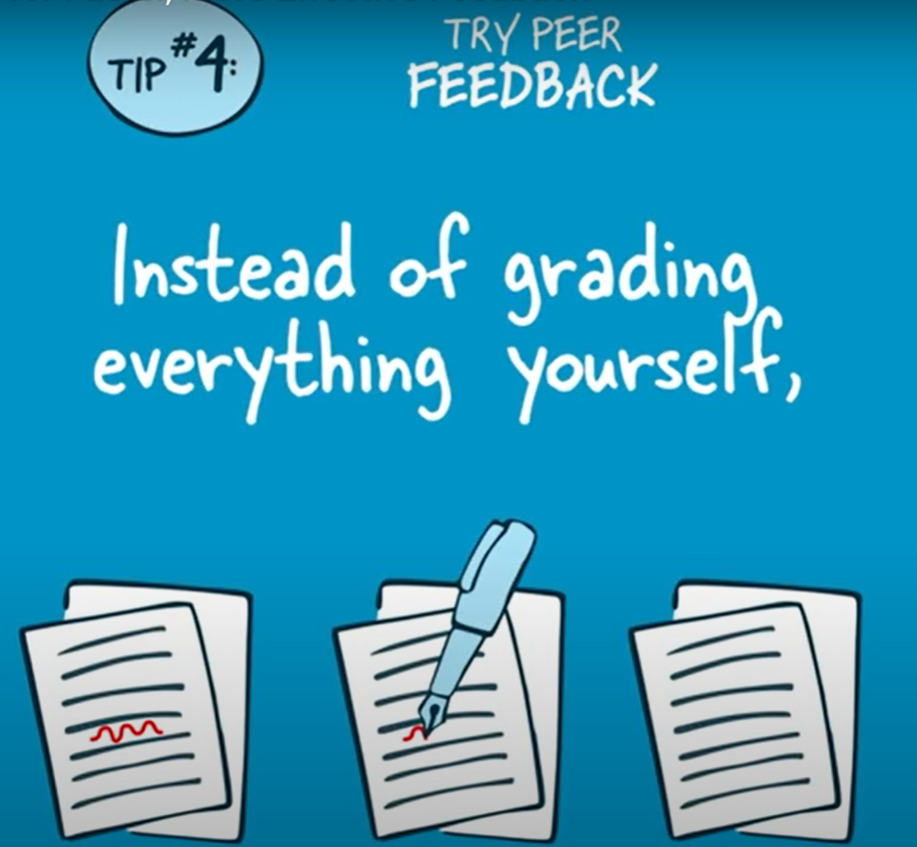
Notes:
M
Many hands make light work.

Slide 17
Notes:
M – build that rubric together.

Slide 18
Notes:
M – conferences

Slide 19
Notes:
M – watch video

Slide 20
20 Minute Peer Feedback System
https://tinyurl.com/feedback-peer
Notes:
M – like a chef asking someone "how does this taste"
Suggest – get the kids really solid at self assessment first – then build on that to get here.
As learners self assessment and peer assessment are important for improvement – we need feedback!
Need to learn how to GIVE it and how to TAKE it or NOT take it and actually USE it.
*what we know *What we don't know *next steps

Slide 21
Other Peer Feedback Options
Provide Structure
Sentence Starters or Frames
Strengths, Weaknesses & Question
Good for EAL and younger students.
E.g., I really like it when you____________
Have you thought about ___________
3-2-1
Provide 3 Strengths
2 Weakness
1 Question
Keep it Loose
Get Lots of Feedback, Fast!
This is less structured. They meet when they need to, discuss the process and provide feedback. This is more like a teacher-student conference, but between peers.
Peer
Coaching
Speed Date
Students line up facing another. Each pair talks for half of a set time. They pitch their ideas, then get feedback & switch roles. After a set time everyone moves one partner to the left/right.
Anonymous Feedback
Students have stickies and move around in carousel style providing anonymous feedback to work.
Carousel
Notes:
M

Slide 22
Notes:
V

Slide 23
Notes:
M – any one else?

Slide 24
The Assessment Hub
Notes:
M

Slide 25
https://resourcebank.ca/hubs/Assessment
Notes:
M

Slide 26
Notes:
K

Slide 27
Notes:
K

