Slide 1
Staff Learner Profiles
Learning Activity #1
Notes:
Kelli, Jason and Greg

Slide 2
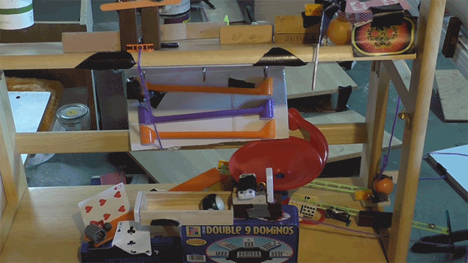
Rube Goldberg Inspired Machine
https://www.youtube.com/watch?v=dFWHbRApS3c
Notes:
Pass out character cards….attached file in One note

Slide 3
Rube Goldberg Machine
Create a Rube Goldberg inspired machine
You have 10 minutes to prepare and present your working machine
You must use at least 10 items or more in your machine
You must have a goal for your machine
This is a team task and you do not have access to help from anyone other than your team members.
Timer: https://www.youtube.com/watch?v=iQBi8D7uePY

Slide 4
Learning Activity #2
*New Groups*

Slide 5
Rube Goldberg Inspired Machine
Review your character card and role with your group & discuss ways you might work well together
Create another Rube Goldberg inspired machine
You have 10 minutes to prepare and present your working machine
You must use at least 10 items or more in your machine
You must have a goal for your machine
This is a team task and you have access to anyone else in the room
Timer: https://www.youtube.com/watch?v=vheMdBBUpoo

Slide 6
Learner Profiles
The Why, The What, The When, The Who, The How…and THEN WHAT????

Slide 7
The Why – Your Observations
School Culture – Equity, Understanding
Knowing who you are as a learner
Mentorship
Knowing who to collaborate with
Strengths and challenges
Skills

Slide 8
The What
A learner profile allows each person to look at all of their strengths and growth opportunities, interests and hobbies, preferences, how they learn best and how they contribute to the world they live in.
Learner profiles outline some of the unique needs of each person by providing the knowledge needed to make good decisions regarding how to do their best learning.

Slide 9
The When
Develop learner profiles as early in the school year as possible (or in life )
Integrate the language into everything you do in your school community
Learner profile components can be revisited often to examine changes and growth that take place

Slide 10
The Who
Everyone in your school is a learner
Everyone in your school in a mentor
Everyone in your school is unique and can learn
Everyone in your school has a unique learner profile
Everyone in your school has strengths and challenges to work on
This is also true for everyone else in the world!

Slide 11
The Where
EVERYWHERE!
At home
At school
With friends
During sports
During music lessons
On holidays
etc………..

Slide 12
The How
Learn what a profile is
Develop it and reflect on it
Integrate it into everything you do
Tell people who you are and how you learn
Work on all aspects of your learner profile not just what you are good at

Slide 13
Staff Learner Profile Components
Your Name
Draw a picture of yourself
Learning Styles – Ways people approach a range of tasks
Multiple Intelligences – Intellectual abilities
True colors
Myers Briggs
Enneagram
Spirit Animals
Strengths & Challenges
Interests and Hobbies
Skills
Learning Environment – Body and mind
I wonder about…. – Curiosity, creativity, critical thinking, enquiry
Personality Types
Expanding the profile

Slide 14
Name
Start with your Name. Write what is most comfortable for you.
For Example:
Kelli
Ms. B
Ms. Boklaschuk
Select your favorite colour to write you name is.
Decorate your name or style it in any way you would like.

Slide 15
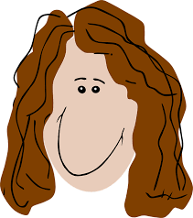
Draw Yourself
Draw a picture of yourself
This can be hard for some who do not feel artistically inclined.
This component shows how you see yourself.
Do not be concerned over your artistic ability. Take a risk and share and draw what you see
It could be a picture of your head, arm or full body.
Anything goes!

Slide 16
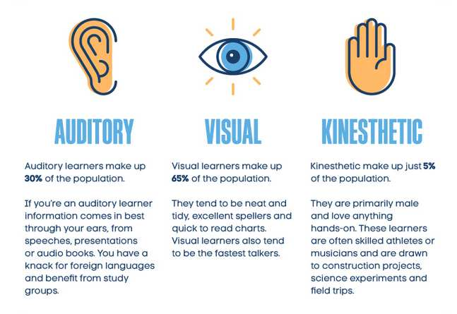
Learning Styles

Slide 17
Learning Styles
Kinesthetic, tactile, visual, auditory.
Seeing, hearing, doing.
What learning style(s) is (are) most dominant for you?
Post the characteristics under your profile.
*Work on non-dominant learning styles*

Slide 18
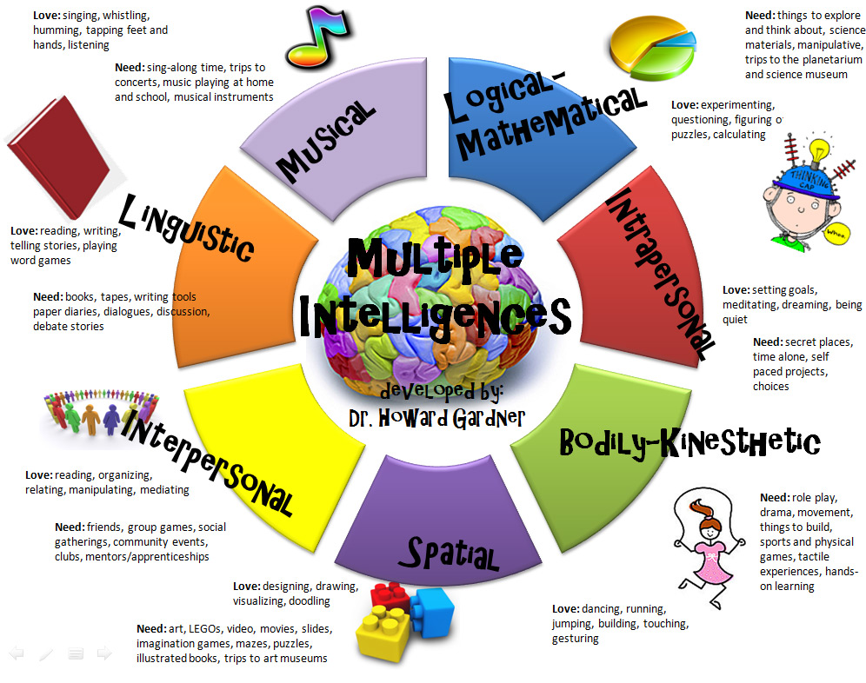
Multiple Intelligences
https://www.edutopia.org/multiple-intelligences-assessment

Slide 19
True Colors
https://lonerwolf.com/true-colors-personality-test/

Slide 20
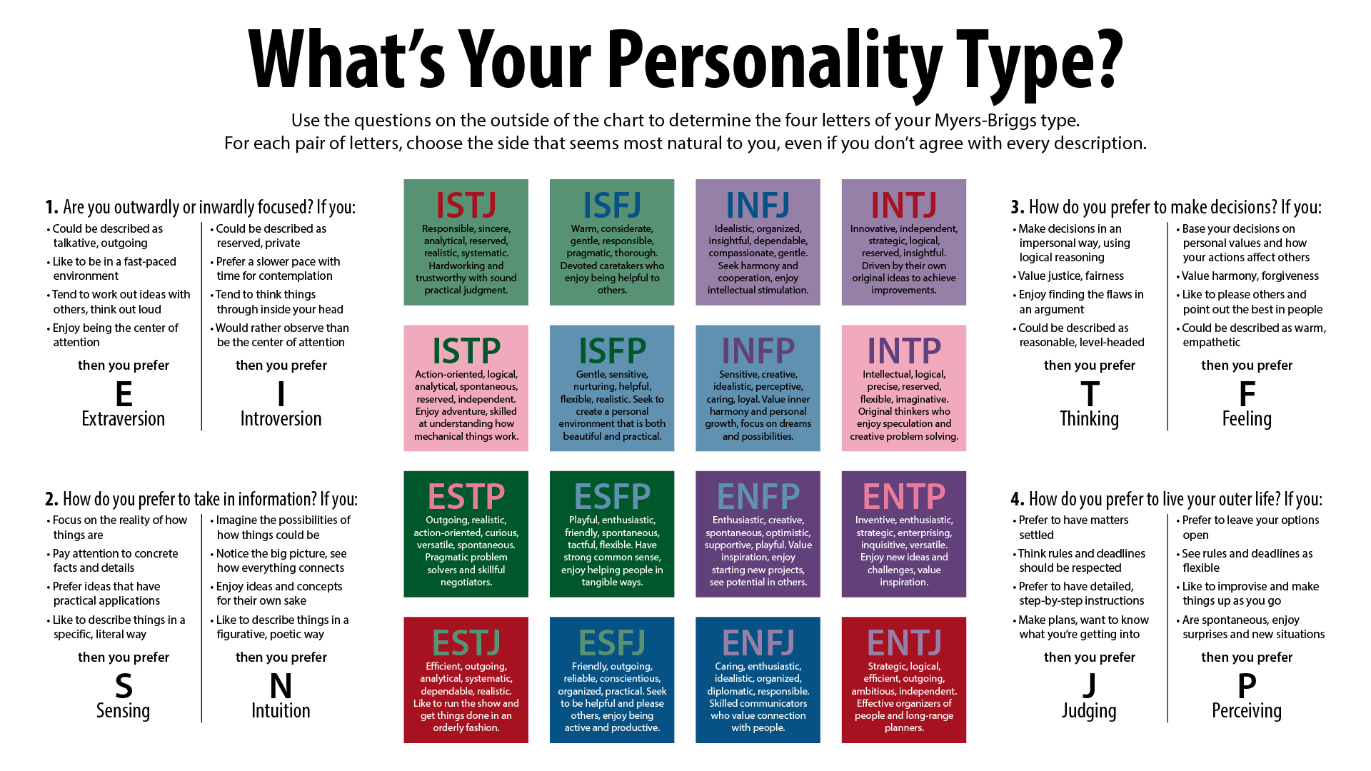
Myers Briggs
http://www.humanmetrics.com/cgi-win/jtypes2.asp

Slide 21
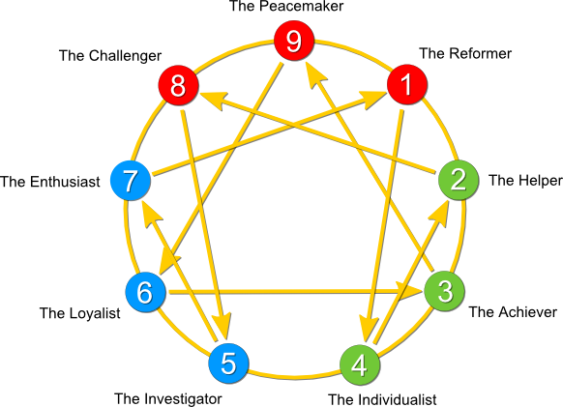
Enneagram
http://www.9types.com/rheti/index.php

Slide 22
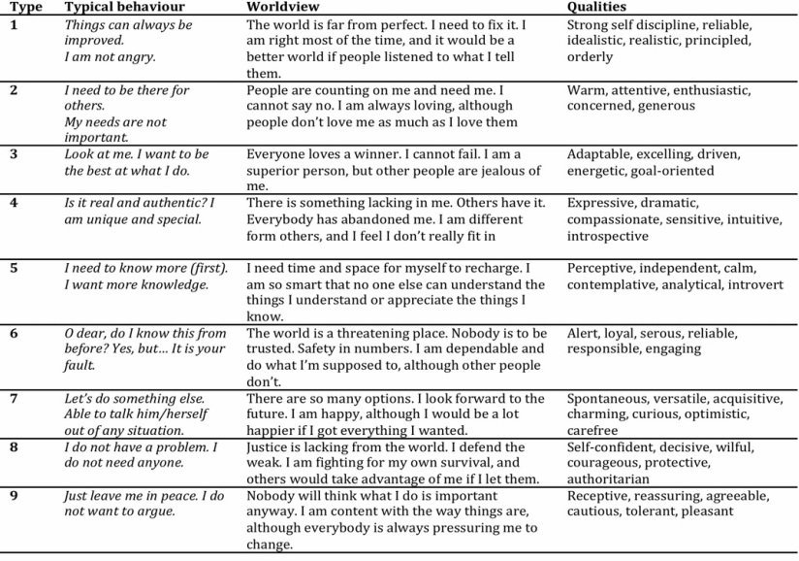
Enneagram

Slide 23
Spirit Animal
Connect to FNMI education
Find an Elder to visit and develop this part of learner profiles
Connect with Amber Thompson from OES for information about inviting guests to come in and lead this

Slide 24
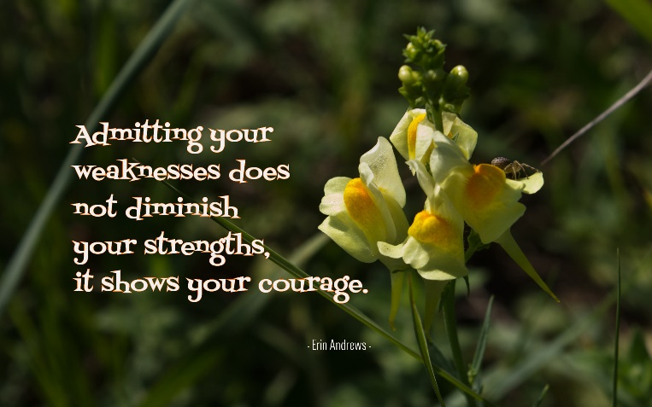
Strengths and Challenges
These are the areas where you can be a mentor for others as well as things you can learn more about.
This list can grow and shift continuously!

Slide 25
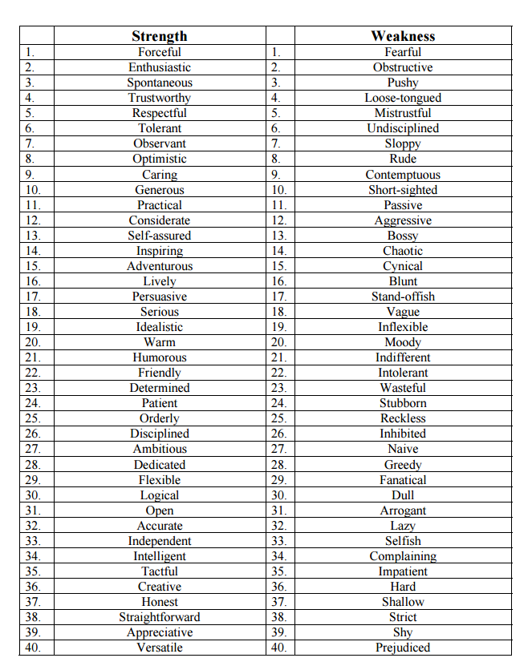
Strengths and Challenges

Slide 26
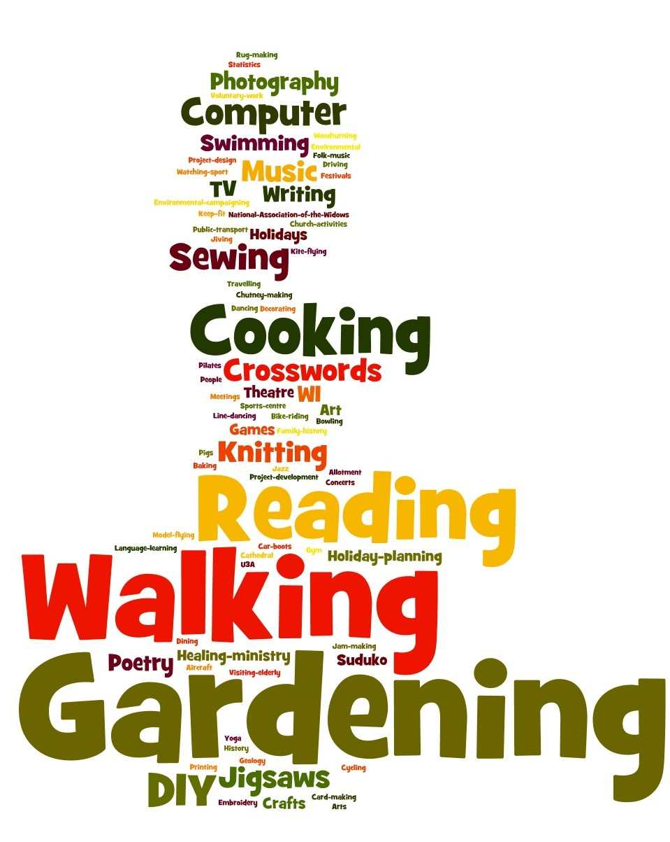
Hobbies and Interests
Finding common interests/hobbies
Finding mentors
Finding collaborators
Expanding your knowledge and curiosity

Slide 27
Skills
What skills do you have that you can use to help mentor others?
Build this list of skills as you progress
Use skills to build your network of experts
Technology
Coding
Robotics
Graphing in Excel

Slide 28
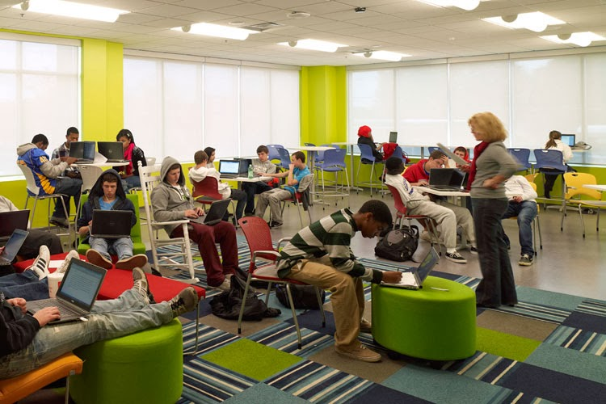
Learning Environment
What does your body and mind need in the environment to do your best learning/work/living?
Consider physical space (furniture, lighting, decor)
Consider sound
Consider organization
Other elements?

Slide 29
I wonder about….
Write something you wonder about, that you may not have had time to investigate, may need helping finding the answer to or are just curious if anyone has an opinion about
Posting these with your profile allows others to learn more about you, as well as identifying others who could work with you to find the answer or someone else might already have the answer to what you are wondering
This supports the development of school wide mentorship. Learning who knows what!
When you have your answer, post it beside the “I wonder” and add a new one.

Slide 30
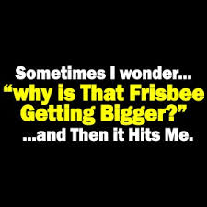

Slide 31
Learning Activity #3
http://www.breakoutedu.com/
Watch the Video
Game Password is…..

Slide 32
Breakout EDU
What is BreakOut EDU?

Slide 33
Breakout EDU
Pick your group members based on the information you have been provided (about the game) and based your learner profiles.
What type of group might you need to succeed in the Break Out game?

Slide 34
Learner Profiles
Staff Profiles + Student Profiles = School Profile = A Community of Leaners and Mentors!
Notes:
What did you like/dislike about the development of Learner Profiles? What would you change? How do you think the development of Staff Profiles will impact your staff culture?

