Slide 1
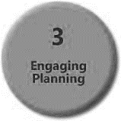
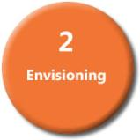
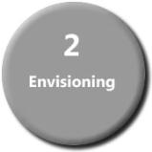
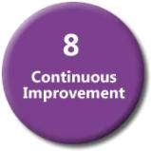
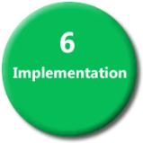
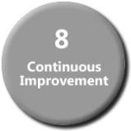
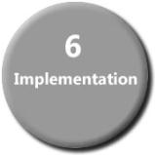
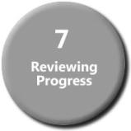
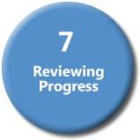
Triad Analysis Exploring Possibilities
On-going Continuous Improvement
Notes:
Using the model for continuous improvement, we will start by exploring possibilities and envisioning before we begin our engaging and planning
After the plan is created, work must follow on creating the culture of innovation, sharing ideas and collaborating prior to implementation
While implementing a new action plan or goal, reviewing progress, working to adjust and reset goals helps lead to continuous improvement and then the cycle begins again with new goals.

Slide 2
Overview
Purpose
The goals of this needs assessment activity is to:
Prioritize what you need to work on as a Triad/School
Focus on setting school based goals and actions involving your Triad
Explore possibilities for these school based goals and actions by...
Discussing the Division Triad Vision Statement.

Slide 3
Overview
Purpose
The goals of this needs assessment activity is to:
Discussing your current school situation
Analyzing your school REORDER plan to reflect your Triad goals and actions
Produce a first draft plan for implementation of goals and actions
Adjust your school REORDER plan to reflect your Triad goals and actions

Slide 4
Pre-requisites:
2018-2019 Form 110-2ESSP Level 3 School Strategic Plan - PeBL REORDER Plan – this will be used to help inform the develop the Triad goals and action plan.
Deliverables:
Your Triad plan based on the templates provides and adjustment of the 2018-2019 Form 110-2ESSP Level 3 School Strategic Plan - PeBL REORDER Plan to include the Triad goals.

Slide 5
Progression towards the ideal
Level | Description | Current State | Future State
5 | Ubiquitous – Triad is actively exploring transformation of its wider community The core principles, intended direction and philosophy of the Triad are understood widely. Teachers, learners and community members are engaged in proposing and evaluating possibilities that include the merging of services in the community and partnerships with schools both locally and globally.
4 | Integrated – Barriers to transformation are being worked on by the Triad, teachers and learners. There is a clear and ambitious Triad vision based on the PeBL philosophy drawing from a range of educational theories. The Triad has described the kinds of changes it needs to achieve clearly enough for learners to propose solutions. There is a strategy in place that allows the Triad to try new ideas to build their capacity for adapting solutions from others
3 | Defined – The Triad has outlined a new vision/model and is looking for examples. Clear about how it would like to transform and why, the Triad is looking for specific answers to specific questions. The Triad may source external experts in their targeted area and require specific questions answered.
2 | Developing – The Triad is looking to adopt a different vision/model. The Triad explores strategies from other contexts and is keen to consider adoption of one of these The Triad is developing capacity (A strategy is under consideration and needs to be implemented, resourced and evaluated.)
1 | Aware – A largely traditional model of education is in place and not likely to change. The Triad is open to Iterative change and ‘good ideas’ rather than systemic change. Case studies showing how particular approaches or tools raise achievement in similar contexts are the most highly valued.

Slide 6
Triad Planning Template REORDER Analysis
Based on the Sun West Triad vision, answer the following questions about your Triad
The Triad Needs assessment document is housed on the one note and is fillable
Also have 11 x17 version

Slide 7
RISC – Reinventing Schools (Alaska)
 | Relationships: Learners make choices around their next challenges and work in multi-age teams.
 | Environment: Flexible and collaboration based allowing learners to switch areas.
 | Opportunities: Based on a progression of opportunities which individuals move into and through when they gain proficiency.
 | Resources: Worksheet based with teachers available to ‘sign off’ those who suggest they have achieved ‘mastery’.
 | Distributed Leadership: Vision process is key and ensures all are engaged in both setting and interpreting.
 | Evaluation: Learners keep their own record of progression through stages in a folder which teachers verify at the ‘mastery’ stage.
 | Recognition: Learners have their progression recognised when they are ready to present.
Performance based not time based learning: pace is determined by progression not age.
Each learning target has stages up to ‘mastery’ based on the work of Bob Marzano.
Collaboration
Responsibility
Self-management

Slide 8
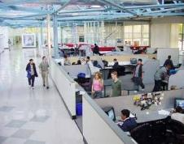
Example: High Tech high
 | Relationships: Trusting teams of learners as commissioned partners with local companies.
 | Environment: Learners should have access to current business environments.
 | Opportunities: Project based learning opportunities in which teams of learners collaborate about real life projects.
 | Resources: The resources that a modern office professional would have access to.
 | Distributed Leadership: Learners construct teams and should seek new projects.
 | Evaluation: Individuals have a mentor who checks progression. Feedback systems from the local partnerships. All outcomes are displayed with an end presentation.
 | Recognition: The presentation process allows teams to be recognised for their work publically.
All learners are equipped and skilled for success in the modern business world:
Entrepreneurship
Collaboration
Work readiness

Slide 9
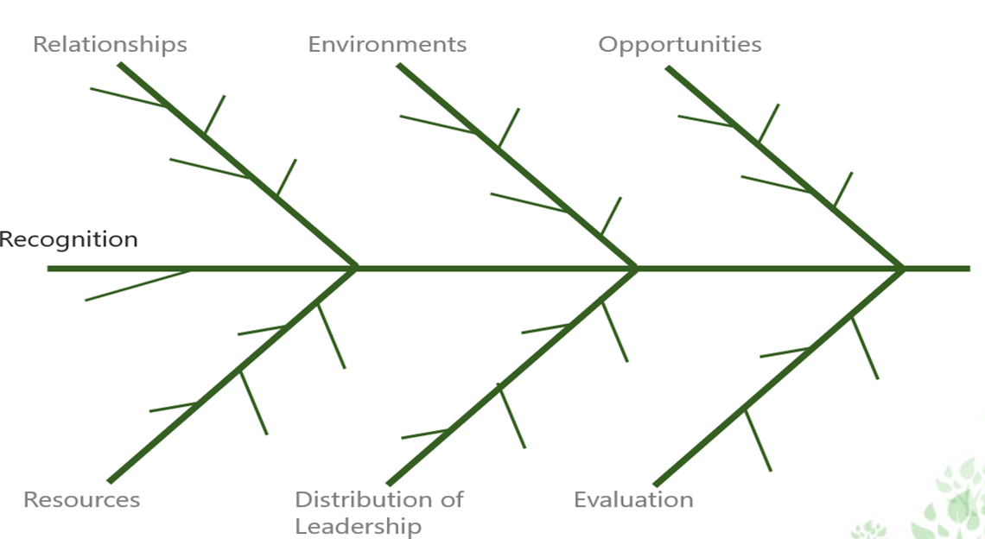
Facilitation techniques
The Fishbone Diagram
Use the REORDER categories as those needing attention (or causes of failure if not addressed) then each major cause under these categories is added as a branch, sub causes branch off these smaller branches

Slide 10
Example: Arrange intentions on a Fishbone
Relationships
Environments
Opportunities
Doubling of choice for learners
Camp fire analogy
Choice of seating
All curriculum subjects provided
Maximise collaboration for learners
All learners treated respectfully
Improve Infrastructure
All have access to outside learning areas
Recognition
Competencies given equal status
Structures allow teachers to work in teams
1:1 access
to IT
Timetabling is in whole day blocks
All learners have opportunity to lead
Impact assessments of innovations use student attitudes
Specialist Staffing
Systematic monitoring and evaluation
Resources
Distribution of Leadership
Evaluation

Slide 11
Goal and Action Planning
 | Goal/Action 1: | Goal/Action 2: | Goal/Action 3:
Key Activities & Timeline | Identify activities to realize the priority from above | Identify activities to realize the priority from above | Identify activities to realize the priority from above
Achievement Measures (Benchmarks & Metrics for continuous improvement) | Specify tools and strategies to achieve measures | Specify tools and strategies to achieve measures | Specify tools and strategies to achieve measures
Challenges /barriers to Success (Identify possible obstacles and ways to overcome them) | Enter specific details here | Enter specific details here | Enter specific details here
Resources Required (Human, Physical, Financial & technological) | Enter specific details here | Enter specific details here | Enter specific details here

Slide 12
Next Steps: Amalgamating your vision into your School Level Strategic Plan
Refer to your Form 110-2 ESSP Level 3 School Strategic Plan PeBL REORDER Template and review your plan as a team
Highlight or mark sections that may need to be changed or altered to encompass your Triad vision goals and actions
Add actions and goals to the REORDER plan and ensure resources, supports timelines and plans are included.
If needed, identify ways to communicate this change and to enlist support from school staff, SCC members, parents, students, etc

Slide 13
Fun idea for Vision: Visual analysis
Assemble all of your vision statements into one block and paste it into the text window at http://www.wordle.net/create. Wordle will generate a visual analysis of your vision based on the frequency of words appearing in the text.
What are the most common words you use?
Paste your school REORDER plan into the tool – are the common words the same?
Paste your school handbook or your speech to new parents into the tool.

