Slide 1
PeBL Mentor Professional Development Day
Facilitated by, Kelli Boklaschuk, Shari Martin, Carole Butcher, Shirley Barclay, Arlene Low, Vanessa Lewis

Slide 2
Welcome
Notes:
Shari and Kelli

Slide 3
Agenda
Welcome
Icebreaker Activity
Self-Reflection
UBD/Unpacking Outcomes
Planning
PeBL Pyramid of Growth/Continuum of Learning
Creating Learning Activities to Meet Outcomes
Resources
LUNCH
Assessment Article
Setting and Using Assessment Criteria
Formative Assessment
Summative Assessment
Exit Slip
Notes:
Finalize once we have reviewed as a team.

Slide 4
Icebreaker Activity
https://scratch.mit.edu/projects/1642467/
Notes:
Shirley
Make eye contact with someone across the room ​
Discuss the topic corresponding to the number rolled​
On the signal, make eye contact with a new partner to discuss a new topic

Slide 5
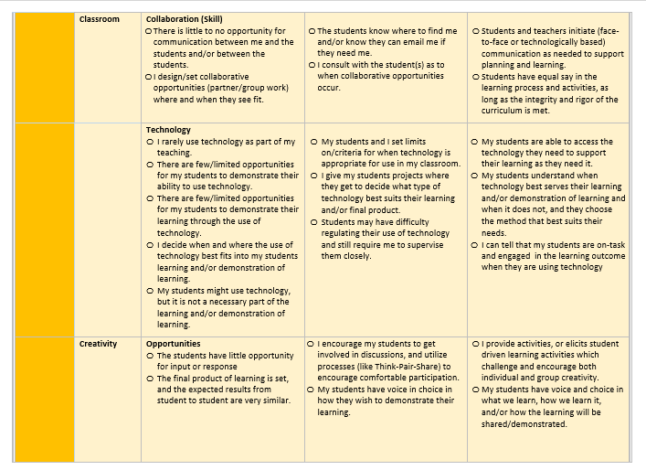
PeBL Teacher Self Reflection
Notes:
Kelli (copies have been made for each participant)

Slide 6
Understanding by Design: UbD
“To begin with the end in mind means to start with a clear understanding of your destination. It means to know where you’re going so that you better understand where you are now so that the steps you take are always in the right direction.” (Covey, 1994)
Notes:
Carole

Slide 7
Start with the End in Mind
Together with your students, know what outcomes need to be covered. Think about what your students should Know, Understand, and Be Able to Do (KUD)
Together with your students, plan learning experiences that will help your students achieve those outcomes.
Notes:
Carole Carole might add a document that she previously used around (KUD) with Assessment added.

Slide 8
Planning with the End in Mind
Notes:
Carole Planning with the End in Mind (at top).
Keep the Backwards Planning and Differentiated Instruction connection in notes.

Slide 9
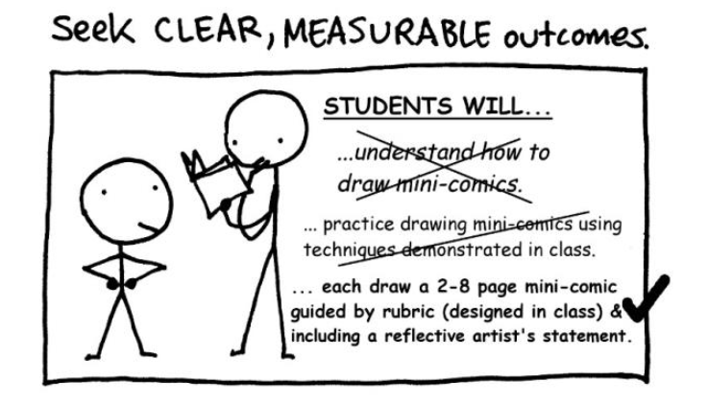
Unpacking Outcomes – I Do, We Do, You Do
Documents to help you plan:
Think Aloud for Unpacking Outcomes
Steps for unpacking each outcome
Notes:
Carole/Vanessa (I do phase) Think Aloud and Practice Grade 7 Math for I do/We Do
Your turn – teachers choose an outcome and unpack (You Do)

Slide 10
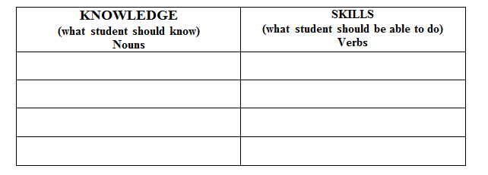
Unpacking Outcomes – I Do, We Do, You Do
Notes:
Carole/Vanessa (I do phase) Think Aloud and Practice Grade 7 Math for I do/We Do
Your turn – teachers choose an outcome and unpack (You Do)

Slide 11
Unpacking Outcomes – I Do, We Do, You Do
N7.5 Develop and demonstrate an understanding of adding and subtracting positive fractions and mixed numbers, with like and unlike denominators, concretely, pictorially, and symbolically (limited to positive sums and differences).
Step 1: Underline the nouns in the outcome; they are the Knowledge that students should know.
Step 2: Circle the verbs in the outcome; they are the Skills that the students should know.
Step 3: List Verbs/Nouns in Knowledge/Skills Box:
Knowledge | Skills
Understanding | Develop & demonstrate
Adding and Subtracting positive fractions & mixed numbers | concretely
Like & unlike denominators | pictorially
Positive sums & differences | symbolically
Notes:
Carole/Vanessa (I do phase) Think Aloud and Practice Grade 7 Math for I do/We Do
Your turn – teachers choose an outcome and unpack (You Do)

Slide 12
Unpacking Outcomes – I Do, We Do, You Do
N7.5 Develop and demonstrate an understanding of adding and subtracting positive fractions and mixed numbers, with like and unlike denominators, concretely, pictorially, and symbolically (limited to positive sums and differences).
Step 4: Rewrite the outcome in language the student will understand.
"I can create and do adding and subtracting of + fractions and + mixed numbers, with same denominator (bottom number) and different denominators. I can use objects, pictures, or numbers to demonstrate.
Step 5: What specific Knowledge and Skills from the unpacked outcomes would you assess? By what measures?
Notes:
Carole/Vanessa (I do phase) Think Aloud and Practice Grade 7 Math for I do/We Do
Your turn – teachers choose an outcome and unpack (You Do)

Slide 13
Unpacking Outcomes – I Do, We Do, You Do
Notes:
Carole/Vanessa (I do phase) Think Aloud and Practice Grade 7 Math for I do/We Do
Your turn – teachers choose an outcome and unpack (You Do)

Slide 14
Planning Templates
Sun West School Division:
Cross Curricular Planning Template
Learning Experiences (Unit) Planning Template
Lesson Planning Template
9 Events of Instruction
Notes:
Arlene?
The cross-curricular planning document has two editable versions – 8.5x11 and 11x17
Unit and lesson templates are editable
Shari could speak to Ministry plans from the past (big picture)
Kelli could speak about curriculum maps. (Sun West version)

Slide 15
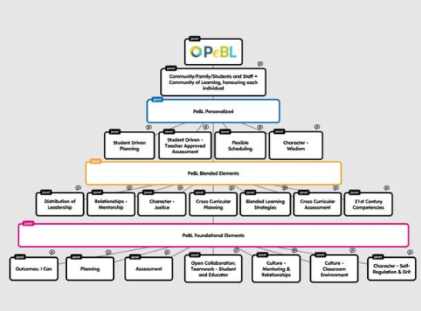
PeBL Pyramind of Growth
Notes:
Kelli/Shari

Slide 16
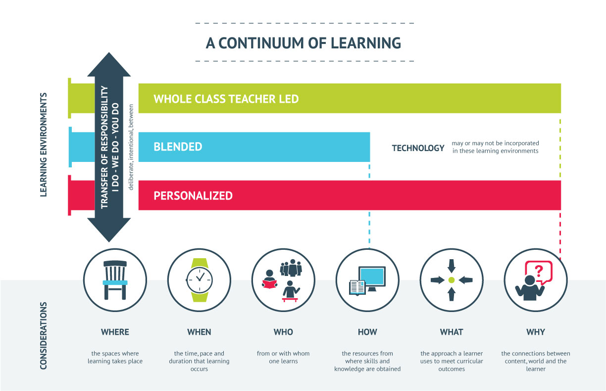
A Continuum of Learning
Notes:
Kelli/Shari

Slide 17
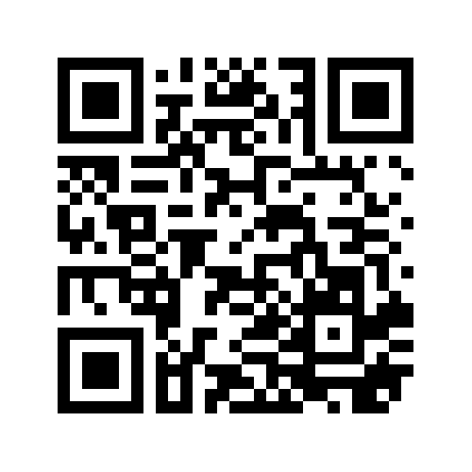
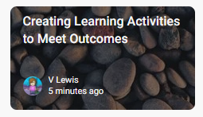
Creating Learning Activities to Meet Outcomes
https://padlet.com/lewey1/6nn63gzoxdsg
What are some considerations to keep in mind when planning learning experiences?
Padlet – Provides an essentially blank canvas for students to create and design collaborative projects. Great for brainstorming
Notes:
Vanessa and Shirley
Talk about the considerations they have to keep in mind as they are planning learning experiences.
Share via Padlet
After the Padlet has been done, we give the areas from the handout and have participants talk about each one. After we have identified ours, talk about others they have come up with
Take the points out of the Planning and Asssessment Best Practices document and leave as blank in initial handout and have table talk about points that we will discuss and review after – we could be recording what they say (one of us should record as there may be ideas to add to the final planning and assessment best practices document)
Arlene to add in the 9 Events of Instruction Summative Assessment (5 point rubric, holistic vs. Analytical/Assessment, Fixes.

Slide 18
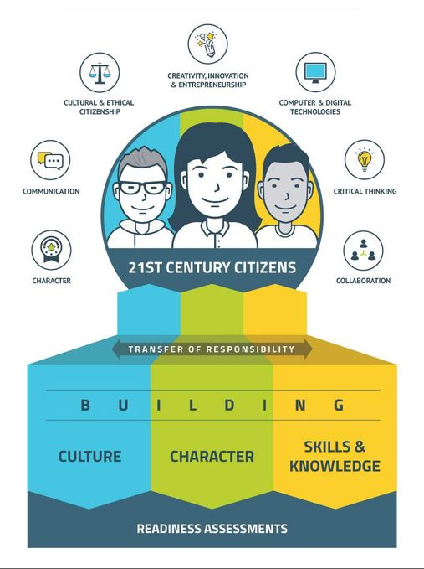
Creating Learning Activities to Meet Outcomes
Notes:
Vanessa and Shirley

Slide 19
Resources
http://www.pearsoned.ca/school/product/skresources/ text
Notes:
Shari
We have had a subscription to Pearson etexts for 5 years
Teacher log in is their Sun West email and password is Educator2
All schools (principal and Secretary) were sent the student passwords and log in info in August

Slide 20
Resources
Notes:
Shari
We have had a subscription to Mathletics for 4 years as a division. Some schools have had this longer
All schools (principal and Secretary)rollover and set up the student passwords directly with Mathletics
The site has had an overhaul and has many more assessments and booklet and activities to support personalized learning added.
Has the option to make personalized assignments for all students
Webinars and presentations can be set up

Slide 21
Resources
https://www.criterionondemand.com/
Notes:
Shari
Criterion on demand
All sun West IP addresses are submitted already so you click on the link and log in button and access to movies that we have paid to show for use in educational purposes
Our licence provides the following rights:
Full institutional copyright protection for our Schools/division
Ability to charge admission fees and keep 100% of fees
Access to prerelease titles at 50% discount
If not o site, access can be obtained through COD user name 93015 and password SunWest

Slide 22
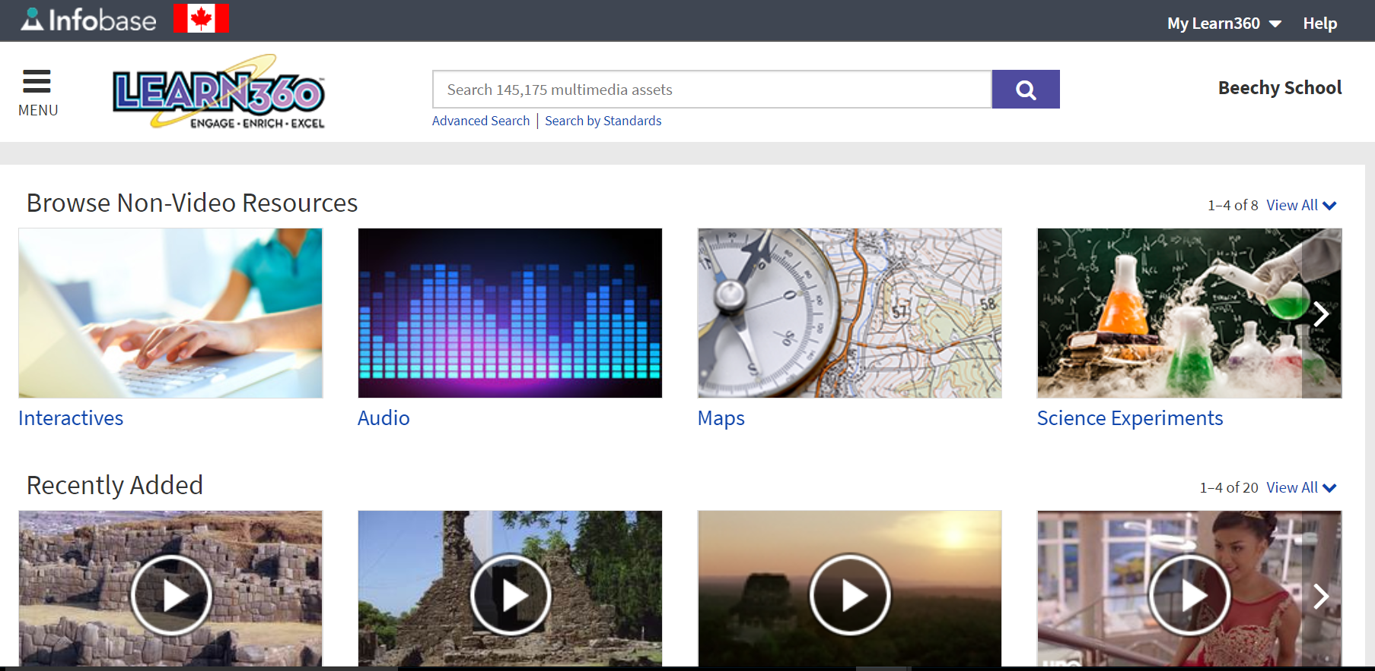
Resources
https://learn360.infobase.com/p_Home.aspx
Notes:
Shari
Learn 360
New licence for 2018
Passwords sent out to school librarians/admin/PeBL mentors this week
Learn360 has a great Support Centre that can be reached by choosing “Help” at the top of any page. The Support Centre features Archived Webinars, Training tutorials, tips, articles and more. Here is a link to the newest “Head Back to School with Learn360” webinar you may share with your users:
http://support.infobaselearning.com/index.php?/videolearn360/Knowledgebase/Article/View/2426/691/head-back-to-school-with-learn360

Slide 23
Resources
Notes:
Shari
The curriculum website has many resources that teachers are often unaware of but are vetted and are connected to learning outcomes.
Virtual sessions presenting the information and how it can be used can be set up with the Ministry leading or with me providing an overview
ROVER
Online Journals and newspapers
EDOnline

Slide 24
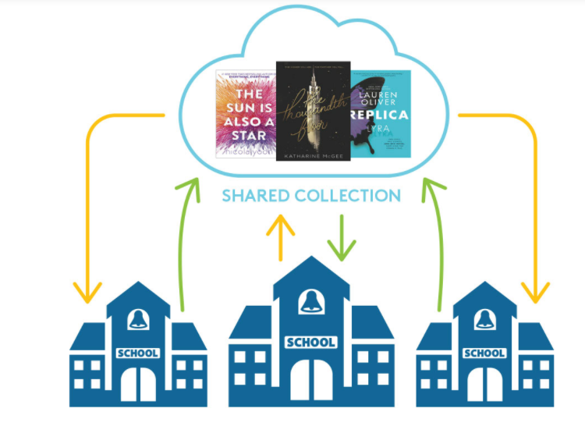
Resources
Notes:
Shari
We are considering as a division joining a Saskatchewan library consortium hosted through overdrive that allows us to share and access ebooks and audiobooks from districts and schools across Saskatchewan
The project is approximately a $1 per student for us to join as a division and depending on the divisions who join, the library grows with each division and with each year schools invest as new titles are added based on the value of the collection and partners who pay the fee to join. This is a yearly licence and can be set up so students can log in at home, school or anywhere directly using the same log ins as their Sun West email
We have a guest access for the month of April and school librarians, PeBL mentors and interested teachers are welcome to use the guest access to view the demo and what the system can do. If people like the product, Sun West will purchase for all our schools starting in Fall 2018 and librarians and PeBL mentors can take the lead in showing staff and students how to use this tool.

Slide 25
Resources
https://www.readnaturally.com/product/read-naturally-live
Notes:
Carole and Shari

Slide 26
Resources
Walkabout activity
Write down on a sticky note a resource you use in your school that you especially like. Provide the title/website and what you use it for.
Get up and find a partner and share your resource and learn about their resource.
Add your resource sticky to our group Resource Share Chart paper. We will compile these and share on the PeBL Mentor group site
Notes:
Shari

Slide 28
Assessment Article Activity
From Educational Leadership Magazine
Notes:
Carole
Get the Gist
Inside-Outside Circle Activity (plan for a few conversations – rotating the circle)

Slide 29
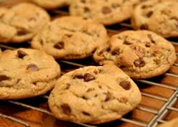
What Makes a Good Chocolate Chip Cookie?
Setting and Using Assessment Criteria
On the sticky notes write a criteria that you believe is vital for a good chocolate chip cookie – one criteria per sticky note
Bring the sticky notes up to the front and put on the wall
Sort the criteria into categories
Test a sample!
Using the sticky dots, rate the cookie on each of the criteria
Feedback
Notes:
Shirley and Vanessa
Shirley show examples of writing criteria from D'Arcy

Slide 30
Formative vs. Summative Assessment
Formative
Summative
Notes:
Carole
https://www.youtube.com/watch?v=IfJkiqLRHF4 a possible – cute – formative/summative video – using Ratatoouie movie – tasting the soup (another option? We can decide....) As of today, March 22nd, I am leaning towards the practice/game day as I think all could relate to this. Plus, one of those assessment articles talks about assessing performance in a 'game' - all is linking together nicely!! Vanessa

Slide 31
Formative Assessment
Tools to formatively assess students:
Notes:
Shirley and Vanessa – use handout
Share ideas if time permits

Slide 32
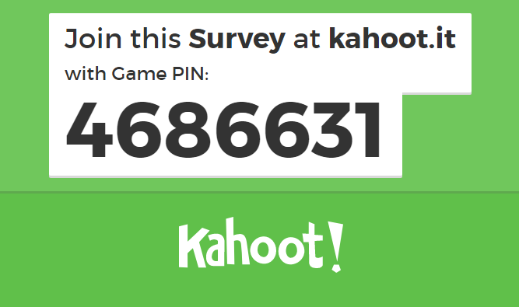
Summative Assessment
Notes:
Arlene/Carole Kahoot??
5 point rubric
Some discussion about providing for level 5 opportunities.
Holistic vs. Analytical
Mastery vs. Competency
4 Fixes?
Don’t use students behavior
Don’t assign grades using unclear standards…
Don’t use info from formative and practice to determine grades.
Don’t leave students out of grading process
Share ideas or followup if time permits.

Slide 33
PeBL Teacher Self Reflection
Notes:
Kelli

Slide 34
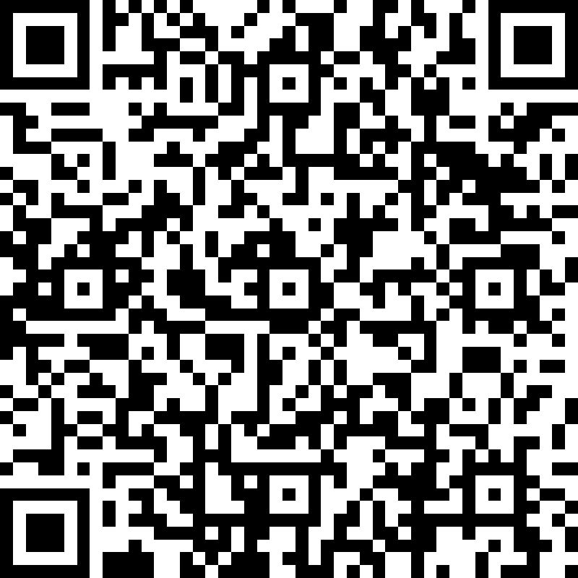
Exit Slip – Key Takeaway.
Please complete the short exit slip about today’s meeting
https://forms.office.com/Pages/ResponsePage.aspx?id=41MmFKVwz0CZUBJfZQ6Epbp0jv8PTE5Hn5-CR16iKhlURVY1NlFTMkROVFpST05OQUhGUTFEMExGMS4u

Slide 35
PeBL Mentor Survey

Slide 36
Thanks for all you do to support Sun West teachers and students on their PeBL journey!

